Slide 1
In late 2025, Polygon.io officially changed its name to Massive.com.

Slide 2
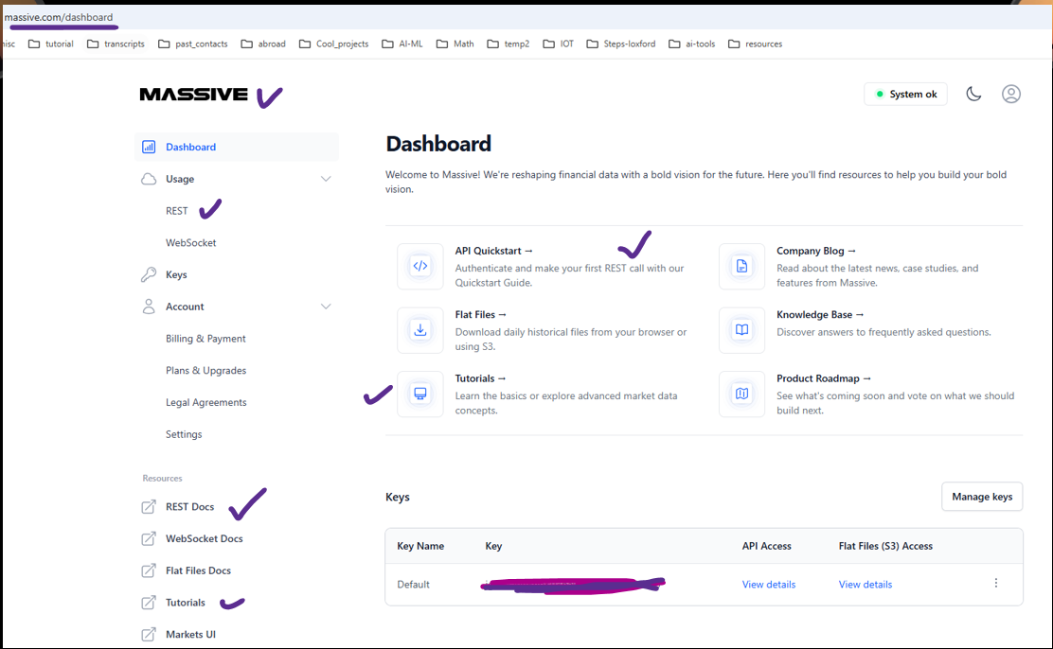

Slide 3
