Slide 1
Finlight.me provides a finance-specific market intelligence and news API designed for quantitative trading and AI workflows.
3 core services :
Financial NLP: It automatically extracts entity metadata like company names, stock tickers, and geopolitical events from raw text.
Real-Time Sentiment Data: It converts global news and financial articles into mathematical sentiment scores (bullish, bearish, or neutral) out of the box.
Low-Latency Delivery: It streams market-moving data using high-speed WebSockets to deliver sub-second alerts for algorithmic trading systems.

Slide 2
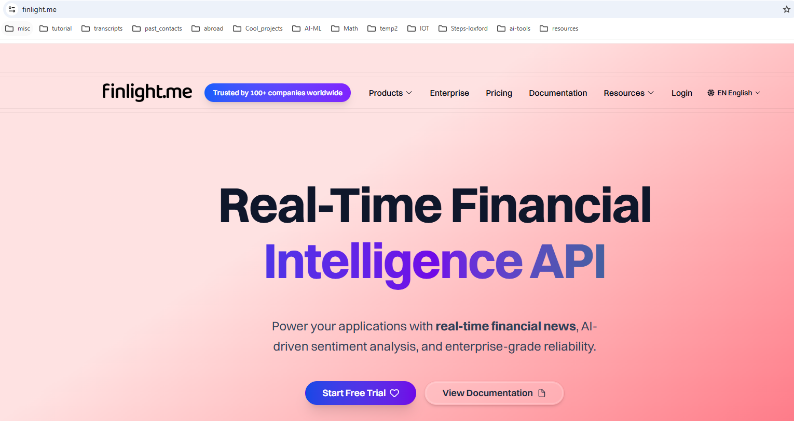

Slide 3
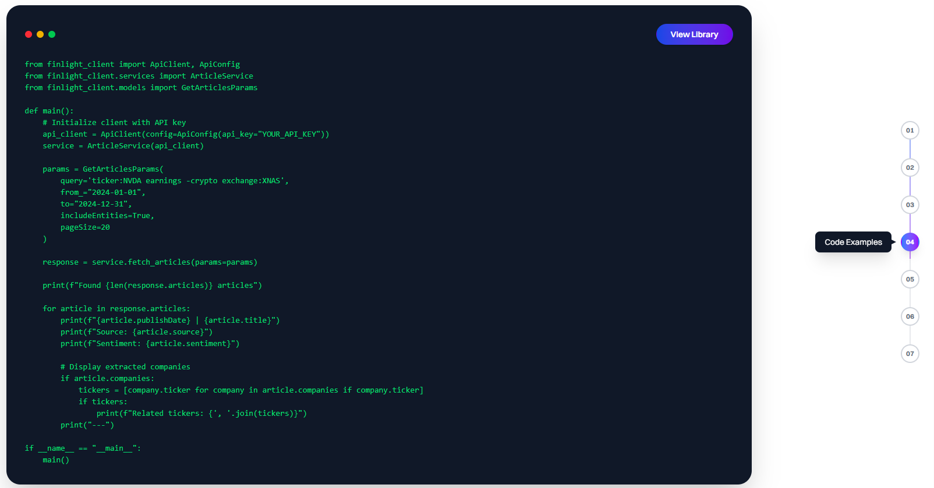

It provides code examples like shown below

Slide 4
