Slide 2
Here students will get their own api key from alphavantage
To run this app:
> python -m streamlit run app.py

Slide 3
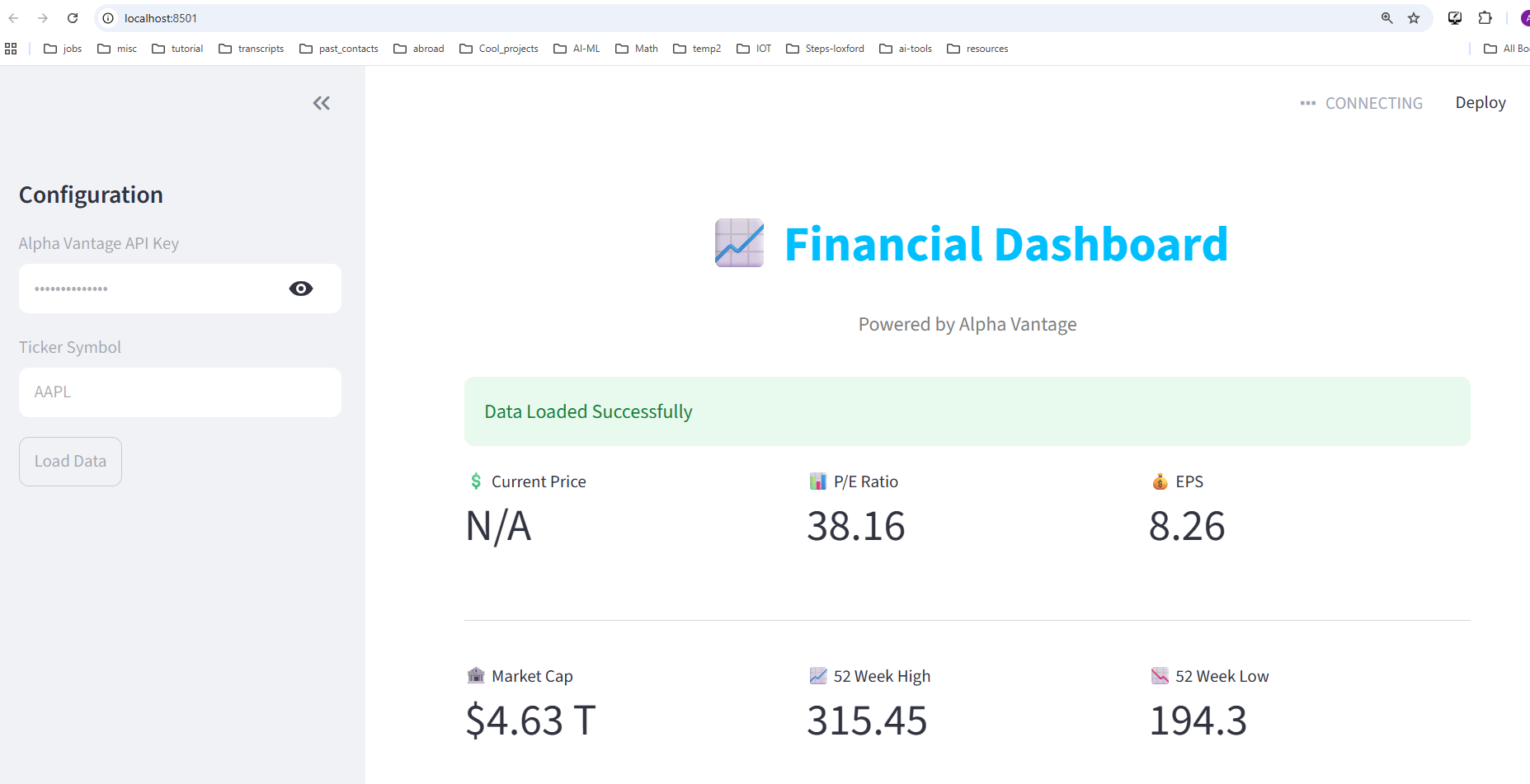


Slide 4
