Slide 1
What is Agentic AI?

Slide 2
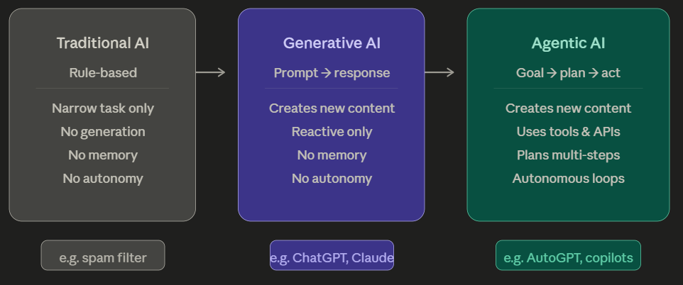
What is Agentic AI?
Traditional AI is rule-based.
It does exactly what it's told, nothing more.
E.g.: A spam filter — these are trained or programmed for one narrow task.
They have no understanding of context beyond their domain.
It does not remember first email from the second email or third email…
Cannot generate any new content/email

Slide 3
2) Generative AI (GenAI):
Models like GPT-4 or Claude can generate new content — text, images, code — by learning patterns from vast data.
They are fundamentally reactive. You prompt them, they respond.
They have no way to take an action in the world – cannot goto website and buy items for you.

Slide 4
3) Agentic AI:
AI that can act. It receives a goal, breaks it into steps, uses tools (web search, code execution, APIs), checks its own output, and iterates — all without a human driving every step.
Example: Agent that opens your laptop -> run a search on your email -> draft response for an email -> and send it — autonomously.

Slide 5
What Makes AI "Agentic"?
The Four Pillars
Goal decomposition
Tool use
Memory
Feedback loops

Slide 6
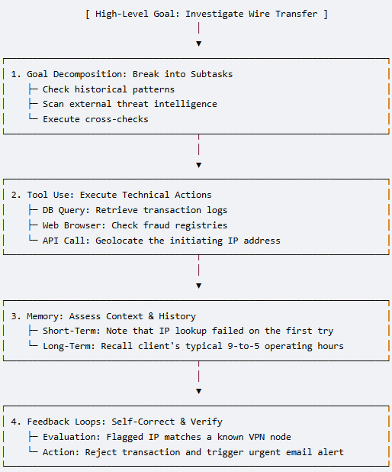
What Makes AI "Agentic"?
Goal decomposition — Given a high-level objective, the agent breaks it into subtasks automatically.
The user gives a single high-level objective:
“Investigate whether wire transfer transaction #88492 is fraudulent”
The agent automatically breaks this into 3 sequential subtasks:
Subtask A: Retrieve and check the client’s historical transaction patterns.
Subtask B: Scan external threat intelligence databases for the destination bank account.
Subtask C: Verify if the login location matches the client's usual geographic profile.

Slide 7
What Makes AI "Agentic"?
2. Tool use — Agents are connected to the world:
they can browse the web, run code, query databases, call APIs, read files, send emails.
The agent begins interacting with external software tools to gather data:
Database Query: Run SQL query to fetch the client's past 12 months of banking history.
API Call: Sends the transaction's IP address to a geolocation API.
Web Browser: It searches public financial fraud registries to see if the recipient routing number has been flagged.

Slide 8
What Makes AI "Agentic"?
3. Memory — Unlike a standard LLM that forgets between sessions, agents can maintain short-term context (what they've done in this task) and often access long-term memory (a database of past interactions).
The agent cross-references its real-time findings with different layers of memory:
Short-Term Memory: The agent remembers that 2 minutes ago, its geolocation API call failed due to a timeout. It holds this context and tries the tool again rather than getting stuck.
Long-Term Memory: The agent accesses a vector database containing the client's historical profile. It recalls that the client only conducts business between 9 AM and 5 PM EST, but this transfer was initiated at 3 AM EST from an IP address in a different country.

Slide 9
What Makes AI "Agentic"?
Feedback loops — Agents can evaluate their own outputs, notice errors, and retry.
(E.g.: A coding agent that writes code will also run it, read the error, fix the bug, and run it again.)
The agent reviews its own findings to catch mistakes and refine its conclusion before final output:
Self-Evaluation: The agent drafts a risk score but notices its geographic analysis contradicts the client's typical device profile.
Correction: It realizes the IP belongs to a commercial VPN provider. It reruns its evaluation script, updating the risk score from "medium" to "critical fraud risk."
Final Action: It automatically freezes the account, blocks the transfer, and drafts an emergency alert email to the fraud operations team.

Slide 10
What Makes AI "Agentic"?
Feedback loops — Agents can evaluate their own outputs, notice errors, and retry.
(E.g.: A coding agent that writes code will also run it, read the error, fix the bug, and run it again.)
The agent reviews its own findings to catch mistakes and refine its conclusion before final output:
Self-Evaluation: The agent drafts a risk score but notices its geographic analysis contradicts the client's typical device profile.
Correction: It realizes the IP belongs to a commercial VPN provider. It reruns its evaluation script, updating the risk score from "medium" to "critical fraud risk."
Final Action: It automatically freezes the account, blocks the transfer, and drafts an emergency alert email to the fraud operations team.

Slide 11
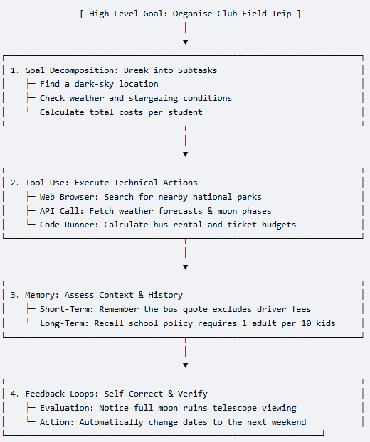
Another example:
A high school teacher gives the AI agent one big task:
"Organize our Astronomy Club field trip next month."

Slide 12
What Makes AI "Agentic"?
1. Goal Decomposition (The Planner)
The agent automatically breaks the big goal down into a checklist of smaller, logical steps:
Step A: Find a dark-sky location within a 2-hour drive.
Step B: Check the weather and moon phases for the best viewing dates.
Step C: Calculate the total budget (bus rental, tickets, food).

Slide 13
What Makes AI "Agentic"?
2. Tool Use (The Doer)
Instead of just guessing, the agent connects to the internet and uses software tools to get real work done:
Web Browser: It searches Google to find open campgrounds or observatories.
Weather API: It pulls live meteorological data to check for clear skies.
Python Code Runner: It runs math code to multiply the number of students by the ticket price to get an exact budget.

Slide 14
What Makes AI "Agentic"?
3. Memory (The Keeper)
The agent keeps track of details so it does not make mistakes or ask you to repeat yourself:
Short-Term Memory: While calculating the budget, it remembers that the bus company quote it looked up two minutes ago does not include the driver's tip. It keeps that extra cost in mind.
Long-Term Memory: It reads the school’s digital handbook and remembers a permanent rule:
"All field trips require 1 adult chaperone for every 10 students."
It uses this to add chaperone tickets automatically.

Slide 15
What Makes AI "Agentic"?
4. Feedback Loops
The agent checks its own work, catches mistakes, and fixes them before showing you the final plan:
The Error: The agent picks Friday, October 14th. But when it checks the moon phase tool, it realizes it is a full moon. A bright full moon makes it impossible to see faint stars.
The Correction: It says to itself, "Wait, a full moon will ruin the stargazing." It automatically goes back to Step B, looks for a new date, and switches the trip to Friday, October 21st (a new moon).
The Output: It presents a perfected itinerary and budget to the teacher, that is conflict free.

Slide 16
Use Case: Agentic AI for Real-Time Fraud Detection & Response

Slide 17
Use Case: Agentic AI for Real-Time Fraud Detection & Response
The Business Problem
A traditional bank or payment company processes millions of transactions daily.
1. Old-school fraud detection uses static rules —
If any transaction over ₹1,00,000, then flag it -or-
if card used in two countries within 1 hour, then block it
These rules are rigid: fraudsters learn to work around them, and legitimate customers get wrongly blocked.
2. A static LLM can help analysts understand fraud patterns when asked — but it can't act on a live transaction in real time, can't pull the customer's history, can't freeze an account, and can't learn from new fraud signals.
3. An agentic AI system changes all of this. It can act.

Slide 18
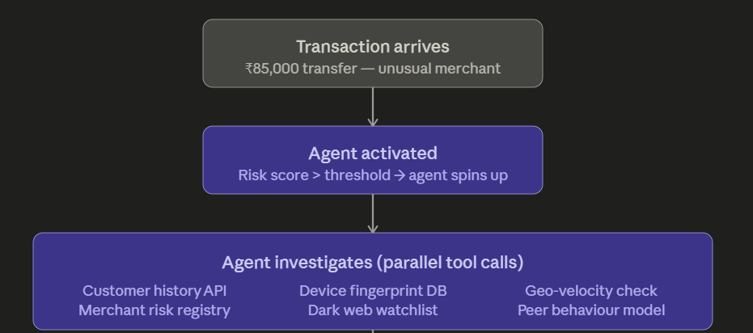
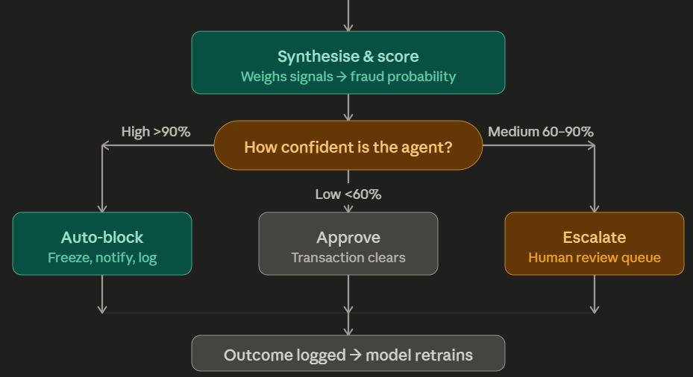
Step 1 — Transaction arrives.
A $85,000 transfer is initiated at 2:14 AM to an unfamiliar merchant.
The rule-based system flags it with a risk score of 78/100 — above the threshold for agent activation.

Slide 19
Step 2 — Agent Activated
Instead of a static rule simply blocking or allowing, an agentic AI wakes up.
It receives the transaction object as its "goal":
Evaluate whether this is fraudulent and take appropriate action.

Slide 20
Step 3 — Parallel tool calls.
The agent simultaneously calls multiple tools without any human driving each call. It might be querying six systems in under a second —
the customer's 18-month transaction history,
the device fingerprint database (is this the same phone the customer usually uses?),
a geo-velocity API (was the card used in Mumbai 40 minutes ago?),
the merchant's risk category,
a dark web credential watchlist, and
a peer behavior model comparing this customer to similar profiles.

Slide 21
Step 4 — Synthesis.
The agent doesn't just receive raw outputs — it reasons across them.
"Device fingerprint matches.
But geo-velocity is impossible — card was scanned in Pune 35 minutes ago.
Merchant is in a high-risk category. Customer has never transacted past midnight."
It produces a combined fraud probability.

Slide 22
Step 5 & 6 — Tiered action.
Based on confidence, the agent takes a calibrated response.
High confidence (>90%) means autonomous block, account freeze, and customer SMS notification — no human in the loop needed.
Medium confidence triggers a human review queue with the agent's full reasoning attached.
Low confidence simply approves and logs for pattern monitoring.

Slide 23
Step 7 — Feedback loop.
Every outcome — whether the human reviewer confirmed fraud or cleared it — is written back into the training pipeline.
The agent gets smarter with every case.

Slide 24
Real Companies Doing This
Bank al Etihad: In July 2023, Bank al Etihad announced it was deploying NetGuardians' AI-enabled payment fraud prevention solution. This system acts as an automated agent that monitors transactions in real-time, providing a risk score by assessing activity against standard customer behavior (behavioral analytics) to prevent financial crimes, such as Authorized Push Payment (APP) fraud.
(Source: https://financialit.net/news/fraud-detection/netguardians-chosen-jordans-bank-al-etihad-mitigate-financial-fraud-risk)

Slide 25
Real Companies Doing This
Several fintech firms have deployed systems that embody this architecture.
Stripe's fraud prevention platform uses ML-driven decisioning that operates at the millisecond level, automatically adjusting to new fraud patterns without rule updates.
PayPal's risk engine processes over 40 signals per transaction autonomously.
Klarna has deployed AI agents that handle both fraud investigation and customer service resolutions end-to-end — in their public reporting they noted a dramatic reduction in repeat inquiries after deployment.

