Slide 1
The Three Generations:
Rule-Based Bot → LLM Chatbot → Autonomous Agent
"When a customer says
'I think someone hacked my account’
— what does each system actually do?"

Slide 2
Generation 1: The Rule-Based Bot
A rule-based bot is essentially a very elaborate decision tree. Someone wrote every possible path in advance. The bot matches your input to a pattern, and returns a pre-written response.
It has no understanding of language — it pattern-matches. If a customer types "I think someone hacked my account," the bot looks for keywords: "hacked," "account." It finds a matching rule and returns:
"For account security, press 1 for password reset, press 2 to speak to an agent."
That's it. Ask it something slightly differently — "my account seems compromised" — and it might return a generic "I didn't understand that.“
The bot has no memory, no reasoning, and no ability to act on anything.

Slide 3
Generation 2: The LLM Chatbot
An LLM chatbot understands language deeply. It can handle "hacked," "compromised," "someone got into my account," "unauthorized access" — all the same. It can ask follow-up questions, maintain context within the conversation, and explain things clearly.
But here's the ceiling: it cannot do anything – no action
It can tell the customer how to reset a password.
It can explain what to look for in suspicious activity.
It can empathize and guide.
But it
cannot look up the account,
cannot freeze the card,
cannot file an incident report.

Slide 4
Generation 3: The Autonomous Agent
The agent understands language like the LLM chatbot — but it also can perform actions
When the customer says "I think someone hacked my account,"
the agent can
simultaneously pull the account transaction history,
cross-reference it with fraud signals,
temporarily freeze the card,
send a confirmation SMS,
open a support ticket, and
draft a case summary for the fraud team
The key shift: the agent's job isn't to answer — it's to resolve.
LLM + Tools = Agents

Slide 5
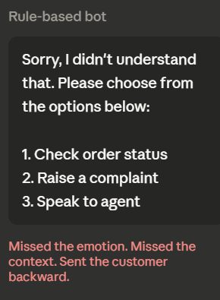
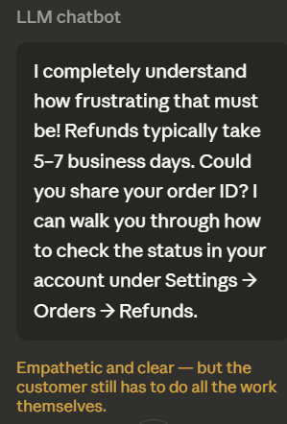
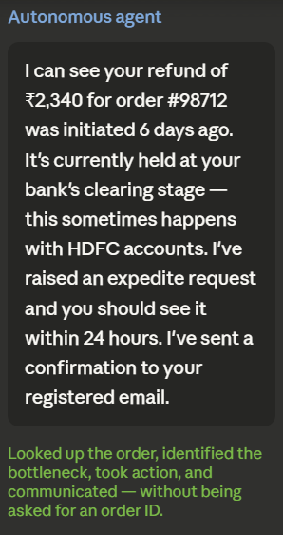
Example:
Customer: "I haven't received my refund from 6 days ago and I'm really frustrated."

Slide 6
Discussion Prompt for Class
"A bank deploys an autonomous agent that can access accounts, move money, and close disputes — all without a human approving each action.
What conditions would need to be true for you to trust that system?
What would make you distrust it?"

Slide 7
EXTRA
Ffnbksdfd
Fdslj;f
Fl;ds

