Slide 1



Plan-and-Execute Agents
Instead of one AI doing everything, you split the work into two roles:
Planner → Thinks what to do Executor → Actually does it
Main Task
🔁 Core Flow
User gives a task
Planner breaks it into steps
Executor performs each step
Results are combined and returned
Sub-task1
Sub-task2
Sub-task3
Task Combined

Slide 2
Example
Task:
"Summarize latest AI trends and create a blog post"

Slide 3
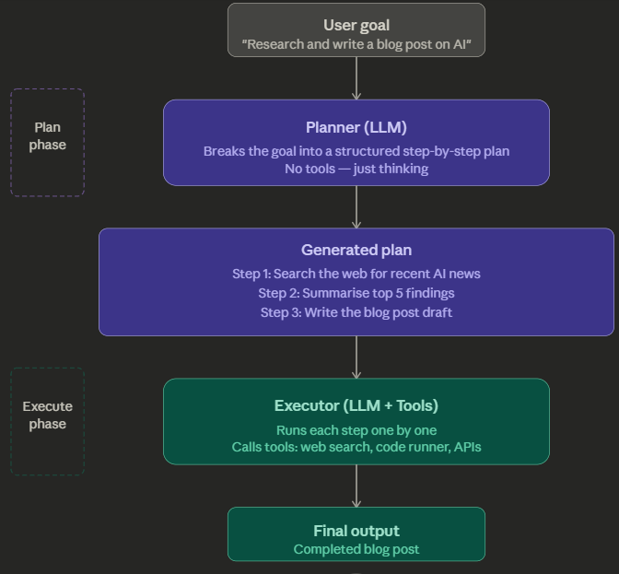
Planner Output:
1. Search for latest AI trends
2. Extract key points
3. Structure blog outline
4. Write blog content
Executor Actions:
Step 1 → calls search API
Step 2 → processes text
Step 3 → creates outline
Step 4 → generates blog

Slide 4
Example Scenario: Customer Support System
Goal: "Cancel order 123 and refund the customer.“
Planner: Breaks the task into:
Find order 123 in the system.
Check if eligible for refund.
Process refund.
Send confirmation email.
Executor:
Executes step 1 using a DatabaseTool,
Execute step 2 with PolicyTool,
Execute step 3 with PaymentTool, and
Execute step 4 with EmailTool

Slide 5
Feature | Planner | Executor
Role | Strategy | Action
Output | Steps / Plan | Results
Thinks? | Yes (reasoning heavy) | Minimal
Uses tools? | Rarely | Yes
Frequency | Once (or few times) | Multiple times

Slide 6
Advantages:
More controlled reasoning
Easier debugging (you see the plan)
Better for complex tasks
Reduces hallucination

Slide 7
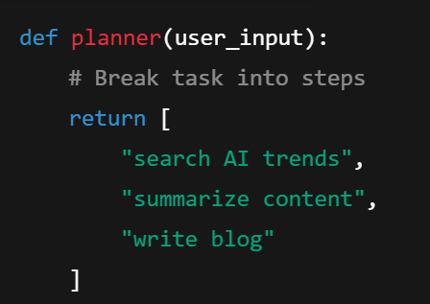
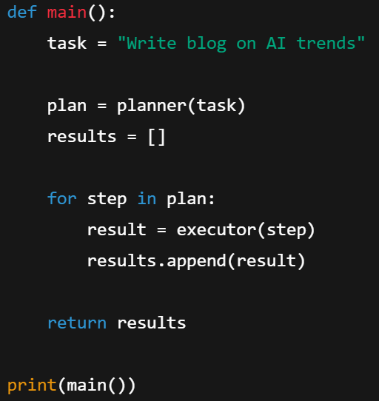
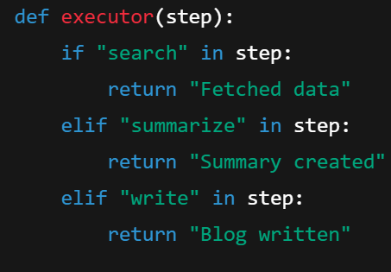
A simple pseudo code

Slide 8
TODO: Implement using following
CrewAI shows you the idea,
LangChain lets you build it,
and LangGraph makes it production-ready.

Slide 9
EXTRA
Ffnbksdfd
Fdslj;f
Fl;ds

