Slide 2
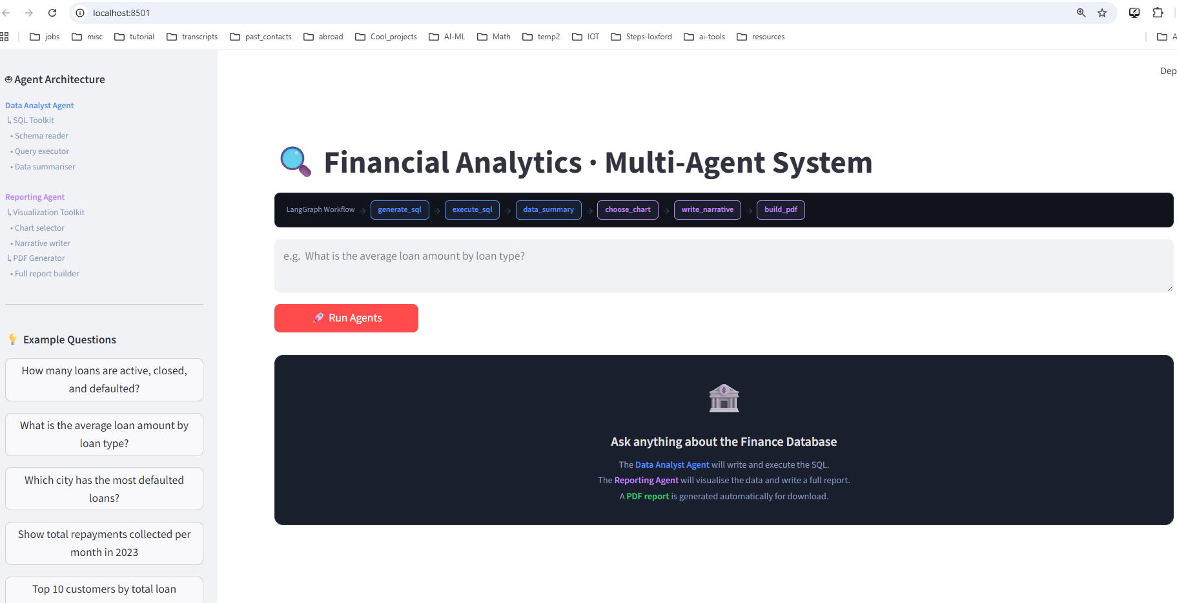

Slide 3
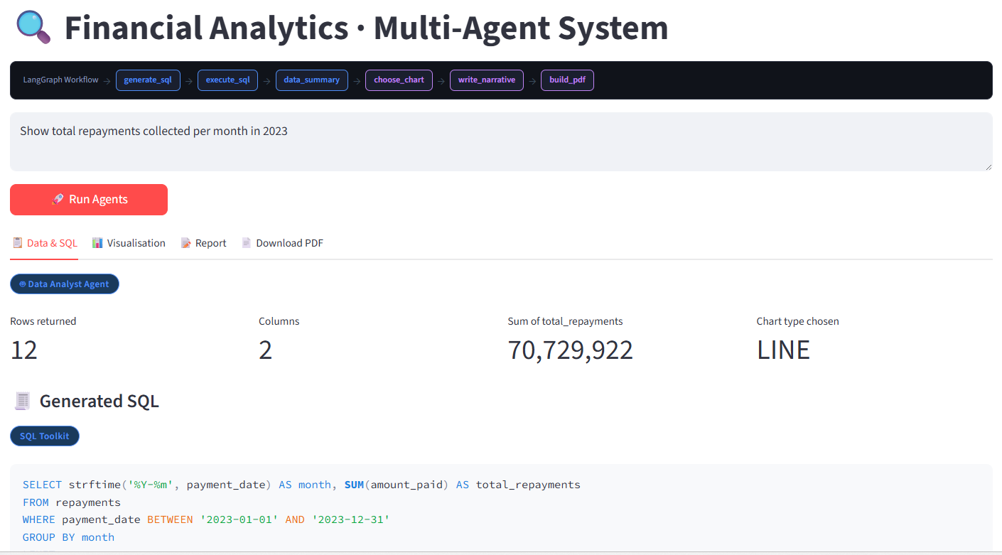



Slide 4
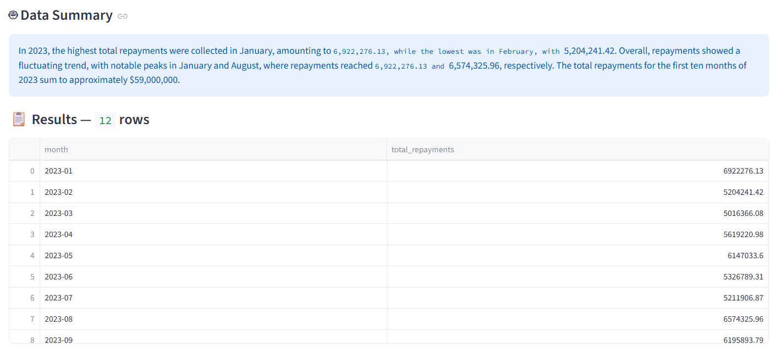


Slide 5
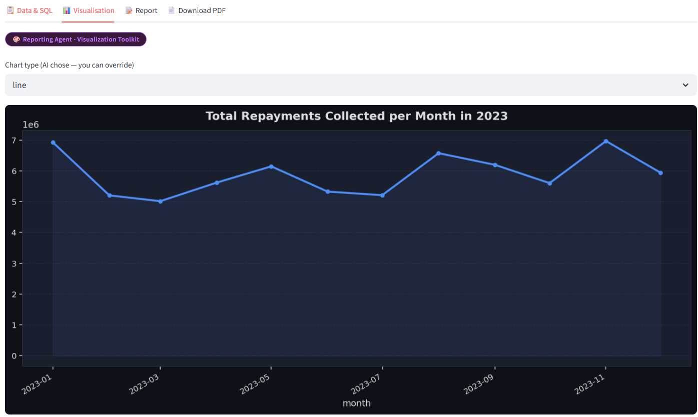


Slide 6
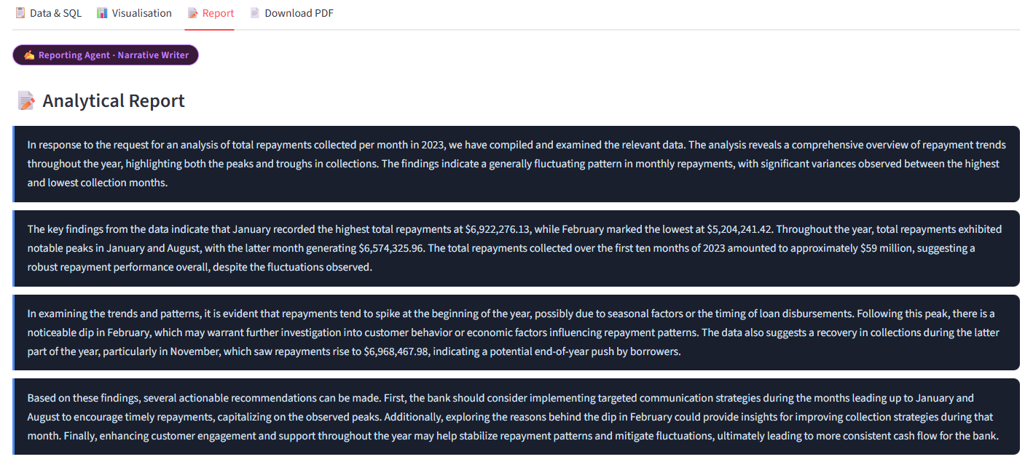



Slide 7
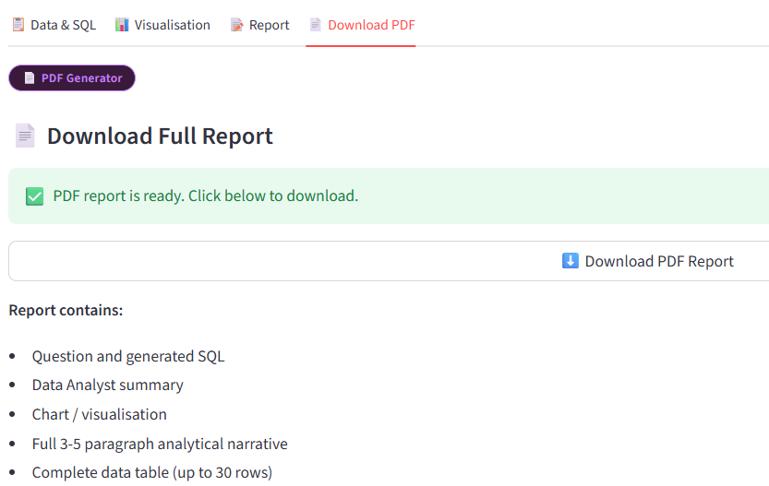

Slide 8
Packages required:
streamlit>=1.35
langchain>=0.2
langchain-openai>=0.1
langgraph>=0.1
openai>=1.30
pandas>=2.0
matplotlib>=3.8
numpy>=1.26
reportlab>=4.1

Slide 9
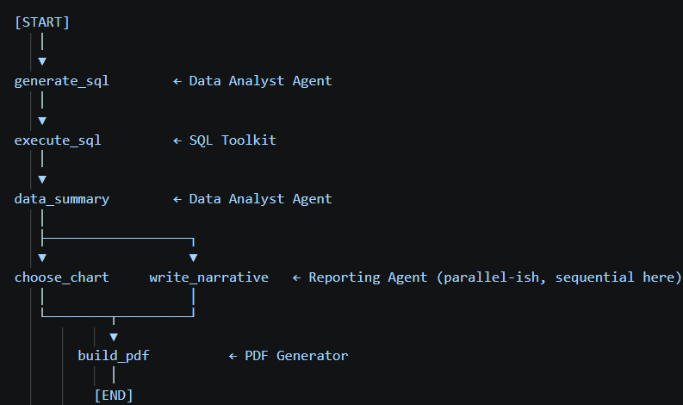

Slide 10
SIDE NOTE:
Here a single agent is sufficient to handle this whole workflow because
The workflow is strictly linear. Every step depends on the previous one:
question → SQL → execute → summarize → chart → narrative → PDF
There is no branching, no parallelism, no step that can run independently.
A multi-agent system makes sense when agents can work simultaneously or independently.
This is for demo purpose

Slide 11
Two specialized agents
1) Data Analyst Agent (agents/data_analyst.py)
Owns three LangGraph nodes:
generate_sql — reads the schema, translates the question to a SELECT query
execute_sql — runs it against SQLite via the SQL Toolkit
data_summary — writes a factual 2-3 sentence summary of the results
Agent - Data Analyst
NL -> SQL -> Execute -> Summary

Slide 12
Two specialized agents
2) Reporting Agent (agents/reporting_agent.py) owns three more:
choose_chart — LLM decides bar/line/scatter/pie/histogram based on data shape
write_narrative — writes a 3-5 paragraph report with findings + recommendations
build_pdf — assembles chart + narrative + data table into a styled PDF

Slide 13
Toolkits (separate from agents)
toolkits/sql_toolkit.py → get_schema, execute_sql tools
toolkits/viz_toolkit.py → choose_chart_type, generate_narrative tools

Slide 14
Tab | Contents
📋 Data & SQL | Metrics, generated SQL, data summary, results table
📊 Visualization | Chart with override dropdown (you can change chart type)
📝 Report | Styled narrative paragraphs from Reporting Agent
📄 Download PDF | One-click PDF with everything included

Slide 15

First create sample database:
> python database/seed_db.py
This will populate the DB.

