Slide 2
Packages required:
langgraph==1.2.4
langchain-openai==1.2.2
reportlab==4.5.1
matplotlib==3.10.9

Slide 3
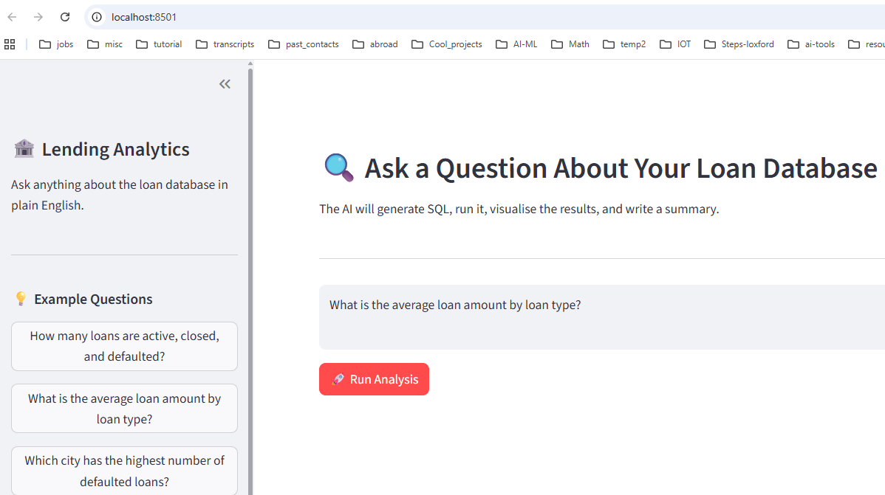




Slide 4
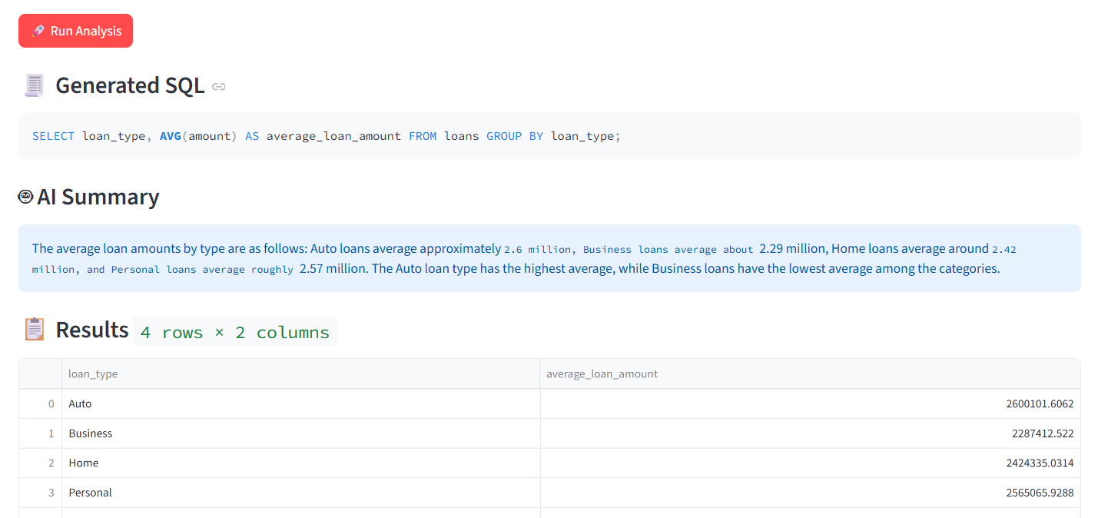



Slide 5
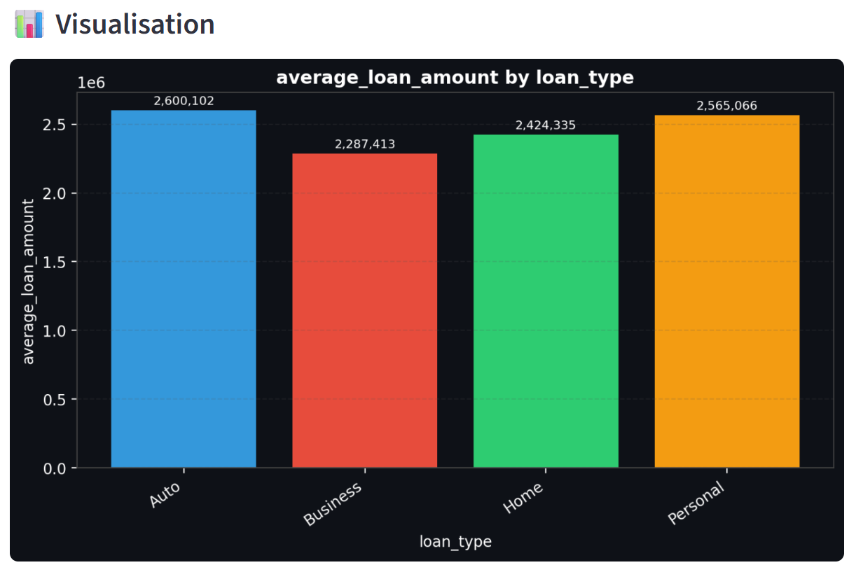
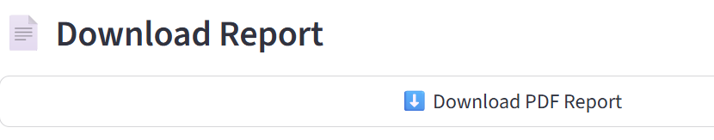


Slide 6
User question
│
▼
[LangGraph Node 1] generate_sql → LLM reads schema, writes a SELECT query
│
▼
[LangGraph Node 2] execute_sql → Runs against lending.db → DataFrame
│
▼
[LangGraph Node 3] summarize → LLM writes a 2-4 sentence plain-English summary
│
▼
Streamlit renders:
SQL block · AI summary · Data table · Chart · PDF download

Slide 7
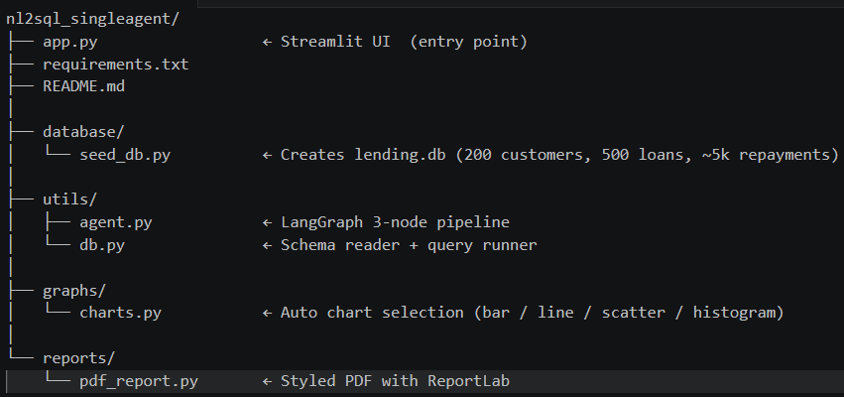

Slide 8

First create sample database:
> python database/seed_db.py
This will populate the DB.
2) Run the app:
> python -m streamlit run app.py

Slide 9
Single-Agent Workflow
The entry point is app.py, which is a Streamlit UI around a single LangGraph-based agent.
User input & setup
app.py renders a sidebar where the user can:
- enter a natural-language question about the loan DB
- optionally choose an example prompt
- provide an OpenAI API key
2. Run button triggers the agent
When the user clicks -> `🚀 Run Analysis`, app.py calls run_agent(question)

Slide 10
3. Agent pipeline in `utils/agent.py`
The single agent is implemented as a simple graph with 3 sequential nodes:
a. `generate_sql`
- reads the DB schema from `utils/db.py`
- prompts the LLM (`gpt-4o-mini`) to convert the user question into raw SQL
- enforces rules:
- output only SQL
- SELECT-only
- use table/column names exactly
- limit to 500 rows unless question implies otherwise
b. `execute_sql`
- runs the generated SQL against the SQLite database at `database/lending.db`
- uses `run_query()` from `utils/db.py`
- returns a pandas DataFrame or captures an error
c. `summarise`
- sends a data preview and the original question back to the LLM
- asks for a concise 2–4 sentence summary of the query results

Slide 11
4. Render results in Streamlit
After `run_agent` returns, app.py displays:
- the generated SQL
- any error message if execution failed
- the LLM summary
- the result table via `st.dataframe`
5. Auto-chart generation
- app.py calls `graphs.charts.auto_chart(df, question)`
- `auto_chart` heuristically chooses a chart type based on the DataFrame:
- line chart if it finds date + numeric
- bar chart if it finds text + numeric
- histogram if only one numeric column
- scatter if two numeric columns
- If a chart can be created, it is shown in the UI

Slide 12
6. PDF report creation
- app.py calls `reports.pdf_report.generate_pdf(...)`
- that function builds a PDF containing:
- the original question
- generated SQL
- the AI summary
- the chart image (if available)
- a table preview of the query results
- The PDF is returned as bytes and offered as a Streamlit download button

