Slide 1
API (Application Programming Interface) In LLM
What is an API ?
Why do we need API ?
Examples of API
How to get API Key ?

Slide 2
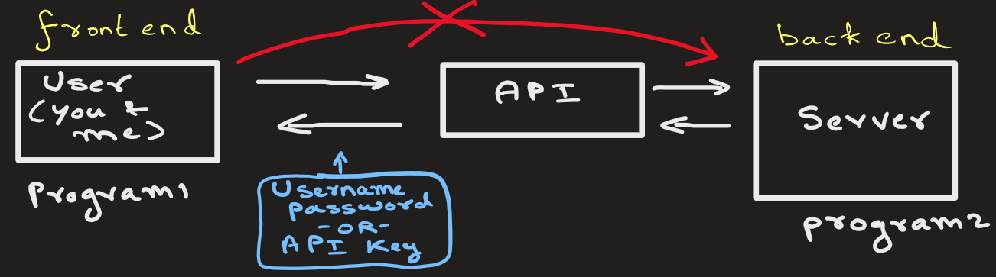
What is an API ?
API is, like a middle man, that allows one program application to talk to another program.
Companies provide API that allows regular user like you and me to access and use their Large Language Models (LLM).
We do not directly talk to their LLM, we use the API.

Slide 3
Generally, to use API you need
Username and password
API key
These are provided by the company that is running LLM

Slide 4
Why do we need an LLM API?
1. Building LLMs is extremely hard
Training something like GPT-4 requires: Massive data, GPUs (=money), Research expertise
👉 Not practical for most developers
With an API, developers have an instant access to LLM

Slide 5
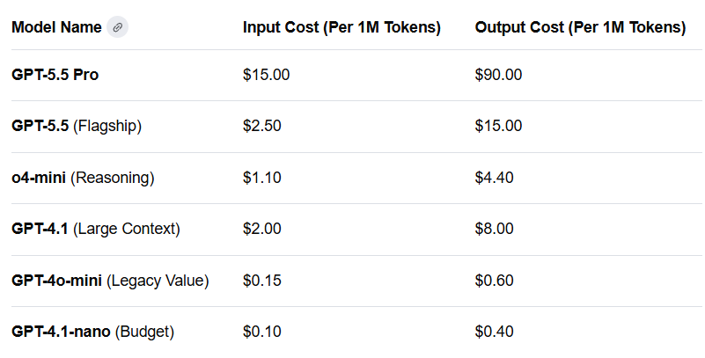
Why do we need an LLM API?
2. Pay-as-you-use
You only pay per request (tokens)
No need to maintain servers
Input tokens are the text you send to the AI
Output tokens are the text the AI generates back to you.

Slide 6


Why do we need an LLM API?
3. API Uses Updated Model
Providers like OpenAI improve models regularly
👉 Your app automatically gets better
Better Newer Model

Slide 7
How to use API ?
Ans: Read API –Docs provided by the company.

Slide 8
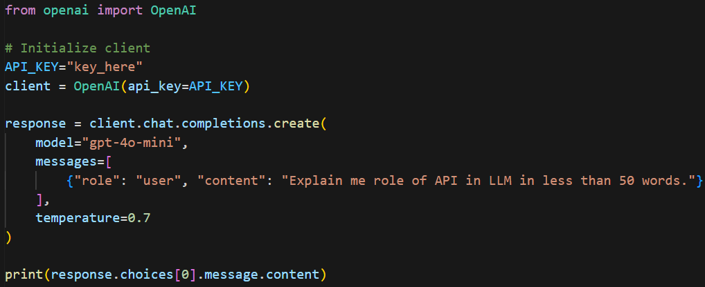





An example:

Slide 9
Output from OpenAI LLM:
An API acts as a bridge, allowing external applications to send requests (prompts) to an LLM and receive generated response. It enables developers to integrate powerful AI capabilities into their own software without needing to host or manage the massive LLM themselves.

Slide 10
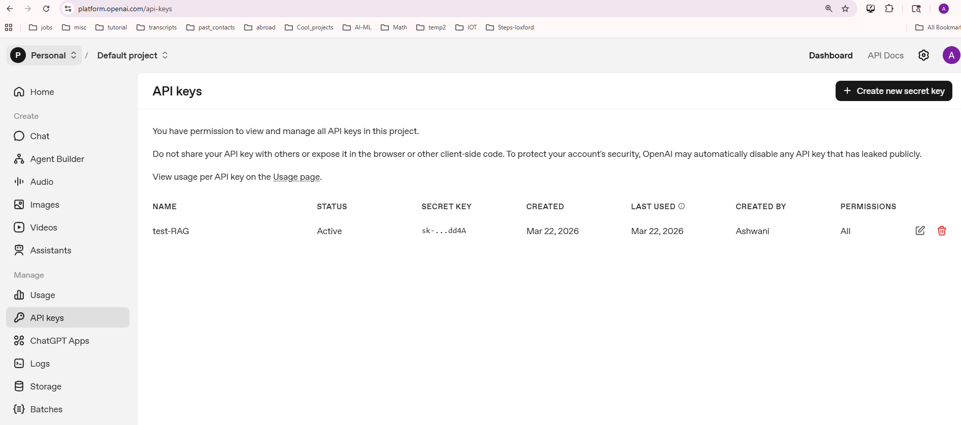
How to get API Key ?
OpenAI API keys : https://platform.openai.com/api-keys

Slide 11
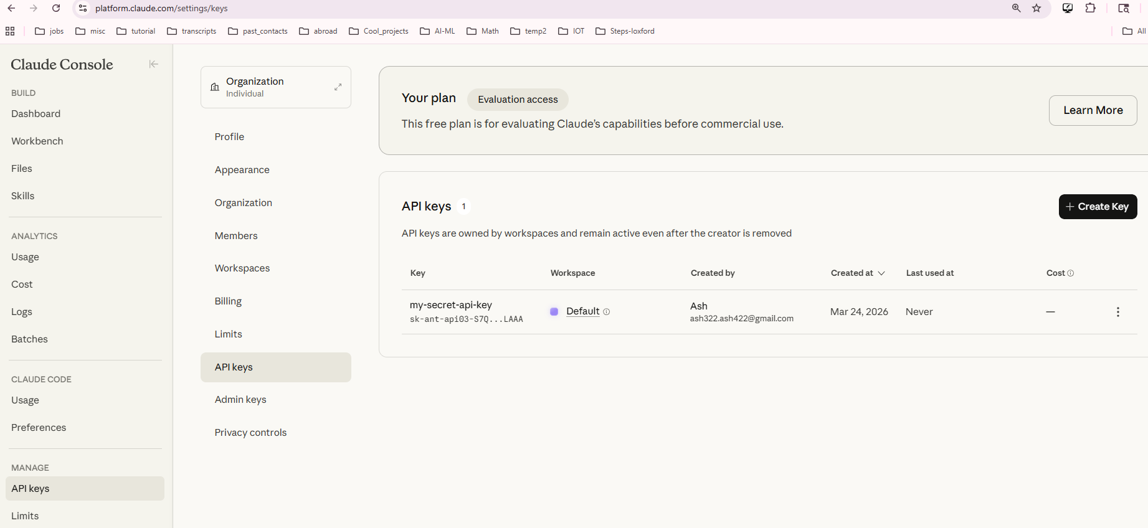
How to get API Key ?
Claude AI API keys : https://platform.claude.com/settings/keys

Slide 12
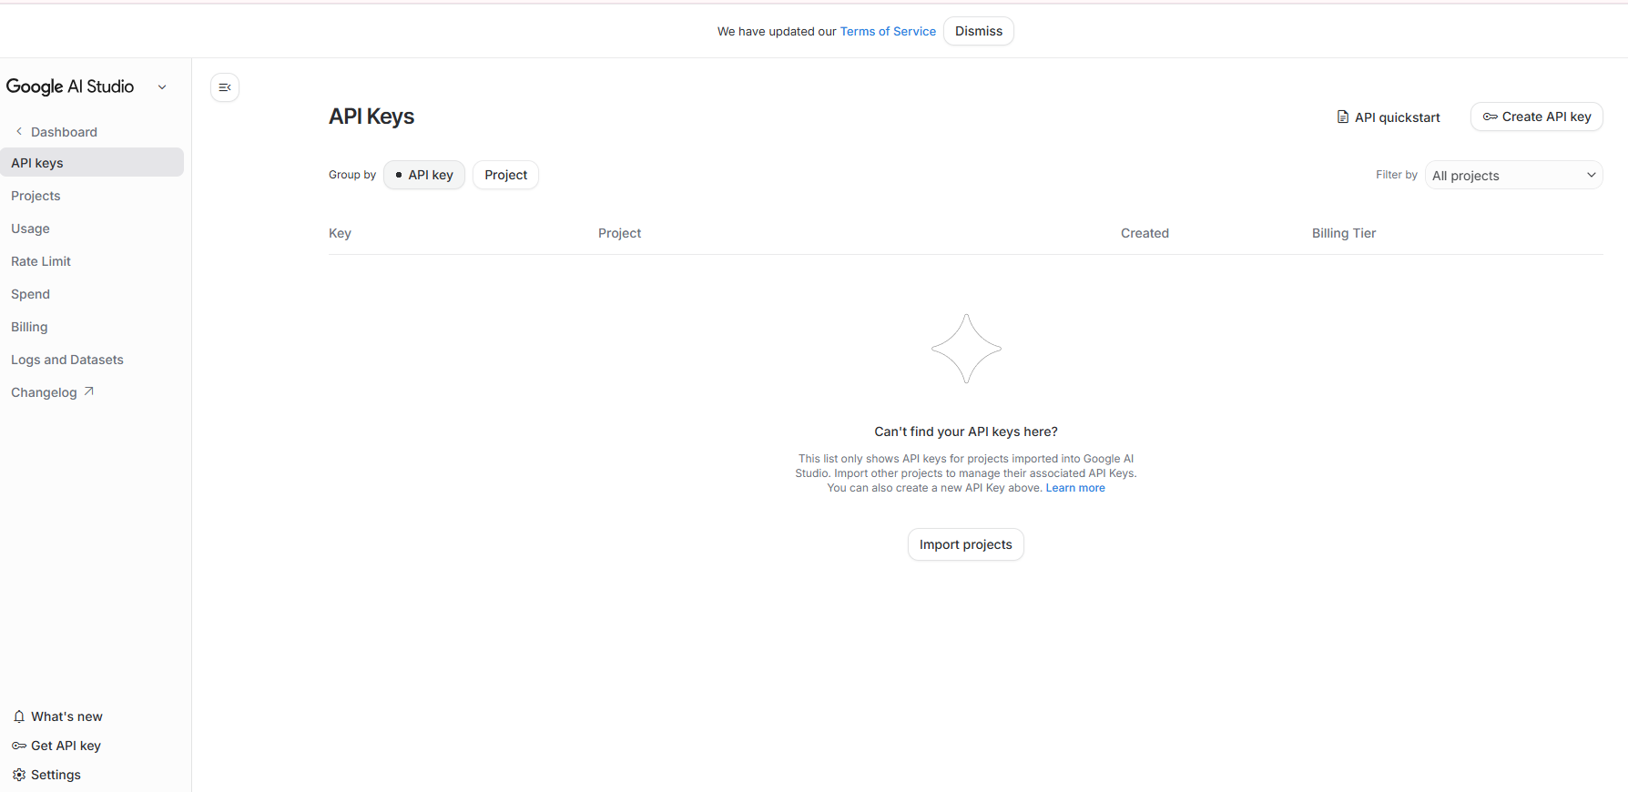
How to get API Key ?
Google AI API keys : https://aistudio.google.com/app/api-keys

Slide 15
EXTRA
Ffnbksdfd
Fdslj;f
Fl;ds

