Slide 1
Fine Tune an Open AI Model

Slide 2
Task:
Your task is to design a fine-tuned model that would take input hospital unstructured data and give output as structured data in the form of JSON

Slide 3
Without fine tuned model, you would have to use prompt to get output in JSON format
You are a medical information extractor. Following is a patient data:
“Mr. Loxford Kumar is a 36 year of age. He is having pain in his gum on left side. Possible tooth decay. Prescribed Helio 50mg daily”
Summarize above and produce output in strict JSON format:
{
“patient_name”: <patient name here>,
“age” : <age here>,
“diagnosis”: “diagnosis here”,
“prescribed medication”: “medication here”
}
{
"patient name": “Loxford Kumar",
"age": 36,
"diagnosis": "Periodontal Abscess",
"prescribed medication": “Helio”
}
No Fine Tuned
Model

Slide 4
With fine tuned model, your prompt would be simpler
Victoria Gupta, a 27-year-old female, presents with chronic fatigue, muscle pain, and tender points throughout body.
Reports unrefreshing sleep and cognitive difficulties. Started on Duloxetine 30mg daily with gradual increase to 60mg.
{
"patient name": "Victoria Gupta",
"age": 27,
"diagnosis": "fibromyalgia",
"prescribed medication": "Duloxetine“
}
Fine Tuned
Model

Slide 5
{
"patient name": “Loxford Kumar",
"age": 36,
"diagnosis": "Periodontal Abscess",
"prescribed medication": “Helio”
}
Mr. Loxford Kumar is a 36 year of age.
He is having pain in his gum on left side. Possible tooth decay.
Prescribed Helio 50mg daily
Fine Tuned
Model

Slide 6


Work flow of fine tuning
Upload training file
+
validation file
Get API Key
Prepare dataset
Create Fine Tuning job
Monitor Fine Tuning Job
Test the model

Slide 7
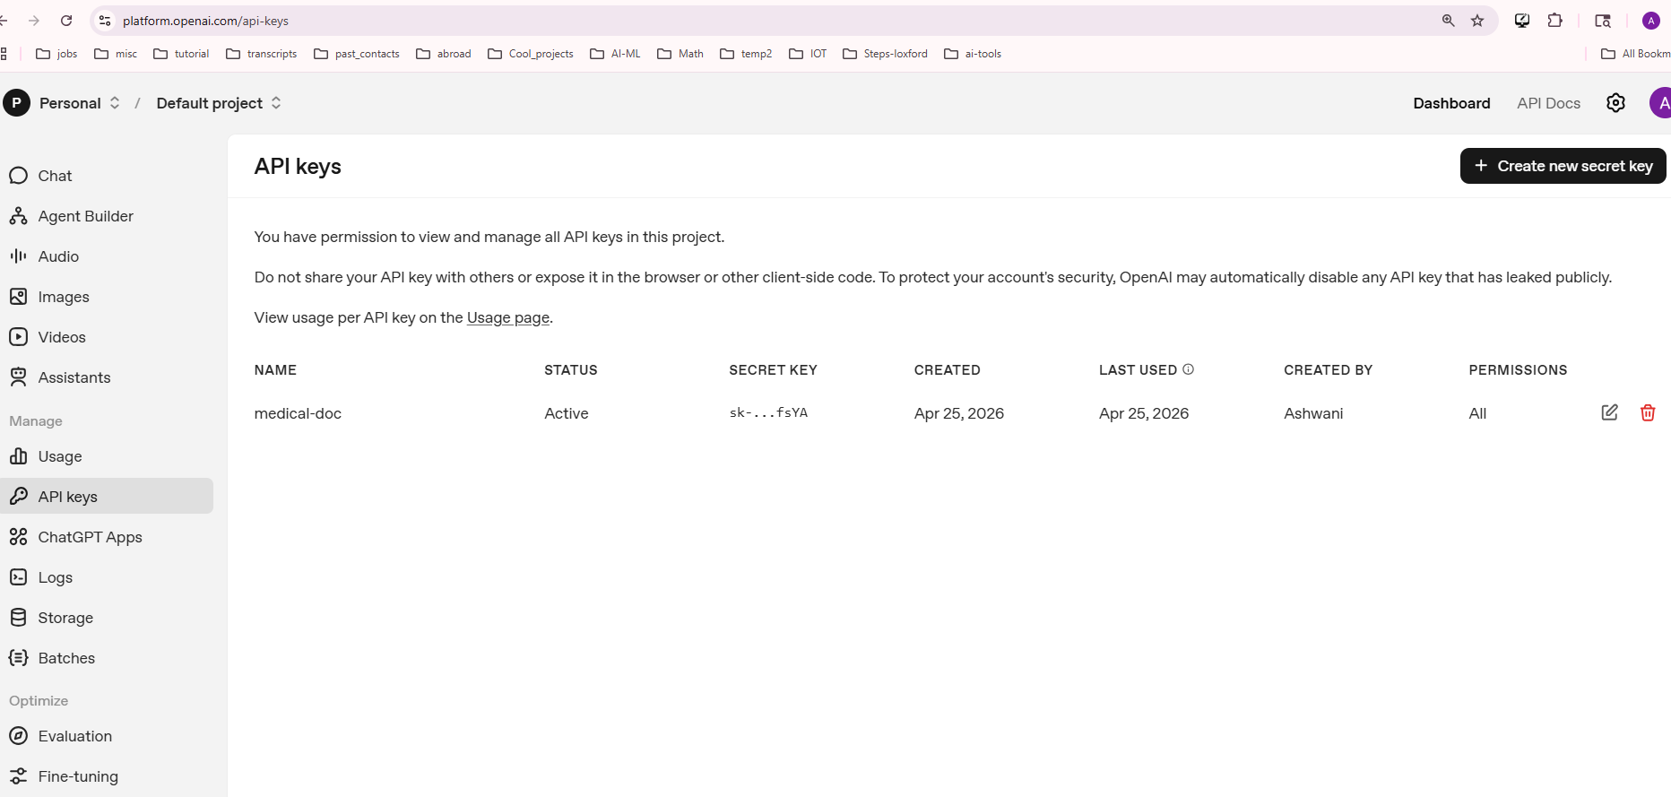


Get API Key

Slide 8
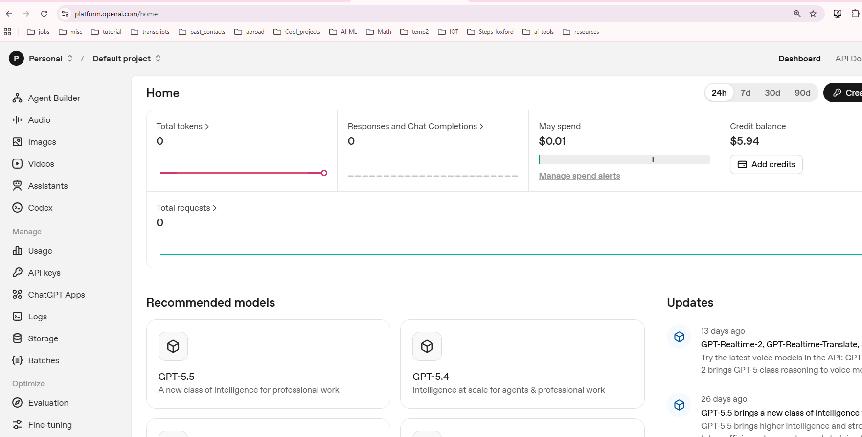


Click on Dashboard

Slide 9
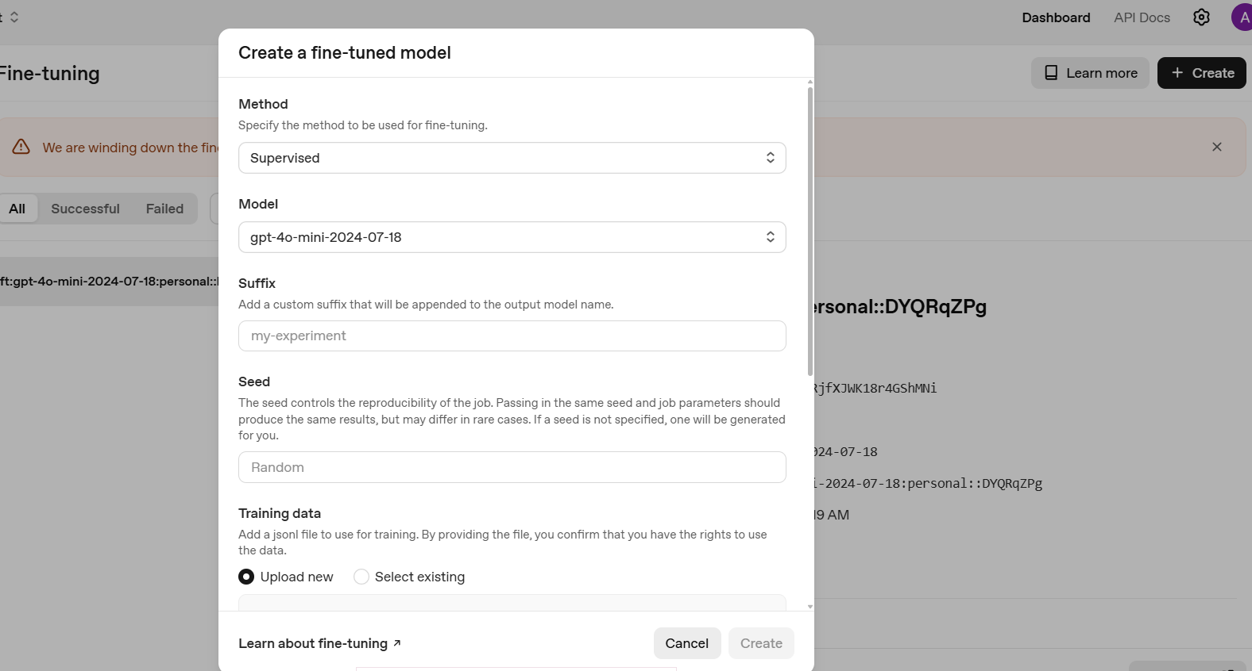

Click on Create -> I used this screen to find the model

Slide 10
Then I ran the jupyter notebook
FT_OpenAI_Models.ipynb

Slide 11
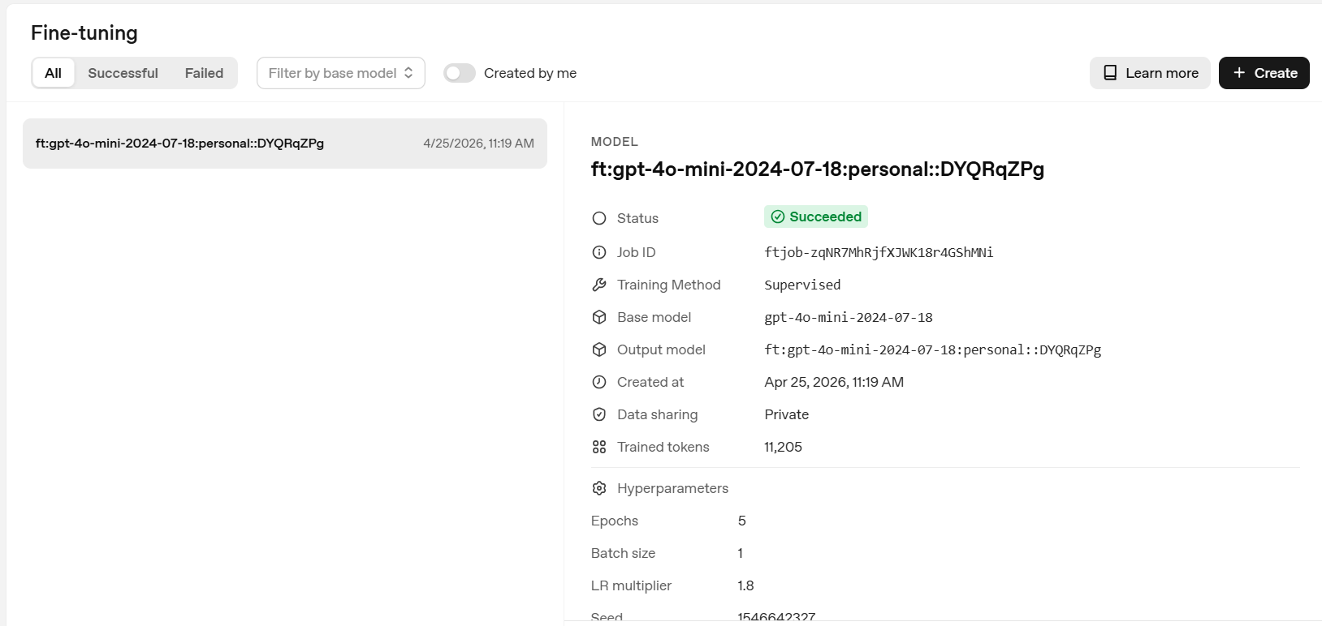


After Fine tuned model is created

Slide 12
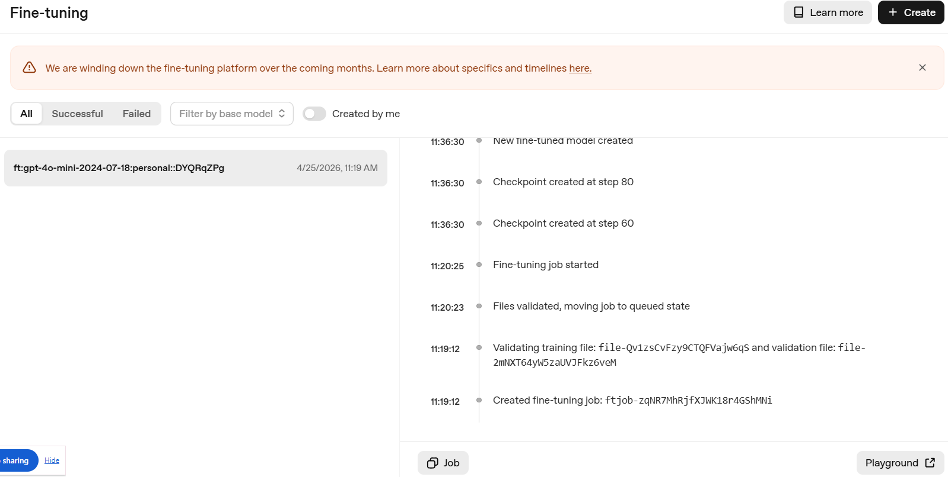

Then I went to Open AI playground to view chat with the model

Slide 13
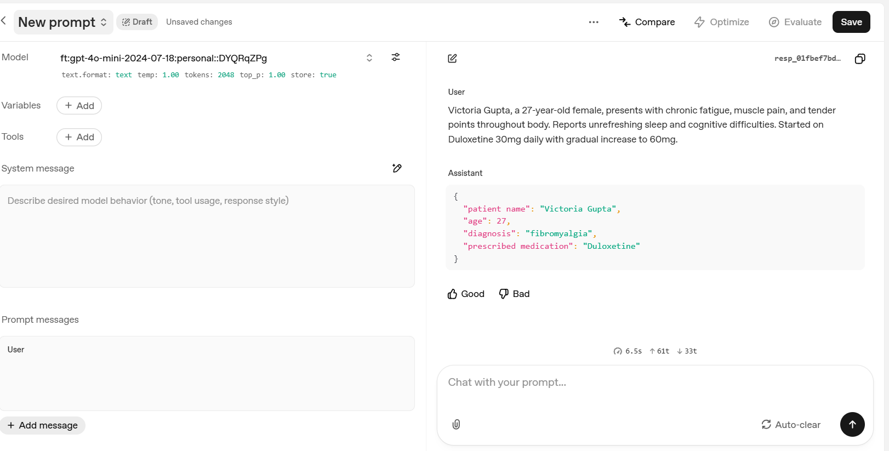


Playground -> Chat with your fine-tuned model

