Slide 2
Workflow
Step 1: User enters ticker
↓
Step 2: Stock service fetches data
↓
Step 3: Prediction service creates forecast
↓
Step 4: AI module summarizes insights
↓
Step 5: Frontend displays everything

Slide 3
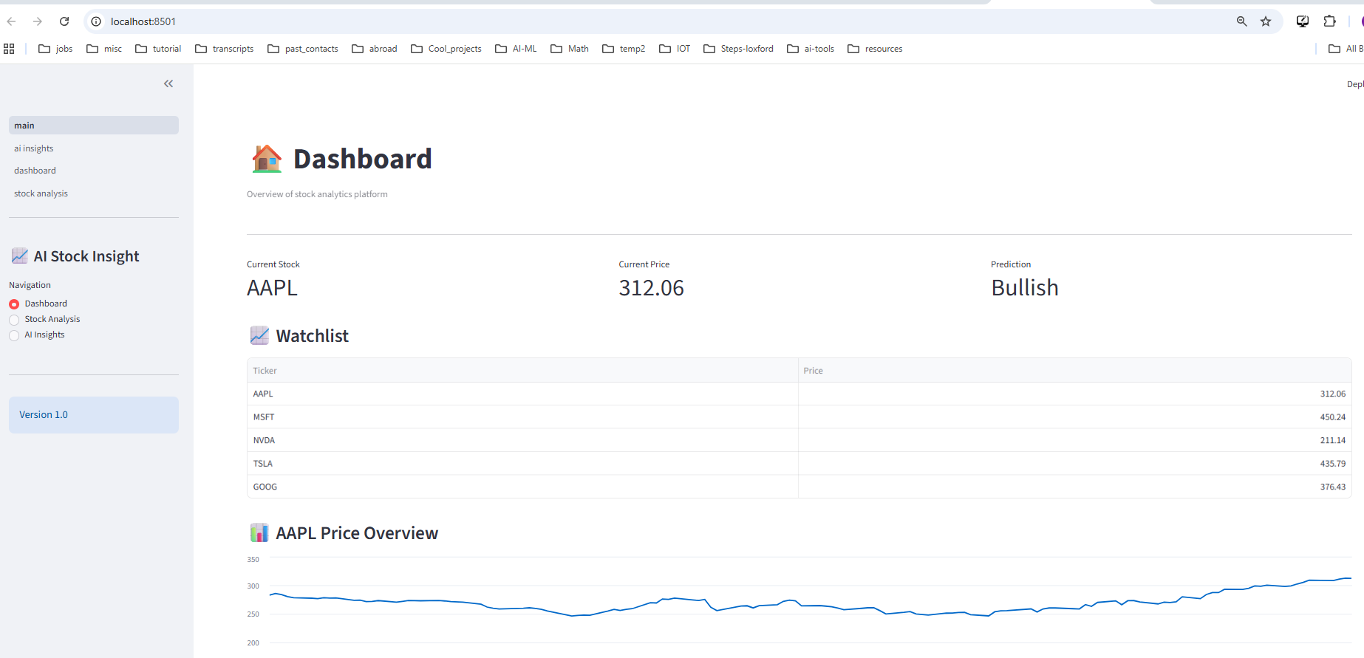





Slide 4
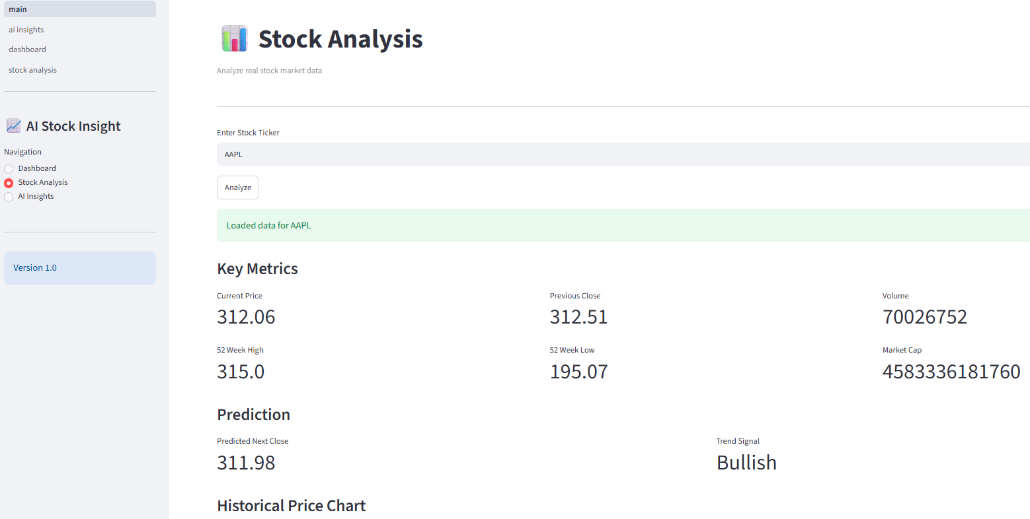


Slide 5
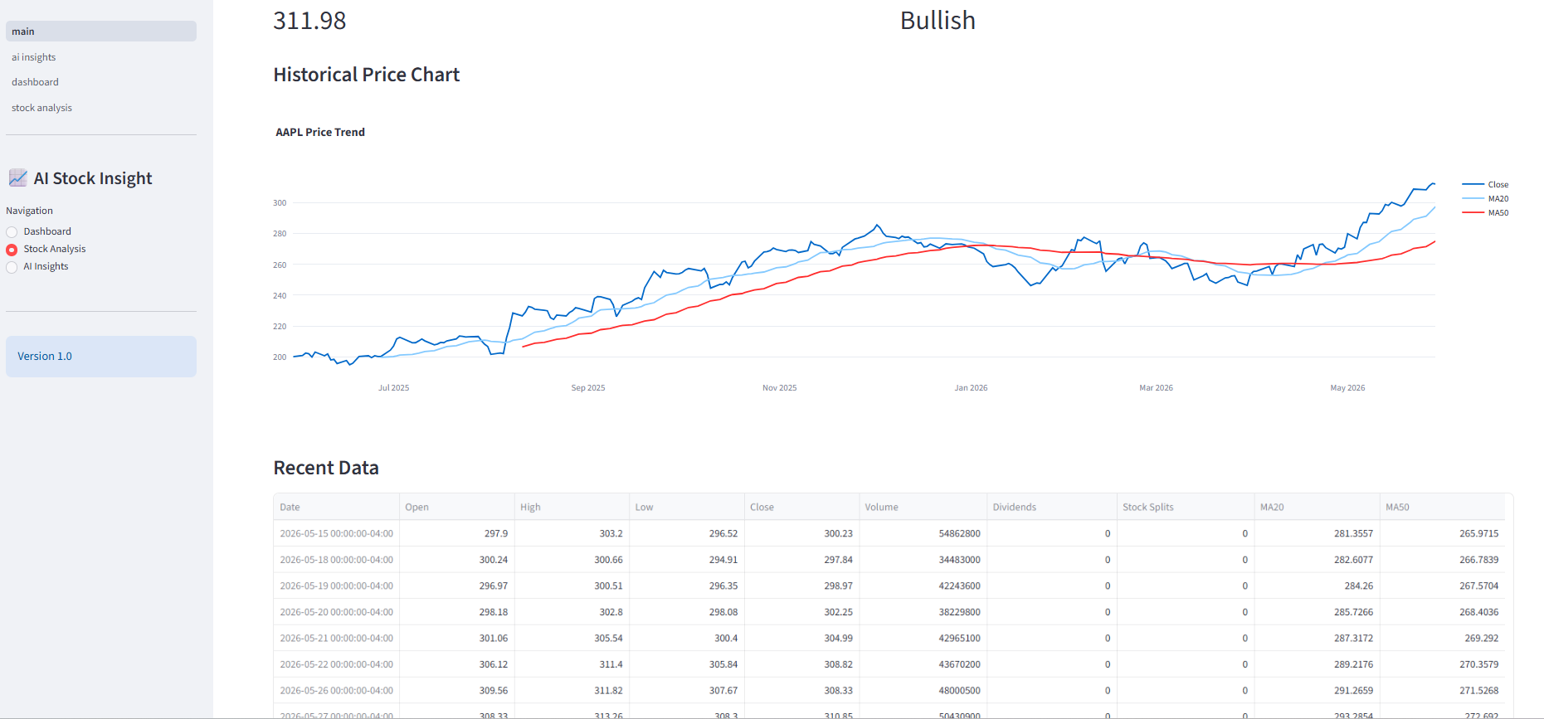


Slide 6
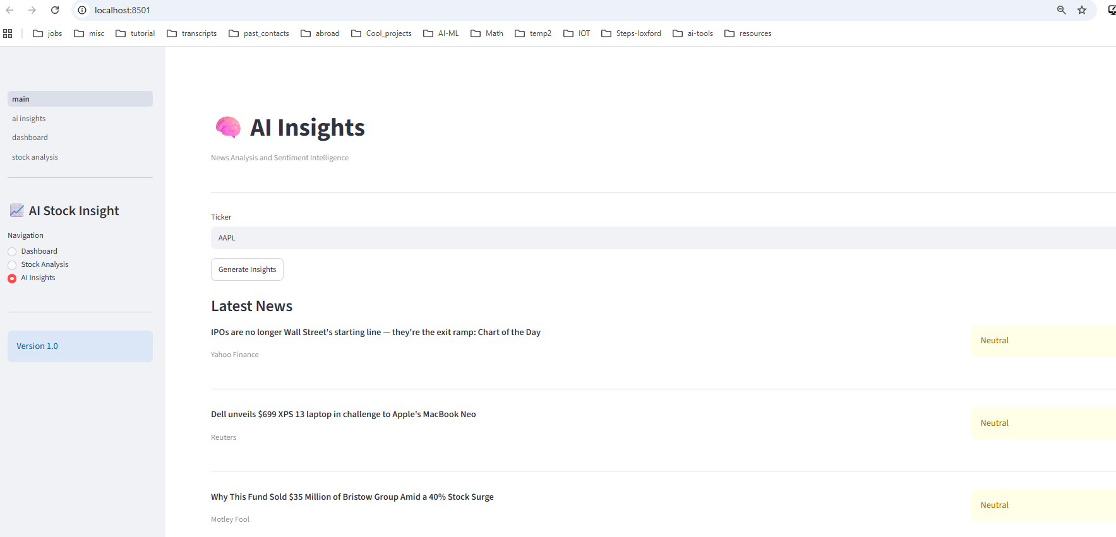


Slide 7
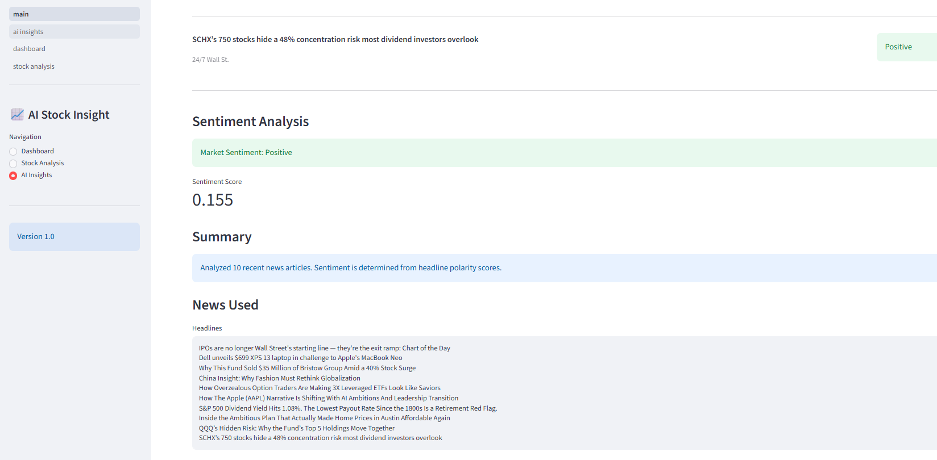




Slide 8
Libraries used:
numpy==2.4.6
pandas==2.2.2
plotly==6.7.0
scikit-learn==1.4.2
streamlit==1.58.0
textblob==0.20.0
yfinance==1.3.0
To run the app:
python -m streamlit run .\finance_ai_app\app\main.py

Slide 9
PHASE 1 — UI Skeleton
Build:
sidebar
pages
navigation
PHASE 2 — Stock Data
Add:
ticker search
chart
metrics
PHASE 3 — Prediction
Add:
moving averages
simple forecasting
PHASE 4 — AI Summary
Add:
news summarization
Sentiment Analysis

Slide 10
Recommended APIs
Stock Data
Yahoo Finance API (yfinance)
Alpha Vantage
News
NewsAPI
Finnhub
In this session
WE DO THIS
Real stock chart
Simple prediction
AI summary
Local app

Slide 11
Future Enhancements
Frontend Options
Backend Options
Option | Why Good
Streamlit | Fastest for demos
Gradio | Great for AI apps
React | Best for production feel
Option | Why Good
FastAPI | Modern AI backend
Flask | Easier for beginners
Django | Full-stack but heavier

