Slide 1
CONTINUOUS TRANSACTION AUDITING
From Sample to Certainty
Moving from sample-based quarterly audits to automated, 100% transaction
coverage with real-time anomaly detection.
1-HOUR SESSION • LECTURE + LIVE DEMO

Slide 2
AGENDA
What we'll cover in the next hour
1
The problem with sampling
10 min
Why testing 30-60 transactions a quarter leaves the other 99% of the ledger unexamined.
2
What continuous transaction auditing is
10 min
Definitions, architecture, and how it differs from continuous monitoring.
3
Detection techniques
10 min
Rule-based tests (Benford's Law, thresholds, timing) and ML-based anomaly detection.
4
Live demo
20 min
Run both detection layers against a year of synthetic transactions and triage the results.
5
Adoption, risks, and next steps
10 min
Implementation roadmap, limitations, and how to pilot this on your own ledger.
Continuous Transaction Auditing
2

Slide 3
THE PROBLEM
Quarterly sampling was built for paper ledgers
Statistical sampling let a small audit team form an opinion on a population too large to review by hand. It was never designed to find every irregularity — it was designed to give reasonable assurance at a cost the engagement could afford.
~4%
That trade-off is now optional. Ledgers are digital, transactions are structured data, and compute is cheap — so the constraint sampling was designed around no longer exists for transaction-level testing.
typical population coverage
in a quarterly sample audit
96%
of transactions are never individually
reviewed by anyone
Continuous Transaction Auditing
3

Slide 4
THE PROBLEM
Fraud and error don't distribute evenly
Sampling assumes an even, non-adversarial population. But the transactions most worth catching — a duplicate payment, a vendor invoice fabricated just under an approval limit, a posting at 2am on a Saturday — are, by construction, rare and deliberately unremarkable. Random or even judgmental samples routinely miss them, and by the time the next audit cycle runs, the exposure window has often already closed.
A YEAR IN A QUARTERLY-SAMPLE WORLD
Q1
~4% tested • 96% unreviewed
Q2
~4% tested • 96% unreviewed
Q3
A control tested quarterly can be silently broken for up to 89 days before the next test
~4% tested • 96% unreviewed
A single reviewer sampling 60 invoices out of 6,000+ has roughly a 1% chance of ever seeing a specific anomalous one
Q4
Manual review scales with headcount; transaction volume doesn't wait for headcount
~4% tested • 96% unreviewed
Continuous Transaction Auditing
4

Slide 5
THE SHIFT
What is continuous transaction auditing?
POPULATION
DEFINITION
100% of transactions, every period — not a drawn sample
The automated, ongoing testing of every transaction as it posts — rather than a subset selected after the period closes — using rule-based tests and statistical/ML models to score each one for risk.
CADENCE
As transactions post, or on a daily/near-real-time batch
METHOD
Deterministic rules + statistical/ML models scoring each transaction
NOT THE SAME AS —
Continuous monitoring (KPI/control dashboards at an aggregate level) or periodic data analytics (running CAATs once against a data extract). CTA operates transaction-by-transaction, in-line with posting.
OUTPUT
A risk-ranked exception queue for human auditor triage — not auto-verdicts
Continuous Transaction Auditing
5

Slide 6
THE SHIFT
Sample-based audit vs. continuous transaction auditing
TRADITIONAL SAMPLING
CONTINUOUS TRANSACTION AUDITING
Coverage
~2–5% of transactions, selected once per period
100% of transactions, every period
Timing
Weeks to months after the transaction posted
At or near the time of posting
Basis for selection
Random or judgmental sampling
Every transaction scored; highest-risk surfaced
Auditor's role
Manually pull and test individual items
Triage a pre-scored exception queue
Best at catching
Systemic, high-frequency control breakdowns
Rare, deliberate, or transaction-specific anomalies
Cost driver
Scales with headcount and hours tested
Scales with compute; marginal cost per txn ≈ 0
Continuous Transaction Auditing
6

Slide 7
HOW IT WORKS
The continuous auditing pipeline
1
2
3
4
5
Ingest
Rule engine
ML scoring
Risk ranking
Auditor triage
Every transaction streams in from the ERP/GL as it posts — no extract-and-wait.
Deterministic tests run first: thresholds, duplicates, timing, Benford's Law, policy checks.
A statistical/ML model scores each transaction for multivariate outlierness relative to its own history.
Rule flags + ML score combine into one explainable composite risk score per transaction.
Highest-risk items land in a queue for human review, disposition, and escalation.
→
→
→
→
Today's demo walks stages 2–5 end to end against one year of synthetic accounts-payable data.
Continuous Transaction Auditing
7

Slide 8
DETECTION TECHNIQUES
Layer 1: rule-based tests
Rules are explainable, fast, and cheap to run on every transaction. They encode things auditors already know to look for — the goal is to make those checks run continuously instead of on a sample.
Benford's Law
Duplicate payments
Threshold clustering
Leading digits of naturally occurring amounts follow a known distribution. Vendors whose invoice amounts deviate sharply are worth a look.
Same vendor, same amount, posted within days of each other — the classic AP leakage pattern.
A spike of invoices just under an approval limit suggests deliberate structuring to avoid secondary sign-off.
Timing anomalies
Round-dollar amounts
Policy/threshold breaches
Postings on weekends, holidays, or outside business hours, when fewer people are watching.
Real invoices rarely land on exact round numbers; a cluster of them often indicates fabrication.
Any hard-coded control limit — spending authority, duplicate vendor IDs, missing PO — checked on every line.
Continuous Transaction Auditing
8

Slide 9
DETECTION TECHNIQUES
Layer 2: machine learning — catching the unknown unknowns
Rules only catch patterns someone already thought to write a rule for. An unsupervised model looks at every transaction's features — amount, timing, vendor history, department — and flags the ones that don't resemble anything else in the data, without needing a predefined pattern.
WHAT ML CATCHES THAT RULES MISS
A payment that's unremarkable in absolute terms, but 10x this specific vendor's normal invoice size
A department whose spending pattern shifts gradually enough that no single threshold trips
TODAY'S DEMO USES: ISOLATION FOREST
An algorithm that isolates each transaction by randomly splitting on its features. Anomalies split apart in fewer steps than normal points — so "average path length to isolate" becomes the anomaly score. It needs no labeled fraud examples to train on, which matters because most ledgers don't have any.
A combination of features — amount + timing + approver — none of which is individually unusual
Continuous Transaction Auditing
9

Slide 10
DETECTION TECHNIQUES
Combining both layers into one worklist
Neither layer alone is sufficient. Rules are explainable but blind to novel patterns; ML catches novel patterns but is harder to justify to a stakeholder on its own. Production systems combine both into a single composite risk score, so every flagged transaction has both a statistical basis and, where possible, a plain-language reason.
Composite risk score = (rules triggered) + 2 × (normalized ML anomaly score)
Explainable
Tunable
Actionable
Every score can be traced back to which specific rules fired, or that the ML model alone flagged it.
Weights and rule thresholds are adjusted per engagement risk appetite — more conservative or more sensitive.
Auditors triage a ranked list, not a firehose — the highest-risk 1–5% surface first.
Continuous Transaction Auditing
10

Slide 11
LIVE DEMO
One year of transactions.
Both detection layers. Live.
6,145 synthetic accounts-payable transactions • 145 planted anomalies • Python + scikit-learn

Slide 12
LIVE DEMO
The dataset: a year of accounts-payable activity
6,145
140
7
145
total transactions, FY2025
unique vendors
departments
known anomalies (planted for scoring)
Why synthetic data: it lets us know the ground truth. Seven anomaly types were deliberately embedded — duplicate payments, threshold structuring, weekend/after-hours postings, round-dollar amounts, a vendor with fabricated invoices, a shell-vendor spike, and plain statistical outliers — so at the end of the demo we can measure exactly what each detection layer caught and missed, the same way you'd validate a model before trusting it on a real ledger.
Continuous Transaction Auditing
12

Slide 13
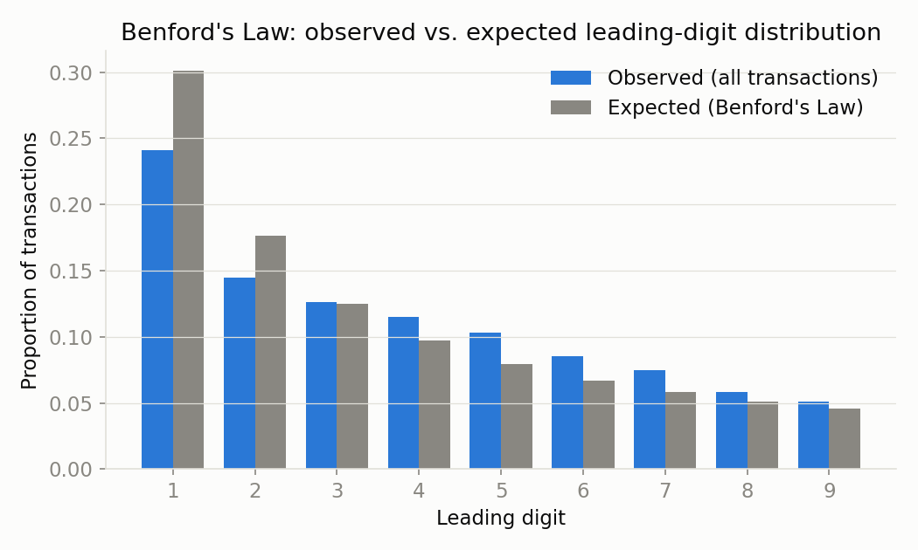
LIVE DEMO
Step 1: Benford's Law on the full population
WHAT TO WATCH FOR
The overall population tracks Benford's expected curve closely — exactly what we'd expect from genuine, organically-generated invoice amounts across 140 vendors.
The real signal is per-vendor: running the same chi-square test vendor-by-vendor isolates which single vendor's amounts don't fit the curve — in this dataset, one vendor's invoices lean hard on leading digits 5–9, a classic fabrication signature.
Continuous Transaction Auditing
13

Slide 14
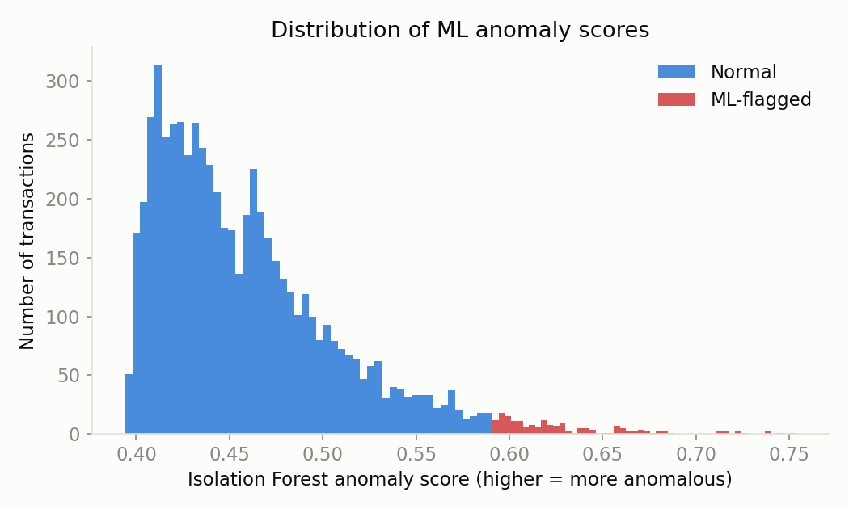
LIVE DEMO
Step 2: Isolation Forest anomaly scores
WHAT TO WATCH FOR
Most transactions cluster at a low anomaly score — that's the model saying "this looks like everything else I've seen." The right-hand tail is where the model is isolating transactions in very few splits.
Contamination is set to 3% here — an explicit, tunable assumption about how much of the population we expect to be anomalous. In production this gets calibrated against your own base rate, not left at a default.
Continuous Transaction Auditing
14

Slide 15
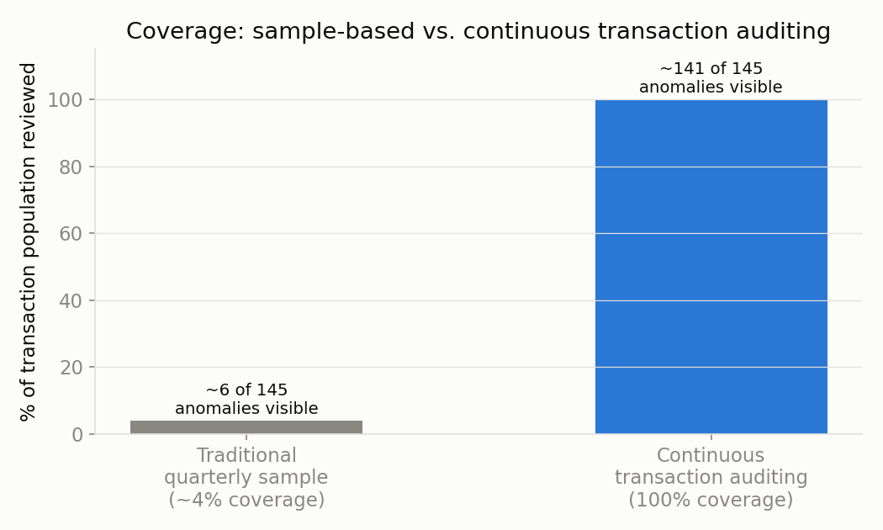
LIVE DEMO
The reveal: coverage vs. anomalies actually seen
RESULTS AGAINST KNOWN ANOMALIES
97%
of planted anomalies caught by rules and/or ML combined
13%
of the population flagged for triage — not 100%, and not 4%
18%
precision — the honest cost of high recall, and why triage still needs a human
Continuous Transaction Auditing
15

Slide 16
LIVE DEMO
The output an auditor actually works from
Detection isn't the deliverable — a triage-ready worklist is. Every flagged transaction carries its composite score, which rules fired, and whether ML independently flagged it, so the reviewer can see why it's on the list before opening the source document.
Transaction
Vendor
Amount
Rules Fired
ML Flag
Risk Score
T106058
Murphy-Juarez
$106.92
1
Yes
3.00
T106103
Meridian Consulting Partners
$9,912.61
2
No
2.98
T106002
Walters, Baker and Freeman
$15,633.09
2
No
2.96
T106065
Martin Group
$10,000.00
2
No
2.91
T106108
Meridian Consulting Partners
$9,859.84
2
No
2.87
Full ranked worklist (top 50) exported to risk_ranked_worklist_top50.csv during the live run.
Continuous Transaction Auditing
16

Slide 17
WHY IT MATTERS
What changes when coverage goes to 100%
Coverage
Speed to detection
Deterrence
Every transaction is tested, not a projection from a sample — no population left unexamined.
Anomalies surface within a reporting cycle, not months after the exposure window closed.
Would-be bad actors can't rely on a low sampling probability — everything is checked.
Audit cost curve
Evidence quality
Auditor focus
Marginal cost per transaction approaches zero; testing scope stops being headcount-bound.
A documented, repeatable, systematic test of the full population is stronger audit evidence than a sample extrapolation.
Staff spend time on judgment and investigation, not manually pulling and testing routine items.
Continuous Transaction Auditing
17

Slide 18
BEING HONEST ABOUT IT
Risks and limitations
1
Precision, not just recall
High recall means more false positives — today's demo flagged 13% of the population for 97% recall. Triage capacity has to be planned for, not assumed away.
2
Data quality dependency
Rules and models are only as good as the underlying ERP data. Garbage in, garbage flagged — or worse, garbage missed.
3
Explainability of ML flags
A rule can be defended in a report; "the model said so" cannot. ML flags need documented rationale and human review before any action is taken.
4
Change management
This shifts audit staff from testing samples to triaging queues and investigating exceptions — a real skills and workflow change, not just a tooling change.
5
Not a replacement for judgment
CTA surfaces candidates for review. It does not issue an audit opinion, and it does not replace controls testing or substantive procedures where those remain required.
Continuous Transaction Auditing
18

Slide 19
GETTING STARTED
A realistic path to pilot
Weeks 1–2
Pick one process
Start with accounts payable or T&E — high volume, well-understood risks, clear data.
Weeks 3–4
Stand up rule layer
Encode the checks your team already does manually: duplicates, thresholds, timing, Benford's Law.
Weeks 5–8
Add the ML layer
Once rules run cleanly, layer in an unsupervised model and calibrate contamination against your real base rate.
Weeks 9–12
Pilot triage workflow
Route flags to a small reviewer group, track disposition, tune thresholds against false-positive feedback.
Ongoing
Expand scope
Extend to additional processes and business units once the pilot's precision/recall trade-off is proven out.
Continuous Transaction Auditing
19

Slide 20
WRAP-UP
Key takeaways
1
Sampling was a workaround for a constraint — limited manual capacity — that digital ledgers and cheap compute have removed for transaction-level testing.
2
Continuous transaction auditing tests 100% of transactions, continuously, using rule-based and ML-based detection layered together — not either one alone.
3
It produces a risk-ranked worklist for human triage, not an automated verdict; auditor judgment stays firmly in the loop.
4
High recall comes with a false-positive cost that has to be planned for — precision, explainability, and workflow change are the real adoption challenges, not the algorithms.
5
The realistic path in is one process, piloted, with disposition tracked — not a big-bang rollout across the whole ledger.
Continuous Transaction Auditing
20

Slide 21
QUESTIONS & DISCUSSION
Where would this fit in
your audit plan?
Demo code, dataset, and slides from today are available on request.

