Slide 1
PROCUREMENT & VENDOR FRAUD PROTECTION
Network-Graph Analysis for Finance & AP Teams
How graphing vendors, employees, and payments together flags ghost vendors, split-purchase schemes, and collusion rings — before cash leaves the bank.
Lecture + Case Study • 1 Hour • Finance / AP / Internal Audit

Slide 2
AGENDA — 60 MINUTES
What We'll Cover
01
Why This Matters
The cost of procurement fraud, and where traditional controls fall short
02
The Core Idea
Turning a flat invoice ledger into a network of vendors and people
03
Three Fraud Patterns
Ghost vendors, split-purchase schemes, and collusion rings — and their graph signatures
04
Live Case Study
Walking a synthetic 730-invoice ledger through the same analysis, together
05
From Detection to Control
Turning this into a standing pre-payment review process
Procurement & Vendor Fraud Protection | Network-Graph Case Study
2

Slide 3
WHY THIS MATTERS
The Cost of Doing Nothing
$104,000
12 months
43%
median loss per occupational fraud case
typical time a scheme runs before it's caught
of frauds are still caught by a tip — not a control
Procurement / billing schemes and vendor collusion are among the most common and longest-running occupational fraud categories — precisely because each individual transaction can look routine.
Source: ACFE, Occupational Fraud 2026: A Report to the Nations
Procurement & Vendor Fraud Protection | Network-Graph Case Study
3

Slide 4
WHY THIS MATTERS
Where Traditional AP Controls Fall Short
✕
✕
✕
Threshold Rules
Manual Review
Siloed Systems
Flag single invoices over a dollar amount. Blind to several small invoices that add up — the exact shape of a split purchase.
An auditor sampling invoices sees amounts and vendor names. Shared bank accounts or addresses across "different" vendors aren't visible row by row.
Vendor master, HR, and payment data live in separate systems. No single view connects who requested, who approved, and who got paid.
Procurement & Vendor Fraud Protection | Network-Graph Case Study
4

Slide 5
THE CORE IDEA
The Core Idea: From Rows to Relationships
A spreadsheet answers “how much did we pay Vendor X?” A network graph answers “who is really connected to whom?”
INVOICE LEDGER
VENDOR ↔ EMPLOYEE NETWORK
INV-1042
V-GH1
EMP-007
$9,410
INV-1055
V-RING2
EMP-014
$14,200
INV-1061
V-SPLIT
EMP-013
$9,880
INV-1073
V-014
EMP-004
$3,120
INV-1080
V-SPLIT
EMP-013
$9,640
Every row looks individually unremarkable.
A single requester paired with a single vendor, isolated from everyone else, stands out instantly.
Procurement & Vendor Fraud Protection | Network-Graph Case Study
5

Slide 6
PATTERN 1 OF 3
Ghost Vendors
A vendor that was created to bill the company for goods or services never actually delivered — often set up by, or in league with, an employee who controls both the request and the approval.
GRAPH RED FLAGS
Only one requester and one approver ever touch this vendor, invoice after invoice
Missing or invalid tax ID / business registration
Address is a PO Box — or matches an employee's own address
Invoice amounts cluster just under a threshold, with no PO or delivery backup on file
Procurement & Vendor Fraud Protection | Network-Graph Case Study
6

Slide 7
PATTERN 2 OF 3
Split-Purchase Schemes
A legitimate-looking vendor is paid through several invoices, each kept just under an approval threshold, so a single larger purchase never triggers the second sign-off it should.
GRAPH RED FLAGS
The same requester–vendor pair files multiple invoices within a short window (days, not months)
Every individual invoice clears the threshold — but the sum of the burst does not
Invoice descriptions reference the same job, PO, or delivery in different words
Bursts repeat on a regular cadence across the year, not a one-time exception
Procurement & Vendor Fraud Protection | Network-Graph Case Study
7

Slide 8
PATTERN 3 OF 3
Collusion Rings
Two or more “independent” vendors are secretly the same economic actor, and an employee (or a small group) makes sure invoices for all of them sail through review.
GRAPH RED FLAGS
Vendors that look unrelated share a bank account, phone number, or address
A tight cluster forms when you connect vendors by those shared identifiers
The same one or two employees request and approve nearly all of the cluster's invoices
Requester and approver roles rotate between the same small group — a segregation-of-duties failure
Procurement & Vendor Fraud Protection | Network-Graph Case Study
8

Slide 9
METHOD
How the Graph Catches Each Pattern
Pattern
What the Ledger Shows
What the Network Shows
Ghost Vendor
Small, unremarkable dollar amounts
One requester + one approver, always; missing tax ID; PO Box address
Split Purchase
Each invoice individually clears approval
Repeated bursts from one requester to one vendor, summing over threshold
Collusion Ring
Four distinct, validly formatted vendor records
Shared bank account / address / phone link them; same 1–2 employees run all the traffic
Procurement & Vendor Fraud Protection | Network-Graph Case Study
9

Slide 10
LIVE CASE STUDY
Case Study: The Dataset
A synthetic accounts-payable ledger, built to feel like a real ERP export — with three fraud patterns hidden inside otherwise normal activity.
727
43
25
3
invoices, one year
vendors
employees
fraud patterns hidden inside
Exercise: as we walk through the network, try to spot the flagged nodes yourself before we reveal the analysis.
Procurement & Vendor Fraud Protection | Network-Graph Case Study
10

Slide 11
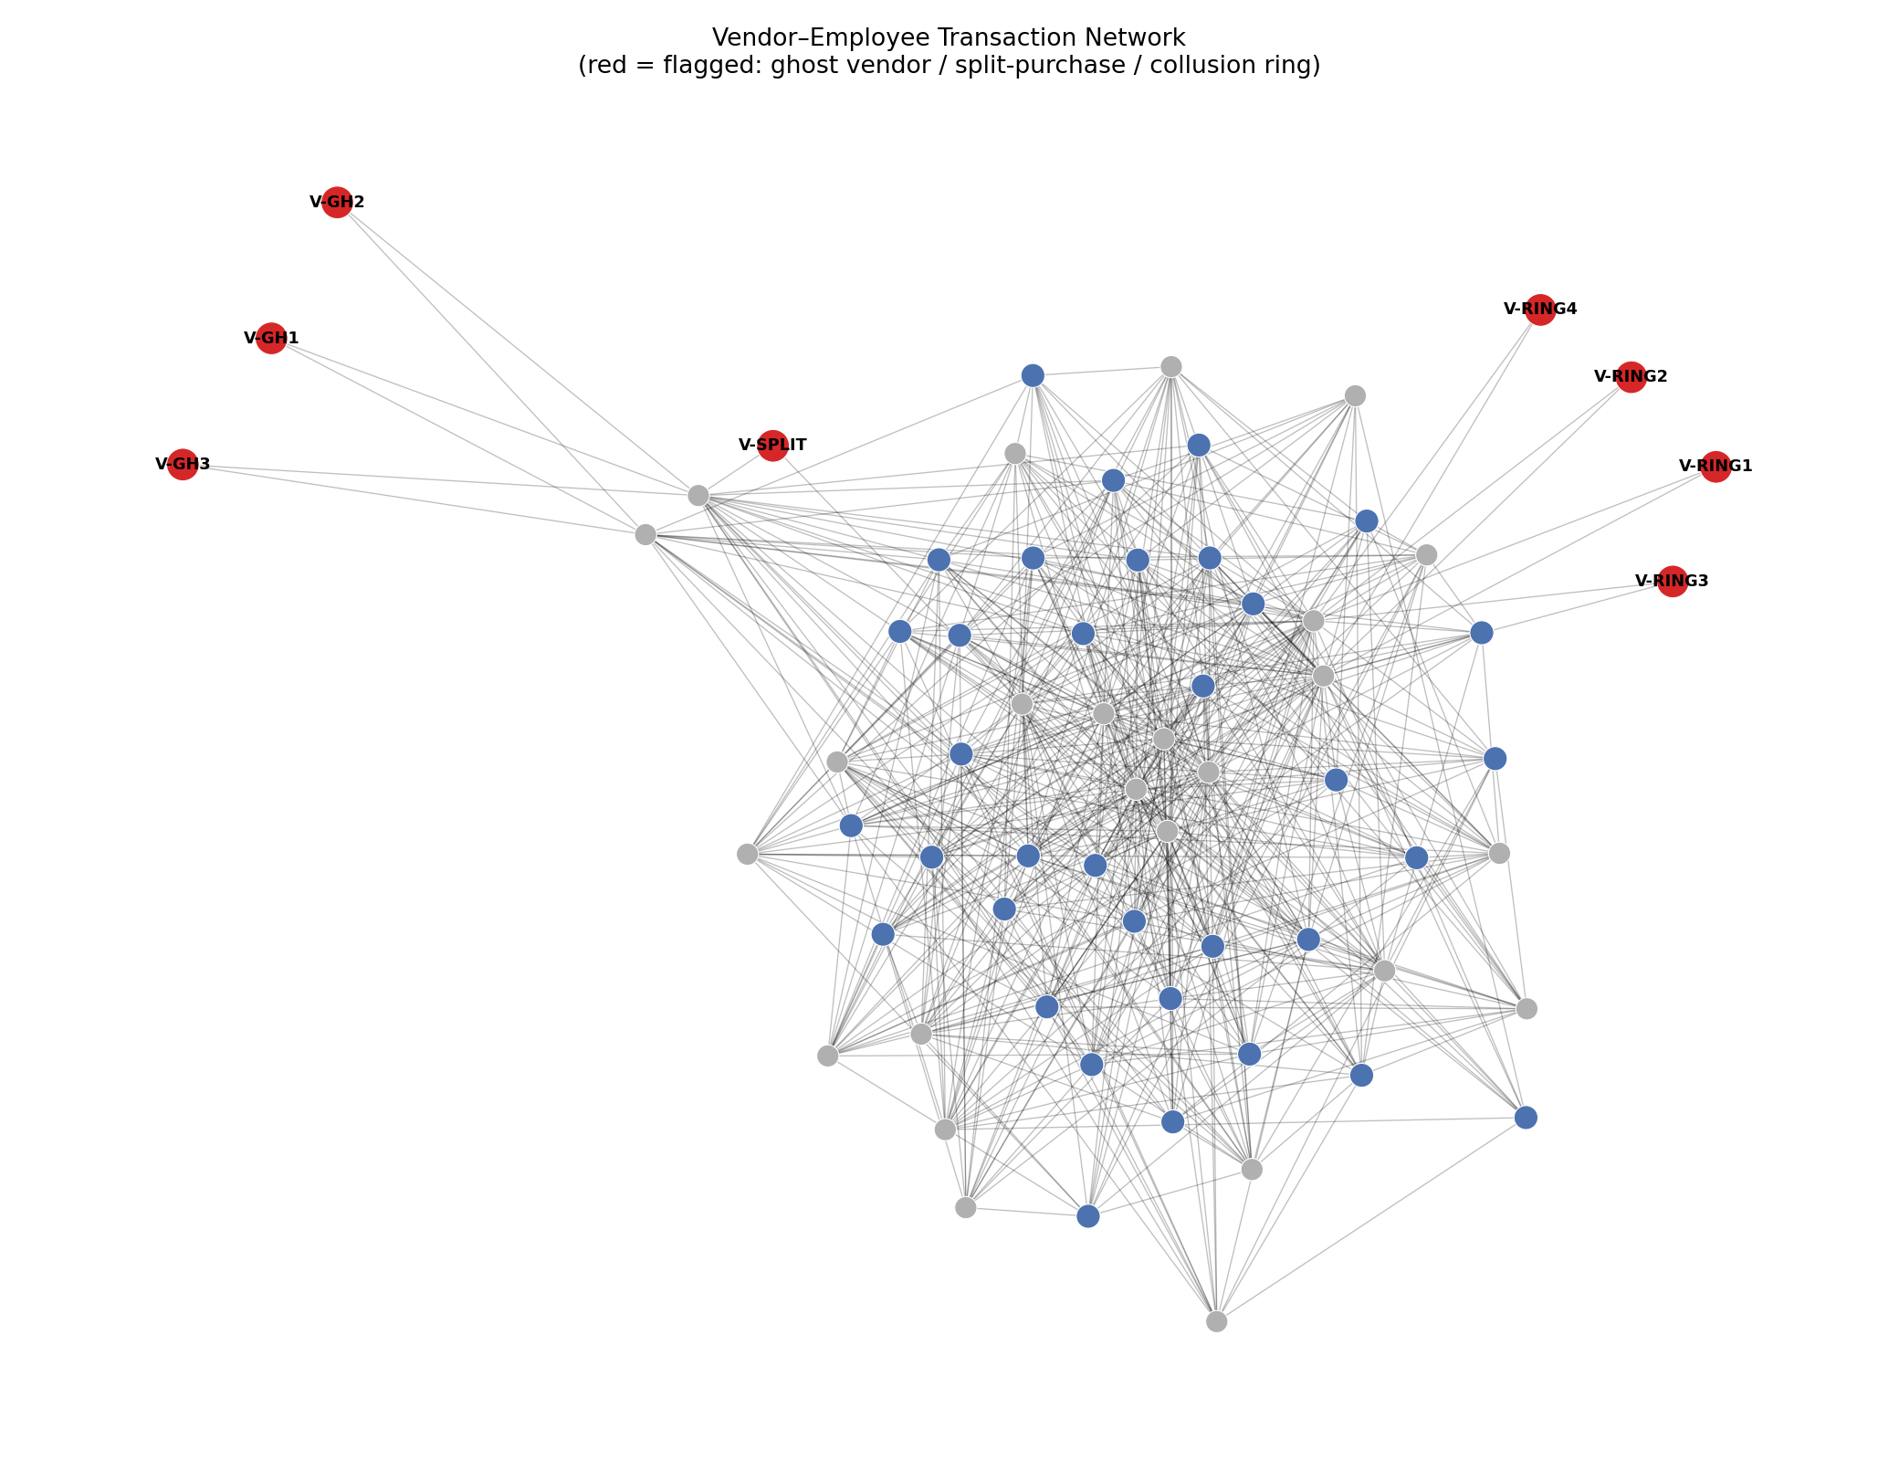
LIVE CASE STUDY
Case Study: The Full Vendor–Employee Network
Grey = employee
Normal vendor
Flagged vendor
Notice: the flagged vendors sit at the edge of the network, thinly connected — exactly what isolation from the normal transaction fabric looks like.
Procurement & Vendor Fraud Protection | Network-Graph Case Study
11

Slide 12
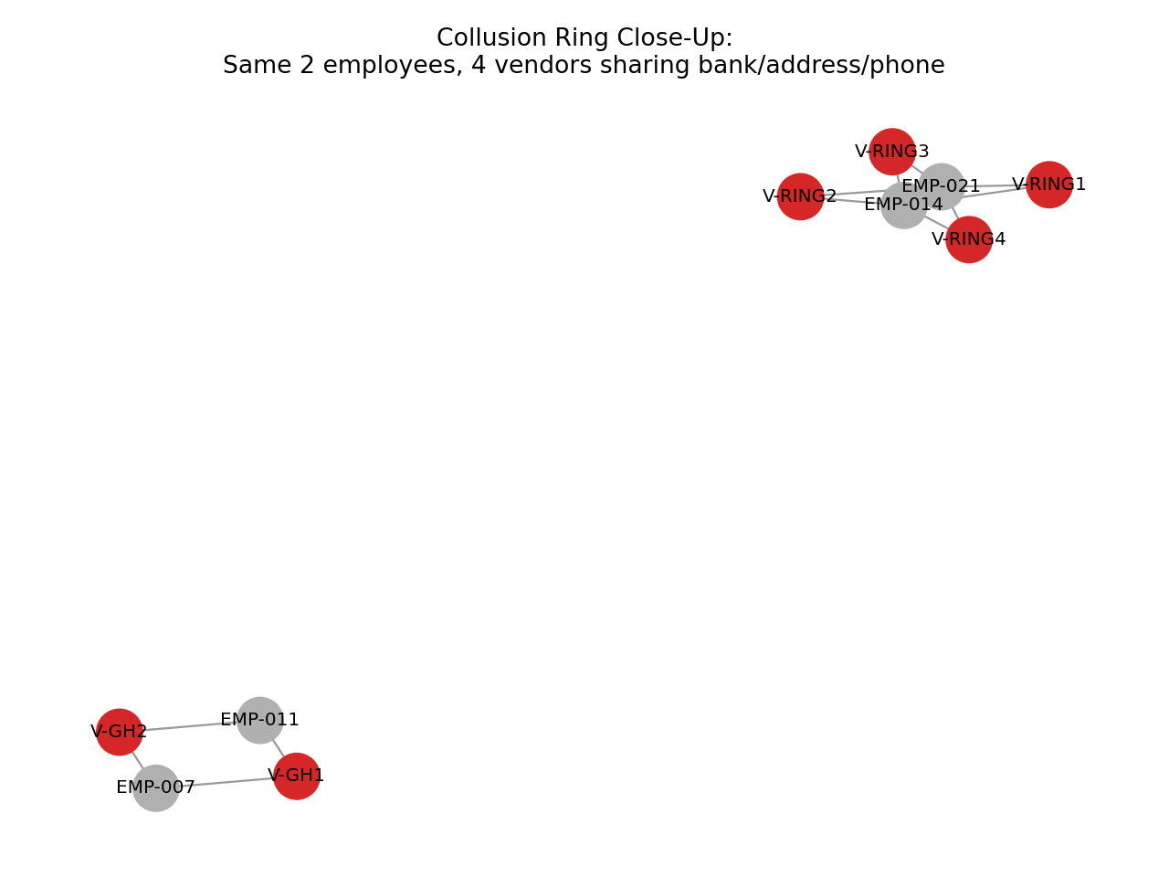
LIVE CASE STUDY
Case Study: Collusion Ring Close-Up
What ties the ring together
V-RING1–V-RING4 share one bank payout account
Two of the four also share an address and phone
EMP-014 and EMP-021 alternate requesting and approving — every invoice
V-GH1 / V-GH2 (ghost vendors) show the same one-requester, one-approver isolation
Procurement & Vendor Fraud Protection | Network-Graph Case Study
12

Slide 13
LIVE CASE STUDY
Case Study: What the Analysis Flagged
Vendor(s)
Pattern
Key Signal
V-GH1, V-GH2, V-GH3
Ghost vendor
1 requester / 1 approver, missing tax ID, PO Box or shared address
V-SPLIT
Split purchase
10 bursts of 2–3 invoices within 7 days, all just under $10,000
V-RING1–V-RING4
Collusion ring
Shared bank account; 2 employees run 100% of the traffic
None of these three patterns required a single alarming invoice amount. Each hid in relationships and repetition.
Procurement & Vendor Fraud Protection | Network-Graph Case Study
13

Slide 14
IMPLEMENTATION
From Detection to Standing Control
1
2
3
4
Score nightly
Route by risk
Review before pay
Feed back
Recompute ghost / split / collusion scores for every vendor & employee pair as new invoices land
Anything crossing threshold goes to AP / audit review — not the full vendor list
Flagged invoices are held for human review before the payment run, not after
Confirmed cases refine the scoring rules and expand the shared-identifier watchlist
Procurement & Vendor Fraud Protection | Network-Graph Case Study
14

Slide 15
CHEAT SHEET
Red-Flag Field Guide
Ghost Vendor
Split Purchase
Collusion Ring
Single requester/approver pair
Multiple invoices, one vendor, one requester
Shared bank account across vendors
Missing tax ID / registration
All just under the approval threshold
Shared address or phone across vendors
PO Box or employee-matching address
Filed within days of each other
Same 1–2 employees on every invoice
No delivery or PO backup on file
Recurs on a regular cadence
Requester / approver roles rotate together
Procurement & Vendor Fraud Protection | Network-Graph Case Study
15

Slide 16
GROUP EXERCISE
Discussion: Your Environment
Which of your current AP controls would catch each of these three patterns today — and which wouldn't?
1
What data would you need to add (vendor bank account, employee HR relationships, onboarding details) to run this where you work?
2
Where would you set the human-review threshold so this augments, rather than replaces, the AP team's judgment?
3
Procurement & Vendor Fraud Protection | Network-Graph Case Study
16

Slide 17
KEY TAKEAWAYS
Fraud hides in relationships, not amounts
Ghost vendors, split purchases, and collusion rings all pass individual invoice checks — they only reveal themselves in who's connected to whom, and how often.
A vendor–employee network turns three separate red-flag heuristics into one standing, automatable control.
The goal is a shorter review queue for AP and audit — not a replacement for their judgment.
Materials: case_study_network_fraud.ipynb (runnable demo) + this deck

