Slide 1
Claude Code

Slide 2
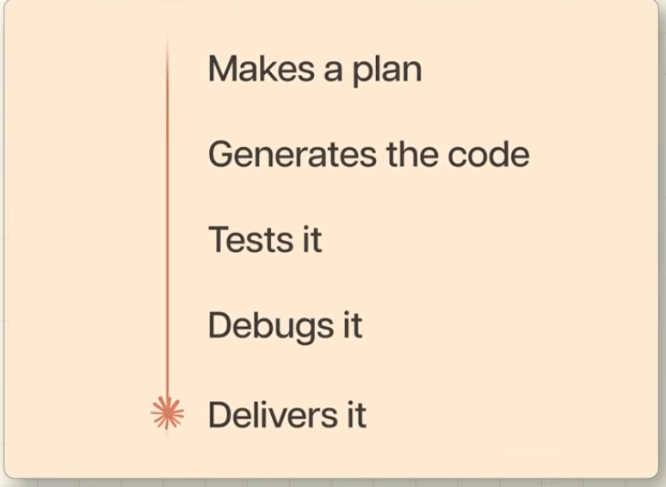
What it can do ?

Slide 3
Key things:
1) It can run directly on your computer – It can read files, edit files, delete files and execute program.

Slide 4
3 main ways to use claude:
Desktop App
Terminal
IDE – Like VSCode

Slide 5
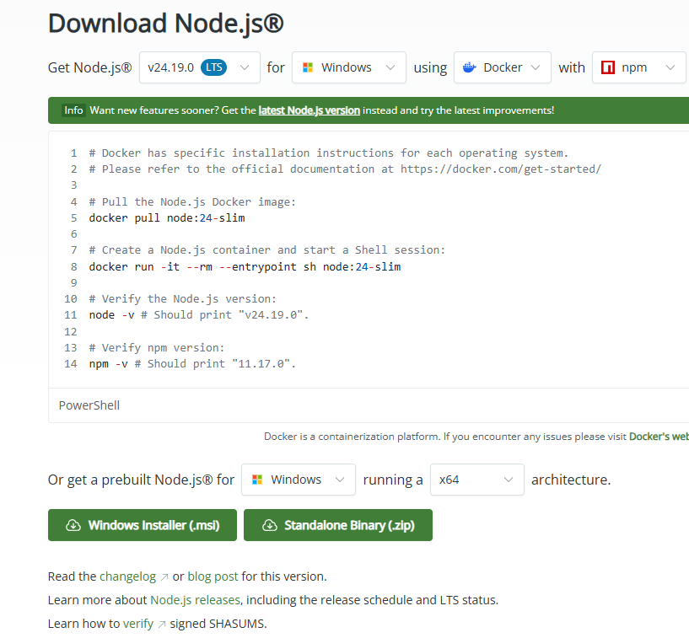

Install VS Code + Python
Install node js:

Slide 6
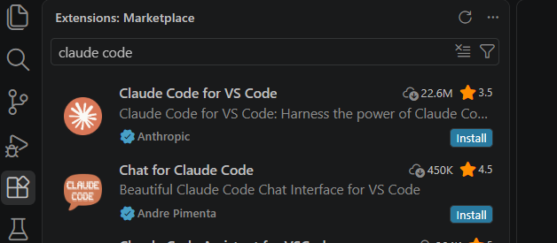
In VSCode Extension, install Claude Code extension

Slide 7
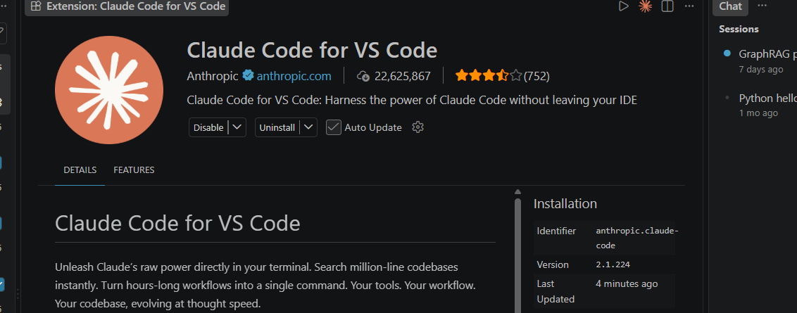






In VS Code, Hide the other chat

Slide 8
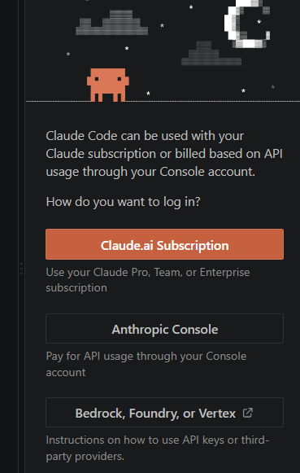
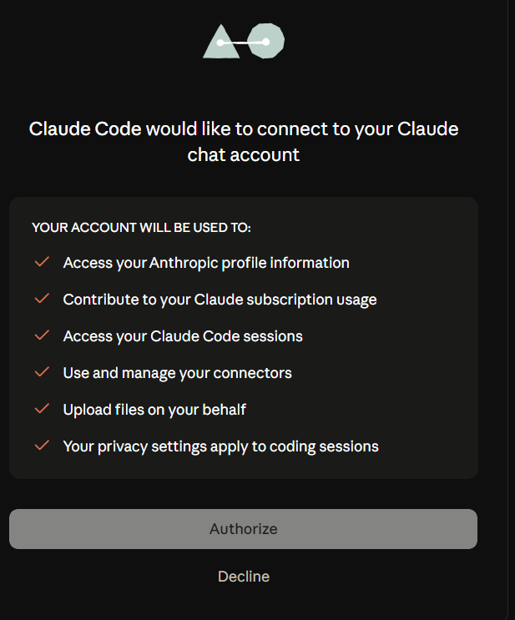

Click Claude.ai subscription

Slide 9
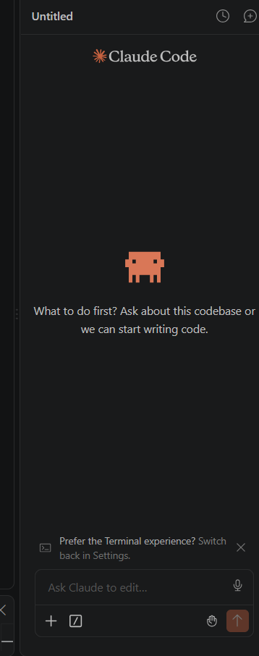
You are good to go

Slide 10
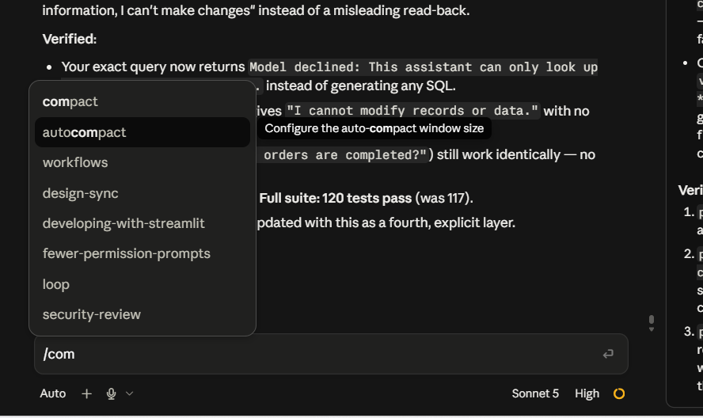



Few Useful commands: Free up some space by compacting/summarizing conversations

