Slide 2
Students will learn to use
Python
Azure AI
Azure Document Intelligence
Docker
Secret environment for storing keys
Creating logs

Slide 3
Problem
Input: A 30-to-100-page PDFs that is a government tender document.
It is packed with eligibility criteria, terms and conditions, pricing schedules, etc.

Slide 4
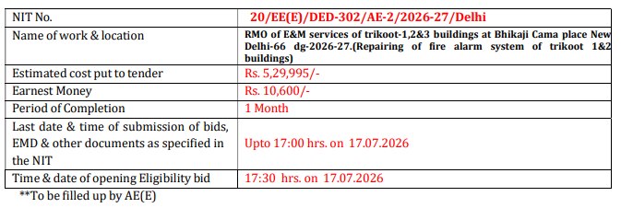
OUTPUT: Key information needed
NIT data

Slide 5
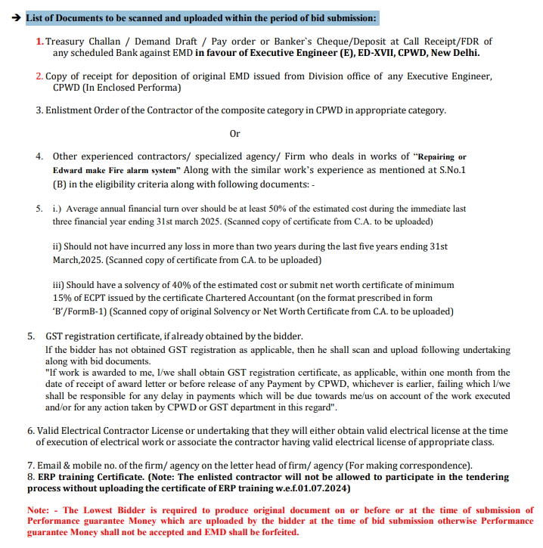
OUTPUT: Key information needed
2) List of Documents to be scanned and uploaded within the period of bid submission

Slide 6
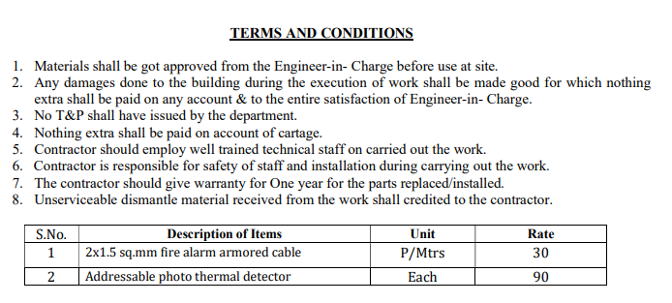
Key information needed
3) Terms and Conditions

Slide 7
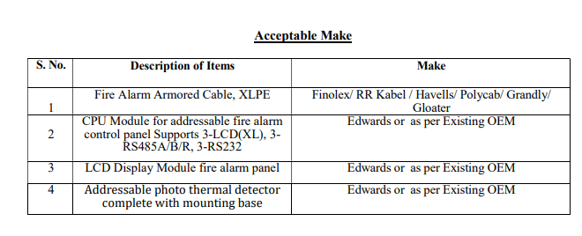
Key information needed
4) List of acceptable make

Slide 8
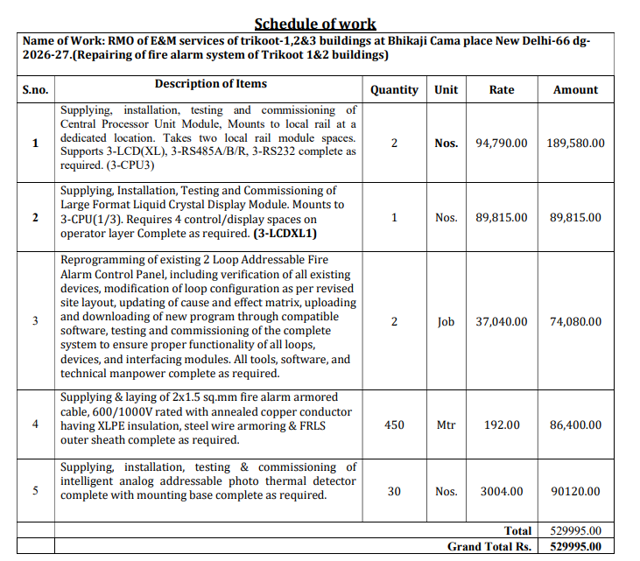
Key information needed
5) Schedule Of Quantity
Aka Bill Of Quantity

Slide 9
Plan
Create a small 10-page pdf documents (mini_version) from the original 60+ pages PDF documents. This saves tokens during development. Use this for testing + POC
Frontend: since this is single user app, use Streamlit for UI. Username / Password is preset.
Backend: select python + Azure AI framework – Storage Blob, Container App, Email Services, Document Intelligence, Azure AI Foundry

Slide 10
User Logs In
Extract Key Data from text (Takes upto 6 min.)
Extract index from first 5 pages
Extract NIT data from first 5 pages
Extract T&C, List of scanned doc, Acceptable make by sending 30 pages at a time. Perform validation on date and amount. Then merge the result
Extract Schedule Of Quantity by sending last 6 pages
Save the extract in JSON
Upload PDF Document
log
Check if PDF is digital or scanned ?
log
log
Scanned
Digital
log
Run OCR to Extract Text
Extract Text from PDF
LLM is better than PDFPlumber – Tested it
Free version return only 2 page -> use Paid version
Save extract in JSON (or Markdown)
During development, save extract in JSON – save tokens
Save the validated file (NIT) in excel in 2 format:
Auditable excel file that contains validated + clean data
Clean file that contains just the clean data
log

Slide 11
Convert JSON
NIT -> Excel sheet
T&C-> Excel sheet
List of Scanned document to upload -> Excel sheet
Acceptable Make-> Excel sheet
Schedule of Quantity-> Excel sheet
Usage report-> Excel sheet
log
Combine all above excel sheets into 1 single workbook
log
Send the user the Excel workbook to download
Send the user an email with a downloadable URL link – valid for 24 hours
log
Log the workflow into DB
Remove Log entries that are older than 30 days

Slide 12
Notes:
The OCR data is saved so that it can be re-used during development and also for log purpose.
Terms and Conditions have heading part. So, use this to find pages that has T&C and extract data from this page for accurate result.
Challenges:
Documents to be scanned + uploaded -> this is not in heading. So used partial match to find pages that has this and extract data from this page for accurate result
The terms and conditions get spilled onto the subsequent pages and those pages do not contain heading T&C . The serial numbers are preserved. So use merging

Slide 13
After local development -> Deployment
Azure
Docker Container
Frontend
Local Development
Frontend
Backend
Docker Container
Backend

