Slide 1
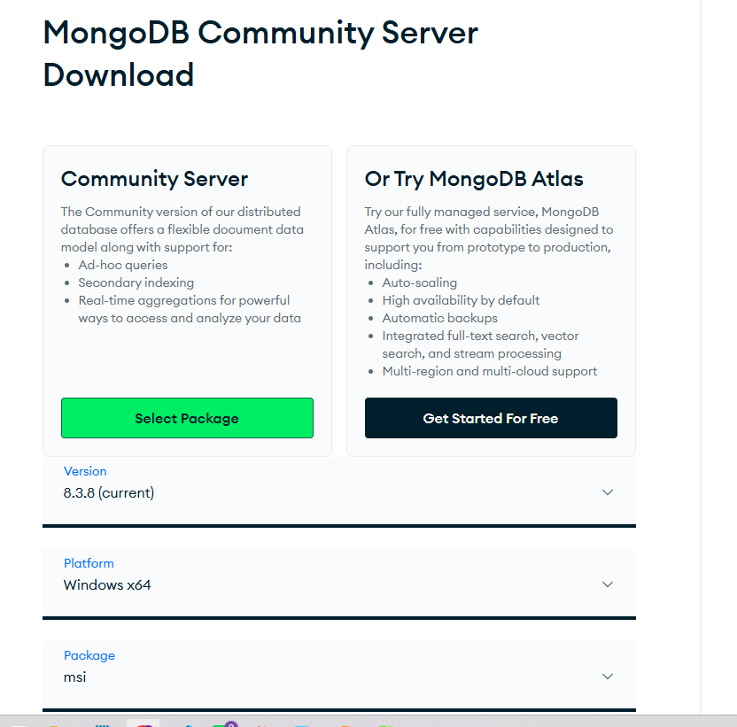




https://www.mongodb.com/try/download/community

Slide 2
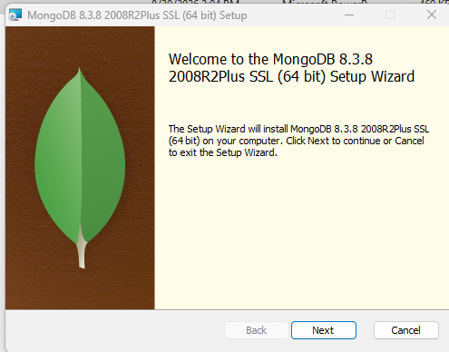
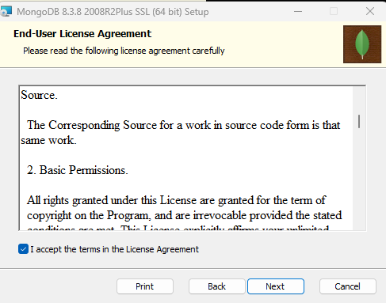





Slide 3
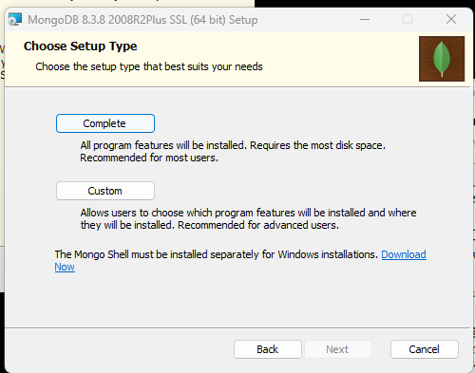
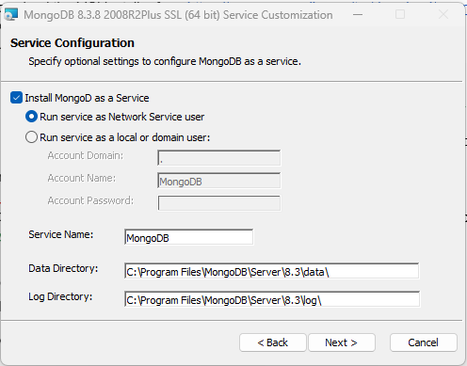



Slide 4
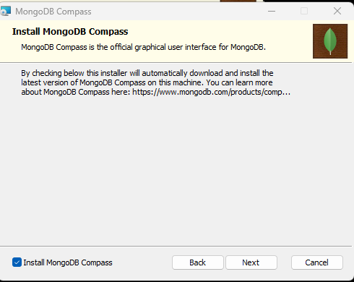
Installation takes 5 – 10 minutes

Slide 5
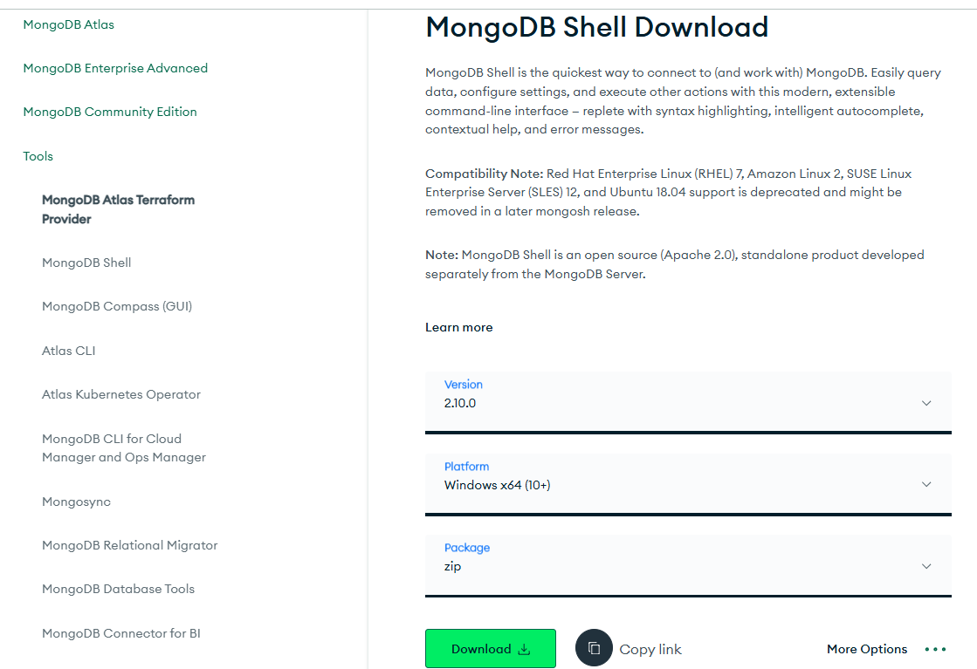


Now we install MongoDB Shell

Slide 6
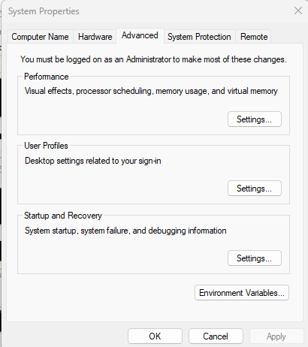


After installation, extract the zip file and move it to document folder
Copy the path of the exe file and put it in env variables

Slide 7
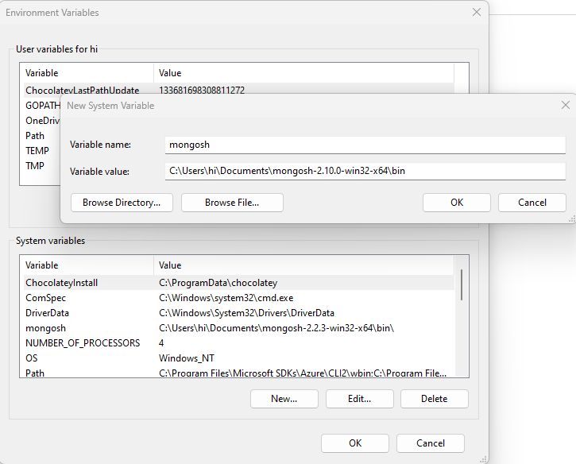
After installation, extract the zip file and move it to document folder
Copy the path of the exe file and put it in env variables

Slide 8
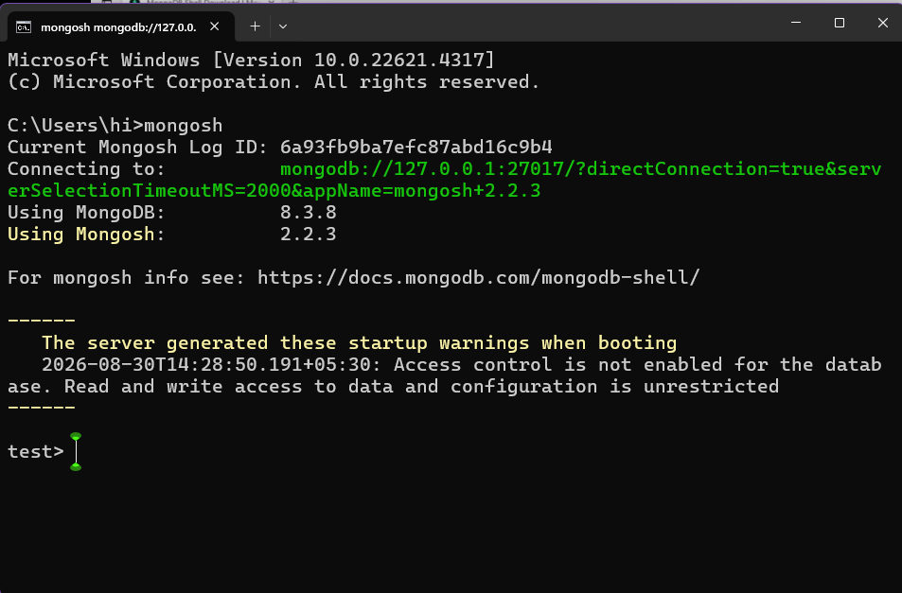
Open command prompt and type mongosh

Slide 9
SQL
NoSQL
[
{ "name": "Arthur", "age": 32, "gpa": 3.2, "fullTime": false },
{ "name": "David", "age": 38, "gpa": 1.5, "fullTime": false },
{ "name": "Elena", "age": 27, "gpa": 4.0, "fullTime": true }
]
name | age | gpa | fullTime
Arthur | 32 | 3.2 | false
David | 38 | 1.5 | false
Elena | 27 | 4.0 | true

