Slide 1
Basic Commands

Slide 2
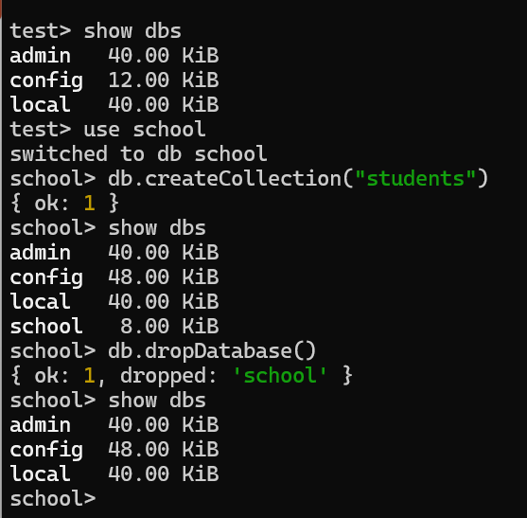


Steps to create a DB, collections and drop DB
By default, MongoDB has 3 DB

Slide 3
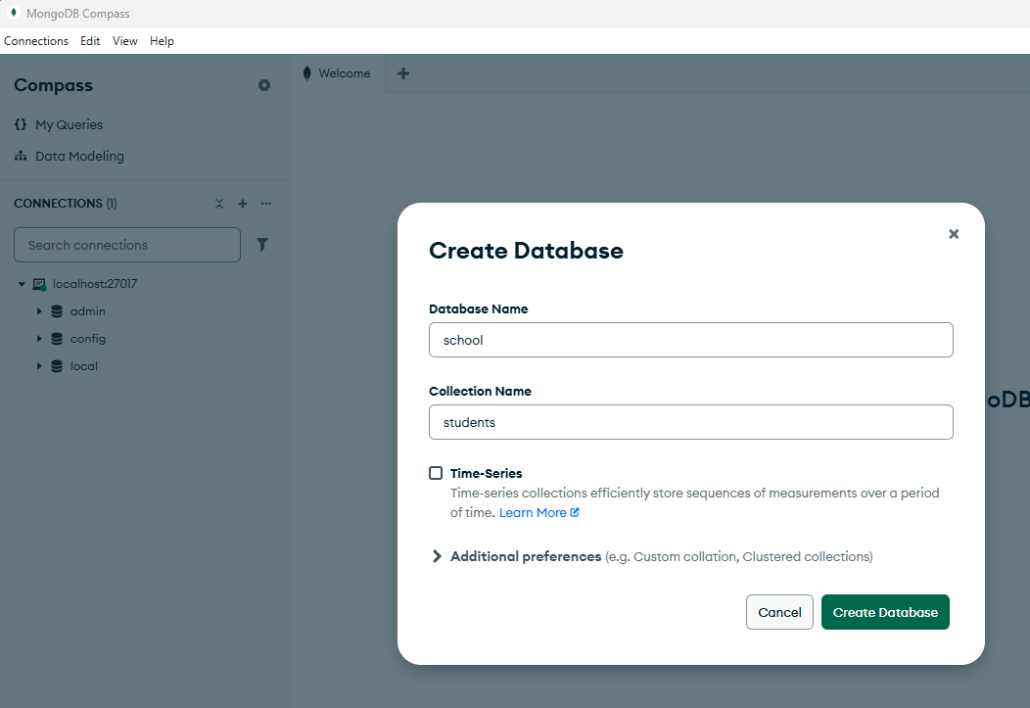


Slide 4
