Slide 1


Dot product of vectors:
For 2 vector a and b:
The dot product is
Example:
a = (3, 5, 1)
b = (2, 4, -7)
Then, a.b
= (3, 5, 1) . (2, 4, -7) = ( 3x2, 5x4, 1x-7) = (6, 20,-7)

Slide 2
Scalar multiplication:
1) 5 x basket1 = basket_total
5 x (2 apple, 4 banana) = (10 apple, 20 banana)
=> 5 x (2,4) = (10, 20)

Slide 3
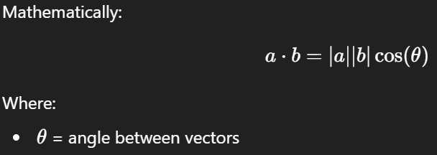
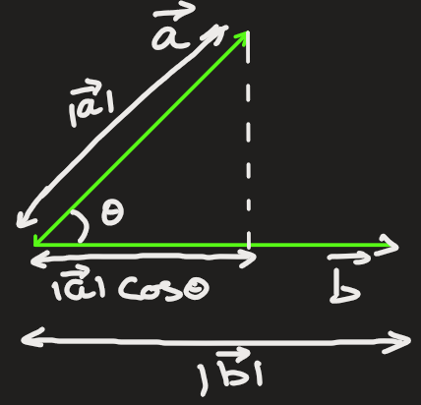
Geometric Meaning (Deep Intuition)
The dot product measures how aligned two vectors are

Slide 4
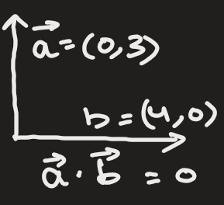
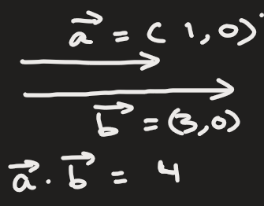
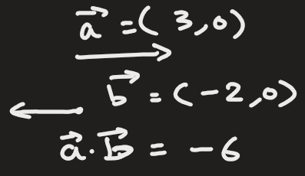
Angle Between Vectors | Dot Product Meaning
0° | Very similar direction (large positive)
90° | Unrelated (0)
180° | Opposite meaning (negative)

Slide 5
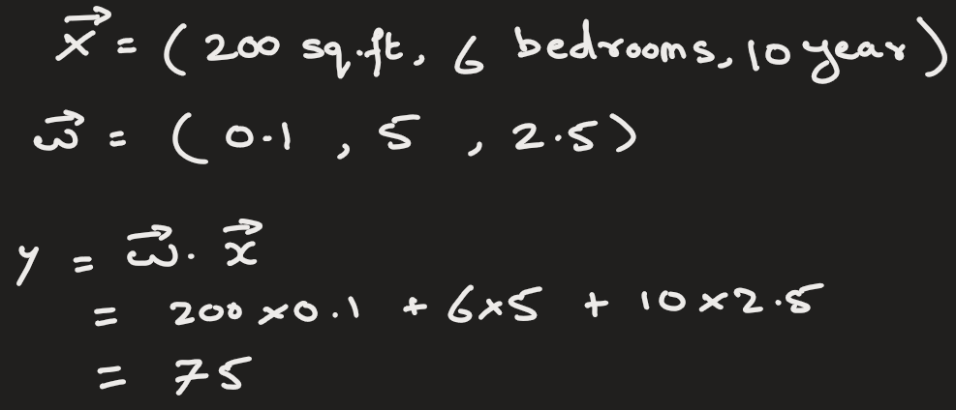
Dot Product in Machine Learning (Core Idea)
In ML:
One vector = data (features)
Another vector = model parameters (weights)
Dot product = model decision score
For example:
x = [size of rooms, number of bedrooms, age of house]
w = [size_weight, bedroom_weight, age_weight]
Prediction on price = w⋅x

Slide 6
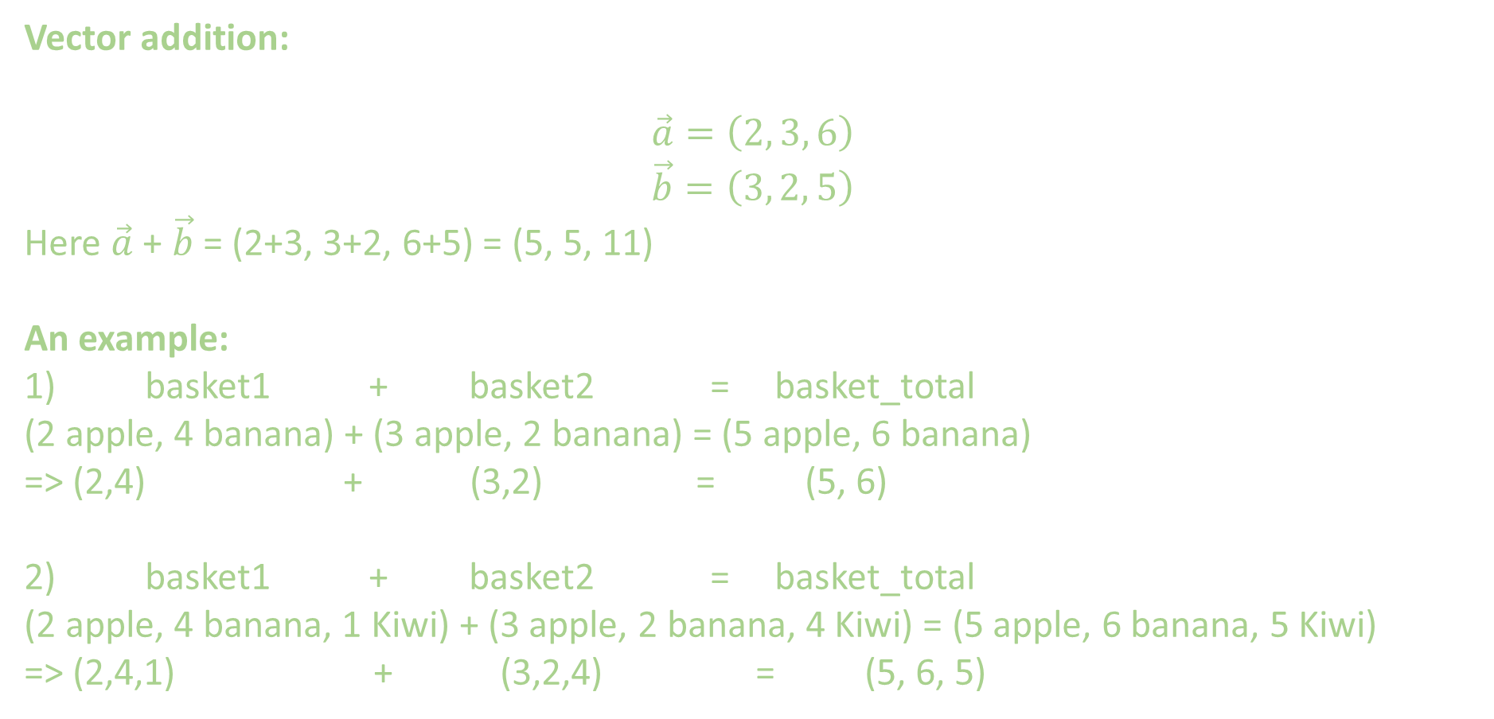
Vector addition:
$$\vec{a}=\left(2, 3, 6\right)$$
$$\vec{b}=\left(3, 2, 5\right)$$
Here $\vec{a}$ + $\vec{b}$ = (2+3, 3+2, 6+5) = (5, 5, 11)
An example:
1) basket1 + basket2 = basket_total
(2 apple, 4 banana) + (3 apple, 2 banana) = (5 apple, 6 banana)
=> (2,4) + (3,2) = (5, 6)
2) basket1 + basket2 = basket_total
(2 apple, 4 banana, 1 Kiwi) + (3 apple, 2 banana, 4 Kiwi) = (5 apple, 6 banana, 5 Kiwi)
=> (2,4,1) + (3,2,4) = (5, 6, 5)

Slide 7
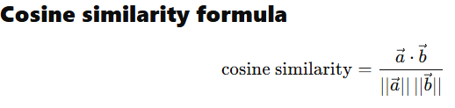
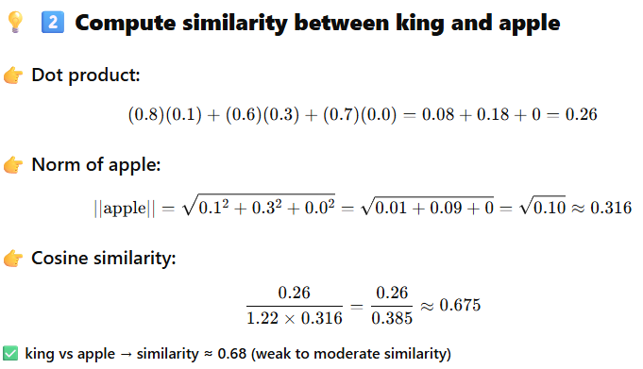
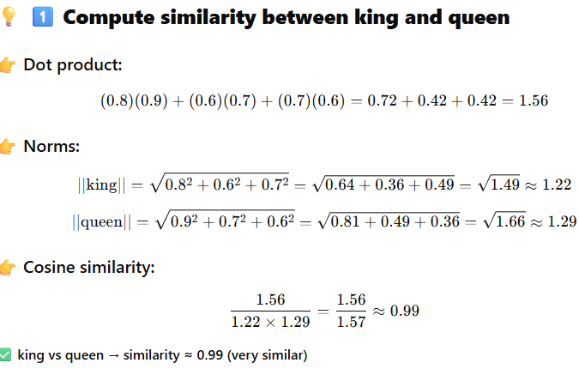
Dot Product to find similarity between 2 vectors

