Slide 1
ML Vector-Matrix

Slide 2
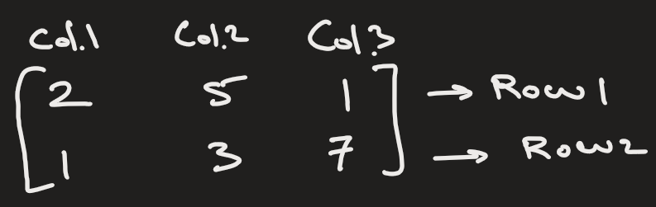
What is a matrix ?
It is a grid of numbers
In a 2D matrix, you have rows and columns
The shape of matrix is rows x columns
Example: 2 x 3

Slide 3
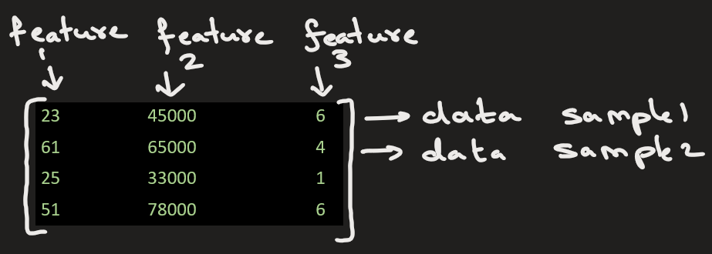
Matrices are used to:
Represent data (e.g., a dataset where rows = samples, columns = features).
age | income | experience
23 | 45000 | 6
61 | 65000 | 4
25 | 33000 | 1
51 | 78000 | 6

Slide 4
Where matrix appear in ML / AI?
Matrices are used to:
Represent data (e.g., a dataset where rows = samples, columns = features).
Perform linear transformations (e.g., scaling, rotation of images, word embeddings).
Encode neural network operations (weights, activations, gradients are matrices).
Solve systems of equations in algorithms (e.g., linear regression).
Handle images, where each image is a matrix of pixel values.

Slide 5
In ML:
Vectors represent one data point.
Matrices represent many data points processed together.

Slide 6
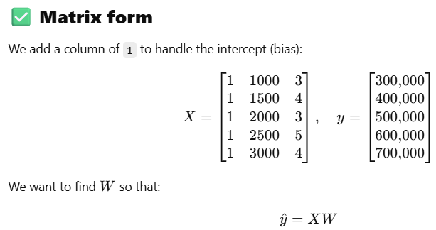
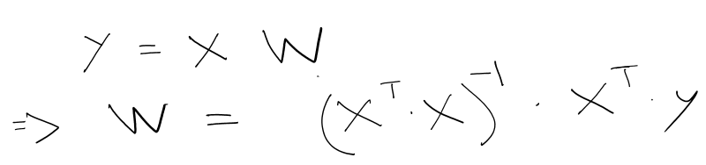
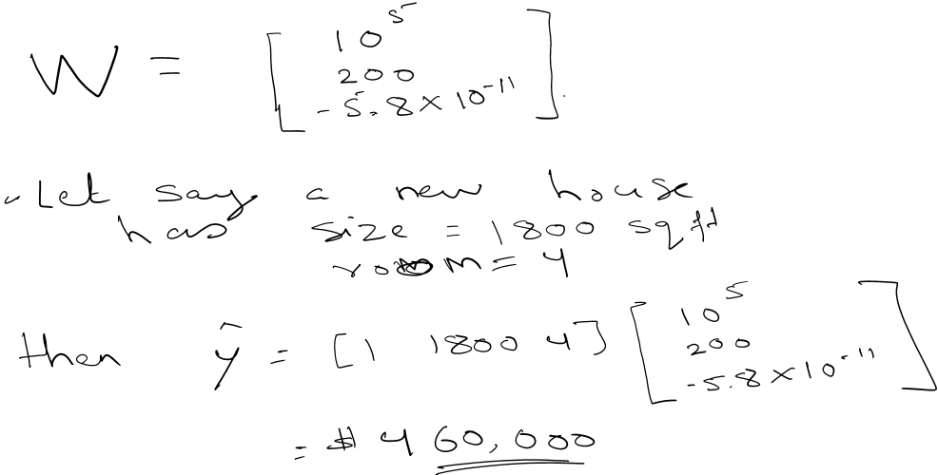
1) Predicting house prices using matrix operations for linear regression ( see jupyter n/b ) :
Predict house prices using:
​y_hat = W*X
where,
X = feature matrix (house size, number of rooms,etc)
W = weight matrix (parameters to learn)
Y_hat = predicted price
W is determined using following mathematical formula:
Size (sqft) | Rooms | Price (target)
1000 | 3 | 300,000
1500 | 4 | 400,000
2000 | 3 | 500,000
2500 | 5 | 600,000
3000 | 4 | 700,000

Slide 7
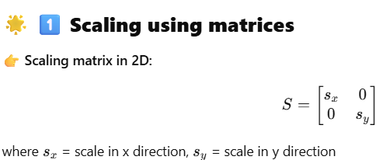
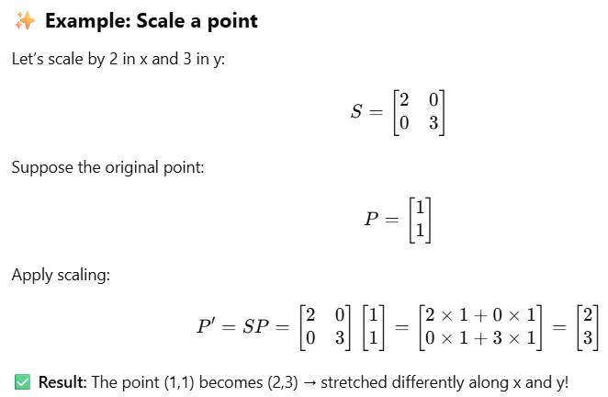
2) Linear Transformation

Slide 8
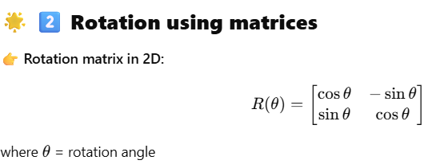
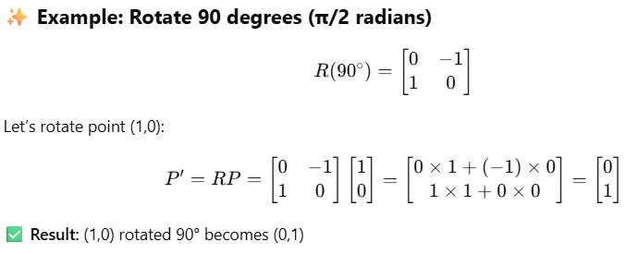
2) Linear Transformation

Slide 9
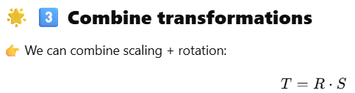
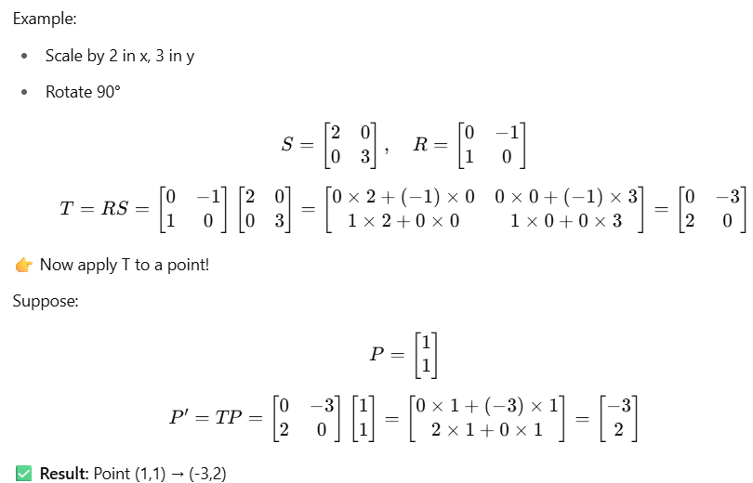
2) Linear Transformation
Key takeways:
Matrices transform coordinates of points in images.
In graphics, robotics, ML — scaling, rotating, and transforming data or images = matrix multiplication.
When you rotate or zoom an image → matrix multiplication is happening!

Slide 10
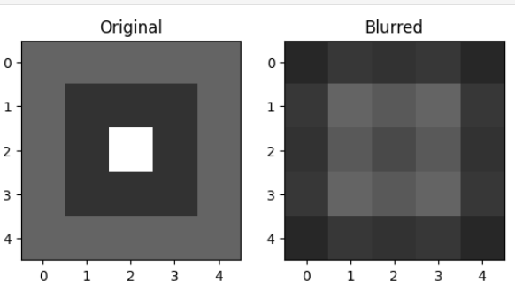
2) Image as matrix & applying a filter (see jupyter n/b)
1) Representing an image as a matrix
Suppose we have a grayscale image:
[
[255, 0, 0],
[ 0, 255, 0],
[ 0, 0, 255]
]
Each value represents brightness of a pixel (0=black, 255=white).
2) Applying a matrix operation — Blurring
Let’s apply a simple average blur filter (kernel):
Filter:
[
[1/9, 1/9, 1/9],
[1/9, 1/9, 1/9],
[1/9, 1/9, 1/9]
]
- The filtered pixel at the center = matrix multiplication (convolution) of filter and the 3×3 patch of the image.
- This is just matrix multiplication + addition!

Slide 11
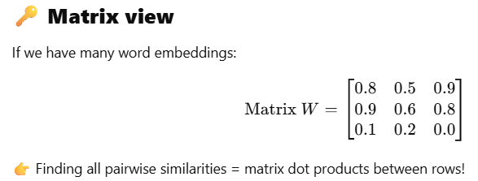
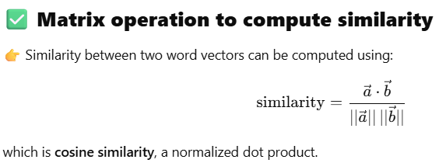
3) In Natural Language Processing (NLP), we need to represent words numerically so machines can understand them.
Word embeddings like Word2Vec, GloVe, and fastText represent each word as a vector — typically 50, 100, or 300-dimensional.
Words with similar meanings have embeddings (vectors) that point in similar directions → we can compute their similarity using matrix operations (like dot product or cosine similarity).
Example: Word embeddings as vectors
Suppose our embedding space is just 3D (for easy illustration):
After performing computation,
king & queen are semantically similar → cosine similarity ≈ 1
king & apple are unrelated → low cosine similarity
Word | Embedding (vector)
king | [0.8, 0.5, 0.9]
queen | [0.9, 0.6, 0.8]
apple | [0.1, 0.2, 0.0]

Slide 12
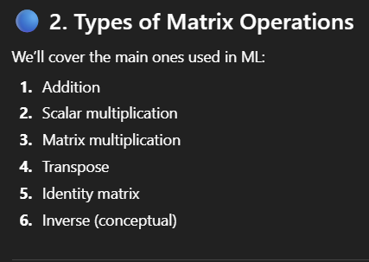

Slide 13
Explain how to find determinant
A = np.array([[2, 1],
[3, 5]])
det_A = 2*5 - 1*3 = 7
A = np.array([[2, 1, 0],
[0, 1, -1],
[0, 2, 4]])
det_A = 12

