Slide 1
Speech To Text
Using Console
Using Python scripts + SDK

Slide 2
Using Console
Load the audio file in bucket
-> Create Job for Speech to Text

Slide 3
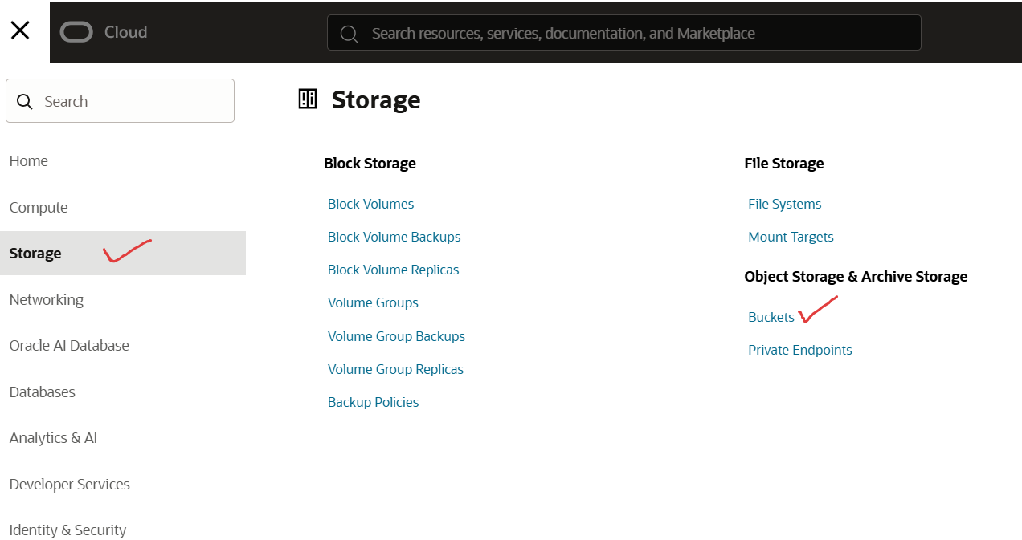

Slide 4
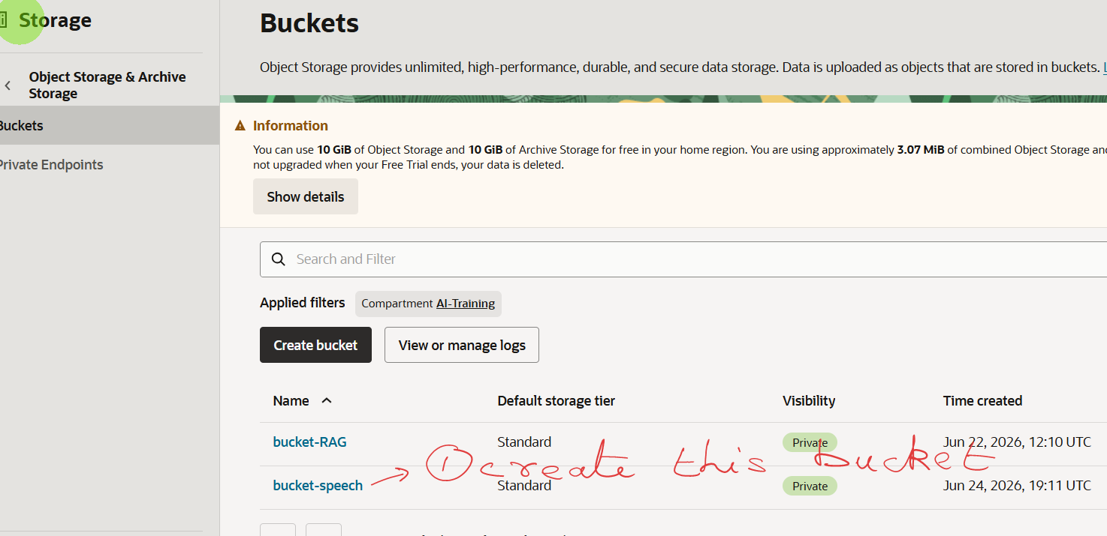

Slide 5
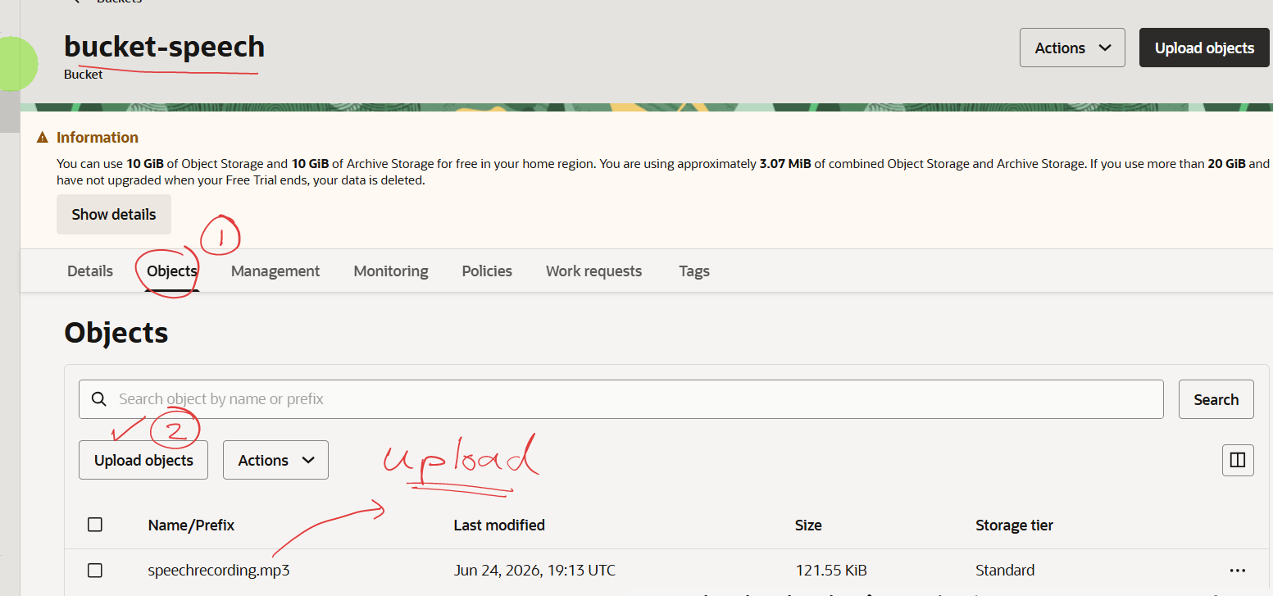

Slide 6
Up to here the audio file has been uploaded in bucket
Now we create Job for Speech to Text

Slide 7
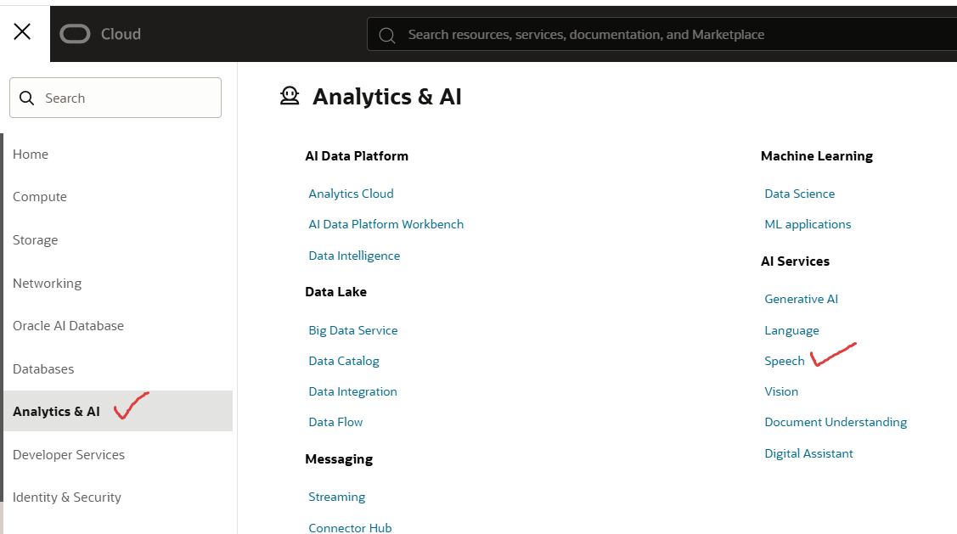

Slide 8
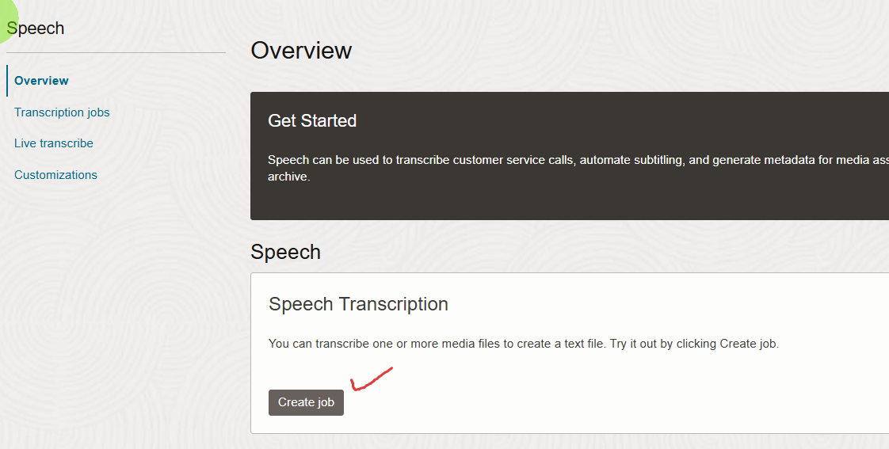

Slide 9
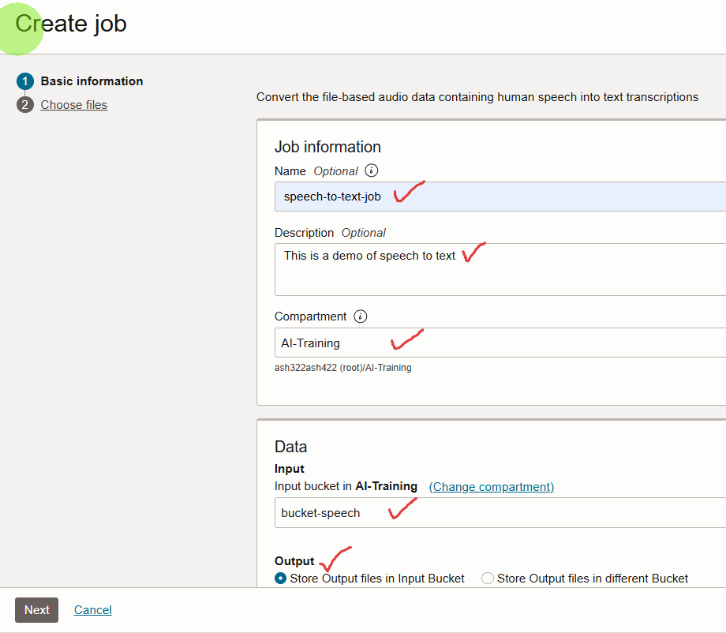


Slide 10
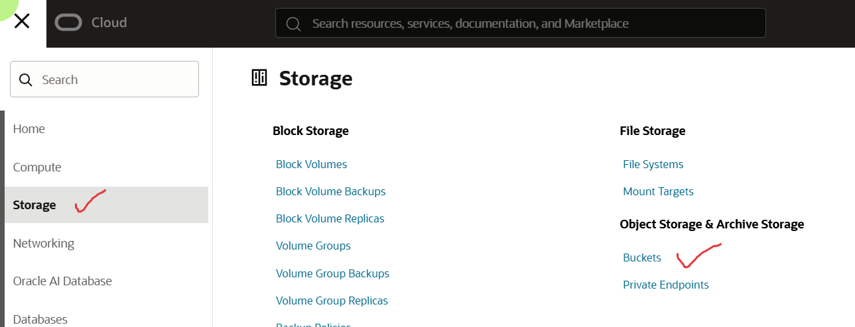

Slide 11
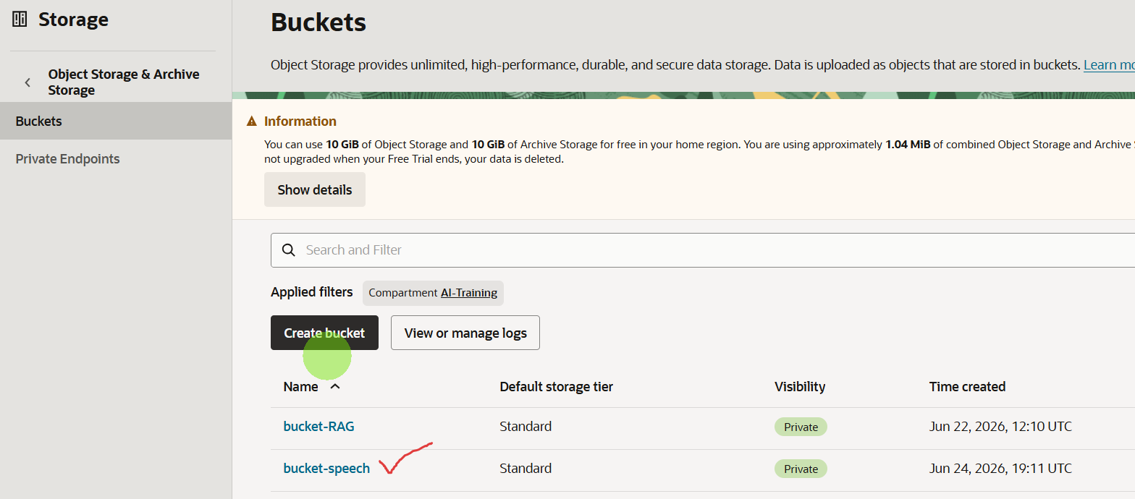

Slide 12
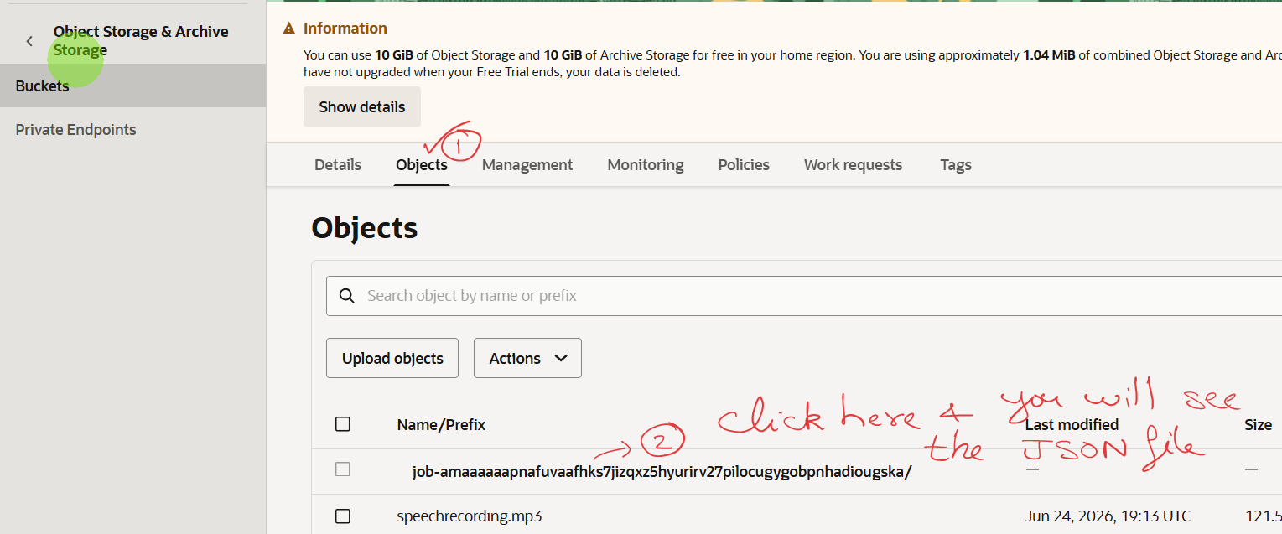

Slide 13
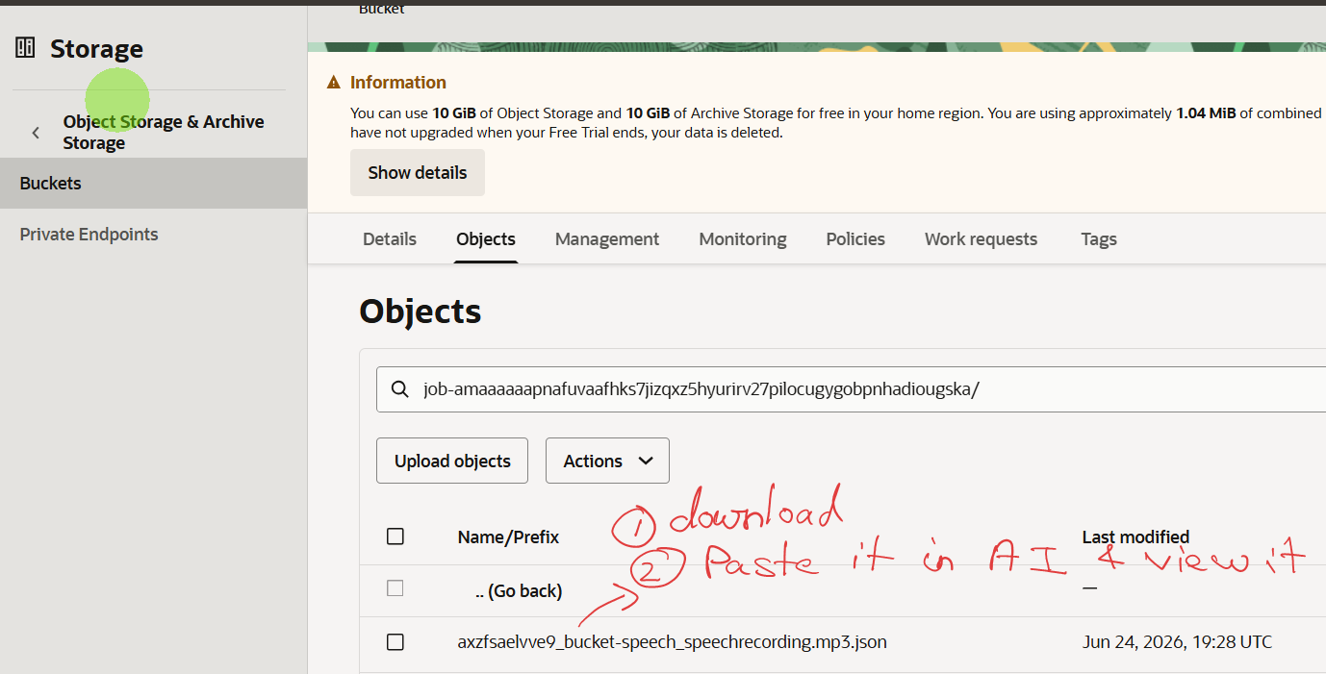

Slide 14
Speech To Text
Using Python scripts + SDK

Slide 15
See jupyter notebook for the code

