Slide 1
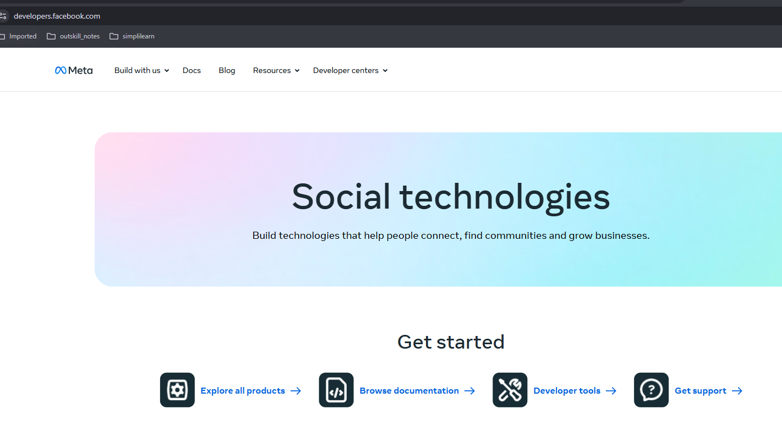
Login to : https://developers.facebook.com/
Click on Build with us -> Whatsapp Business Platform

Slide 2
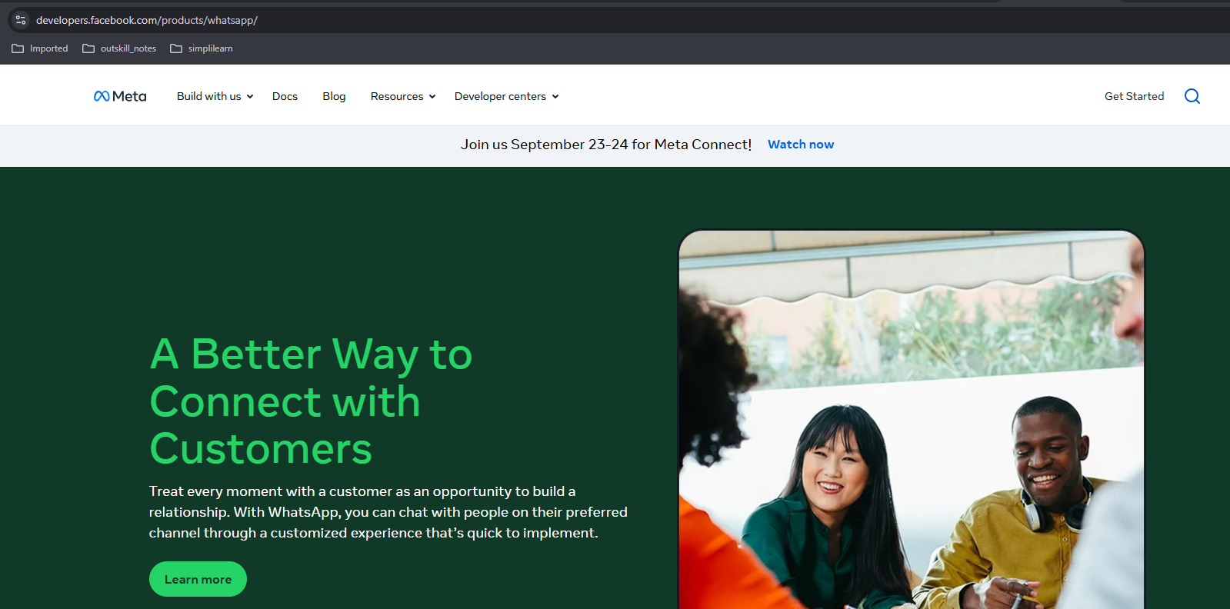

Click Get Started

Slide 3
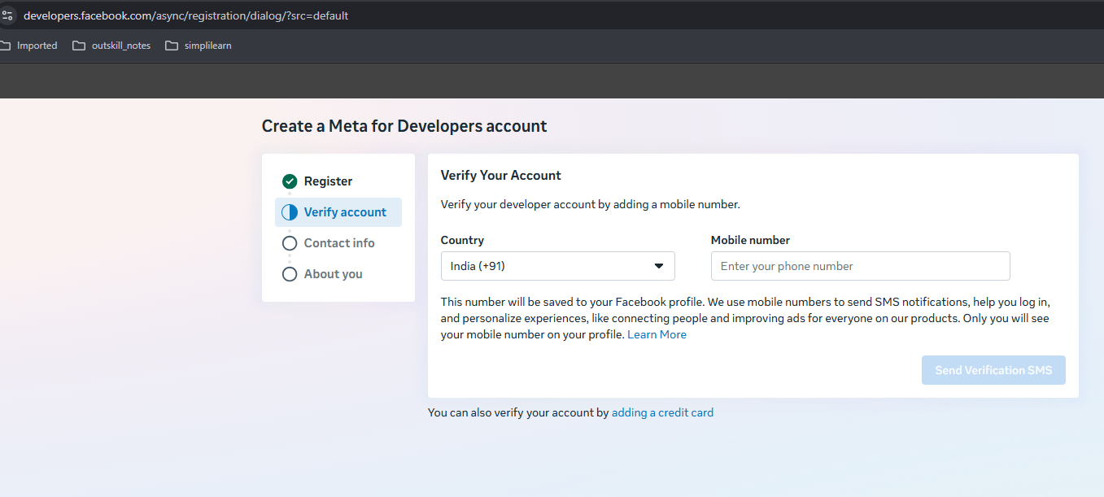
Enter the info here. (Need to have facebook account)

Slide 4
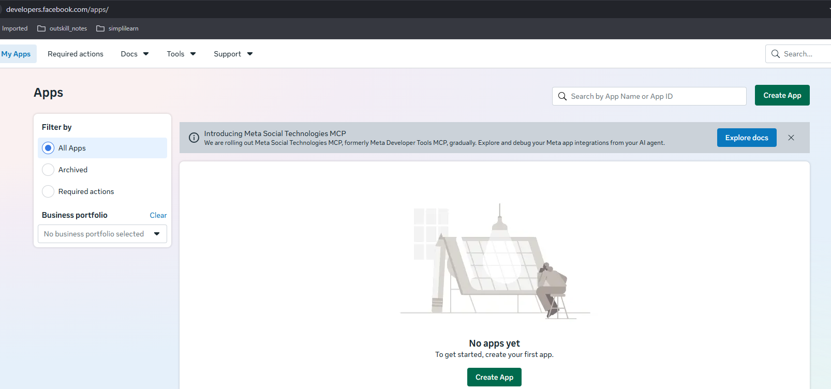
Enter the info here. (Need to have facebook account)

Slide 5
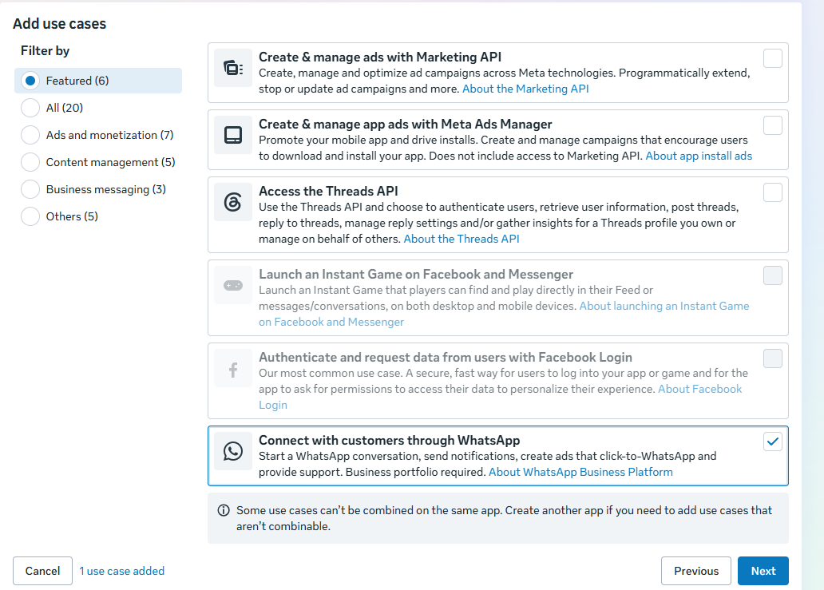


Slide 6
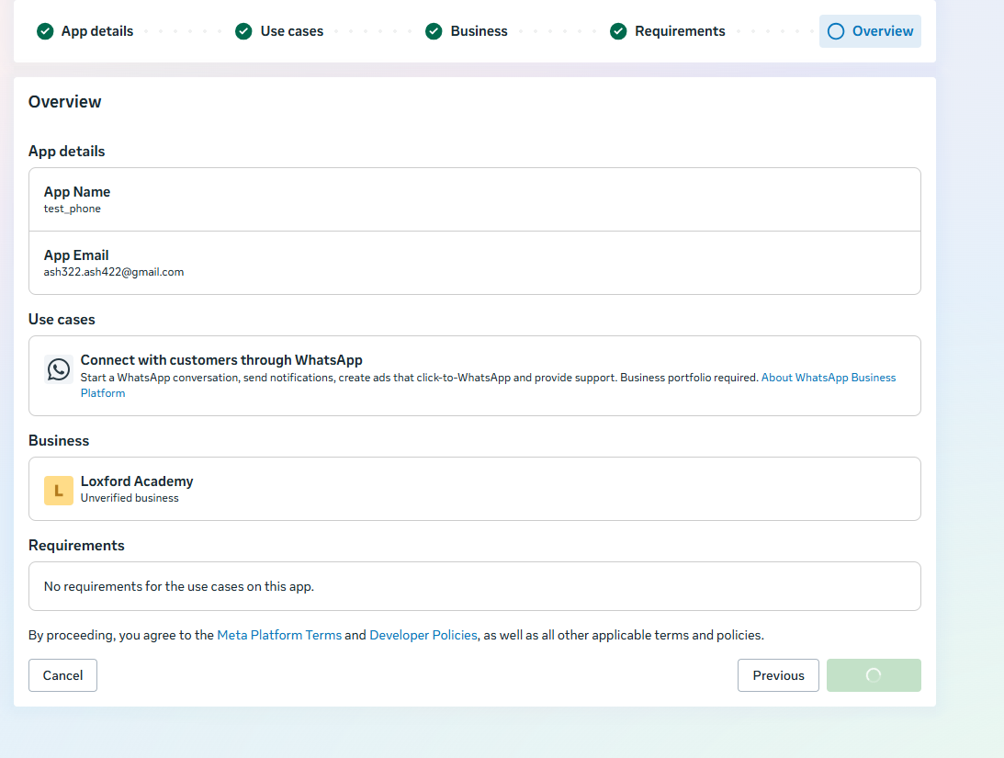


Slide 7
