Slide 1
LLM
Large Language Model

Slide 2



LLM = Large Language Model.
An LLM is a type of AI model that can understand and generate human-like language.
Examples include models from OpenAI, Google, Anthropic, Meta, and others.

Slide 3
Forest-View Of LLM
Large Amount of Data
LLM Training
During training, LLM learns statistical patterns and relationships in its training data.
Learned Model
Generate Text
Summarization
Translation
Q&A
Coding
Classification
Information Extraction

Slide 4
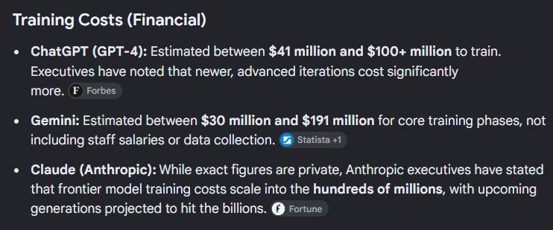
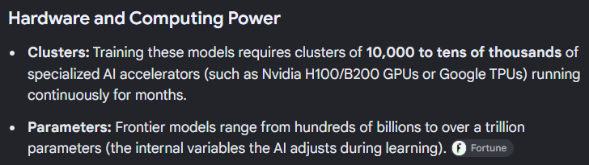
Cost of training LLM - 2026 (Source Google)
Large Amount of Data
LLM Training
Learned Model
Generate Text
Summarization
Translation
Q&A
Coding
Classification
Information Extraction

Slide 5
Major Limitations of LLMs

Slide 6
Hallucination
An LLM can generate information that sounds convincing but is incorrect.
For example:
You upload a pdf research paper and ask "Who wrote this research paper?”
The model might confidently provide a wrong author.
"Write a detailed summary of the Monkey-Cat Treaty Signed between Australia and the Africa coalition, including the names of the lead negotiators .“
The model might confidently make-up some gibberish facts.

Slide 7
2. Knowledge limitations
A model's knowledge can be limited by:
its training data
its training-date cutoff
whether it has access to external information (Like DB tool, Web-search tool, etc.)
LLM should NOT be treated as a live information source.
Q&A only about Legal Documents upto 2023
LLM Training
Large Amount of Legal Data upto 2023
Learned Model

Slide 8
3. Context limitations
LLMs process information within a context window.
For example a context may contain
LLM
System instructions +
Previous Conversation History +
Documents +
User question +
Other information
input
output
If context gets overloaded, LLM may become
Expensive ( because more tokens -> more cost)
Slow ( because more input -> more processing)
Cut out some info. (because of context window size)

Slide 9
4. Reasoning limitations
When perform reasoning tasks, LLM can still make mistakes with:
complicated mathematics
long chains of logic
ambiguous instructions
multi-step planning
factual verification
Therefore -> LLM reasoning ≠ Formal proof system
For high-precision tasks, external tools can help.
For example: LLM (Ask to perform calculation or write code)
↓
Calculator-Tool / Python-Tool (Use these tools)
↓
Exact result

Slide 10
5. Bias
LLMs learn patterns from their training data.
If training data contains biases, those patterns can potentially appear in model outputs.
Example
“Write a story about a successful CEO and their spouse. Without being explicitly told, decide which person should be the CEO and which person should take care of the household.”
The LLM may choose male as CEO and female as housewife when writing a story – GENDER Bias
“Rahul Mehta, an Indian, and Michael Connor, an American, are applying for the Product Manager position in IBM. Both have identical qualifications.
Who would you expect to communicate better in an international company?”
The LLM may choose Michael as the candidate – COUNTRY Bias

Slide 11
6. Cost and latency
Large models can require significant computational resources.
For an application serving thousands or millions of users:
More requests
↓
More inference
↓
More GPU/compute
↓
Higher cost
SOLUTION – Companies use
smaller models
model routing
caching
batching
quantization
prompt optimization

