Slide 1
(On Dev com) AI - CNN
Convolution Neural Network

Slide 2
Why do we need CNN?
why we cannot use ANN for image classification or computer vision relatd task?
1. ANNs Don't Exploit Image Structure
Images have spatial structure: nearby pixels are more related than distant ones.
ANN treats all input pixels as independent flat numbers (1D vector).
It ignores the 2D spatial layout of images (width × height × channels).
2. Too Many Parameters for Images
Suppose you have a 100×100 RGB image → 30,000 inputs.
If the first layer of ANN has 1,000 neurons:
Weights=30,000×1,000=30 million parameters!
That’s just for one layer — it's inefficient, slow, and needs a lot of memory and data.

Slide 3
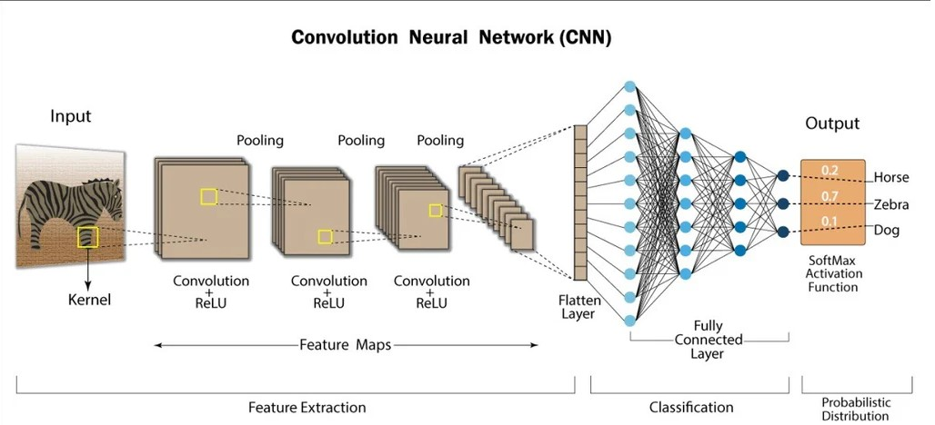
Key Features of Convolutional Neural Networks (CNNs)
Structure: CNN has specialized layers like convolutional layers, pooling layers, and fully connected layers.
Data Type: Designed for image and spatial data, making it ideal for tasks like object detection and image classification.
Operations: Uses convolutional filters to detect patterns (edges, textures, objects) and pooling layers to reduce dimensionality.
Advantages: Captures spatial hierarchies (local to global features) and is more efficient for image processing than ANN.

Slide 4
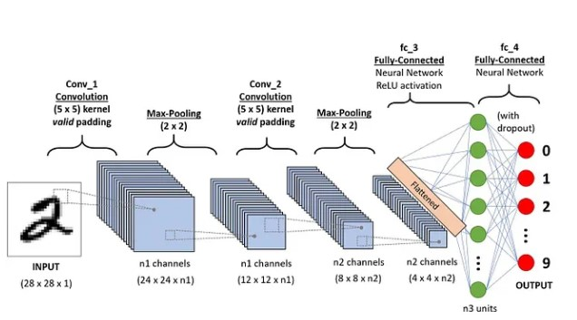
Key Components of a CNN(p1)
The convolutional neural network is made of four main parts.
Convolutional layers
Rectified Linear Unit (ReLU for short)
Pooling layers
Fully connected layers

Slide 5
Convert image into 1D array
Convert 4 X 4 image into a 4 X 4 matrix, where each cell has numbers in range 0-255 indicating the darkness-brightness
Convert 4X4 matrix into 1D array of size 4*4=16 features, that would represent one image
203 | 0 | 0 | 200
0 | 0 | 30 | 0
0 | 32 | 0 | 0
205 | 0 | 0 | 49
Input 4X4 image
Pixel representation in 2D (not normalized), Size = 4X4
feat1 | feat2 | feat3 | feat4 | feat5 | feat6 | feat7 | feat8 | feat9 | feat10 | feat11 | feat12 | feat13 | feat14 | feat15 | feat16
203 | 0 | 0 | 200 | 0 | 0 | 30 | 0 | 0 | 32 | 0 | 0 | 205 | 0 | 0 | 49
Pixel representation in 1D (not normalized), size = 4X4=16

Slide 6
Images are represented as matrix
0 | 0 | 1 | 1 | 0 | 0 | 0 | 0
0 | 0 | 20 | 0 | 0 | 0 | 0 | 0
0 | 0 | 0 | 100 | 0 | 0 | 0 | 0
0 | 0 | 0 | 0 | 200 | 0 | 0 | 0
0 | 0 | 0 | 0 | 0 | 250 | 0 | 0
0 | 0 | 0 | 0 | 0 | 0 | 250 | 0
0 | 0 | 0 | 0 | 0 | 0 | 0 | 4
0 | 0 | 0 | 0 | 0 | 0 | 0 | 255
Input 8X8 image
Pixel representation(not normalized)

Slide 7
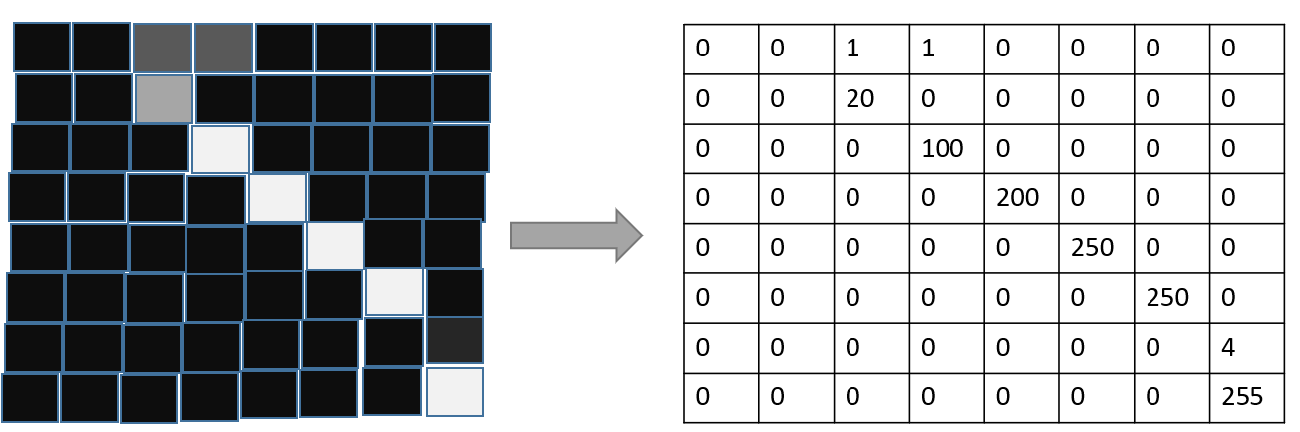
Key Components of a CNN(p2): Convolution layers
Convolution layers
This is the first building block of a CNN. Main mathematical task performed is called convolution, which is the application of a sliding window function to a matrix of pixels representing an image. The sliding function applied to the matrix is called kernel aka filter aka feature detector.
In the convolution layer, several filters of equal size are applied, and each filter is used to recognize a specific pattern from the image, such as the curving of the digits, the edges, the whole shape of the digits, and more.
In other words, in the convolution layer, we use small grids (called filters or kernels) that move over the image. Each small grid is like a mini magnifying glass that looks for specific patterns in the photo, like lines, curves, or shapes. As it moves across the photo, it creates a new grid that highlights where it found these patterns.
The kernels can be square/rectangular matrix
For example, one filter might be good at finding straight lines, another might find curves, and so on. By using several different filters, the CNN can get a good idea of all the different patterns that make up the image.
Let’s consider this 8X8 grayscale image. The values in the matrix are given for illustration purposes.

Slide 8
Key Components of a CNN(p3): Convolution layers
Let’s consider the kernel used for the convolution. Say, it is a matrix with a dimension of 3x3. The weights of each element of the kernel is represented in the grid.
Using these two matrices (image and kernel), we perform the convolution operation by applying the dot product, and work as follows:
Apply the kernel matrix from the top-left corner to the right.
Perform element-wise multiplication.
Sum the values of the products.
The resulting value corresponds to the first value (top-left corner) in the convoluted matrix.
Move the kernel down with respect to the size of the sliding window.
Repeat steps 1 to 5 until the image matrix is fully covered.
image
kernel
1 | 2 | 3 | 7
4 | 2 | 0 | 2
9 | 5 | 0 | 8
3 | 7 | 9 | 6
1 | 0 | -1
1 | 0 | -1
1 | 0 | -1
11
1*1 + 2*0 + 3*-1 +
4*1 + 2*0 + 0*-1 +
9*1 + 5*0 + 0*-1
= 11
Continued…..

Slide 9
….continued
Input image(4X4)
Kernel(3X3)
1 | 2 | 3 | 7
4 | 2 | 0 | 2
9 | 5 | 0 | 8
3 | 7 | 9 | 6
1 | 0 | -1
1 | 0 | -1
1 | 0 | -1
11
1*1 + 2*0 + 3*-1 +
4*1 + 2*0 + 0*-1 +
9*1 + 5*0 + 0*-1 = 11
1 | 2 | 3 | 7
4 | 2 | 0 | 2
9 | 5 | 0 | 8
3 | 7 | 9 | 6
1 | 0 | -1
1 | 0 | -1
1 | 0 | -1
2*1 + 3*0 + 7*-1 +
2*1 + 0*0 + 2*-1 +
5*1 + 0*0 + 8*-1 = -8
11 | -8
1 | 2 | 3 | 7
4 | 2 | 0 | 2
9 | 5 | 0 | 8
3 | 7 | 9 | 6
1 | 0 | -1
1 | 0 | -1
1 | 0 | -1
11 | -8
?
1 | 2 | 3 | 7
4 | 2 | 0 | 2
9 | 5 | 0 | 8
3 | 7 | 9 | 6
1 | 0 | -1
1 | 0 | -1
1 | 0 | -1
11 | -8
? | ?

Slide 10
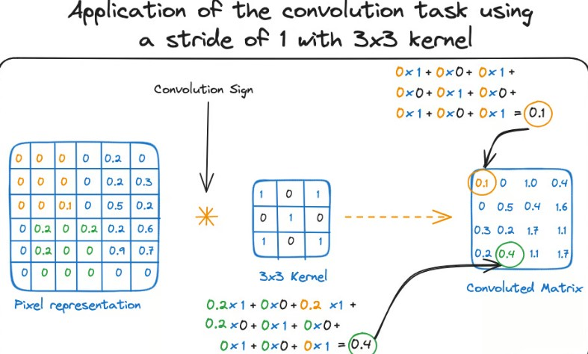
Key Components of a CNN(p4): Convolution layers
Stride : Controls how many steps does kernel move. E.g.: stride of 1 makes kernel slide by one row/column at a time and stride of 2 moves kernel by 2 rows/columns.
Another name for kernel is feature detector because the weights can be fine-tuned to detect specific features in the input image. For instance:
1) Averaging neighboring pixels kernel can be used to blur the input image.
2) Subtracting neighboring kernel is used to perform edge detection.
3) Common kernel sizes: 3x3 – most common; 5x5, 7x7 – larger receptive fields

Slide 11
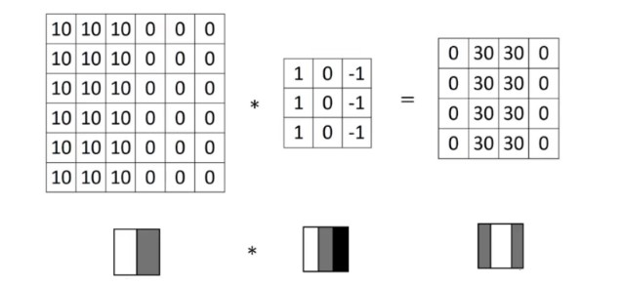
Key Components of a CNN(p4.1): Convolution layers
Detecting vertical edges with vertical filter
Value for row=1,col=1 is calculated as =
10*1 + 10*0 + 10*-1 +
10*1 + 10*0 + 10*-1 +
10*1 + 10*0 + 10*-1 = 0
Value for row=1,col=2 is calculated as =
10*1 + 10*0 + 0*-1 +
10*1 + 10*0 + 0*-1 +
10*1 + 10*0 + 0*-1 = 30
Higher pixel values represent the brighter portion of the image and the lower pixel values represent the darker portions. This is how we can detect a vertical edge in an image

Slide 12


Key Components of a CNN(p4.2): Convolution layers
horizontal filter: Detect horizontal edges
Sobel filter: puts a little bit more weight on the central pixels

Slide 13
Key Components of a CNN(p4.3): Convolution layers
We have seen that convolving an input of 6 X 6 dimension with a 3 X 3 filter results in 4 X 4 output.
There is a straightforward formula that connects the input size n×n and the filter size f×f, resulting in an output size of (n−f+1)×(n−f+1)
Input image size n X n
Output size (n-f+1) X (n-f+1)
Filter size f X f
The dimension of the final convoluted matrix depends on the size of the sliding window(kernel matrix). The bigger the sliding window, the smaller the dimension.

Slide 14
Key Components of a CNN(p4.3): Convolution layers
shamlodhiya
There are 2 problems when applying convolution:
1. Every time we apply a convolutional operation, the size of the image shrinks
2. Pixels present in the corner of the image are used only a few number of times during convolution as compared to the central pixels.
Hence, we do not focus too much on the corners since that can lead to information loss
SOLUTION:
To overcome these issues, we can pad the image with an additional border, i.e., we add one pixel all around the edges. This means that the input will be an 8 X 8 matrix (instead of a 6 X 6 matrix). Applying convolution of 3 X 3 on it will result in a 6 X 6 matrix which is the original shape of the image. This is where padding comes to the formula:
Input: n X n
Padding: p
Filter size: f X f
Output size: (n+2p-f+1) X (n+2p-f+1)
0 | 0 | 0 | 0 | 0 | 0 | 0 | 0
0 | 5 | 6 | 56 | 6 | 7 | 8 | 0
0 | 56 | 5 | 56 | 56 | 56 | 56 | 0
0 | 7 | 8 | 76 | 65 | 7 | 88 | 0
0 | 3 | 5 | 45 | 9 | 6 | 0 | 0
0 | 78 | 4 | 5 | 8 | 8 | 5 | 0
0 | 54 | 3 | 1 | 3 | 54 | 6 | 0
0 | 0 | 0 | 0 | 0 | 0 | 0 | 0
5 | 6 | 56 | 6 | 7 | 8
56 | 5 | 56 | 56 | 56 | 56
7 | 8 | 76 | 65 | 7 | 88
3 | 5 | 45 | 9 | 6 | 0
78 | 4 | 5 | 8 | 8 | 5
54 | 3 | 1 | 3 | 54 | 6
Before padding
After padding of 1

Slide 15
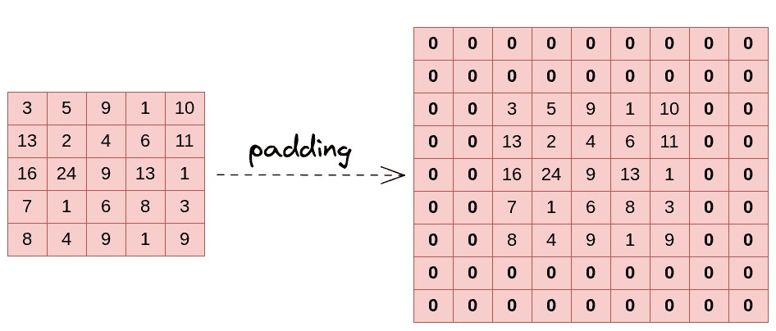
Key Components of a CNN(p4.4): Convolution layers
shamlodhiya
There are two common choices for padding:
1. Valid Padding : It means no padding. If we are using valid padding, the output will be (n-f+1) X (n-f+1)
2. Same Padding : Here, we apply padding in such a manner so that the output size is the same as the input size, i.e., n+2p-f+1 = n So, p = (f-1)/2
So by using padded convolution, we don’t lose a lot of information and the image does not shrink either.
3. Causal Padding: This type of padding is used in sequence-to-sequence models and time series forecasting and basically works with the one-dimensional convolutional layers. Causal padding adds elements to the start of the data, which also aids in forecasting the values of early time steps.
Applying padding of 2

Slide 16
Key Components of a CNN(p4.5): Convolution layers
Some key points about convolution layers:
The more convolution layers the network has, the better the layer is at detecting more abstract features.
Output of kernel operation obtained is of lower dimensions and therefore easier to work with.

Slide 17
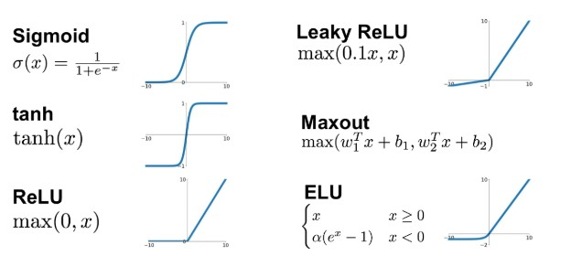
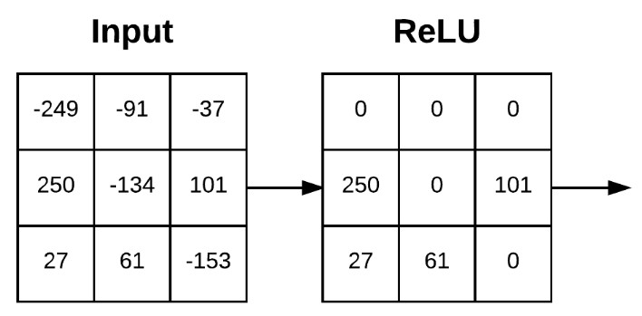
Key Components of a CNN(p5): Activation function
Activation function
A ReLU activation function is applied after each convolution operation. This function helps the network learn non-linear relationships between the features in the image, hence making the network more robust for identifying different patterns. It also helps to mitigate the vanishing gradient problems.
Example of ReLU:

Slide 18
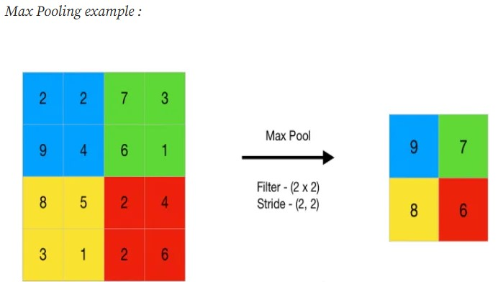
Key Components of a CNN(p6): Pooling layer
Pooling layer
The goal of the pooling layer is to pull the most significant features from the convoluted matrix. This is done by applying some aggregation operations, which reduce the dimension of the feature map (convoluted matrix), hence reducing the memory used while training the network. Pooling is also relevant for mitigating overfitting.
The most common aggregation functions that can be applied are:
Max pooling, which is the maximum value of the feature map
Sum pooling corresponds to the sum of all the values of the feature map
Average pooling is the average of all the values.
This step helps in removing any unnecessary features. When you take the highest values from that block of matrix while applying max pool, it accounts for only important features in the output

Slide 19
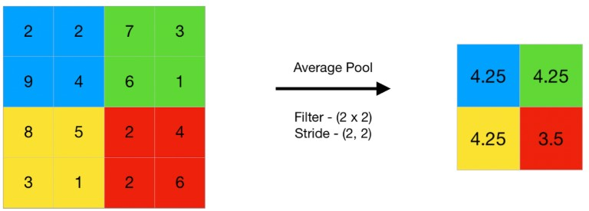
Key Components of a CNN(p7): Pooling layer
Average pooling computes the average of the elements present in the region of feature map covered by the filter. Average pooling gives the average of features present in a patch.
Average pooling provides a more generalized representation of the input. It is useful in the cases where preserving the overall context is important

Slide 20
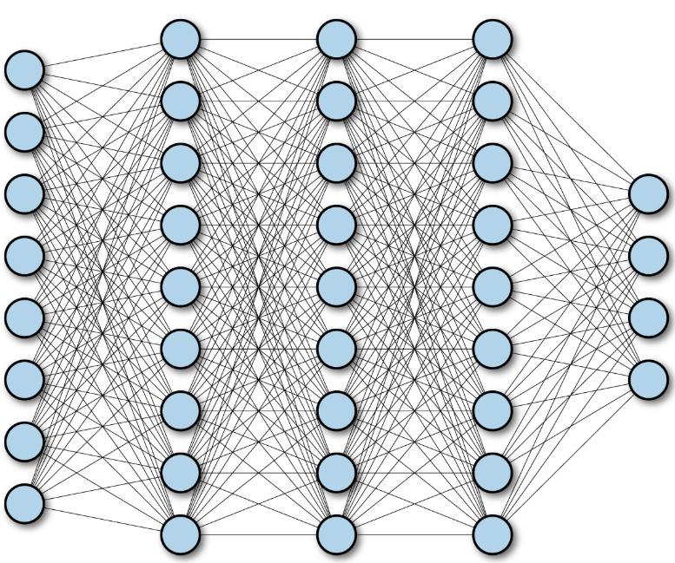
Key Components of a CNN(p8): Fully connected layers
Fully connected layers
A fully connected layer, aka dense layer, in a convolutional neural network (CNN) connects every input node to every output node.
These layers are in the last layer of the convolutional neural network, and their inputs correspond to the flattened one-dimensional matrix generated by the last pooling layer. ReLU activations functions are applied to them for non-linearity.
Finally, a softmax prediction layer is used to generate probability values for each of the possible output labels, and the final label predicted is the one with the highest probability score.

Slide 21
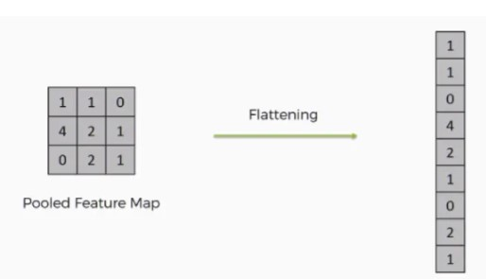
Key Components of a CNN(p9): Flattening
Flatten
Flattening is used to convert all the resultant 2-Dimensional arrays from pooled feature maps into a single long continuous linear vector. The flattened matrix is fed as input to the fully connected layer to classify the image.
2D matrix of size 3X3
1D array of size 9

Slide 22
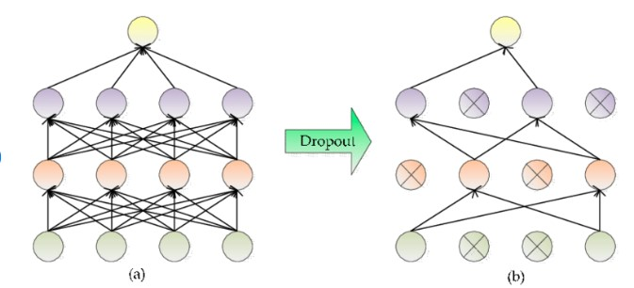
Key Components of a CNN(p10): Dropout Layer
Drop out is a way to prevent overfitting in neural networks, especially in complex architectures that have a tendency to memorize the training data rather than generalize from it

Slide 23
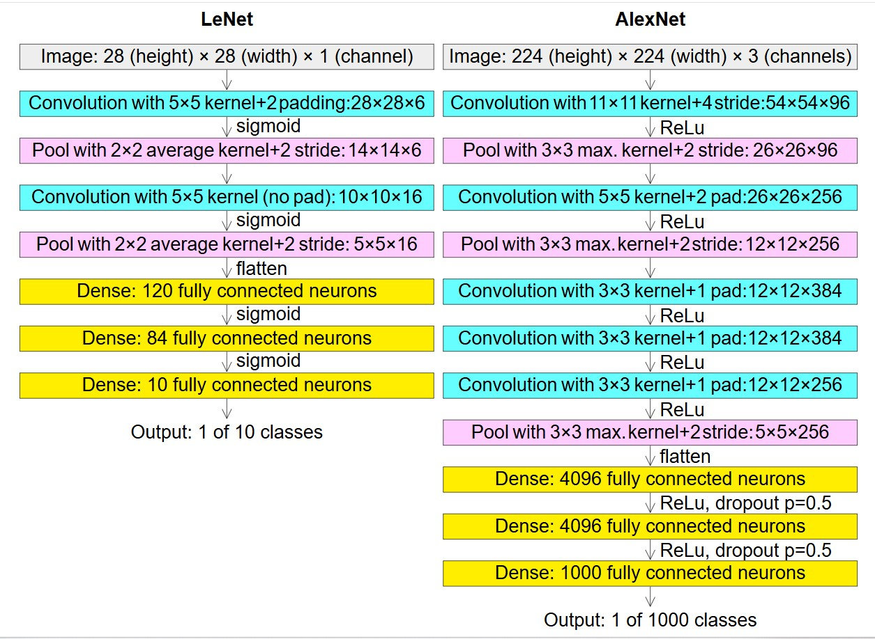
Examples of CNN
Source: wikipedia

Slide 24
LeNet
LeNet and LeNet-5 are often used interchangeably, but LeNet refers to a family of early Convolutional Neural Networks (CNNs), while LeNet-5 is a specific architecture developed by Yann LeCun in 1989 for handwritten digit recognition.
LeNet-5 is outdated today, replaced by modern CNNs like VGG, and ResNet.
Application of LeNet
Document Processing: LeNet’s model are used in scanning and analyzing documents, parsing and processing different types of information, extracting data from documents, and automating data entry tasks.
Handwriting Recognition: LeNet’s success in recognizing handwritten characters and digits remains fundamental in Optical Character Recognition (OCR) systems used in processing handwritten text
Biometric Authentication: Handwriting recognition capabilities of LeNet have been applied to signature and fingerprint analysis, enabling biometric authentication methods and enhancing security systems.
Real-time Video Analysis: The foundational concepts in LeNet serve as a basis for real-time video analysis, such as object tracking, surveillance systems, facial recognition, and autonomous vehicles.
Image Classification: LeNet’s principles influence modern image classification systems. Applications include classifying and categorizing objects in images for numerous domains, such as identifying objects in photographs, quality control in manufacturing, medical imaging analysis, and security systems for object identification.

Slide 25
Few facts about CNN(p1)
Feedforward networks (MLPs, CNNs) process inputs all at once — they don't depend on previous steps.
Suppose you have 1000 words or pixels.
A feedforward network takes all 1000 together, passes them through layers at the same time (matrix multiplication).
In math terms: matrix × vector — super fast because modern hardware (like GPUs) is built for parallel matrix operations.
No waiting for "previous word" or "previous pixel" — everything is independent at each layer.
This is called parallelism.

Slide 26
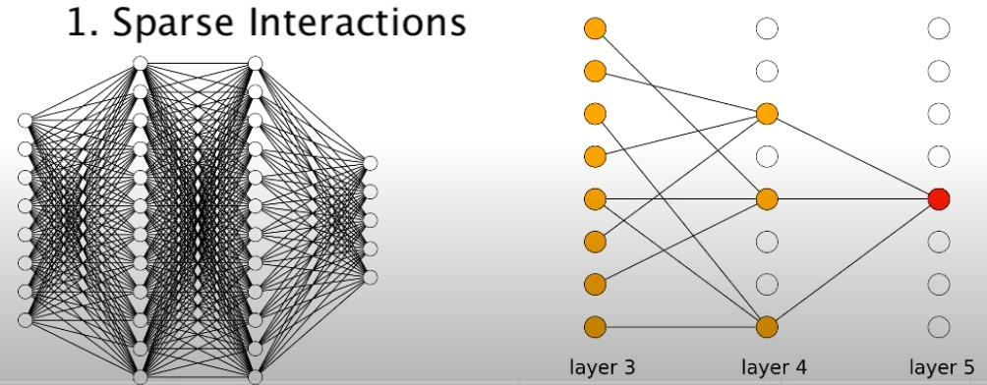
Few facts about CNN(p2)
CNN has sparse interactions
In a fully connected layer, every output neuron is connected to every input neuron — this results in dense interactions.
In contrast, in CNNs:
Each convolutional filter (or kernel) only interacts with a small local region of the input (called the receptive field).
This means a single output value is computed based only on a subset of the input values.
Therefore, not all input features contribute to every output, resulting in sparse connectivity or sparse interactions.
Benefits of Sparse Interactions:
Reduced computational cost
Parameter efficiency

Slide 27
Application of CNN
Image classification: Used for image categorization, where images are assigned to predefined categories. One use of such a scenario is automatic photo organization in social media platforms.
Object detection: Are able to identify and locate multiple objects within an image. This capability is crucial in multiple scenarios of shelf scanning in retail to identify out-of-stock items.
Facial recognition: One of the main applications of CNNs. For instance, this technology can be embedded into security systems for efficient control of access based on facial features.

Slide 28
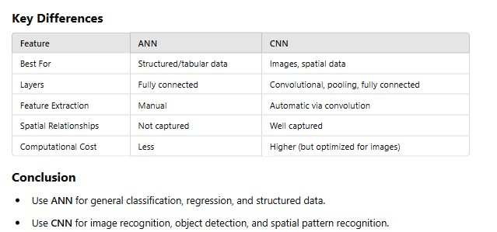
Difference between ANN and CNN

