Slide 2
Memory in Agents: How AI Remembers
“There are 2 types of memory – Short Term and Long Term"
Short-term memory
Stores what is happening in the current conversation
Long-term memory
Stores what should be remembered about the user/application across many conversations.

Slide 3
Short-term memory
Example 1:
User: My name is Ash.
Agent: Nice to meet you, Ash.
User: I live in Berlin.
Agent: Got it.
User: What is my name?
Agent: Ash <-- It remembers
Example 2:
User: I took a loan of 2 lakh at 10% for 2 years. What is my EMI?
Agent: 9,229
User: Now if interest changes to 20%, then what is my EMI?
Agent: (The agent may hallucinate and make up wrong figures)

Slide 4
Long-term memory
Conversation 1:
User: My name is Ash.
Agent: Nice to meet you, Ash.
User: I live in Berlin.
Agent: Got it.
User: I am thinking of going to India
Agent: I think it is good idea
Conversation 2:
User: How much is ticket to India ?
Agent: The price of ticket from Berlin to India could range from $ 1000 to $ 1500
It remembers the city Berlin from conversation 1

Slide 5
Agent
Short-term memory
SQLite (Local / POC)
PostGreSQL (Industry)
Long-term memory
PineCone (Industry)

Slide 6
Short-Term Memory:
Agents use a technique called memory summarization — periodically compressing older conversation into a summary, keeping the gist without keeping every word.

Slide 7
Long-Term Memory:
Long-term memory is persisted in a database, retrievable when needed, growing indefinitely.
When a new session starts, the agent doesn't load all of long-term memory into context (that would overflow it). Instead, it fetches only what's relevant to the current task.
The question is: how do you know what's relevant?
For structured data — account numbers, transaction records, customer profiles — a standard SQL database query works fine. You search by ID or date, get back exact rows.
For unstructured knowledge — past conversations, documents, notes, emails — exact-match SQL fails. You use vector databases.

Slide 8
Best Official documentation:
https://docs.langchain.com/oss/python/concepts/memory

Slide 9
Discussion Prompt for Class
"A fintech agent remembers everything a customer has ever said —
their financial worries,
their family situation,
their investment fears.
This makes it far more helpful.
But it also means someone is storing a detailed psychological and financial profile of every customer.
Who owns that memory?
Can the customer delete it?
What if the bank is acquired?
Should there be a 'right to be forgotten' for AI memory?"

Slide 10
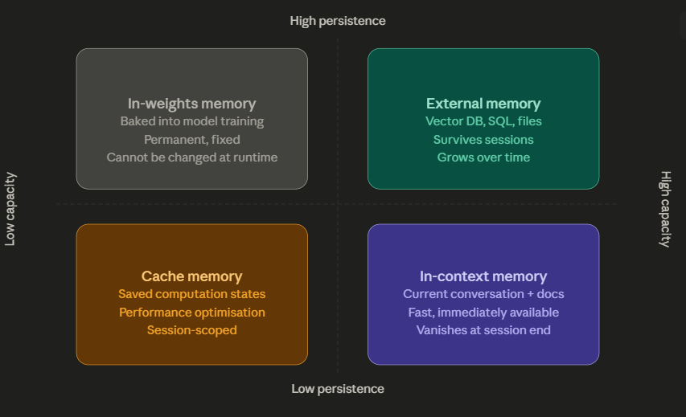

Slide 11
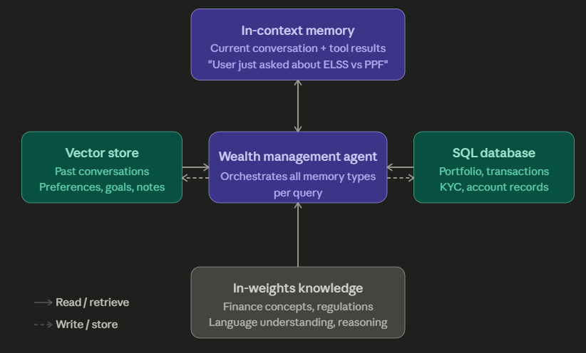
Here is how a well-designed fintech agent — say, a wealth management assistant — would wire all four memory types together:

