Slide 1
Example 1

Slide 2
Prompt for returning highest number:
Act as an expert software engineer.
Convert the following step-by-step algorithm into clean, production-ready Python code.
Provide only the executable code and a single usage example.
Do not include explanations.
Algorithm:
Receive a list of numbers.
Initialize a variable highest with the first number in the list.
Loop through each remaining number in the list.
If the current number is greater than highest, update highest to be this number.
After checking all numbers, return highest.
Role/Persona
Task
Constraint

Slide 3
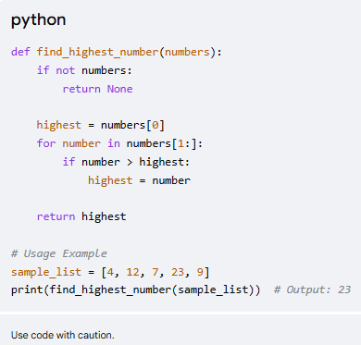
Response from Gemini

Slide 4
Example 2

Slide 5
Prompt for returning highest number:
Act as an expert software engineer.
Convert the following step-by-step algorithm into clean, production-ready Java code.
Provide only the executable code and a single usage example.
Do not include explanations.
Algorithm:
Receive a list of numbers.
Initialize a variable highest with the first number in the list.
Loop through each remaining number in the list.
If the current number is greater than highest, update highest to be this number.
After checking all numbers, return highest.
Role/Persona
Task
Constraint

Slide 6
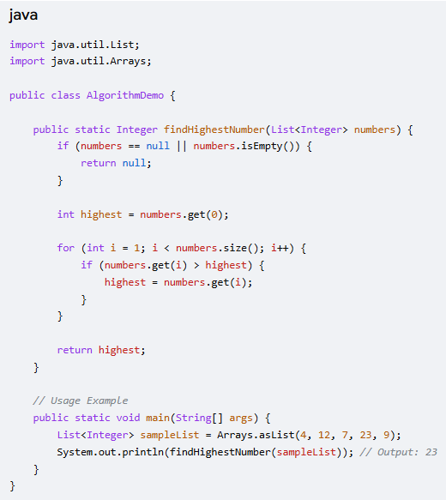
Response from Gemini

Slide 7
Example 3

Slide 8
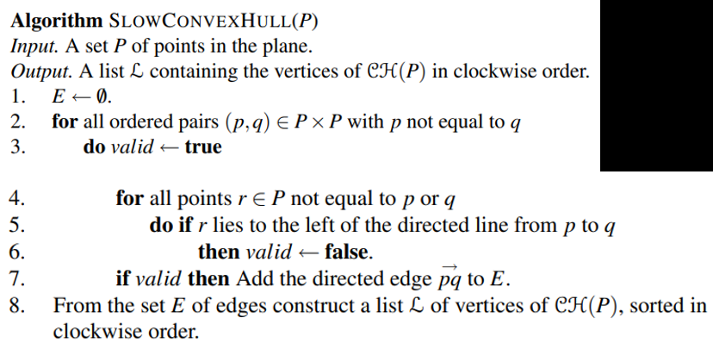
Act as an expert software engineer.
Convert the attached algorithm into clean, production-ready Python code.
Provide only the executable code and a single usage example.
Do not include explanations.

Slide 9
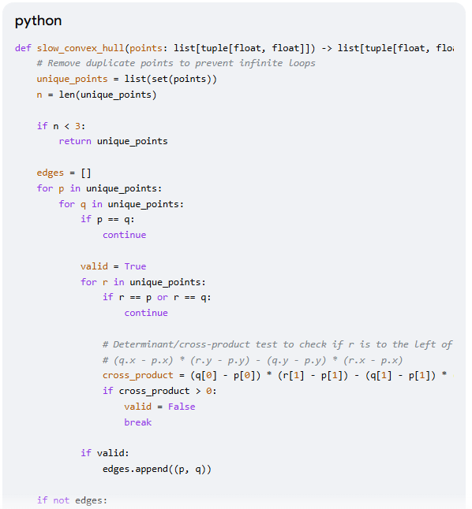

Slide 10
Example 4

Slide 11
Prompt 1:
I have bunch of points in 2 dimension.
What are different algorithms for finding the closest pair of points.
Give their space / time complexity.
Do not implement it.

Slide 12
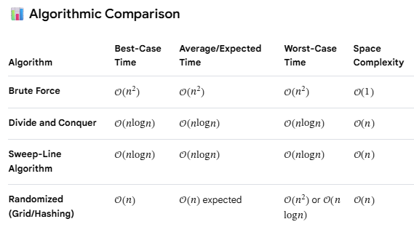

Slide 13
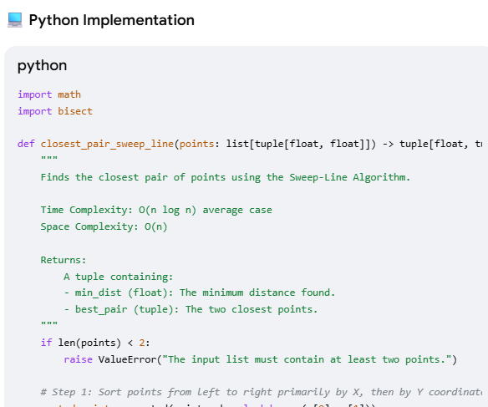
Prompt 2 (Follow up):
Now implement the Sweep line algorithm
Use python code.
Give me an example of its usage

