Slide 1
Example 1

Slide 2
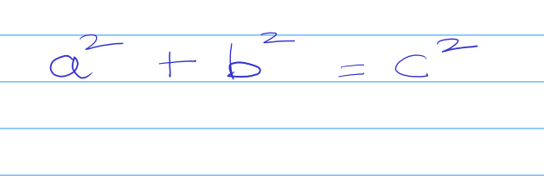

Understanding equations:
Prompt:
I am attaching an equation. What is this equation ?

Slide 3
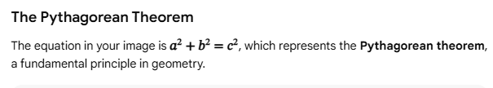
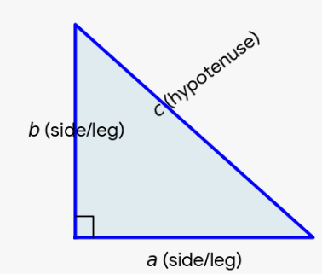
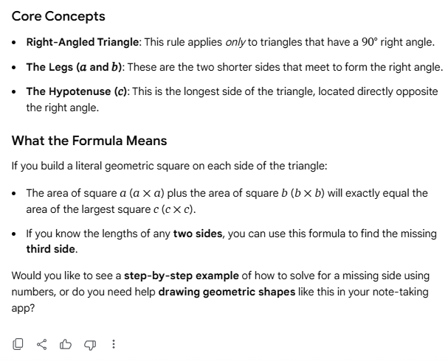
Response from Gemini

Slide 4
Example 2

Slide 5
Understanding equations:
I am a university professor teaching a diverse class. I am attaching an equation:
To help me prepare my upcoming materials, please perform the following tasks:
1. HISTORICAL CONTEXT: Give a 2-sentence background on its origins.
2. REAL-WORLD APPLICATION: Provide one concrete application of this formula in three distinct fields: Architecture, Video Game Development, and Data Science.
3. INTERACTIVE PYTHON CODE: Write a clean, commented Python function that calculates 'c' given 'a' and 'b'. Include a sample run.
4. LATEX: Give me the latex format of this equation

Slide 6
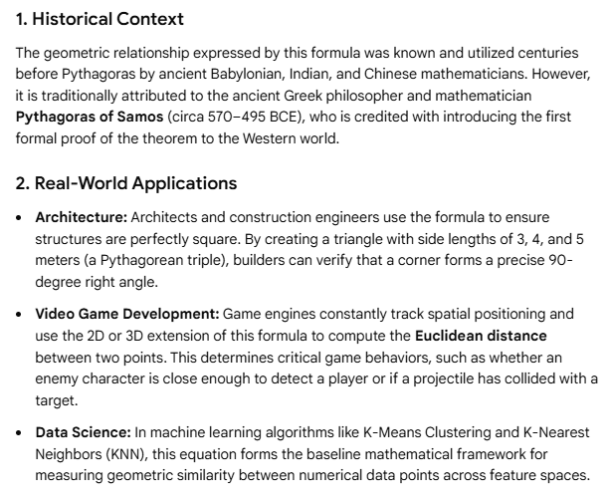
Response from Gemini

Slide 7
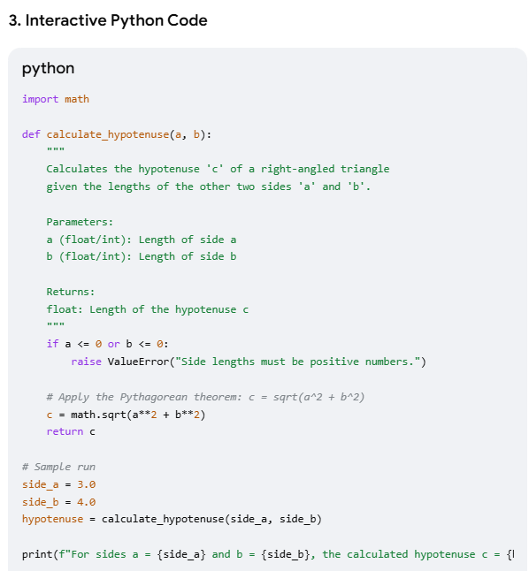
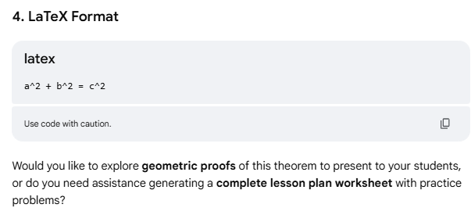
Response from Gemini

Slide 8
Example 3

Slide 9
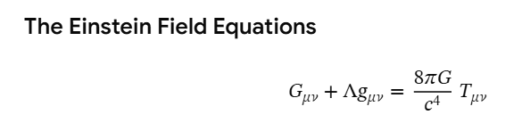
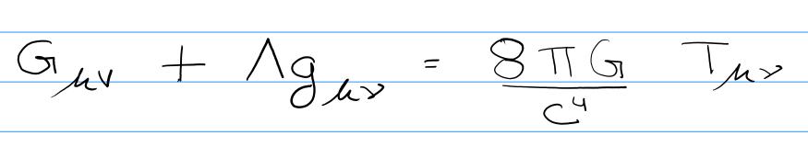
Understanding equations:
I am attaching an equation:
1. EXPLAINATION: What is this equation ? What is the variable c, G, T ?
2. REAL-WORLD APPLICATION: Provide one concrete application of this formula.
3. INTERACTIVE PYTHON CODE: Write a clean, commented Python function that computes T
4. LATEX: Give me the latex format of this equation

Slide 10
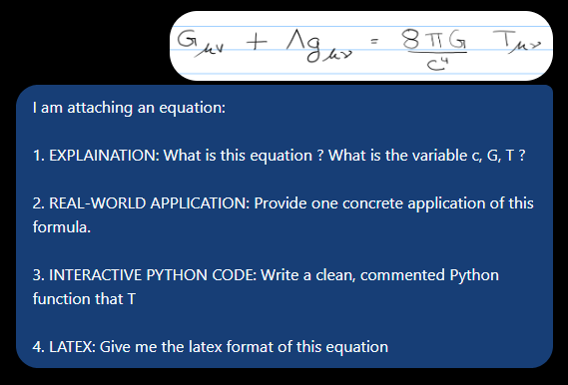
Response from ChatGPT

Slide 11
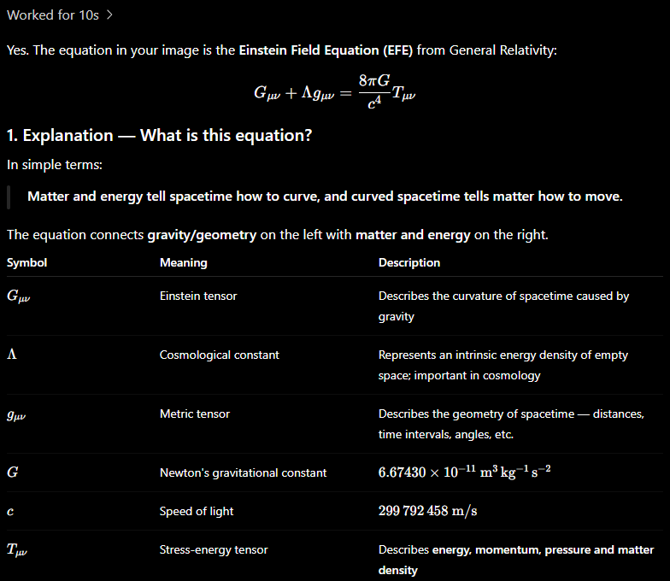
Response from ChatGPT

Slide 12
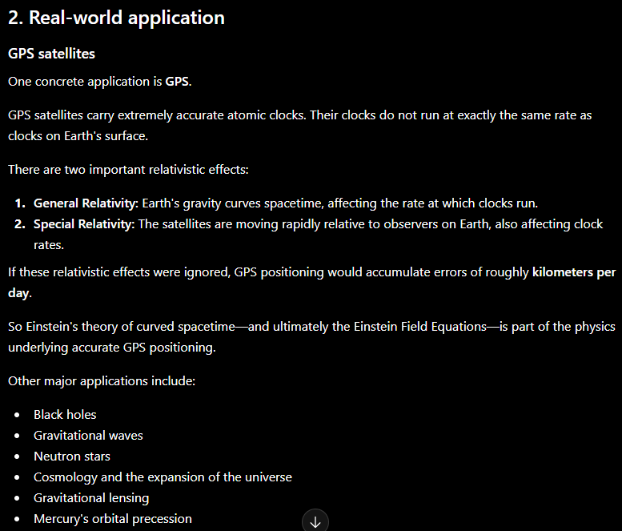
Response from ChatGPT

Slide 13
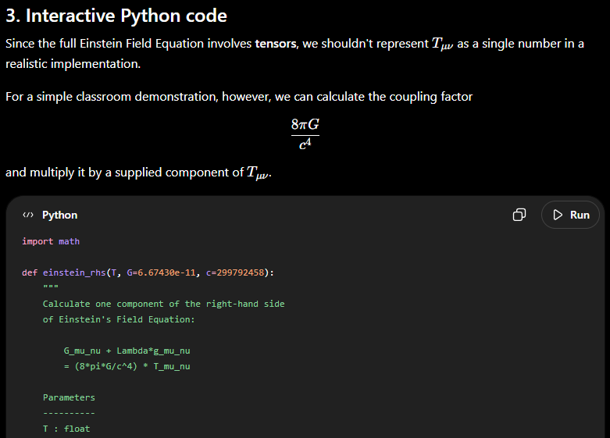
Response from ChatGPT

Slide 14
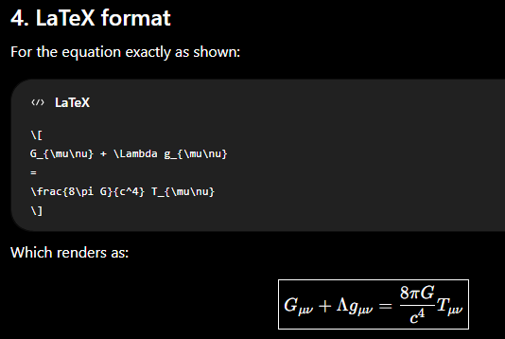
Response from ChatGPT

