Slide 1
Example 1

Slide 2

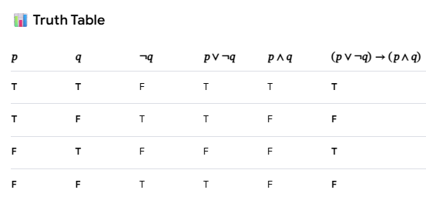
Copy and paste following into Gemini
Response from Gemini

