Slide 1
CI
CD

Slide 2
https://www.youtube.com/watch?v=G1u4WBdlWgU

Slide 3
In a normal app:
Code → Build → Test → Deploy
In an ML app:
Code + Data + Model → Train → Evaluate → Deploy → Monitor → Retrain
👉 Key difference:
Output depends on data + model, not just code

Slide 4
ML CI/CD Pipeline (Industry Flow)
🔄 Full Lifecycle
Data → Preprocessing → Training → Evaluation → Deployment → Monitoring → Retraining

Slide 5
Continuous Integration (CI) in ML

Slide 6
What gets integrated?
All code : Model training code, etc
Data pipelines
Feature engineering
Config files

Slide 7
✅ CI Steps in ML
Code Validation
Python code runs correctly
Linting (flake8)
Unit tests
2. Data Validation 🚨 (VERY IMPORTANT)
Check:
Missing values
Schema mismatch
Data drift
Example:
assert df.shape[1] == 10
assert df.isnull().sum().sum() < 100

Slide 8
3. Model Training (Optional in CI)
Train small/quick version of model
Not full training (too expensive)
4. Model Evaluation
Check:
Accuracy
Precision/Recall
F1 Score
Example:
assert accuracy > 0.75
👉 If model is worse → pipeline FAILS ❌

Slide 9
2. Continuous Delivery / Deployment (CD)

Slide 10
Once CI passes:
🔹 Model Packaging
Save model:
import joblib
joblib.dump(model, "model.pkl")
🔹 API Creation (Serving Model)
Using FastAPI:
@app.post("/predict")
def predict(data):
return model.predict(data)

Slide 11
🔹 Deployment
Deploy to:
Cloud (AWS / GCP)
Docker container
Kubernetes

Slide 12
3. Continuous Monitoring (ML-Specific)

Slide 13
This is where ML is DIFFERENT.
After deployment:
Monitor:
Model accuracy in real world
Data drift
Prediction distribution
Example Problem:
Model trained on:
Age: 20–40
Production data:
Age: 60–80
👉 Model performance drops → NEED retraining

Slide 14
4. Continuous Retraining (Advanced CD)
Pipeline automatically:
Collect new data
Retrain model
Re-evaluate
Deploy new version

Slide 15
Example: GitHub Actions for ML Pipeline
name: ML Pipeline
on: [push]
jobs:
ml-pipeline:
runs-on: ubuntu-latest
steps:
- uses: actions/checkout@v3
- name: Install Dependencies
run: pip install -r requirements.txt
- name: Run Data Validation
run: python validate_data.py
- name: Train Model
run: python train.py
- name: Evaluate Model
run: python evaluate.py
- name: Save Model
run: python save_model.py

Slide 16
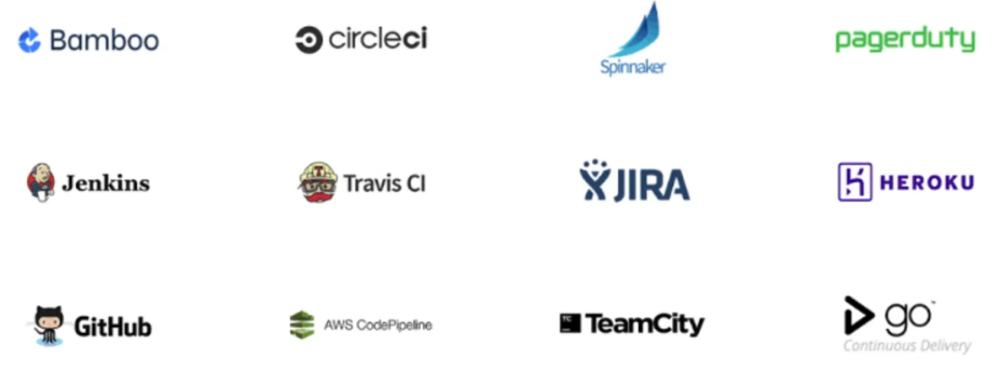

Slide 17
Ffnbksdfd
Fdslj;f
Fl;ds

