Slide 1
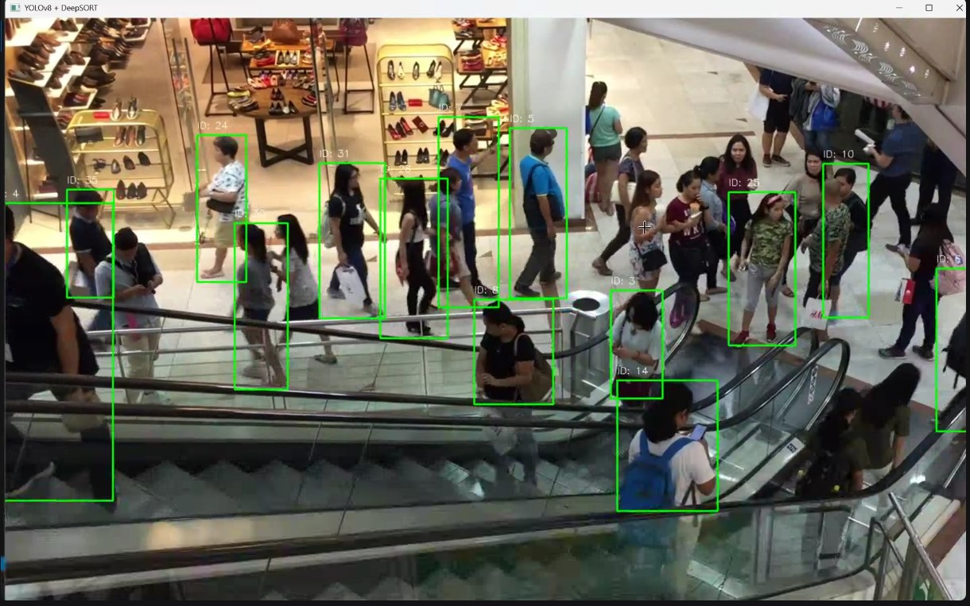
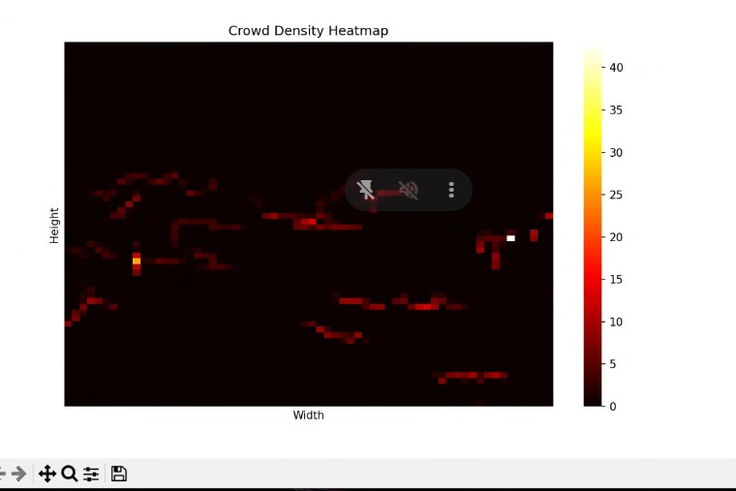
Crowd density detection

Slide 2
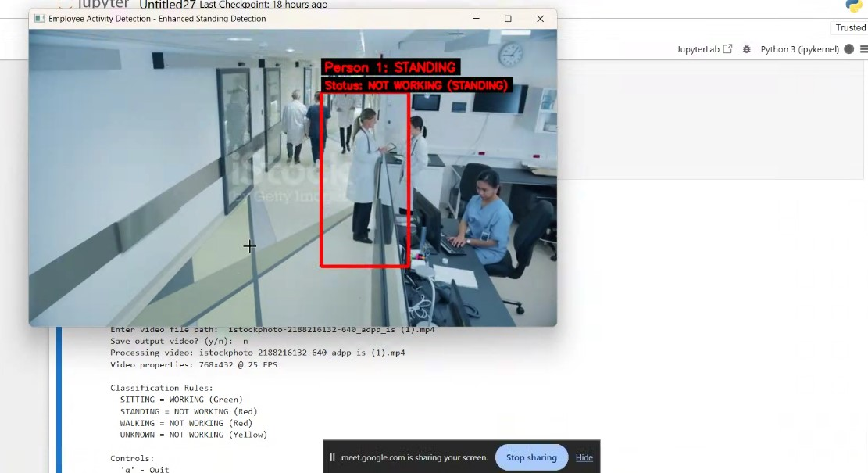
Activity: Working or Standing

Slide 3
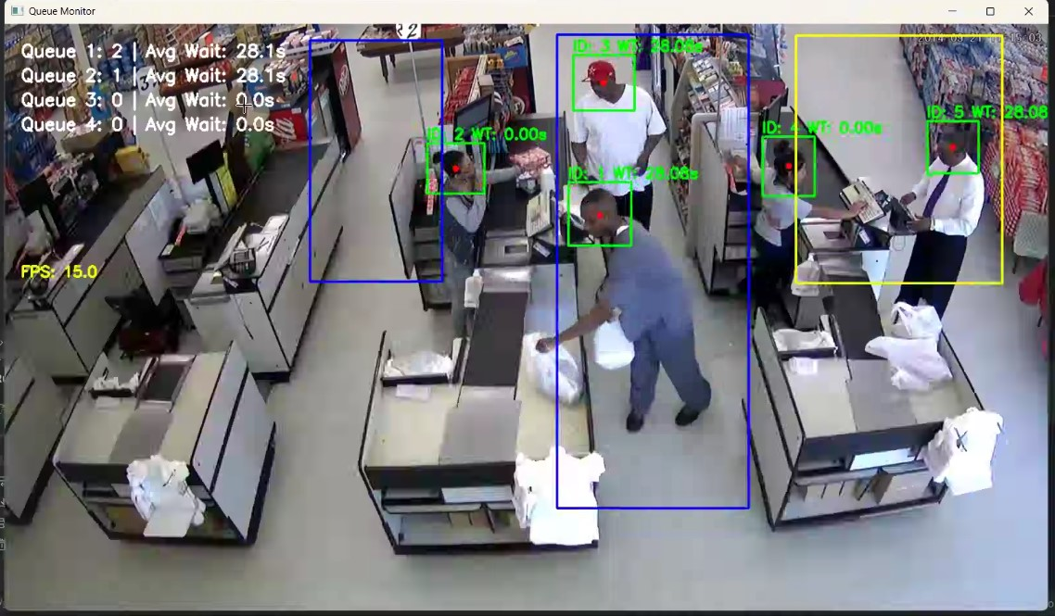
Queue statistics: How many people waiting and their wait time

Slide 4
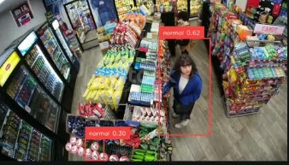

Theft detection

Slide 5
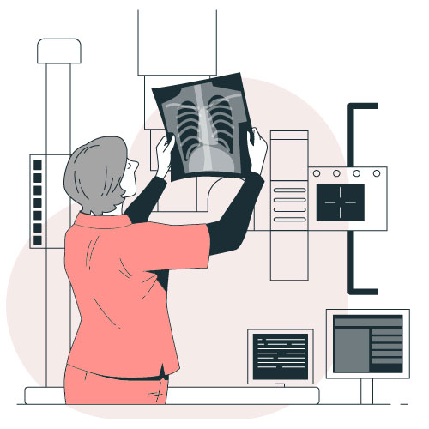
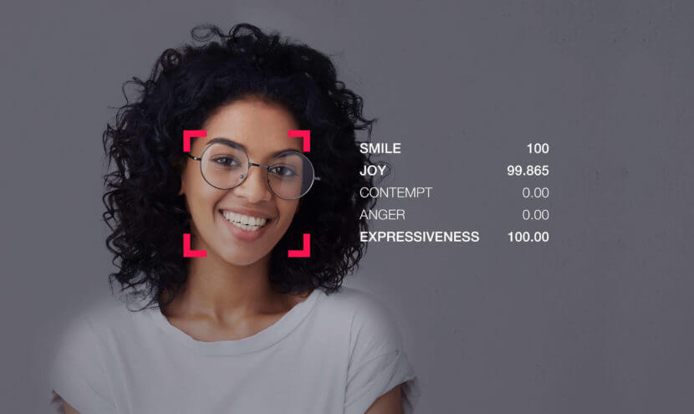
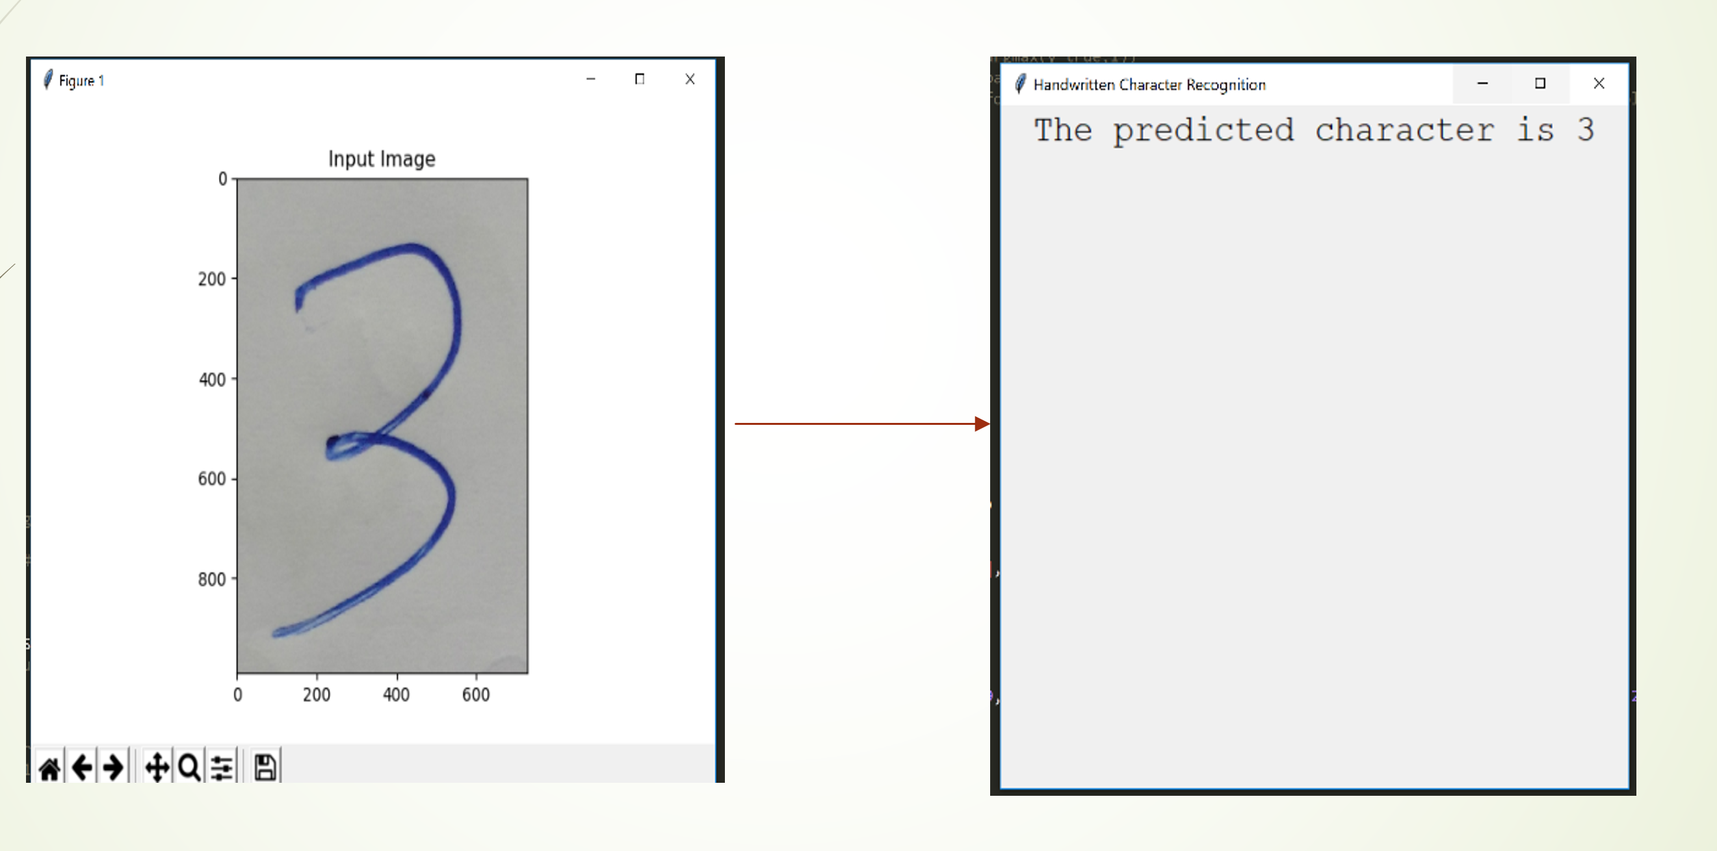
Application of CNN
X-ray Image Analysis
Facial Emotion Recognition
Hand-written digit recognition

Slide 6
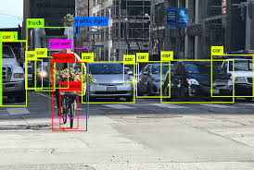
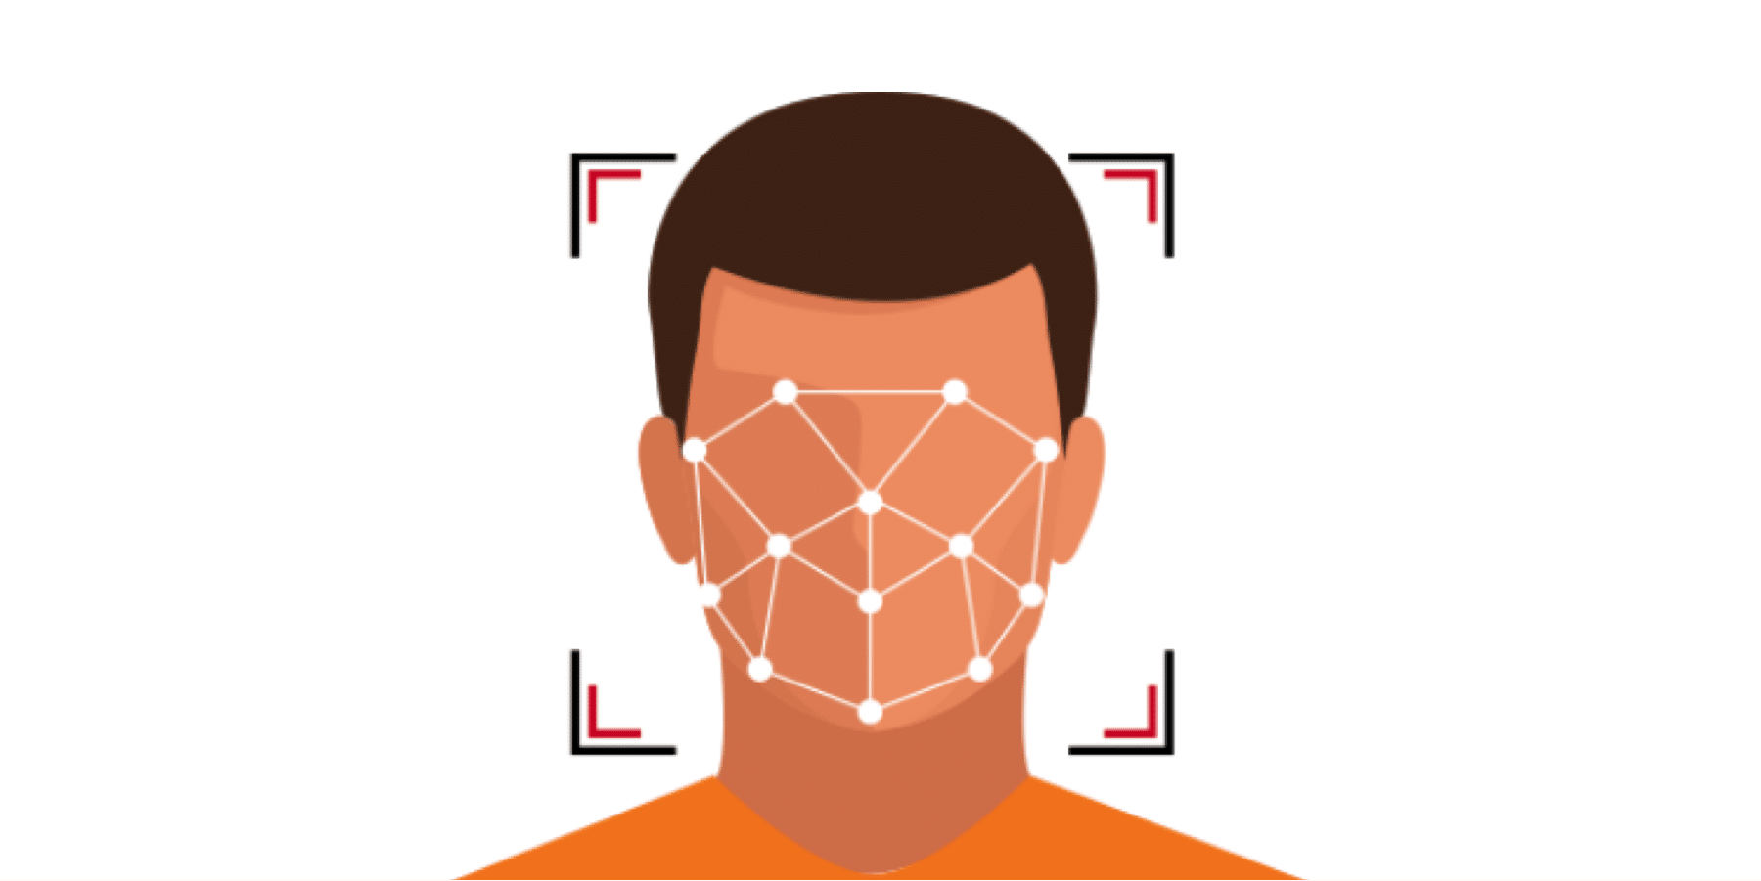
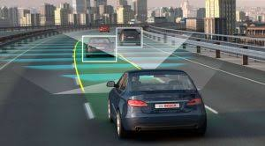
Application of CNN
Object Detection
Face Detection
Self-Driving Vehicle

Slide 7
EXTRA
Xxxxxxxxxxx
xxxxxxxxxxxx

