Slide 1
Learning Goals
By the end of the class, students should:
Use cases of RNN
Understand sequential data
Grasp why traditional ML fails for sequences
Build intuition for RNN
Implement a simple RNN in TensorFlow/Keras

Slide 2
Use cases of RNN

Slide 3
Use cases of RNN
Autocompletion by google in search/email:
What is deep ____ -> learning
Places near me to ___ -> eat
What is recurrent neural ___ -> network
Thanks, and _____ -> regards.
Note: Here sequence is important

Slide 4
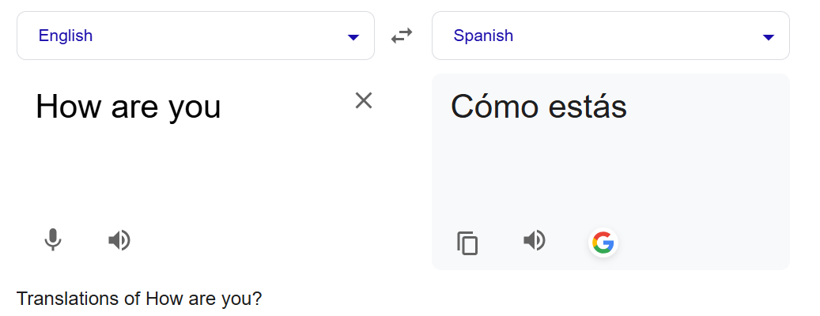
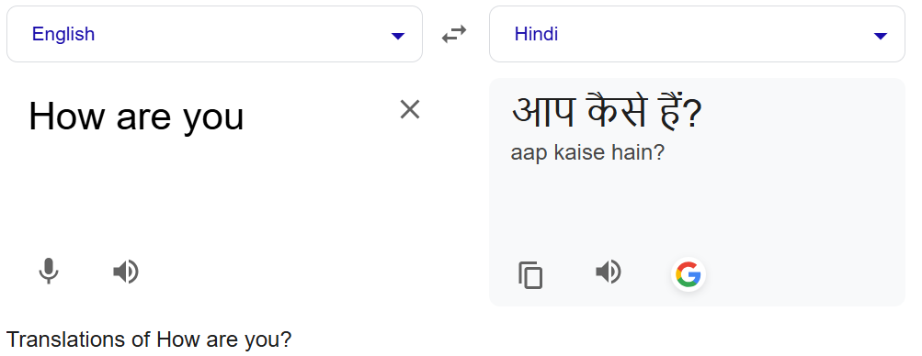
Use cases of RNN
Language translation:
Note: Here sequence is important

Slide 5
Use cases of RNN
Named Entity Recognition
X:
John Doe works at Loxford Academy in Bangalore. He met Lomax Kumar at Google headquarters in California. The meeting happened on 12 January 2024.
X y
John → B-PER
Doe → I-PER
works → O
at → O
Loxford → B-ORG
Academy → I-ORG
in → O
Bangalore → B-LOC
. → O
He → O
met → O
Lomax → B-PER
Kumar → I-PER
at → O
Google → B-ORG
headquarters → O
in → O
California → B-LOC
. → O
The → O
meeting → O
happened → O
on → O
12 → B-DATE
January → I-DATE
2024 → I-DATE
. → O
Tag meanings:
B- → Beginning of entity
I- → Inside entity
O → Outside (not an entity)
Entity Types:
PER → Person
ORG → Organization
LOC → Location
DATE → Date

Slide 6
Use cases of RNN
Named Entity Recognition
X1: John works at Loxford Academy.
B-Per
B-Org
X2: Loxford works at John Academy
B-Per
B-Org
Note: Here sequence is important

Slide 7
Use cases of RNN
Sentiment Analysis
I love pizza and watching movies -> 5 star -> Positive
This movie was OK. I would not watch it again -> 3 star -> Positive
3 – 5 star → Positive sentiment
0 – 2 star → Negative Sentiment
In all of the above problems, sequence is important.
To deal with this type of data, where sequence is important, we have RNN.
RNN is a type of NN that specializes in dealing with sequential type data.

Slide 8
What is Sequential Data?

Slide 9




1️⃣ What is Sequential Data?
Examples:
Text → “I love AI”
Time series → stock prices
Speech → audio waveform
👉 Key idea:
Order matters!
Example in text:
“dog bites man” ≠ “man bites dog”
Recurrent neural networks (RNNs) shine in tasks involving sequential data, where
Order and
Context
are crucial.

Slide 10
2️⃣ Problem with Traditional Models

Slide 11
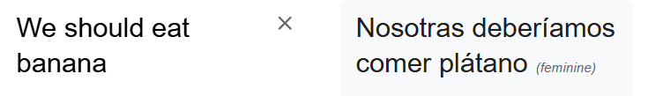
2️⃣ Problem with Traditional Models
I cannot use static ANN to for sentence translation
For ANN, the number of neurons in input and layer is fixed
Whereas , sentences length changes.
ANN will fail

Slide 12
2️⃣ Problem with Traditional Models
The order of sentence is important:
man eats banana != banana eats man
The traditional NN does not take this into account
man
eats
banana

Slide 13
2️⃣ Problem with Traditional Models
👉 If I use Logistic Regression:
It treats inputs as independent
No memory of previous words
Example:
"I ate good food. I liked the taste. It brought me a feeling of ___"
Traditional Model doesn’t know previous words → poor prediction (maybe sorrow, angry, happy, etc.)

Slide 14
2️⃣ Problem with Traditional Models Why we cannot use ANN for sentiment analysis?
Word | One-Hot Vector
apple | [1, 0, 0, 0, 0, 0, 0, 0, 0]
was | [0, 1, 0, 0, 0, 0, 0, 0, 0]
rotten | [0, 0, 1, 0, 0, 0, 0, 0, 0]
fresh | [0, 0, 0, 1, 0, 0, 0, 0, 0]
tasted | [0, 0, 0, 0, 1, 0, 0, 0, 0]
sweet | [0, 0, 0, 0, 0, 1, 0, 0, 0]
I | [0, 0, 0, 0, 0, 0, 1, 0, 0]
disappointed | [0, 0, 0, 0, 0, 0, 0, 1, 0]
by | [0, 0, 0, 0, 0, 0, 0, 0, 1]
Sentence | Is_happy
apple was rotten | n
apple was fresh | y
I was disappointed by apple | n
apple tasted sweet | y

Slide 15
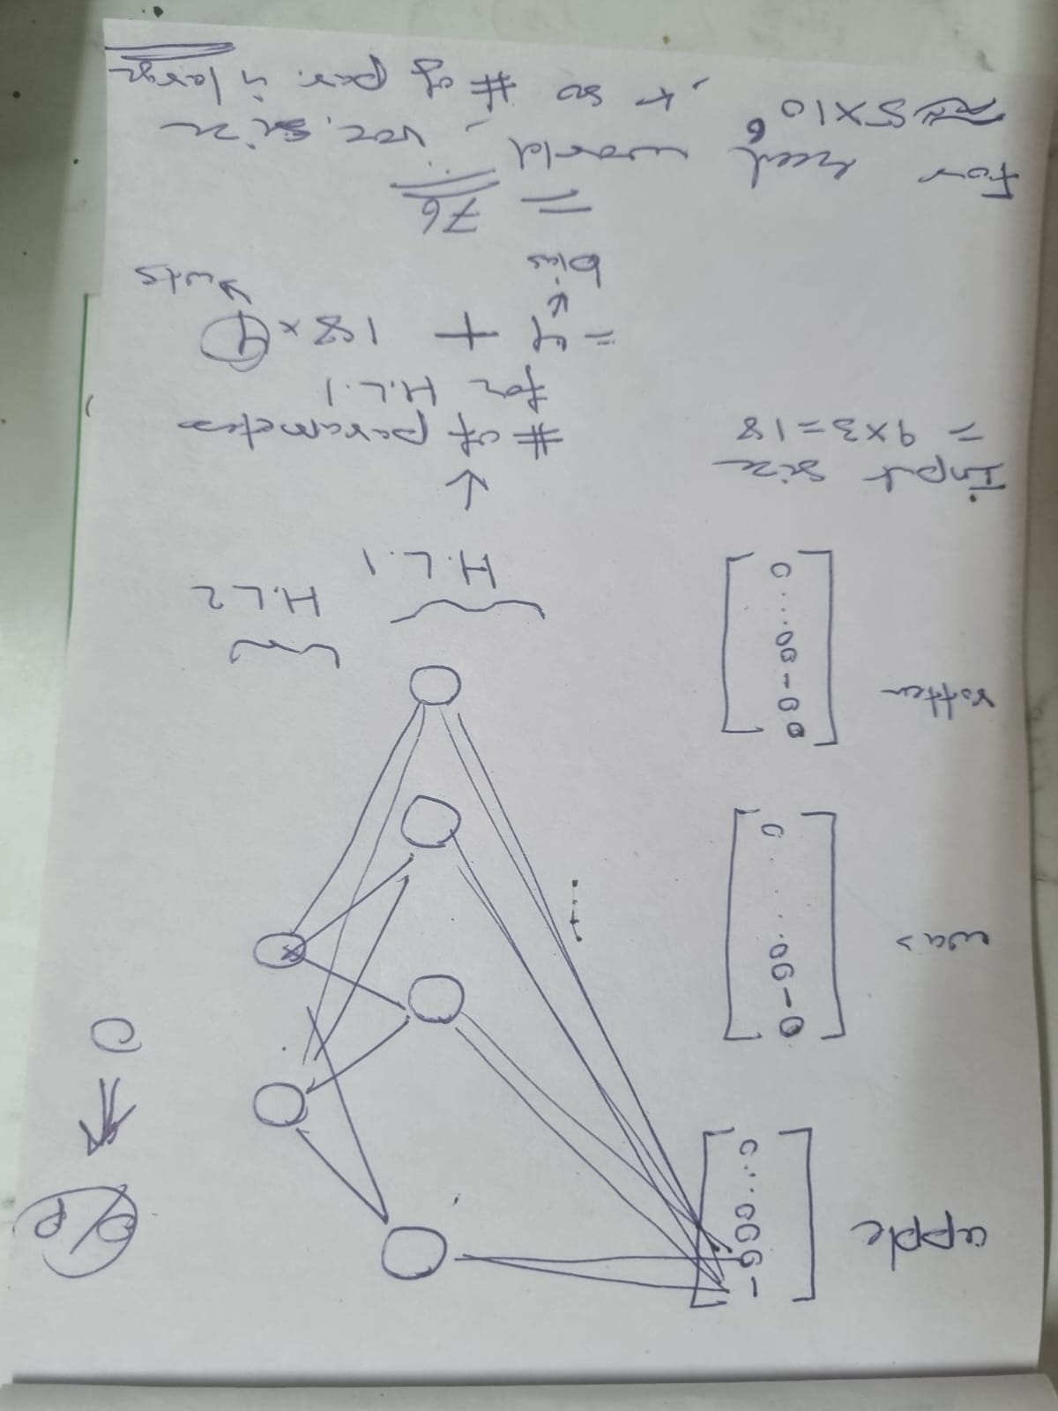
Why we cannot use ANN for sentiment analysis?
Problem 1)
When sentence is ‘apple was rotten’, then size of input layer is
= number of words in sentence X vocab. size
= 3 X 9 = 18.
The number of param in HL1 is
= num_of_bias_terms + input_size * num_of_wts_from_each_input
= 4 + 18*4 = 76
In real world, vocabulary size is around 5 million.
So, number of parameters would be large
=> computational complexity increases for ANN.

Slide 16
Why we cannot use ANN for sentiment analysis?
Problem 2) The size of input is not fixed: Different sentences have different length
“apple was rotten”
apple -> [1, 0, 0, 0, 0, 0, 0, 0, 0 ]
was -> [0, 1, 0, 0, 0, 0, 0, 0, 0 ]
rotten -> [0, 0, 1, 0, 0, 0, 0, 0, 0 ]
So, it needs 3*9=18 inputs
“I was disappointed by apple”
I -> [0, 0, 0, 0, 0, 0, 1, 0, 0]
was -> [0, 1, 0, 0, 0, 0, 0, 0, 0]
disappointed -> [0, 0, 0, 0, 0, 0, 0, 0, 1]
by -> [0, 0, 0, 0, 0, 0, 0, 0, 1]
apple -> [1, 0, 0, 0, 0, 0, 0, 0, 0]
It needs 5*9=45 inputs.
ANN would not be able work with this type of varying input-size scenario.
So, padding of 0 was used to make it fixed size input….but this in turn would lead to unnecessary large number of 0 causing sparsity.

Slide 17
Why we cannot use ANN for sentiment analysis?
Problem 3)
“Dog was chased by cat” and “cat was chased by dog”.
The ANN would treat both as same sentence
but they have semantically different meaning.

Slide 18
Why can't we use a plain ANN for time series forecasting?
Short answer: Because ANN doesn't remember the past.
No memory of past inputs: ANN treats every input independently; it doesn’t remember what happened before.
No temporal ordering: ANN sees data points randomly; time order (yesterday → today → tomorrow) is not naturally handled.
Fixed-size input: ANN expects all inputs to have a fixed shape. Time series may grow or shrink dynamically.
Lag features must be hand-crafted: To make ANN "see the past", you have to manually create "lag features" (previous values), which gets messy for long dependencies.

Slide 19
3️⃣ RNN Intuition (Core Concept)

Slide 20














3️⃣ RNN Intuition (Core Concept)
🔁 Key Idea:
RNN has "memory“
Information flows backward
ANN
RNN

Slide 21

Visual representation
X1
(Bob)
X2
(loves)
RNN at time t=1
RNN at time t=2
h1 = f(x1)
h2 = f(x2, h1)
h1
X1
X2

Slide 22
Visual representation:
Diagram Explanation
h1 = f(x1)
h2 = f(x2, h1)
h3 = f(x3, h2)
X1 is input at t=1, X2 is input at t=2, X3 is input at t=3, etc.
h1 = f(x1)
h2 = f(x2, h1)
h3 = f(h2, x3)
h1
h2
h3
X1
X2
X3

Slide 23

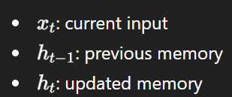
👉 Hidden state carries information forward
Input: I → love → AI
State: h1 → h2 → h3
NOTE: Each state has time associated with it.
h1 = f(x1)
h2 = f(x2, h1)
h3 = f(h2, x3)
h1
h2
h3
X1
X2
X3

Slide 24
4️⃣ A simple example of RNN in NLP
Task: Next Word Prediction
Input: "I love"
Output: "AI"
Flow:
Convert words → numbers (tokenization)
Feed sequence into RNN
Predict next word
h1 = f(x1)
h2 = f(x2, h1)
h3 = f(h2, x3)
h1
h2
h3
X1
X2
X3

Slide 25

RNN Representation
y
X1
X2
X3
X4
Xn

Slide 26
EXTRA
Xxxxxxxxxxx
xxxxxxxxxxxx

