Slide 1
There are 3 main types of RNN

Slide 2

RNN Representation
X1
X2
X3
X4
Xn

Slide 3
RNN Types
Many to many
Many to one
One to many

Slide 4
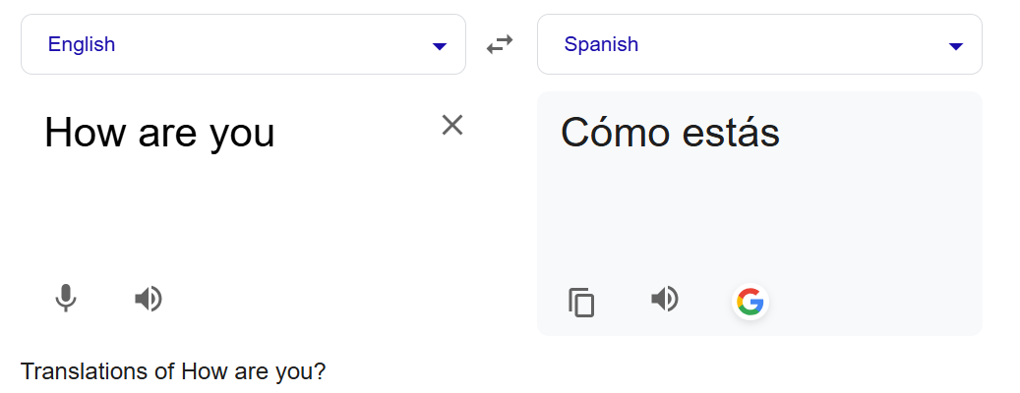
Many to Many
Language translation:
Represented as shown below
Como
Estas
X1
how
X2
are
X3
you

Slide 5
Many to Many
Named Entity Recognition
X:
John works at Loxford Academy.
X y
John → PER
works → O
at → O
Loxford → ORG
Academy → ORG
0
1
RNN detects ORG entity
0
1
X1
John
X2
works
X3
at
X4
Loxford

Slide 6
Many to Many
Named Entity Recognition
X:
John works at Loxford Academy.
X y
John → PER
works → O
at → O
Loxford → ORG
Academy → ORG
1
0
0
RNN detects PER entity
0
X1
John
X2
works
X3
at
X4
Loxford

Slide 7
Many to one
Sentiment Analysis
I love pizza -> 5 star
This movie was OK. I would not watch it again -> 3 star
Representation of Many to One NN:
5 star
I
love
pizza

Slide 8
Autocompletion by google in search/email: (Predicting only 1 word)
I want to understand deep ____ -> learning
Places near me to ___ -> eat
What is recurrent neural ___ -> network
Thanks, and _____ -> regards.

Slide 9



One to many
Music Generation
Pass 1 tone, RNN will generate sequence of music based on 1 input tone
Representation of One-to-Many NN:

Slide 10
EXTRA
Xxxxxxxxxxx
xxxxxxxxxxxx

