Slide 1
GenAI Module7 – NLP- applications-TopicModelling

Slide 2
Source: https://www.analyticsvidhya.com/blog/2021/06/part-16-step-by-step-guide-to-master-nlp-topic-modelling-using-lsa/

Slide 3
What is topic Modelling?
Topic modeling is a frequently used approach to discover hidden semantic patterns portrayed by a text corpus and automatically identify topics that exist inside it.
Namely, it’s a type of statistical modeling that leverages unsupervised machine learning to analyze and identify clusters or groups of similar words within a body of text.
For example, a topic modeling algorithm may be deployed to determine whether the contents of a document imply it’s an invoice, complaint, or contract.

Slide 4
Why topic Modelling?
The objective of analytics is to derive insights from data.
Traditionally, such data was structured, i.e. rows and columns.
Today much of the data being generated is unstructured, meaning there’s no predefined data model. Unstructured data represents > 70% of all new enterprise data. Furthermore, it’s growing faster than structured data.
So, we need new techniques to obtain relevant information from this unstructured data. This is where topic modelling comes.

Slide 5
Topic Modelling Techniques: LSA and LDA
Two popular topic modeling techniques are Latent Semantic Analysis (LSA) and Latent Dirichlet Allocation (LDA)

Slide 6
Topic Modelling Techniques: LSA(see jupyter n/b)
LSA assumes words with similar meanings will appear in similar documents. It does so by constructing a matrix containing the word counts per document, where each row represents a unique word, and columns represent each document, and then using a Singular Value Decomposition (SVD) to reduce the number of rows while preserving the similarity structure among columns. SVD is a mathematical method that simplifies data while keeping its important features. It's used here to maintain the relationships between words and documents.
To determine the similarity between documents, cosine similarity is used. This is a measure that calculates the cosine of the angle between two vectors, in this case, representing documents. A value close to 1 means the documents are very similar based on the words in them, whereas a value close to 0 means they're quite different.

Slide 7
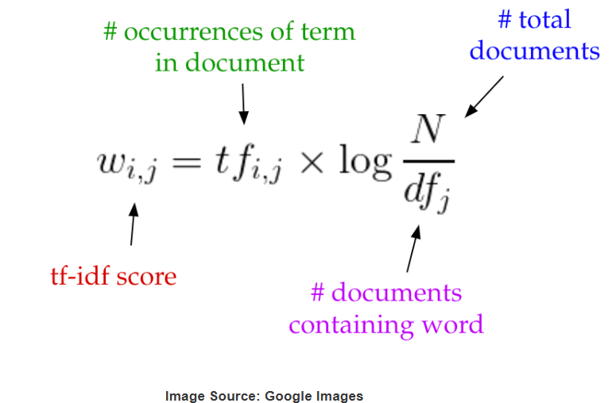
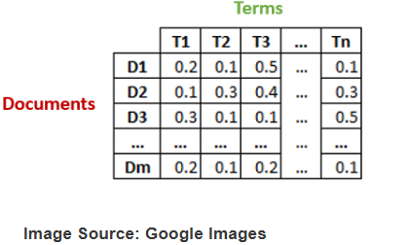
LSA explained(p1):
https://medium.com/nanonets/topic-modeling-with-lsa-psla-lda-and-lda2vec-555ff65b0b05
Step1) we construct an m × n matrix A, where m is number of documents and n is number of words in our vocabulary
- In the simplest version of LSA, each entry can simply be a raw count of the number of times the j-th word appeared in the i-th document. In practice, however, raw counts do not work particularly well because they do not account for the significance of each word in the document.
Better would be use tf-idf score as an entry in the document-term matrix. Tf-idf, or term frequency-inverse document frequency, assigns a weight for term j in document i.
Intuitively, a term has a large weight when it occurs frequently across the document but infrequently across the corpus(i.e. collection of docs). For e.g., word “see” might appear often in a document and because it’s likely fairly common in the rest of the corpus, it will have low tf-idf score. However, if the word “super-nova” appears often in a document and it is rarer in the rest of the corpus, it will have a higher tf-idf score.

Slide 8

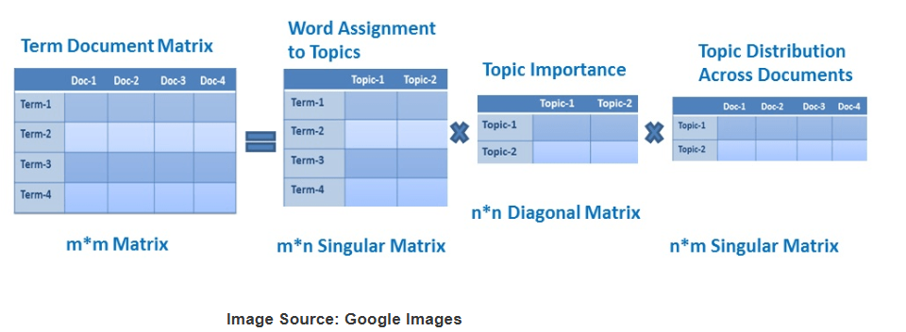

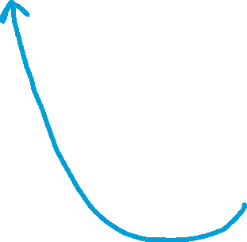


LSA explained(p2):
https://medium.com/nanonets/topic-modeling-with-lsa-psla-lda-and-lda2vec-555ff65b0b05
Step2) Here we do dimensionality reduction using truncated SVD. SVD, or singular value decomposition, is a technique in linear algebra that factorizes any matrix M into the product of 3 separate matrices: M=U*S*V, where S is a diagonal matrix of the singular values of M. Critically, truncated SVD reduces dimensionality by selecting only the t largest singular values, and only keeping the first t columns of U and V. In this case, t is a hyperparameter we can select and adjust to reflect the number of topics we want to find.

Slide 9
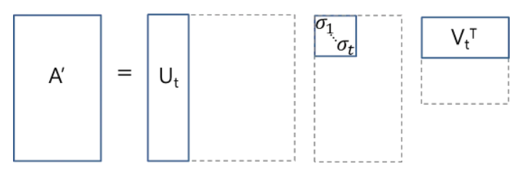
LSA explained(p3):
https://medium.com/nanonets/topic-modeling-with-lsa-psla-lda-and-lda2vec-555ff65b0b05
U ∈ ℝ^(m ⨉ t) emerges as our document-topic matrix, and V ∈ ℝ^(n ⨉ t) becomes our term-topic matrix. In both U and V, the columns correspond to one of our t topics. In U, rows represent document vectors expressed in terms of topics; in V, rows represent term vectors expressed in terms of topics.

Slide 10
LSA: Application of Document and Term Vectors
Now with the help of these document vectors and term vectors, we can easily calculate some measures such as cosine similarity to evaluate:
The similarity of different documents.
The similarity of different words.
The similarity of terms or queries and documents which will become useful in information retrieval, when we want to retrieve passages most relevant to our search query.

Slide 11
Applications of LSA
The LSA is considered the pioneer for Dimensionality Reduction algorithms.
1. The LSA can be used for dimensionality reduction. We can reduce the vector size drastically from millions to thousands without losing any context or information. As a result, it reduces the computation power and the time taken to perform the computation.
2. The LSA can be used in search engines. Latent Semantic Indexing(LSI) is the algorithm developed based on LSA, as the documents matching the given search query are found with the help of the vector that is developed from LSA.
3. LSA can also be used for document clustering. As we can see that the LSA assigns topics to each document based on the assigned topic so we can cluster the documents.

Slide 12
Topic Modelling Techniques: LDA(see jupyter n/b)
Some interesting source: https://towardsdatascience.com/light-on-math-machine-learning-intuitive-guide-to-latent-dirichlet-allocation-437c81220158/
https://www.geeksforgeeks.org/latent-dirichlet-allocation/
LDA is a generative probabilistic model that leverages Bayesian inference to find the underlying topics in a corpus of texts. It assumes each document is a combination of a small number of latent topics, and each word is generated by a particular topic.

Slide 13
Topic Modelling Techniques: LDA
2. How LDA Works:
Generative Model: LDA is a generative model, meaning it assumes that documents are generated from a process where each document is a mixture of underlying topics, and each topic is a mixture of words.
Mixture of Topics: Each document is represented as a probability distribution over the topics, indicating which topics are most relevant to that document.
Mixture of Words: Each topic is represented as a probability distribution over the words, indicating which words are most likely to appear in that topic.
Latent: The topics themselves are "latent" variables, meaning they are not directly observed but inferred from the data.
Dirichlet Distribution: LDA assumes that both the topic proportions within a document and the word probabilities within a topic follow a Dirichlet distribution, a probability distribution that describes the probabilities of multiple events.
3. Key Steps in LDA:
Data Preparation: The text data needs to be preprocessed, including cleaning, removing stop words, and creating a vocabulary of words.
Model Training: The LDA model is trained on the prepared data, which involves inferring the latent topics and their associated word distributions.
Topic Interpretation: Once the model is trained, the topics can be interpreted by examining the words with the highest probabilities within each topic.
Document Analysis: The model can be used to determine which topics are most relevant to each document.

Slide 14
Applications of Topic Modelling
Document Classification: It helps in automatically classifying documents into predefined categories based on their content.
Customer Feedback Analysis: Companies use topic modeling to analyze customer reviews and feedback to identify common issues and areas for improvement.

