Slide 2
1. What is Image Processing?
Definition: Image processing is the technique of manipulating images to extract useful information.
Basic idea: An image = matrix of pixel values
Grayscale → 2D matrix
RGB → 3D matrix (Height × Width × Channels)
Example:
Pixel value range: 0–255
0 = black, 255 = white

Slide 3
Key operations:
Resizing
Filtering (blur, sharpen)
Edge detection
Thresholding
Why important?
Computer vision systems rely on it
Used in medical imaging, self-driving cars, face recognition

Slide 4
2. Traditional Feature Extraction
Before deep learning, we manually designed features.
👉 Idea: Convert image → meaningful numbers (features)
Examples: SURF , SIFT, HOG - No longer used widely

Slide 5
🔹 2.1 SIFT (Scale-Invariant Feature Transform)
Goal: Detect keypoints that are:
Scale invariant (zoom doesn’t matter)
Rotation invariant
Steps:
Detect keypoints (corners/blobs)
Assign orientation
Generate descriptor (vector of features)
Output:
Keypoints + 128-dimensional vector per keypoint
Use cases:
Object recognition
Image matching
Strength:
Very robust
Weakness:
Slow, computationally expensive

Slide 6
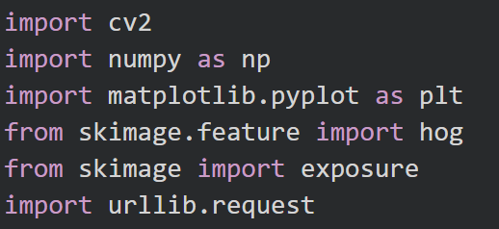
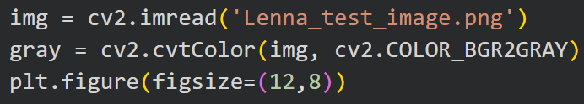
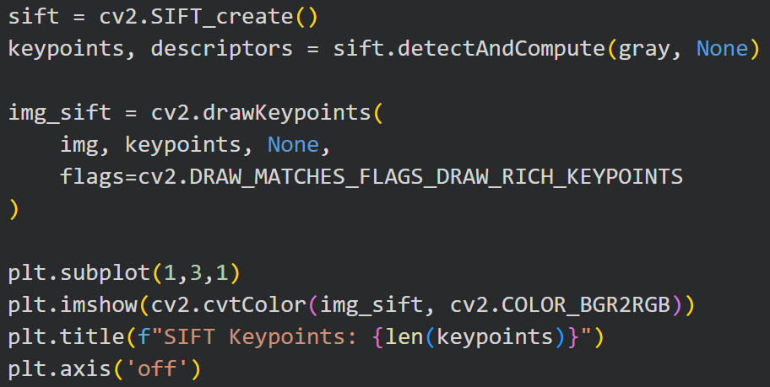

Slide 7
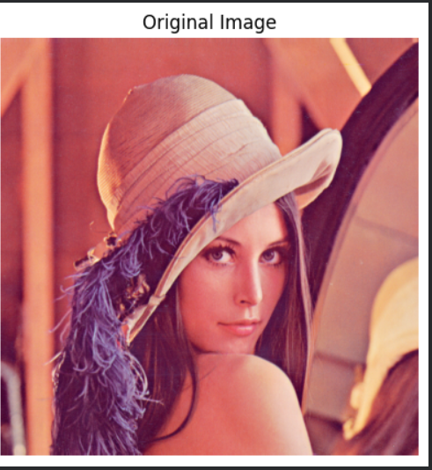
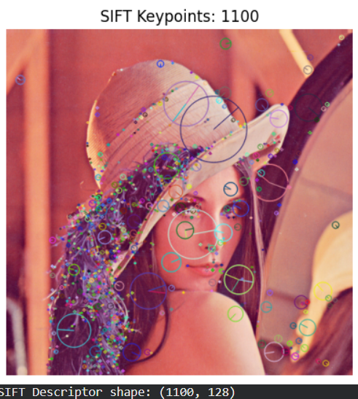

Slide 8
🔹 2.2 SURF (Speeded-Up Robust Features)
Goal: Faster version of SIFT
How it's different:
Uses approximations → faster computation
Uses integral images
Pros:
Faster than SIFT
Cons:
Slightly less accurate

Slide 9
🔹 2.3 HOG (Histogram of Oriented Gradients)
Idea: Capture edge directions (gradients) in an image
Steps:
Divide image into small cells
Compute gradients (edges)
Create histogram of directions
Normalize across blocks
Output:
Feature vector representing shape
Best for:
Human detection
Object detection
Key intuition: 👉 Objects are defined by edges, not raw pixels

Slide 10
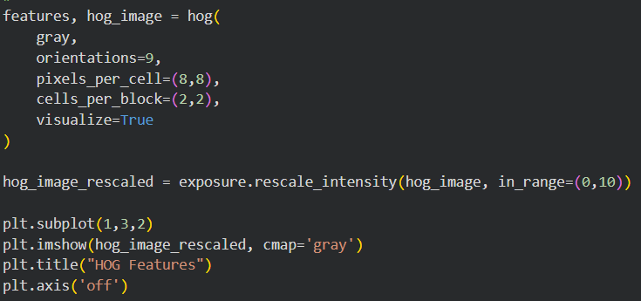
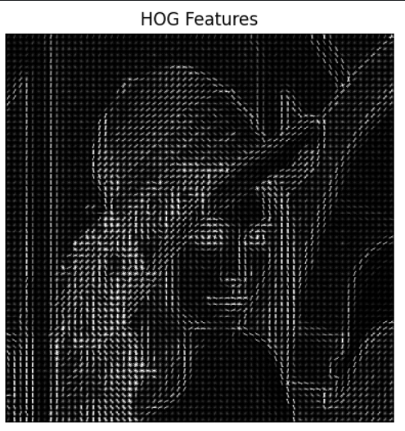

Slide 11
Method | Strength | Weakness
SIFT | Very robust | Slow
SURF | Faster | Less precise
HOG | Simple, good for shapes | Not good for complex objects
3. Why Traditional Methods Failed?
Manual feature design
Not scalable for complex tasks
Struggle with:
Lighting changes
Background noise
Large datasets
👉 This led to Deep Learning

