Slide 1
A/B Testing An example

Slide 2

Scenario: Website Button Color Test
You run an online learning platform and want to test:
Version A (Control): Blue “Enroll Now” button
Version B (Variant): Green “Enroll Now” button
Goal → Check if Version B increases conversion rate (clicks / users) at 5% significance
Enroll Now
Enroll Now

Slide 3
Data Collected
Group | Users | Conversions
A (Blue) | 1000 | 200
B (Green) | 1000 | 240
Enroll Now
Enroll Now

Slide 4
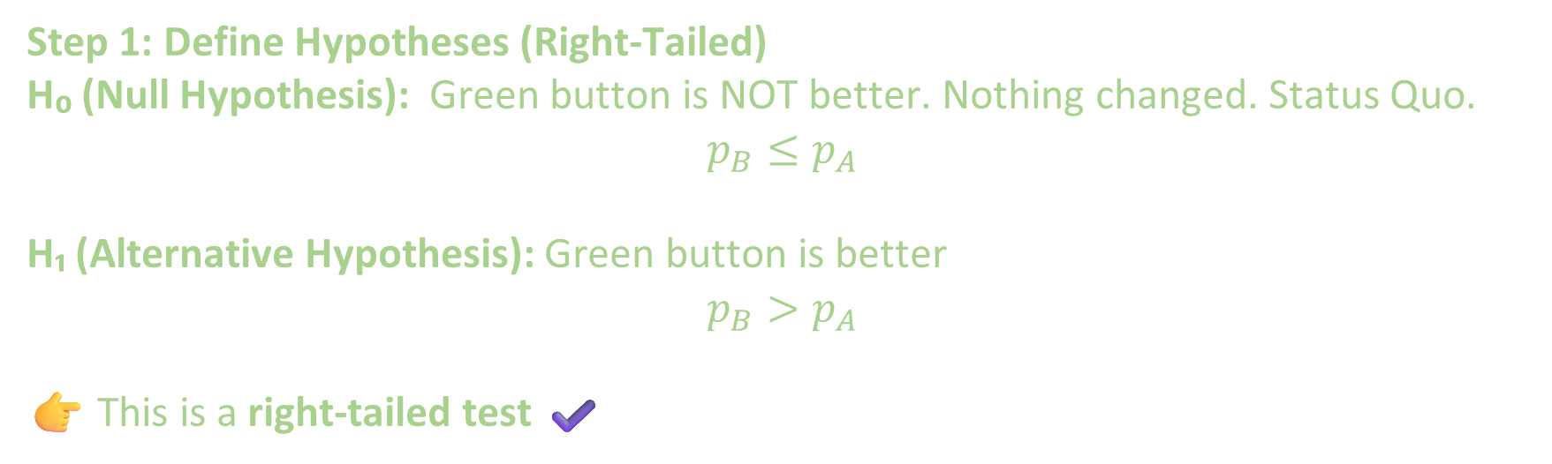
Step 1: Define Hypotheses (Right-Tailed)
H₀ (Null Hypothesis): Green button is NOT better. Nothing changed. Status Quo.
$$p_{B}≤p_{A}$$
H₁ (Alternative Hypothesis): Green button is better
$$p_{B}>p_{A}$$
👉 This is a right-tailed test ✔️
Enroll Now
Enroll Now

Slide 5
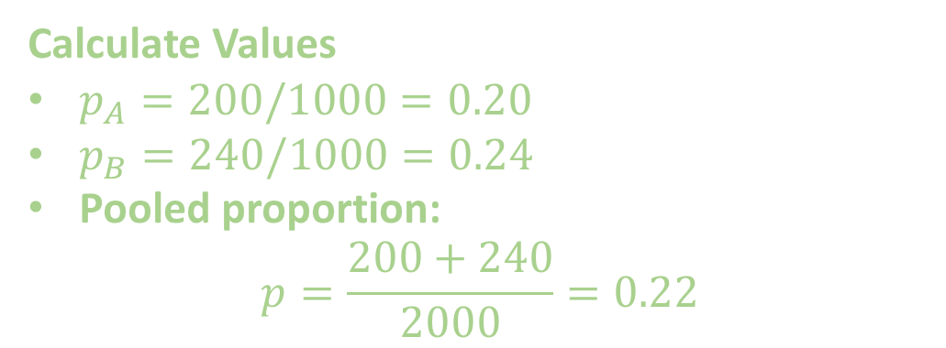
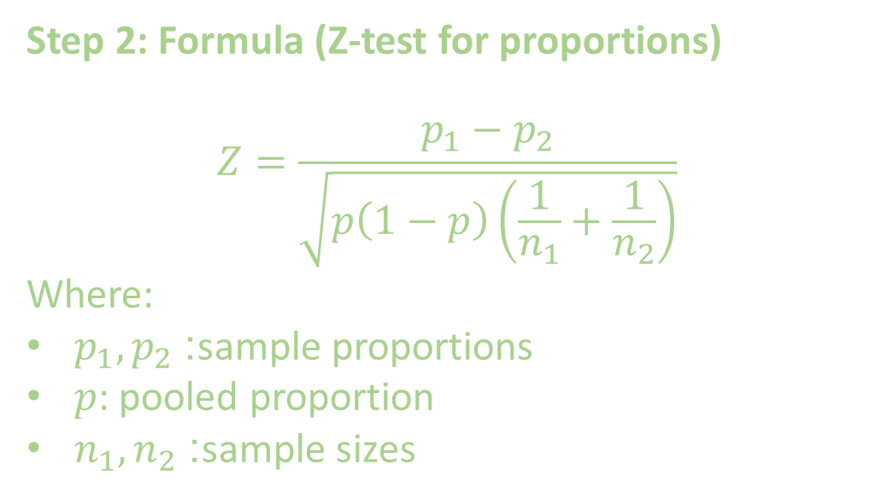

Step 2: Formula (Z-test for proportions)
$$Z=\frac{p_{1}−p_{2}}{\sqrt{p\left(1−p\right)\left(\frac{1}{n_{1}}+\frac{1}{n_{2}}\right)}}$$
Where:
$p_{1},p_{2}$: sample proportions
$p$: pooled proportion
$n_{1},n_{2}$: sample sizes
Calculate Values
$p_{A}=200/1000=0.20$
$p_{B}=240/1000=0.24$
Pooled proportion:
$$p=\frac{200+240}{2000}=0.22$$
Compute Z-score
$$Z≈−2.04$$

Slide 6
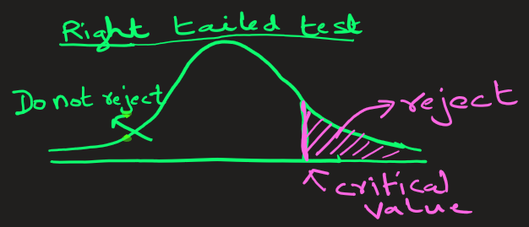
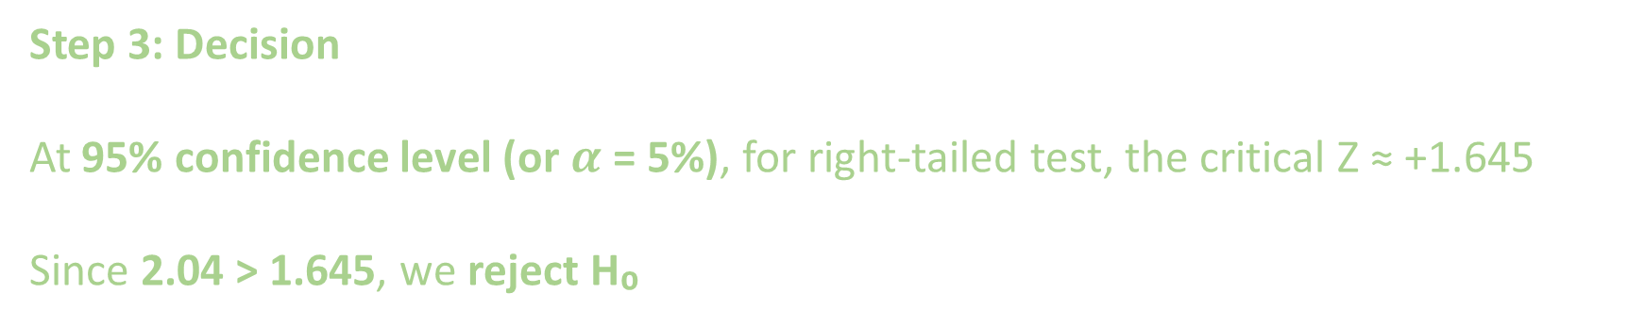
Step 3: Decision
At 95% confidence level (or $α$ = 5%), for right-tailed test, the critical Z ≈ +1.645
Since 2.04 > 1.645, we reject H₀

Slide 7
Step 4: Conclusion (Business Insight)
👉 The green button performs significantly better than the blue one.
Action: Deploy Version B (Green button) → increases conversions
Enroll Now

Slide 8
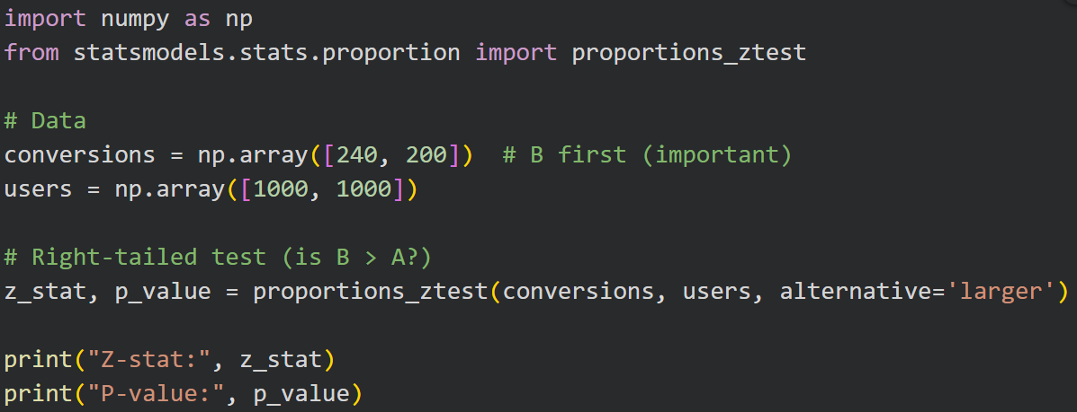
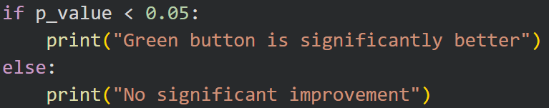
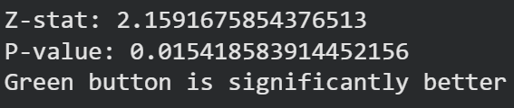

Slide 9
Recap
A/B testing = compare two versions
Z-test = checks if difference is real or just luck
If Z-score is large → difference is statistically significant

Slide 10
Assignment –
TODO…The critical value should not be negative
Investigate

Slide 11
Scenario: Comparing Two ML Models (A/B Test)
You deployed two recommendation models on your platform:
Model A (Old) : Logistic Regression
Model B (New): Deep Learning Model
Goal → Check if Deep Learning model (Model B) significantly improves CTR: i.e. user engagement (click-through rate, CTR). Use significance level 5%.
Data Collected
Model | Users Shown Recommendations | Clicks
A (old) | 5000 | 600
B (New) | 5000 | 750

Slide 12
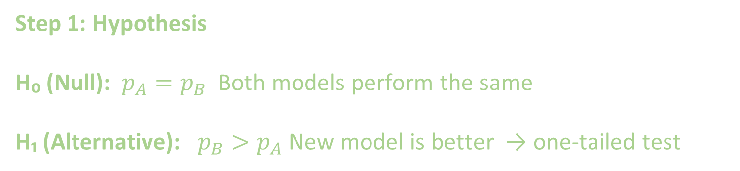
Step 1: Hypothesis
H₀ (Null): $p_{A}=p_{B}$ Both models perform the same
H₁ (Alternative): $p_{B}>p_{A}$ New model is better → one-tailed test

Slide 13


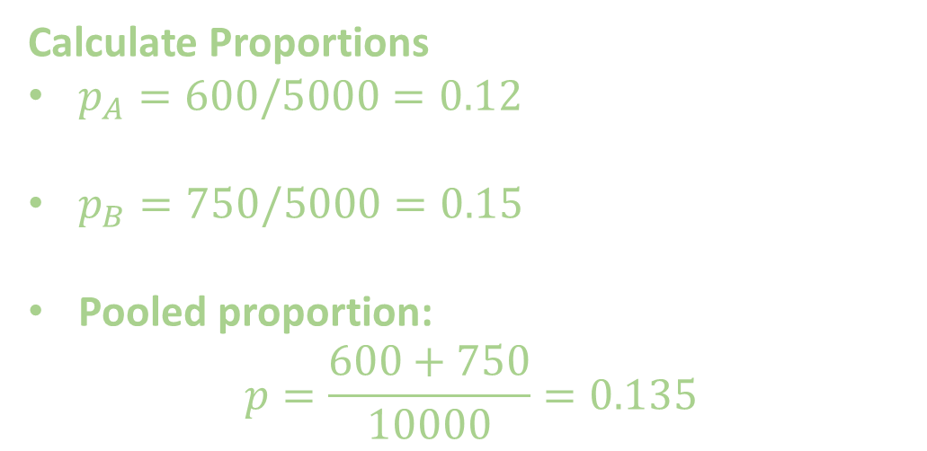
Step 2: Z-test Formula
$$Z=\frac{p_{1}−p_{2}}{\sqrt{p\left(1−p\right)\left(\frac{1}{n_{1}}+\frac{1}{n_{2}}\right)}}$$
Calculate Proportions
$p_{A}=600/5000=0.12$
$p_{B}=750/5000=0.15$
Pooled proportion:
$$p=\frac{600+750}{10000}=0.135$$
Compute Z-score
$$Z≈−4.35$$

Slide 14
Step 3: Decision
For one-tailed test (α = 0.05) → critical Z ≈ -1.645
Since Z = -4.35 < -1.645, we reject H₀
Step 4: Conclusion (ML Insight)
👉 The Deep Learning model (Model B) significantly improves CTR.

Slide 15
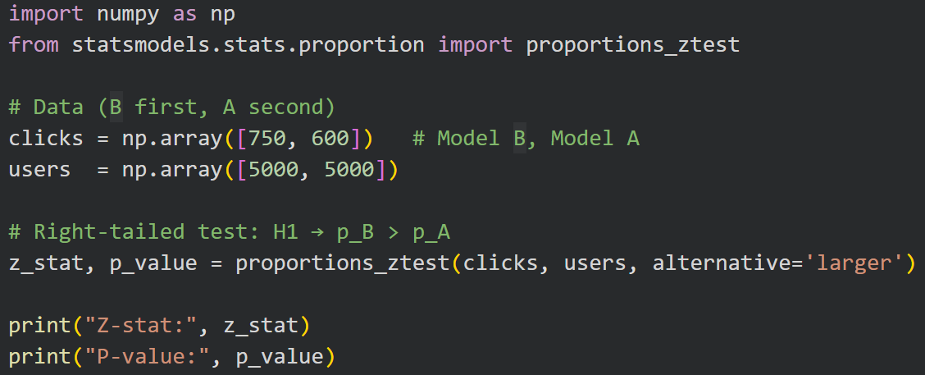
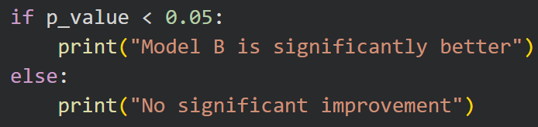
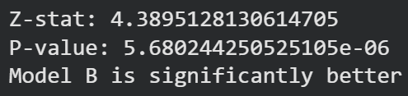

Slide 16
STOP

