Slide 1
Chi Square Test

Slide 2
What is the Chi-Square Test?
The Chi-Square Test is a statistical test used to examine the relationship between categorical variables.
Blood | Age group | Sleep_level(1 - 10)
A | young | 2
B | young | 4
A | middle | 3
A | Old | 8

Slide 3
What type of variables is it used for?
Categorical variables only
These are variables that represent groups or categories, not numbers.
Example:
Gender: Male, Female
Blood Type: A, B, AB, O
Favorite Color: Red, Blue, Green
You cannot use it directly for continuous variables like height, weight, or temperature unless you first convert them into categories (e.g., "short", "tall").
Blood | Age group | Sleep_level(1 - 10)
A | young | 2
B | young | 4
A | middle | 3
A | Old | 8
Height
1.4
1.1
1.9
1.8
1.9
Height
Short
Short
Tall
Tall
Tall

Slide 4
Why do we need it?
We use the Chi-Square test to answer questions like:
Is there an association between gender and voting preference?
Does smoking status affect whether someone gets lung disease?
Are people from different cities equally likely to prefer a particular brand?
In short, it's about checking whether observed differences between groups are statistically significant or could have happened just by chance.
Gender | Voted_for
M | Party_a
M | Party_a
F | Party_b
M | Party_c

Slide 5
2 Types of Chi-Square Tests
Chi-Square Test of Independence
Tests if two categorical variables are related.
Example: Is there a relationship between education level and job type?
Chi-Square Goodness-of-Fit Test
Tests if the observed distribution of a single categorical variable matches an expected distribution.
Example: Is a die fair (i.e., all numbers appear equally)?
education | Job_type
10 | Mgr
11 | Clrk
10 | Clrk
12 | Janitor
Dice
2
3
2
5
3

Slide 6
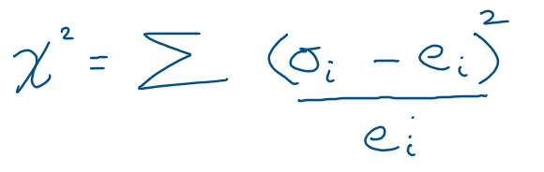
How does the Chi-Square Test work?
Here’s the basic idea:
Observe data (what actually happened).
Calculate expected data (what you would expect if there was no relationship).
Compare observed vs expected.
Compute a statistic called Chi-Square (χ²):
If the chi-square value is large, it suggests there’s a significant difference between observed and expected values — i.e., something is going on.

Slide 7
1) TEST FOR INDEPENDENCE

Slide 8

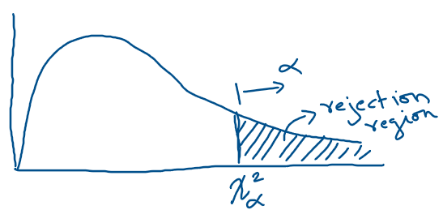
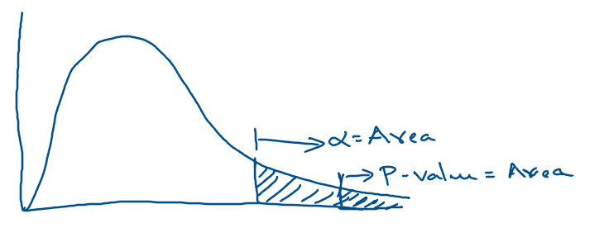
Steps for Chi-Square Test of Independence
4. Calculate the Degrees of Freedom
D.f. = (Number of Rows − 1 )×( Number of Columns − 1)
1) Set Up the Hypothesis
Null Hypothesis (H₀): The variables are independent
(no relationship).
Alternative Hypothesis (H₁): The variables are associated (some relationship).
5. Find the Critical Value
Use a Chi-Square distribution table or software (Excel, Python, R).
Compare your χ² statistic with the critical value: If χ² > critical value, reject the null hypothesis.
2) Calculate the Expected Counts E for each cell
6. Summarize
3) Compute the Chi-Square Statistic
Add up all values for all cells.

Slide 9
We can also use P-value:
4. Calculate the Degrees of Freedom
D.f. = (Number of Rows−1)×(Number of Columns−1)
1) Set Up the Hypothesis
Null Hypothesis (H₀): The variables are independent (no relationship).
Alternative Hypothesis (H₁): The variables are associated (some relationship).
5. Find the P-Value
Use software (Excel, Python, R).
If p-value < 0.05 (common threshold for α), reject the null hypothesis.
2) Calculate the Expected Counts E for each cell
6. Summarize
3) Compute the Chi-Square Statistic
Add up all values for all cells.

Slide 10
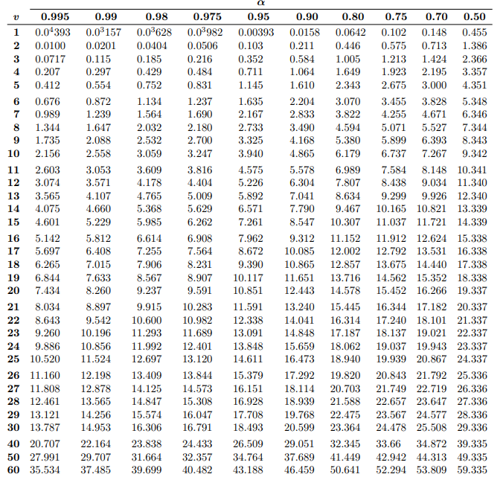
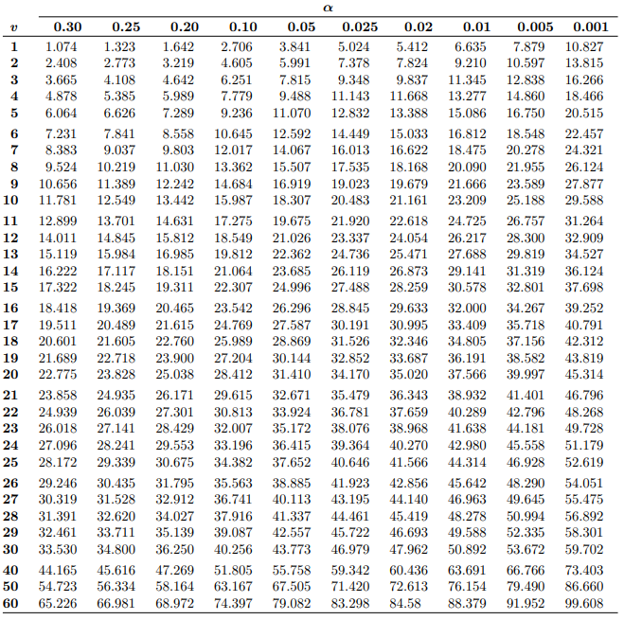
How to find critical value using d.f. , α and Chi square table ?
Given d.f. = 1 , α = 0.05, find critical value. Answer: 3.841
Given d.f. = 4 , α = 0.025, find critical value. Answer: 11.143

Slide 11
Example: Chi-Square Test of Independence(see jupyter n/b and excel sheet)
Question: Following is the result of survey on whether male and female like certain product. At α = 0.05, can it be concluded that the there is a relationship between gender and preference for a product?
 | Like Product | Don’t Like Product | Total
Male | 30 | 20 | 50
Female | 10 | 40 | 50
Total | 40 | 60 | 100

Slide 12
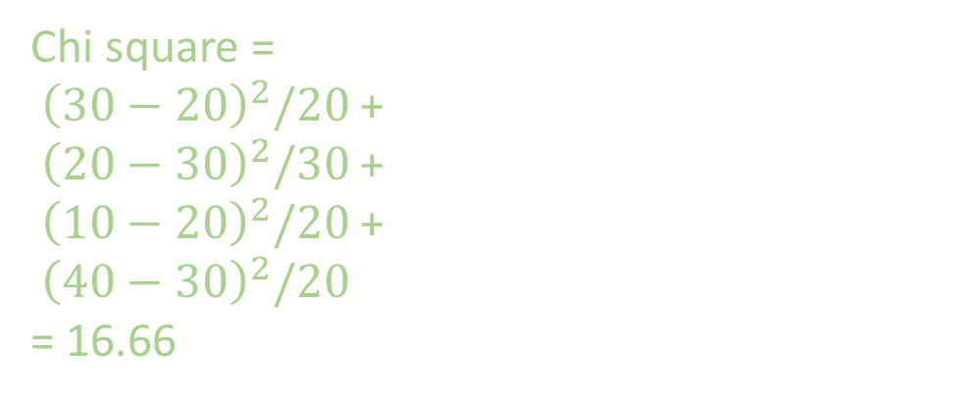
Solution:
1) Hypothesis:
Null Hypothesis (H₀): Gender and preference are independent (no relationship).
Alternative Hypothesis (H₁): There is a relationship between gender and preference.
3. Calculate Chi using the formula:
 | Like | Don’t Like
Male | o = 30 e = 20 | o = 20 e = 30
Female | o = 10 e = 20 | o = 40 e = 30
2) Calculate Expected Counts
Use the formula:
Chi square =
${\left(30−20\right)}^{2}/20$ +
${\left(20−30\right)}^{2}/30$ +
${\left(10−20\right)}^{2}/20$ +
${\left(40−30\right)}^{2}/20$
= 16.66
For example, expected count for male and like product:
e = (50*40)/100 = 20
 | Like | Don’t Like
Male | e = 20 | e = 30
Female | e = 20 | e = 30

Slide 13
4. d.f = (2-1)(2-1) = 1
5. At α = 0.05 , with d.f. = 1, using the table we find the critical value 3.841
6. Since 3.841 < 16.66, so we reject the null hypothesis.
There is a statistically significant relationship between gender and product preference.

Slide 14
Now we redo the previous question, but use P-value.
Question: Following is the result of survey on whether male and female like certain product. At α = 0.05, can it be concluded that the there is a relationship between gender and preference for a product?
 | Like Product | Don’t Like Product | Total
Male | 30 | 20 | 50
Female | 10 | 40 | 50
Total | 40 | 60 | 100

Slide 15
Solution:
1) Hypothesis:
Null Hypothesis (H₀): Gender and preference are independent (no relationship).
Alternative Hypothesis (H₁): There is a relationship between gender and preference.
3. Calculate Chi using the formula:
 | Like | Don’t Like
Male | o = 30 e = 20 | o = 20 e = 30
Female | o = 10 e = 20 | o = 40 e = 30
2) Calculate Expected Counts
Use the formula:
Chi square =
${\left(30−20\right)}^{2}/20$ +
${\left(20−30\right)}^{2}/30$ +
${\left(10−20\right)}^{2}/20$ +
${\left(40−30\right)}^{2}/20$
= 16.66
For example, expected count for male and like product:
e = (50*40)/100 = 20
 | Like | Don’t Like
Male | e = 20 | e = 30
Female | e = 20 | e = 30

Slide 16
4. d.f = (2-1)(2-1) = 1
5. At chi square=16.66, with d.f = (2-1)(2-1) = 1, using table we find P-value = .000045
6. Since 0.000045 < 0.05 , so we reject the null hypothesis.
There is a statistically significant relationship between gender and product preference.

Slide 17
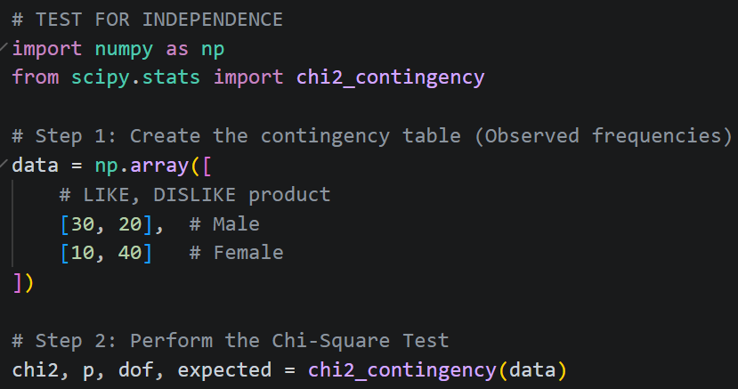

Slide 18
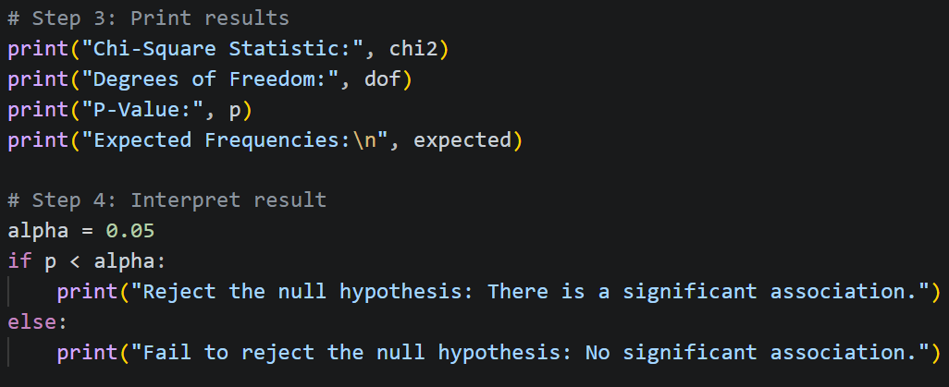
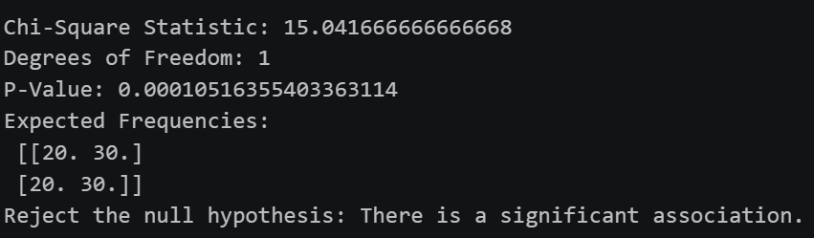

Slide 19
2) Goodness-of-Fit Test

Slide 20

Goal of Goodness-of-Fit Test
You want to check whether the distribution of a single categorical variable matches some expected distribution.
Example (see jupyter n/b): You perform an experiment to check if the dice is fair. You roll the dice total of 60 times and record its observed face.
Face | Observed
1 | 8
2 | 10
3 | 9
4 | 12
5 | 11
6 | 10
Total | 60
Question:
At α = 0.05 , can we conclude that the die is fair,
i.e., does each face have an equal probability?

Slide 21
Step 1: Hypotheses
Null Hypothesis (H₀): The die is fair (each face has equal probability: 1/6)
Alternative Hypothesis (H₁): The die is not fair (some faces are more/less likely)
Step 2: Calculate Expected Frequencies
If the die is fair, then for 60 rolls, each face should appear:
E=1/6×60=10
So expected frequency for each face is 10.
Face | Observed | Expected
1 | 8 | 10
2 | 10 | 10
3 | 9 | 10
4 | 12 | 10
5 | 11 | 10
6 | 10 | 10
Total | 60

Slide 22
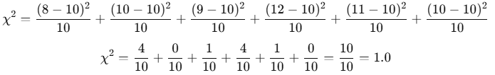
Step 3: Compute Chi-Square Statistic
Face | Obs | Exp
1 | 8 | 10
2 | 10 | 10
3 | 9 | 10
4 | 12 | 10
5 | 11 | 10
6 | 10 | 10
Step 4: Degrees of Freedom
D.f. = Number of categories − 1 = 6−1 = 5
Step 5: OPTION1: Using P-value
Look Up p-value
Using a Chi-Square table or software we find using χ2 = 1 and d.f. = 5, the p-value ≈ 0.96.
Since p-value > 0.05, we fail to reject the null hypothesis.
The die appears fair.

Slide 23
Step 5: OPTION2: Using critical value
Using a Chi-Square table, at α = 0.05 , with d.f = 5, we find the critical value 11.07
Since 1 < 11.07, we fail to reject the null hypothesis.
The die appears fair.

Slide 24
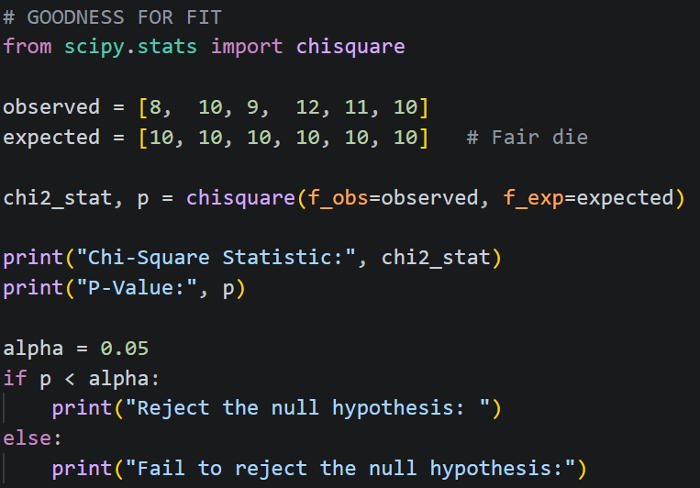
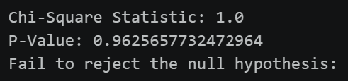

Slide 25
Dggfdfgf
gdfgfd

