Slide 2
DEMONSTRATE using Julius AI

Slide 3
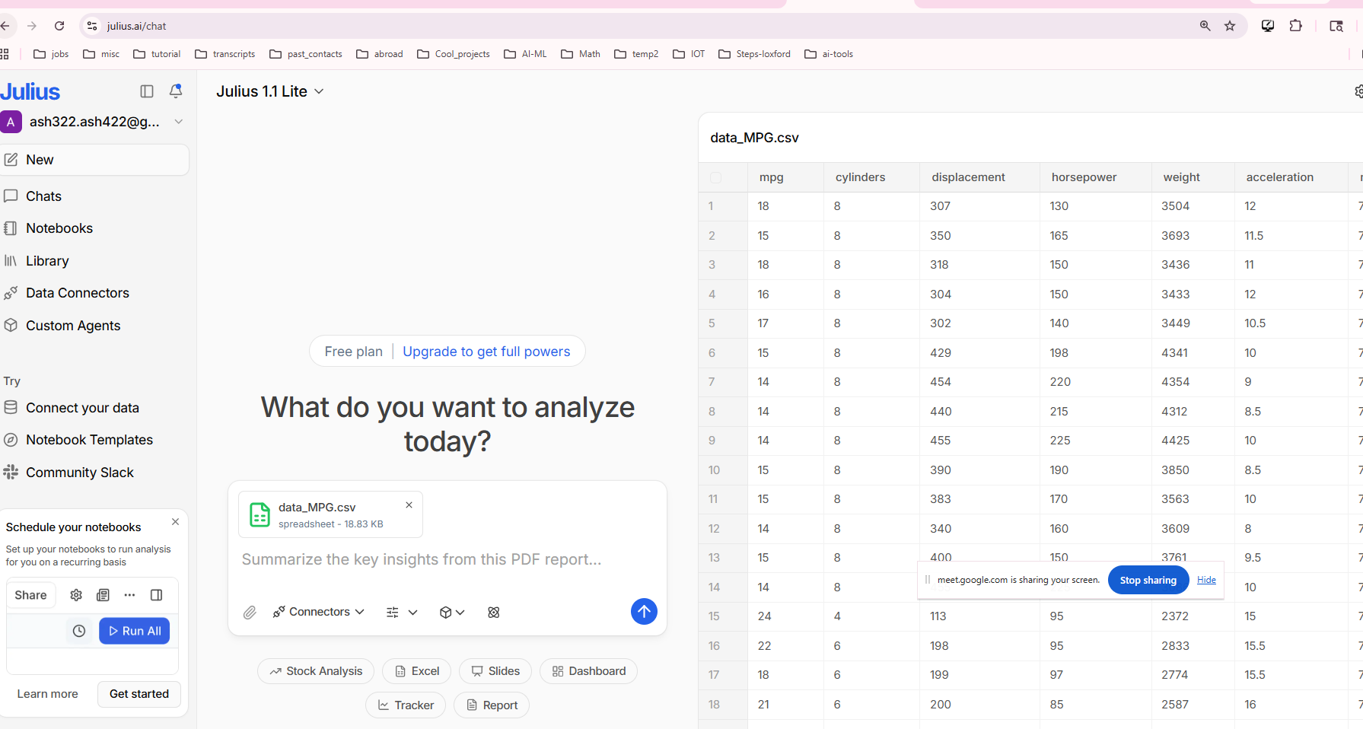


Slide 4
Give descriptive stats

Slide 5
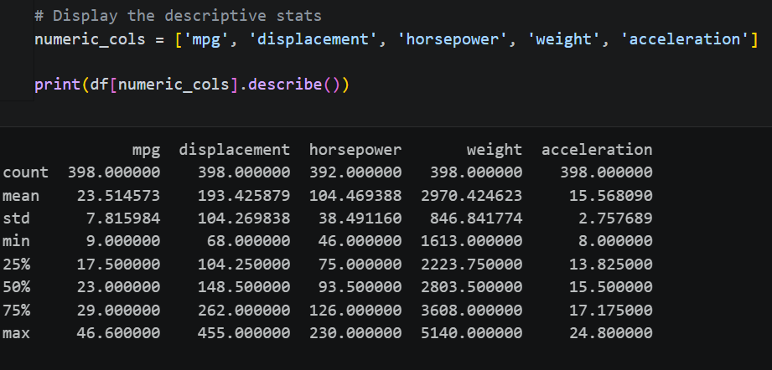
What is the count, min, max , standard deviation, 25th percentile of mpg column

Slide 6
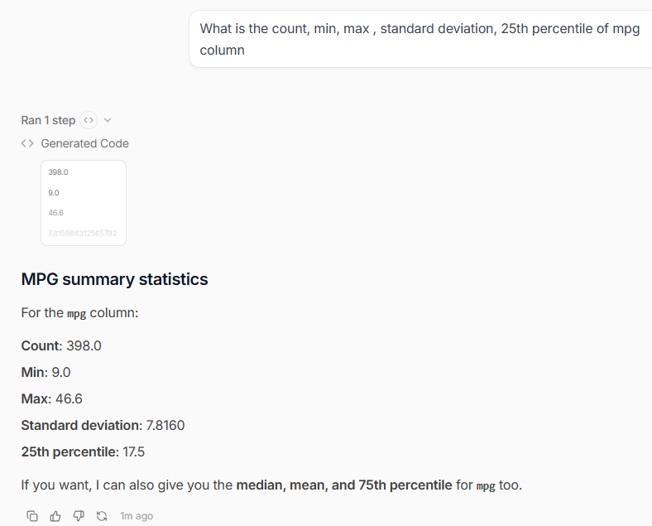

Slide 7
RUN1
Natural Language → Analysis (CORE Julius strength)
Start with simple prompts:
Show correlation between horsepower and mpg”
What factors affect MPG the most?
Find trends over model years
👉 Julius will:
auto-generate code
run analysis
visualize results
💡 Key point:
“This replaces manual pandas + matplotlib coding”

Slide 8
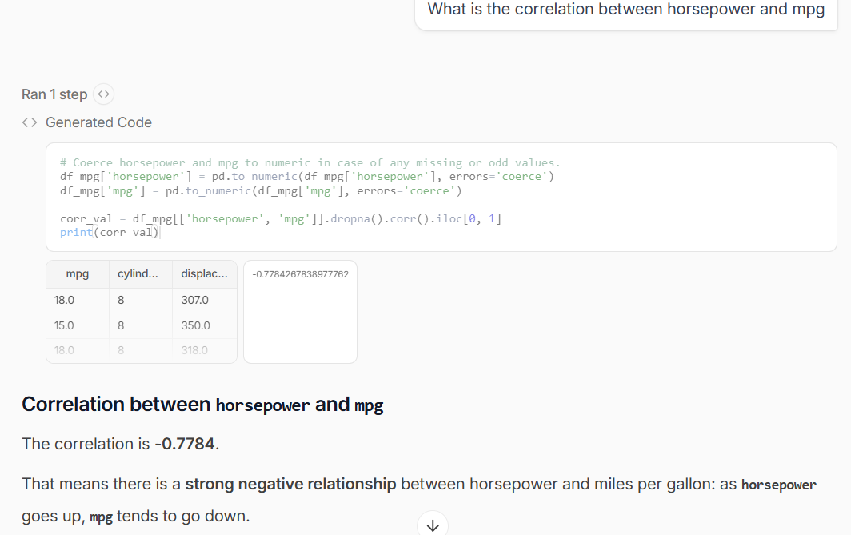


Slide 9
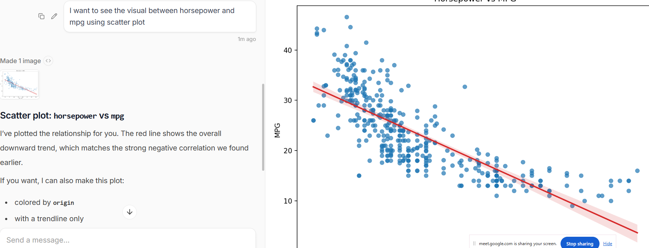



Slide 10
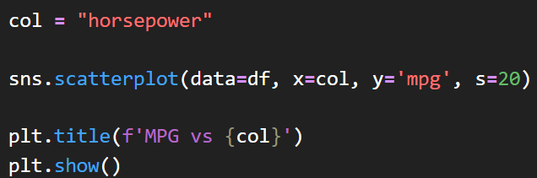
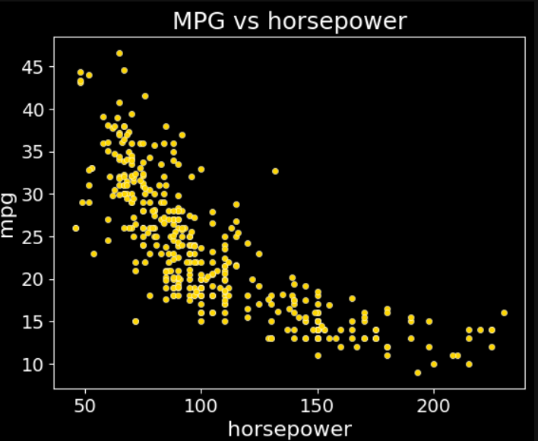
Let’s compare with our python code that was done in jupyter

Slide 11
Run 2:
Deeper analysis of column mpg

Slide 12
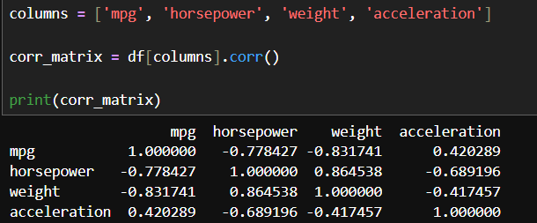
I want to see which columns have lowest and highest correlation with mpg
Using the jupyter notebook code, the answer is weight (-0.831) and acceleration (0.42)

Slide 13
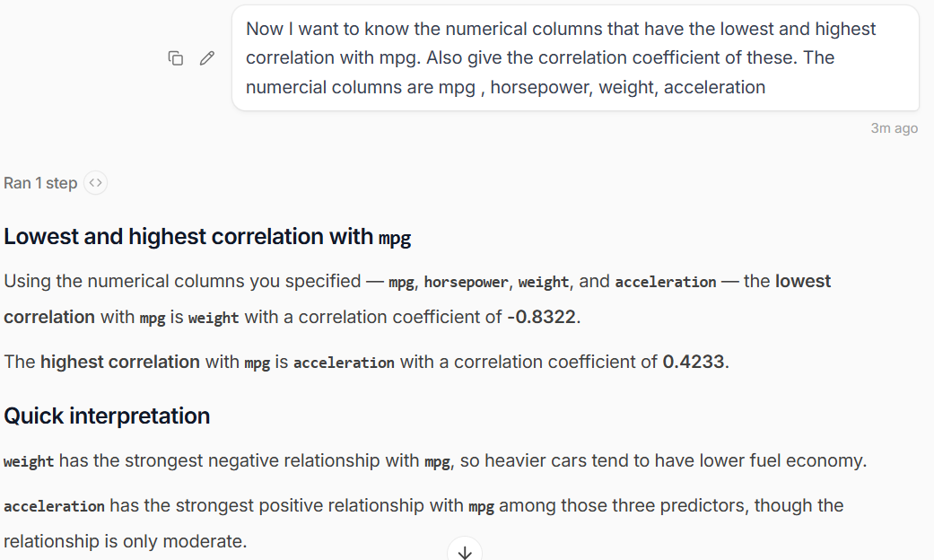

Output from Julius AI

Slide 14
Run 3:
Auto Visualization
Ask:
Compare mpg across origin
Plot mpg vs weight
Show distribution of horsepower

Slide 15
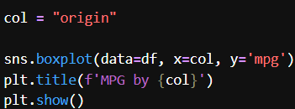
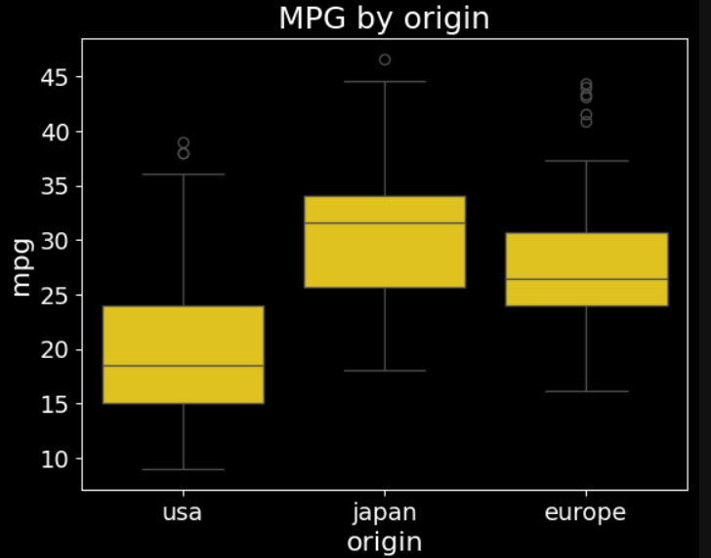
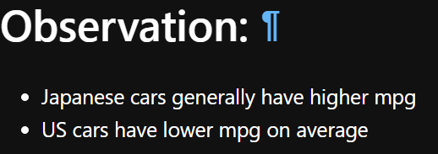
I want to see which cars have better mpg: Is it Japan, Europe or USA

Slide 16

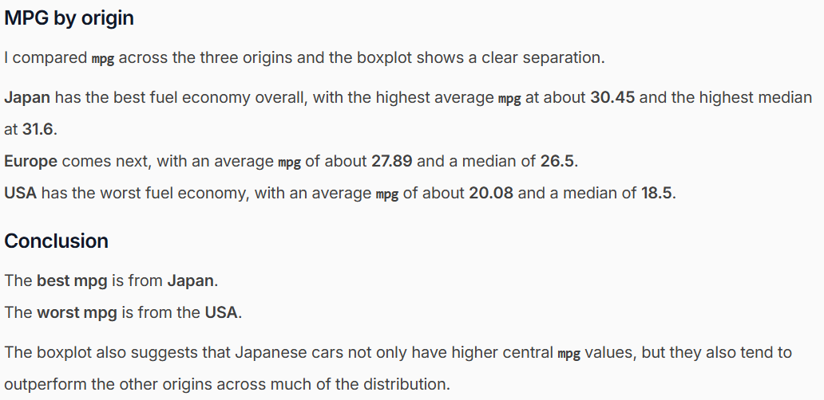
Now using Julius ai

Slide 17
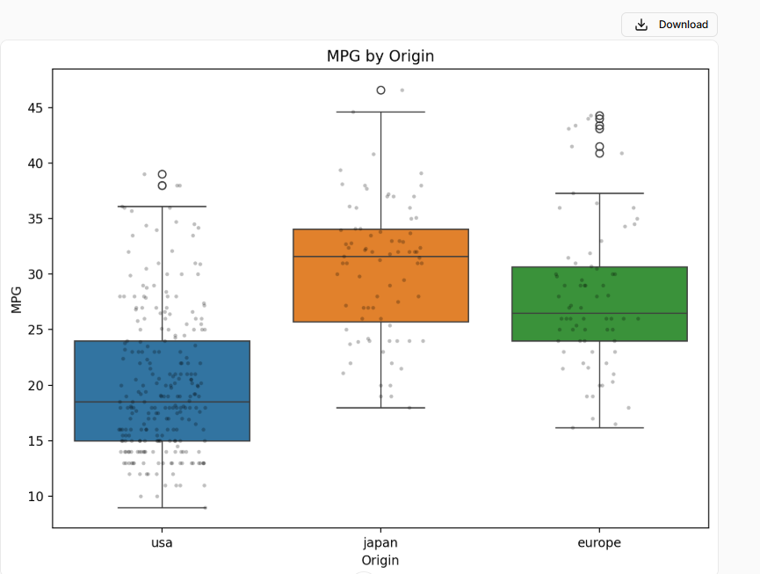

Slide 18
Run 4:

Slide 19
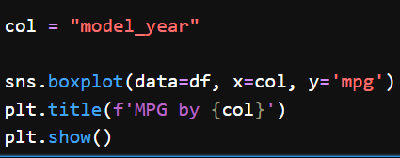
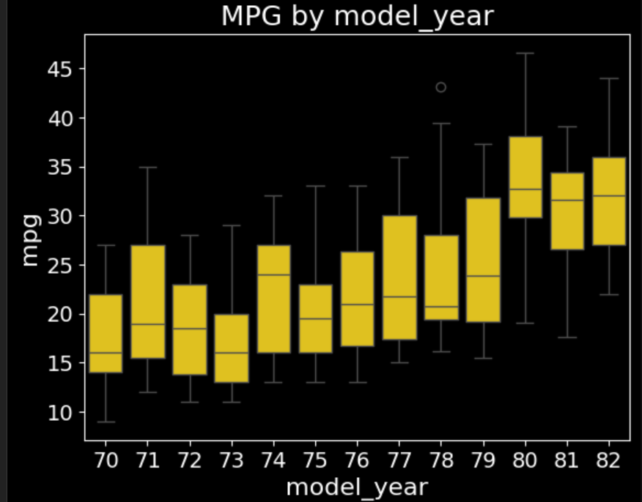
Compare the mpg and the model year. Has there been any correlation
We see that with years, the mpg has been increasing

Slide 20

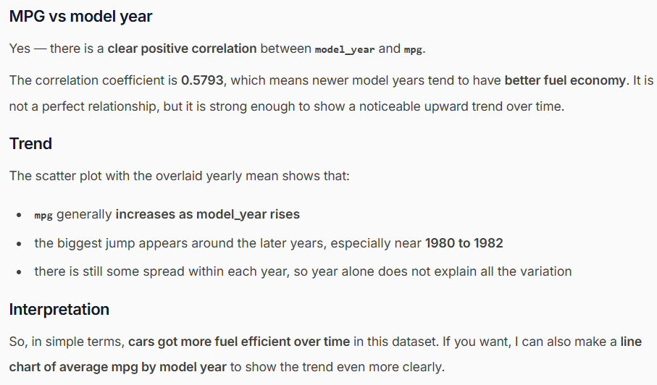

Slide 21
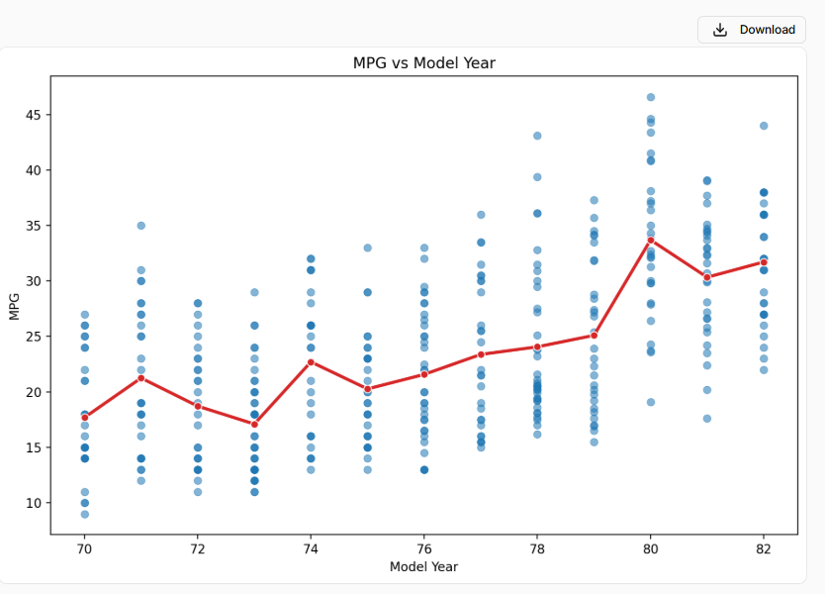

Slide 22
Data Cleaning via AI
MPG dataset often has missing horsepower.
Try:
“Check for missing values”
“Fill missing horsepower intelligently”
👉 Julius will:
detect issues
suggest fixes
💡 Key moment:
AI-assisted preprocessing vs manual cleaning

Slide 23
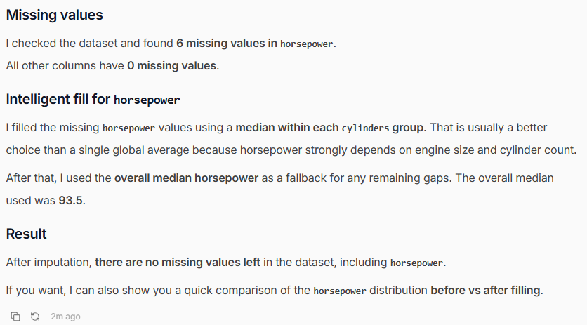

Slide 24
Feature Importance
Ask:
“Which features impact mpg the most?”
👉 Julius may:
train model
show importance ranking
💡 Key points about AI tool:
explainability
model reasoning

Slide 25

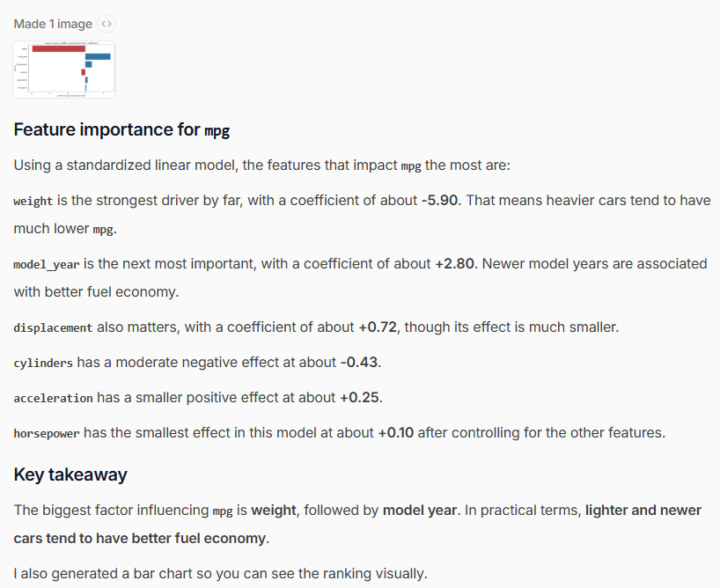

Slide 26
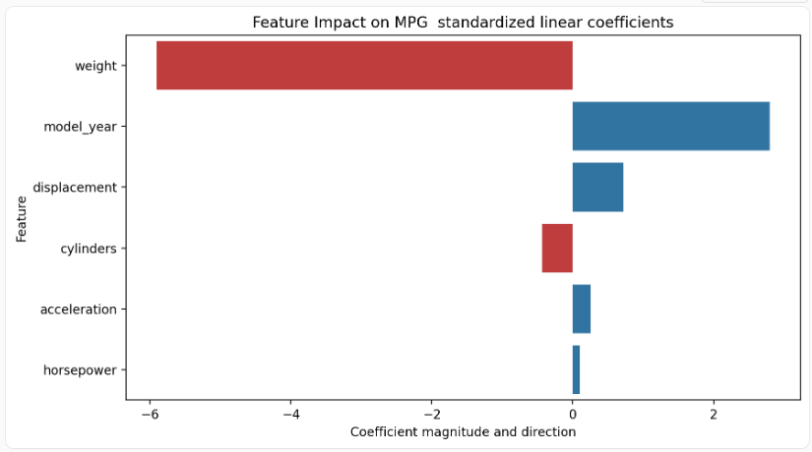

Slide 27
Build ML Model (No Code ML)
Prompt:
“Build a model to predict mpg”
Then:
“Evaluate the model”
“Improve performance”
👉 Julius handles:
train/test split
model training
metrics
💡Key points:
End-to-end ML pipeline in minutes

Slide 28
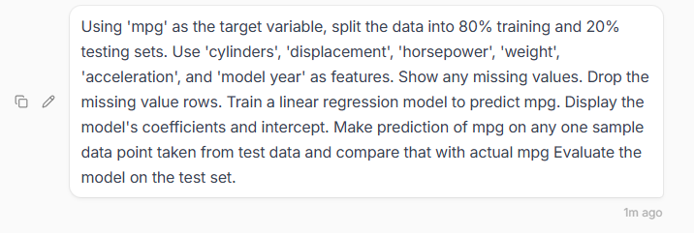
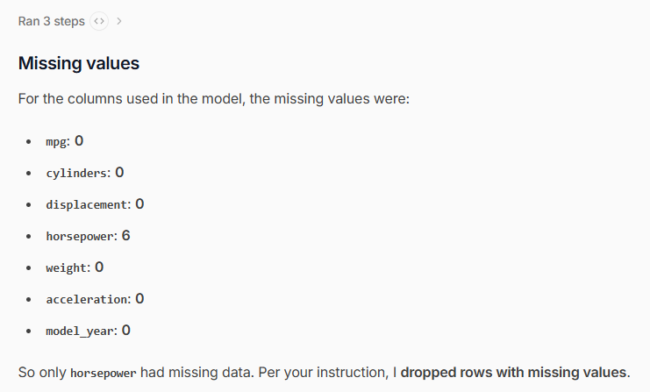

Slide 29
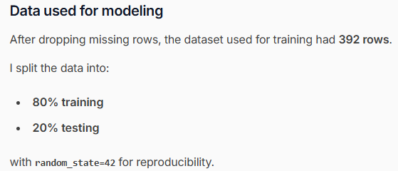
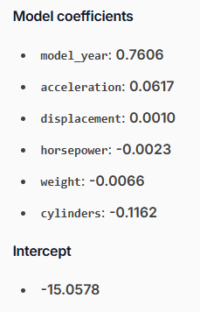
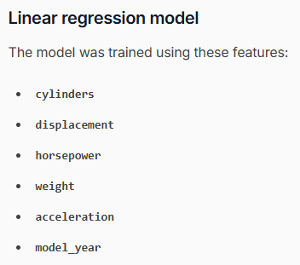

Slide 30
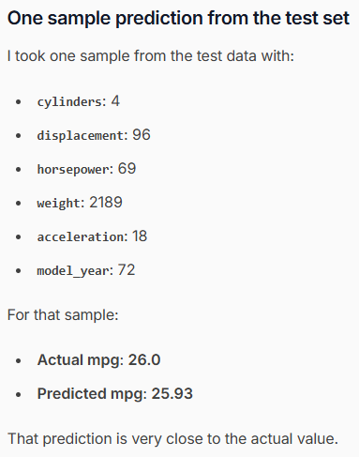
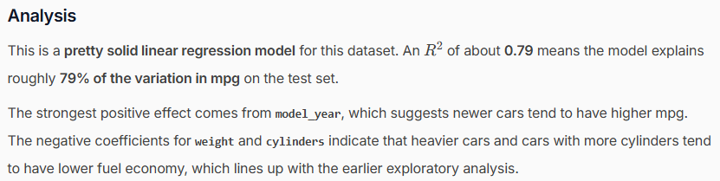
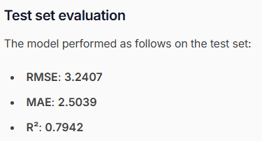

Slide 31

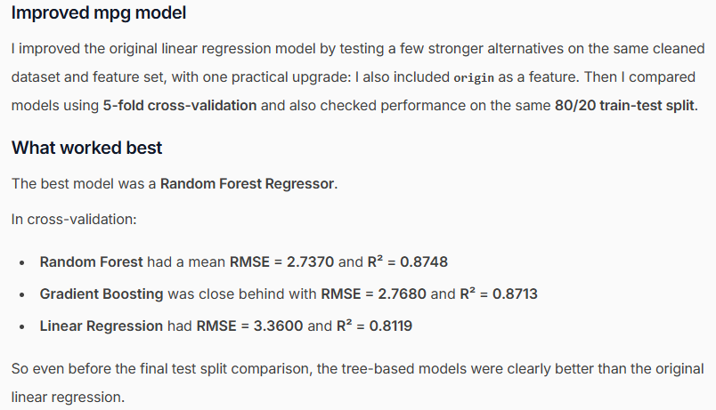
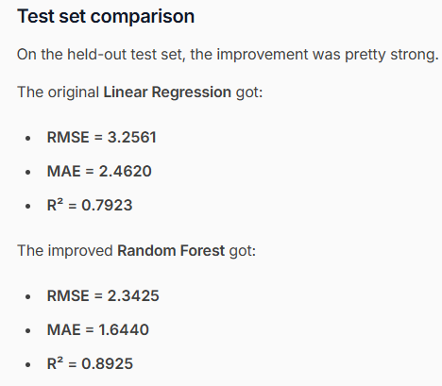
Now I asked to improve the model

Slide 32
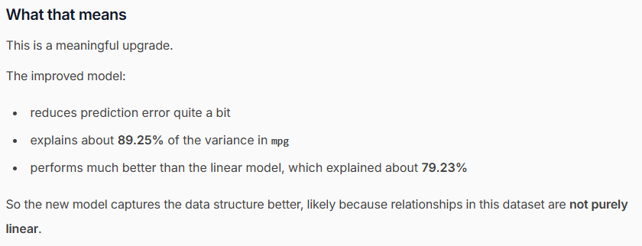
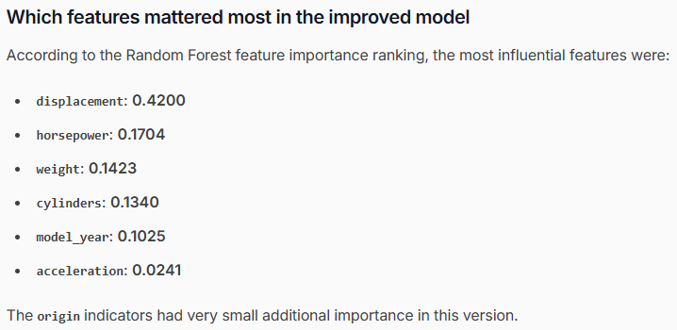

Slide 33
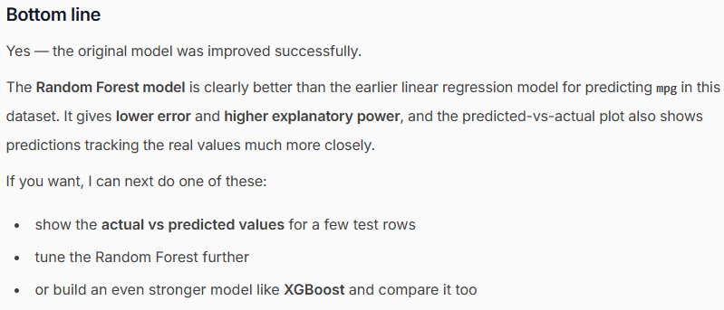

Slide 34
Hypothesis Testing
Ask:
Do cars from USA have lower mpg than Europe?
👉 Julius may:
compare distributions
perform statistical reasoning
💡 Key points:
Data-driven conclusions

Slide 35

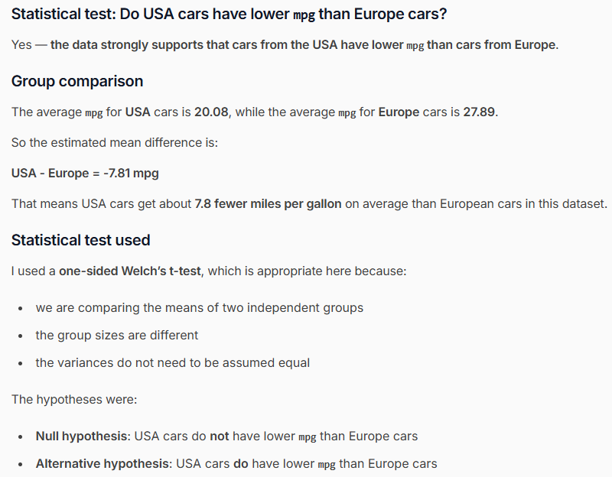

Slide 36
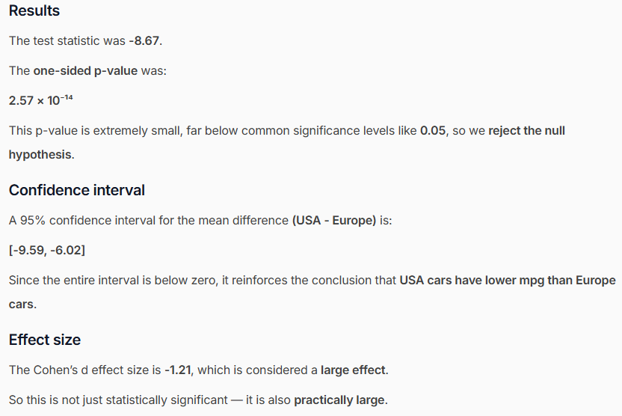

Slide 37
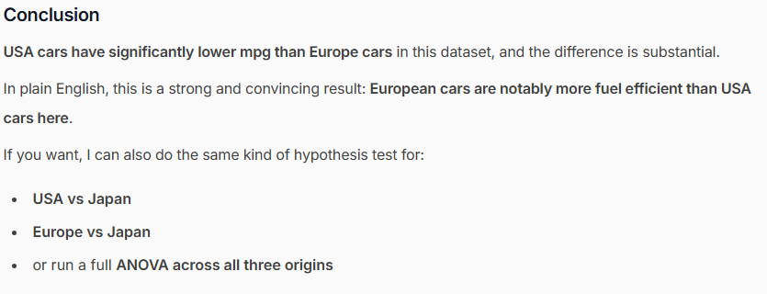
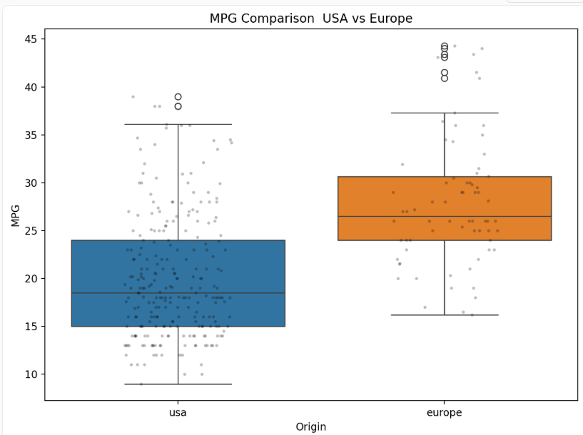

Slide 39
Ffnbksdfd
Fdslj;f
Fl;ds

