Slide 2
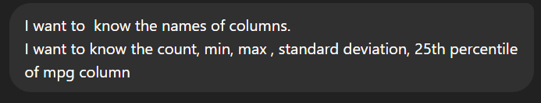
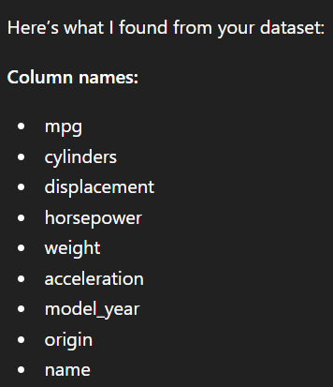
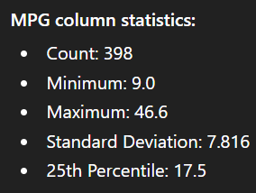
I want to know the names of columns.
I want to know the count, min, max , standard deviation, 25th percentile of mpg column

Slide 3
Natural Language → Analysis (CORE Julius strength)
Start with simple prompts:
Show correlation between horsepower and mpg”
What factors affect MPG the most?
Find trends over model years
👉 Julius will:
auto-generate code
run analysis
visualize results
💡 Key point:
“This replaces manual pandas + matplotlib coding”

Slide 4
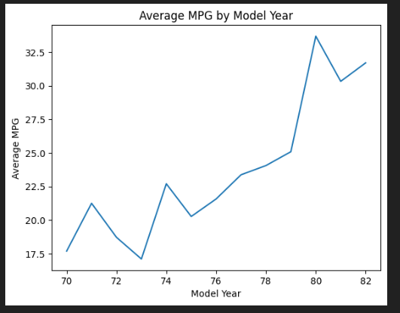

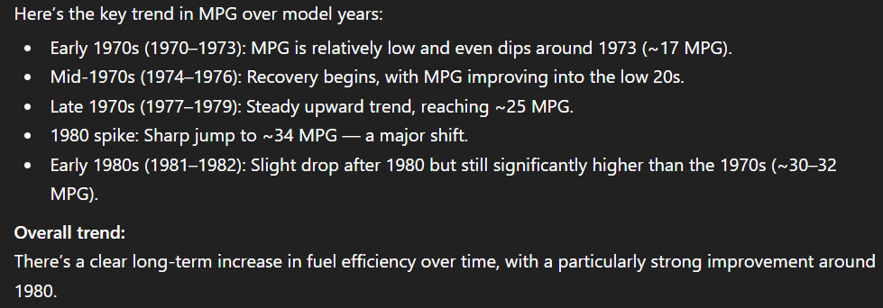

Slide 5
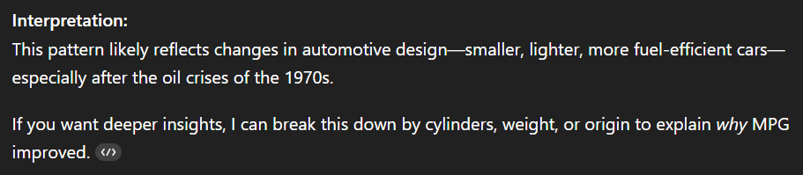

Slide 6
Ffnbksdfd
Fdslj;f
Fl;ds

