Slide 2
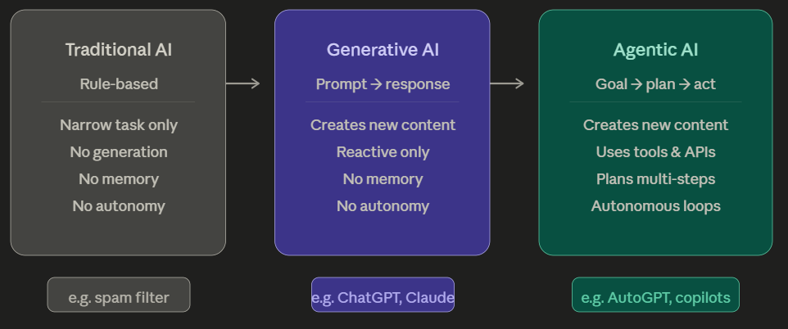
What is Agentic AI?
Traditional AI is rule-based.
It does exactly what it's told, nothing more.
A spam filter, a chess engine, a recommendation algorithm — these are trained or programmed for one narrow task.
They have no understanding of context beyond their domain.

Slide 3
2) Generative AI (GenAI): models like GPT-4 or Claude can generate new content — text, images, code — by learning patterns from vast data.
But they are fundamentally reactive. You prompt them, they respond. They have no memory of yesterday, no ability to go check a website, no way to take an action in the world.

Slide 4
3) Agentic AI:
AI that can act. It receives a goal, breaks it into steps, uses tools (web search, code execution, APIs), checks its own output, and iterates — all without a human driving every step.
Example: Agent that opens your laptop, run a search on email, draft response for an email, and send it — autonomously.

Slide 5
What Makes AI "Agentic"? The Four Pillars
Goal decomposition — Given a high-level objective, the agent breaks it into subtasks automatically.
Tool use — Agents are connected to the world: they can browse the web, run code, query databases, call APIs, read files, send emails.
Memory — Unlike a standard LLM that forgets between sessions, agents can maintain short-term context (what they've done in this task) and often access long-term memory (a database of past interactions or documents).
Feedback loops — Agents can evaluate their own outputs, notice errors, and retry. A coding agent that writes code will also run it, read the error, fix the bug, and run it again.

Slide 6
Use Case: Agentic AI for Real-Time Fraud Detection & Response
The Business Problem
A traditional bank or payment company processes millions of transactions daily. Old-school fraud detection uses static rules — "flag any transaction over ₹1,00,000" or "block if card used in two countries within 1 hour." These rules are rigid: fraudsters learn to work around them, and legitimate customers get wrongly blocked.
A static LLM can help analysts understand fraud patterns when asked — but it can't act on a live transaction in real time, can't pull the customer's history, can't freeze an account, and can't learn from new fraud signals.
An agentic AI system changes all of this.

Slide 7
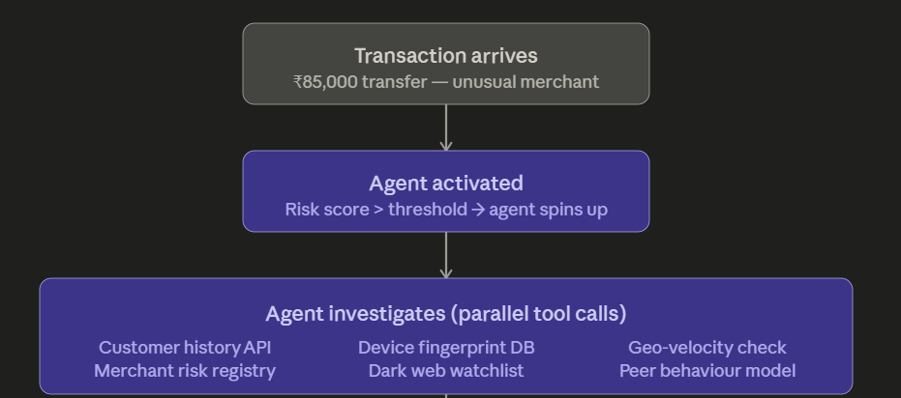
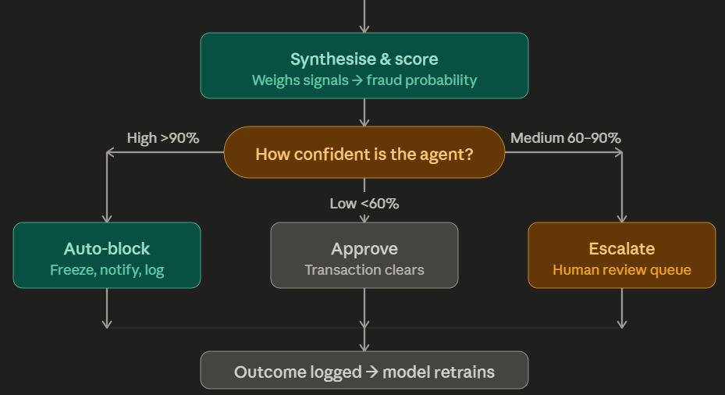
Step 1 — Transaction arrives.
A $ 85,000 transfer is initiated at 2:14 AM to an unfamiliar merchant.
The rule-based system flags it with a risk score of 78/100 — above the threshold for agent activation.
Step 2 — Agent spins up.
Instead of a static rule simply blocking or allowing, an agentic AI wakes up. It receives the transaction object as its "goal": evaluate whether this is fraudulent and take appropriate action.

Slide 8
Step 3 — Parallel tool calls.
The agent simultaneously calls multiple tools without any human driving each call. It might be querying six systems in under a second —
the customer's 18-month transaction history,
the device fingerprint database (is this the same phone the customer usually uses?),
a geo-velocity API (was the card used in Mumbai 40 minutes ago?),
the merchant's risk category,
a dark web credential watchlist, and
a peer behavior model comparing this customer to similar profiles.

Slide 9
Step 4 — Synthesis.
The agent doesn't just receive raw outputs — it reasons across them.
"Device fingerprint matches.
But geo-velocity is impossible — card was scanned in Pune 35 minutes ago.
Merchant is in a high-risk category. Customer has never transacted past midnight."
It produces a combined fraud probability.

Slide 10
Step 5 & 6 — Tiered action.
Based on confidence, the agent takes a calibrated response.
High confidence (>90%) means autonomous block, account freeze, and customer SMS notification — no human in the loop needed.
Medium confidence triggers a human review queue with the agent's full reasoning attached.
Low confidence simply approves and logs for pattern monitoring.

Slide 11
Step 7 — Feedback loop.
Every outcome — whether the human reviewer confirmed fraud or cleared it — is written back into the training pipeline.
The agent gets smarter with every case.

Slide 12
Real Companies Doing This
Several fintech firms have deployed systems that embody this architecture.
Stripe's fraud prevention platform uses ML-driven decisioning that operates at the millisecond level, automatically adjusting to new fraud patterns without rule updates.
PayPal's risk engine processes over 40 signals per transaction autonomously.
Klarna has deployed AI agents that handle both fraud investigation and customer service resolutions end-to-end — in their public reporting they noted a dramatic reduction in repeat inquiries after deployment.
In India, the UPI ecosystem — handling over 10 billion transactions monthly — has fintech companies like Razorpay and PhonePe building agentic layers on top of NPCI's fraud flags, extending the basic rules with contextual, multi-signal reasoning.

Slide 13
EXTRA
Ffnbksdfd
Fdslj;f
Fl;ds

