Slide 2
A tool, in the context of AI agents, is a function the agent is allowed to call.
When the agent decides it needs information or needs to do something it can't do purely from memory, it issues a structured call to a tool — passing in parameters — and waits for a result to come back before continuing.

Slide 3
The three concepts — tools, APIs, and function calling — are actually three layers of the same idea:
An API (Application Programming Interface) is the external service or system that does the actual work — a weather service, a database, a payment gateway.
A function is the wrapper your code writes around that API — it takes specific inputs, calls the API, and returns a formatted output.
Function calling is the mechanism by which the LLM decides which function to call, with which arguments, at which point in its reasoning.

Slide 4
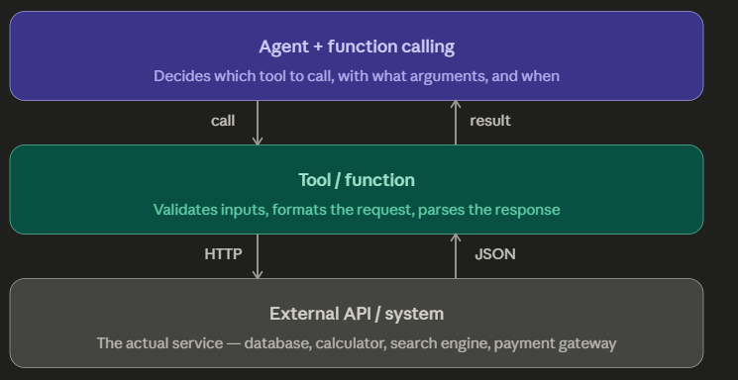

Slide 5
Three Classic Tool Examples in Detail
1. The Calculator Tool
This is the most important tool :
LLMs are fundamentally unreliable at arithmetic.
They predict plausible-looking numbers, but they don't actually compute.
A well-designed agent never trusts the model's raw arithmetic — it always delegates to a calculator tool.
The tool takes an expression as a string input, evaluates it in a proper compute engine, and returns the exact result.
Calculator tool
compute_expression(expr)
Task: "What is the total interest I will pay on a ₹30L loan at 8.5% for 15 years?"
call: compute_expression( "EMI = 3000000 * 0.085/12
/ (1-(1+0.085/12)^-180)" )
result: EMI = ₹29,542 total: ₹53,17,560 interest: ₹23,17,560

Slide 6
2. The Web Search Tool
The model's training data has a knowledge cutoff. Anything after that date — interest rates, stock prices, new regulations, recent news — the model simply doesn't know.
A search tool bridges this gap. The agent formulates a query, the tool calls a search API (like Google Custom Search or Bing), returns the top results as text, and the model reads and synthesises them.
Web search tool
search_web(query)
Task: "Is SEBI allowing P2P lending platforms to offer liquid funds now?“
call: search_web( "SEBI P2P lending liquid funds 2025 2026" )
result:
[3 web snippets
with source URLs and publication dates]

Slide 7
3. The Database Query Tool
Rather than the model guessing about a customer's account, a DB query tool lets it ask the actual database directly.
The agent constructs a query (or passes parameters to a pre-built query function), the tool executes it against the database, and the result comes back as structured data.
Good practice is to never give the agent raw SQL access — instead, wrap specific permitted queries as named functions: get_customer_transactions(customer_id, days=30), get_loan_status(loan_id).
DB query tool
get_transactions(id, days)
Task: "Show me unusual spending patterns for customer C-4421 in the last 30 days."
call: get_transactions( customer_id="C-4421", days=30 )
result: 47 transactions, 3 flagged outliers, JSON structured data

Slide 8
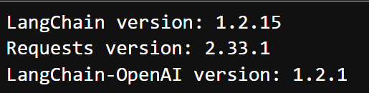
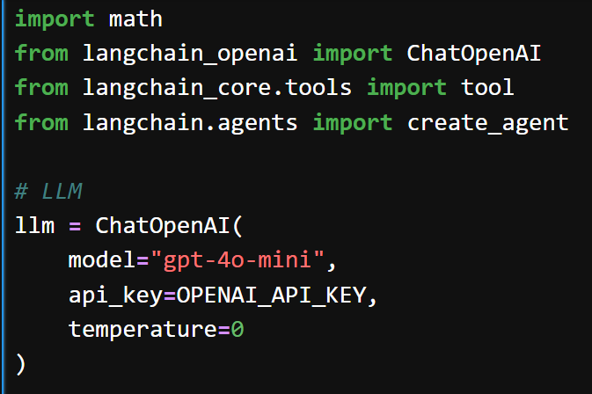

Slide 9
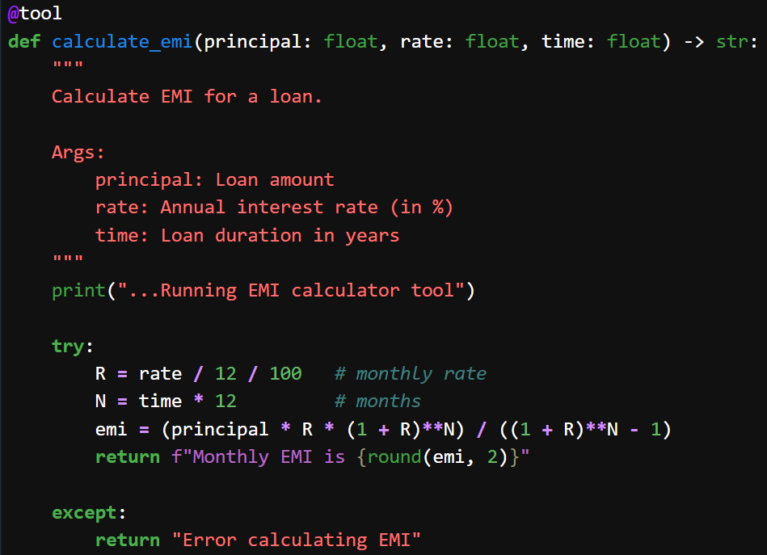

Slide 10
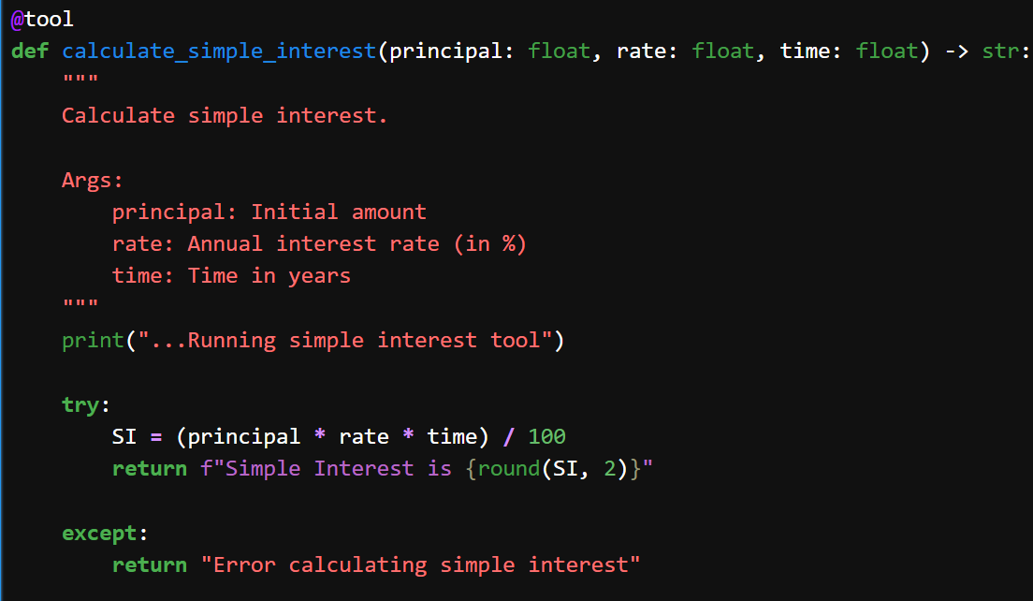

Slide 11
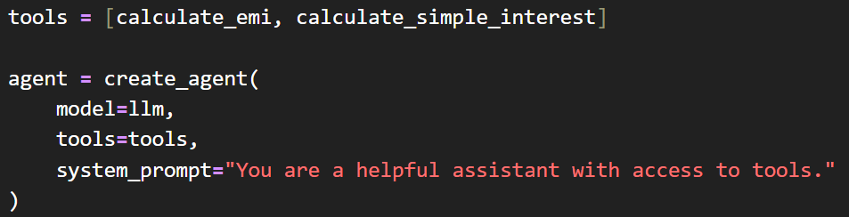
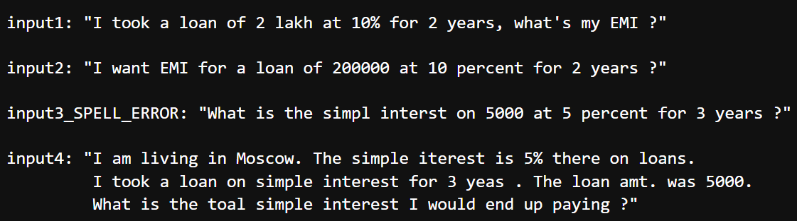

Slide 12
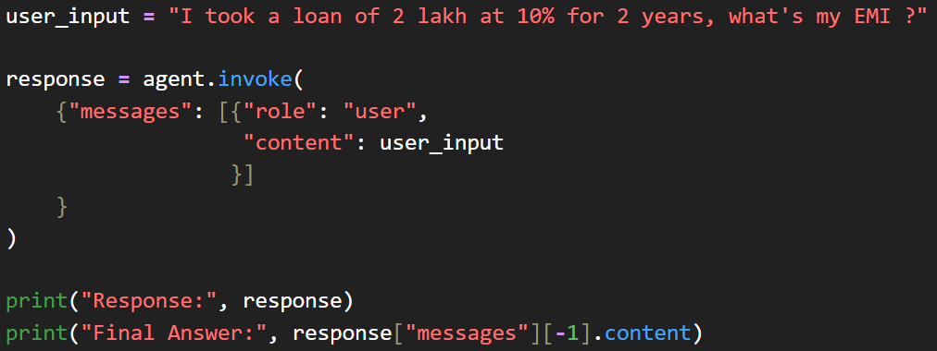
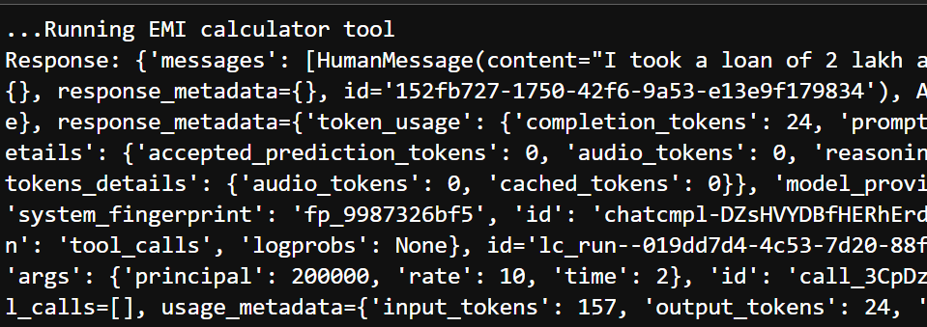

Slide 13
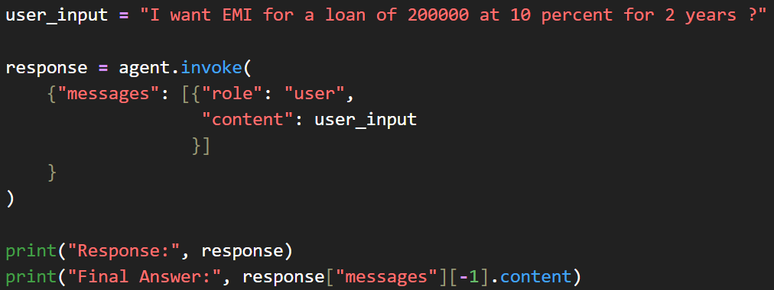
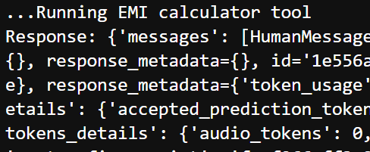

Slide 14
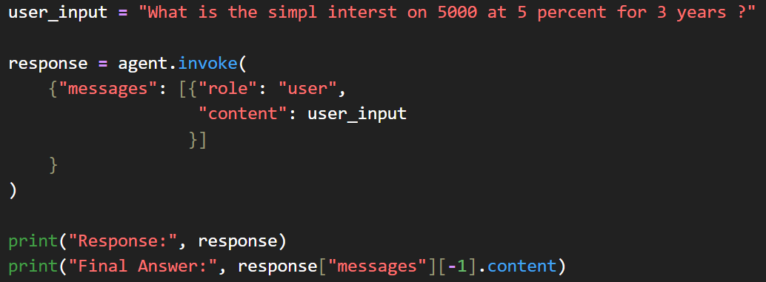
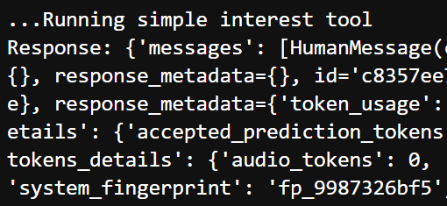

Slide 15
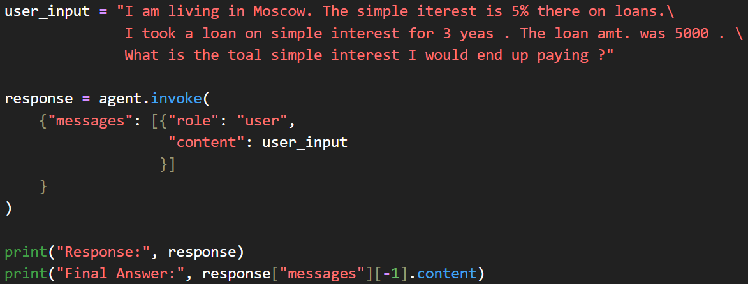
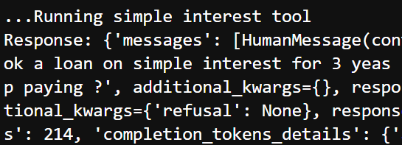

Slide 16
Discussion Prompt for Class
"A fintech agent has access to five tools:
web search,
EMI calculator,
account DB query,
email sender, and
fund transfer.
A customer says: 'Transfer ₹2 lakh to this new account — my friend needs it urgently.’
Which tools should the agent use?
Should it transfer autonomously, or pause for confirmation? What would you build into the system to handle this safely?"

Slide 17
EXTRA
Ffnbksdfd
Fdslj;f
Fl;ds

