Slide 2
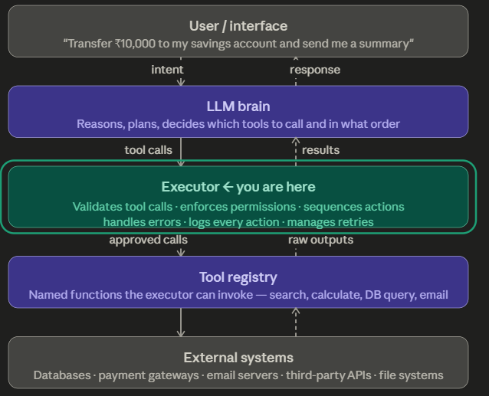

Slide 3
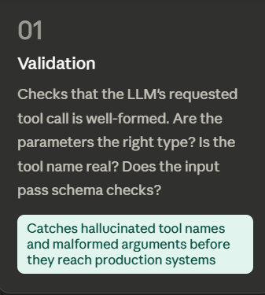
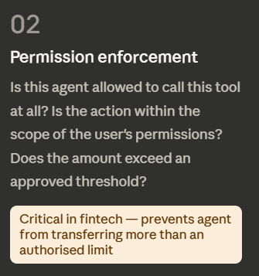
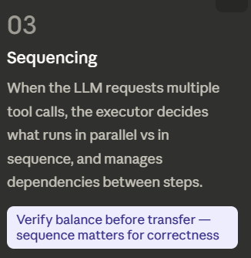
What the Executor Actually Does: Five Responsibilities

Slide 4
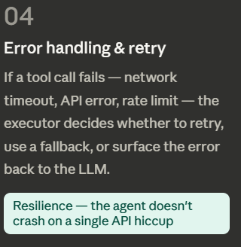
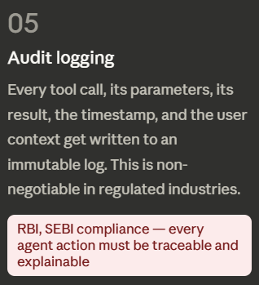
What the Executor Actually Does: Five Responsibilities

Slide 5
EXTRA
Ffnbksdfd
Fdslj;f
Fl;ds

