Slide 2
Memory in Agents: How AI Remembers
"You walk into your bank.
The relationship manager recognizes you, remembers your loan application from three months ago, knows you prefer WhatsApp over email, and recalls that you asked about NPS last time. He remembers you.
Now imagine if every time you visited, they had no memory of you at all —
you'd have to re-introduce yourself,
re-explain your situation,
re-state your preferences.
That's what a memoryless AI does to every user, every session."

Slide 3
Short-Term Memory: The Context Window
The context window is the agent's working desk. Everything on the desk right now — the conversation so far, documents you've handed it, tool results, instructions — that's the context. The model can see and use all of it simultaneously.
The critical constraint is size. Context windows are measured in tokens (roughly 0.75 words per token). You have only finite size in context window
This creates a real engineering problem:
what do you keep on the desk, and what do you store elsewhere?
Agents solve this with a technique called memory summarization — periodically compressing older conversation into a summary, keeping the gist without keeping every word.

Slide 4
Long-Term Memory: The External Store
Long-term memory is everything outside the context window — persisted in a database, retrievable when needed, growing indefinitely.
When a new session starts, the agent doesn't load all of long-term memory into context (that would overflow it). Instead, it fetches only what's relevant to the current task.
The question is: how do you know what's relevant?
For structured data — account numbers, transaction records, customer profiles — a standard SQL database query works fine. You search by ID or date, get back exact rows.
For unstructured knowledge — past conversations, documents, notes, emails — exact-match SQL fails. You use vector databases.

Slide 5
Best Official documentation:
https://docs.langchain.com/oss/python/concepts/memory

Slide 6
Discussion Prompt for Class
"A fintech agent remembers everything a customer has ever said —
their financial worries,
their family situation,
their investment fears.
This makes it far more helpful.
But it also means someone is storing a detailed psychological and financial profile of every customer.
Who owns that memory?
Can the customer delete it?
What if the bank is acquired?
Should there be a 'right to be forgotten' for AI memory?"

Slide 7
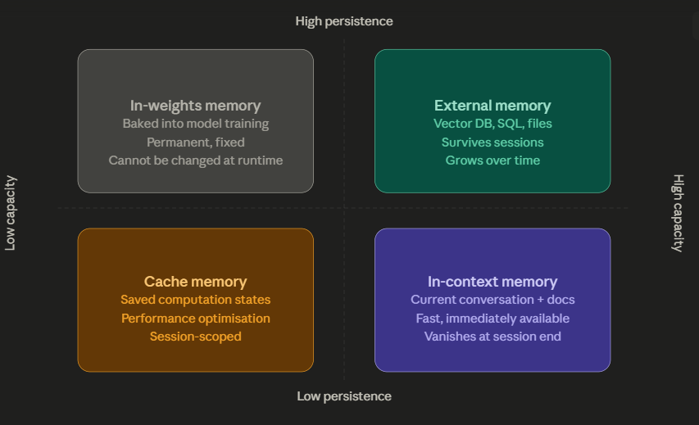

Slide 8
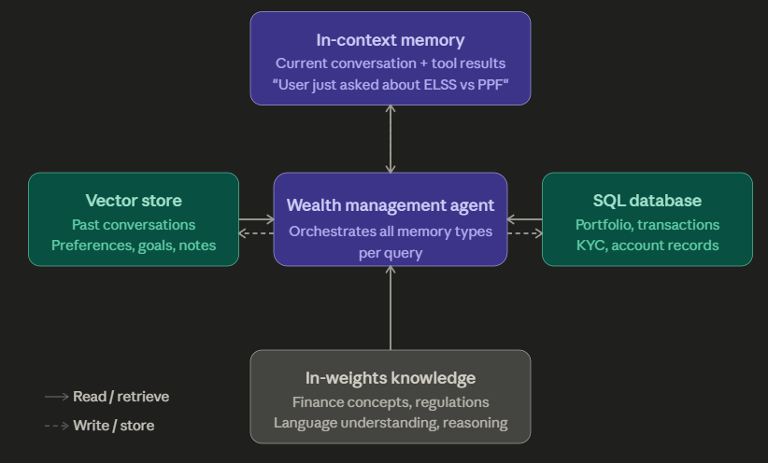
Here is how a well-designed fintech agent — say, a wealth management assistant — would wire all four memory types together:

Slide 9
EXTRA
Ffnbksdfd
Fdslj;f
Fl;ds

