Slide 2
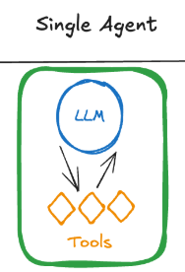
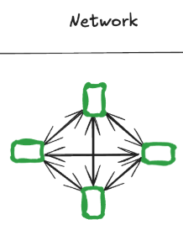
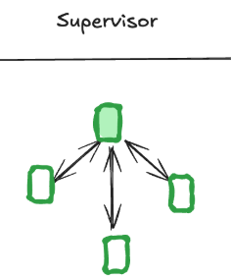
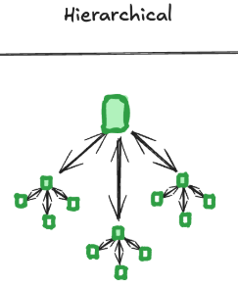
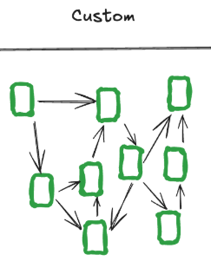
Multi-Agent Systems(p1)
A multi-agent system (MAS) is a framework that allows multiple AI agents to collaborate to solve problems and achieve predetermined goals.
They offer several benefits over systems consisting of a single AI agent:
- If a single agent has too many tools at its disposal, then MAS makes decision which tools to invoke. You have more control on how task are to be executed
MAS are capable of taking on more complex tasks: A key reason for this is that agents in MAS can learn from the behavior of other agents as well as their environment.
MAS are modular and hence scalable – additional agents can be instantiated if the existing system isn’t up to the task, or can’t cope with growing demand.

Slide 3
Multi-Agent Systems(p1)
- MAS are more fault-tolerant to individual agent failures than single-agent systems. This offers higher availability, which is desirable if the agent-powered system represents a critical function.
MAS can achieve its given goal is to have agents cooperate to reach a desired objective. This could involve agents sharing information about the measures they have taken so far, so other agents avoid wasting effort.
You can create multiple specialized agents that are expert in their domain
Types of MAS: Network, Supervisor, Hierarchical, Custom (Explained later)

Slide 4
Multi-Agent Systems Architecture(p2)
Lets understand single agent first and its limitations:
Single Agent:
Relies on one LLM or tool to perform all tasks sequentially.
SA work well for simple workflows.
3 Challenges of Single-Agent Systems:
A) Tool Overload:
1. Handling numerous tools can confuse decision-making.
2. Incorrect decisions in tool selection can cascade, causing failures in subsequent steps.
3. Constant back-and-forth among tools slows down the system.
Empirical observations suggest that a sweet spot exists for tool usage: 5-10 tools.
Below this range the agent may lack capabilities to perform complex workflows.
Above this range the agent’s ability to choose tools effectively diminishes.
LLM
Tool1
Tool2
Tool3

Slide 5
Multi-Agent Systems Architecture(p3)
B) Contextual Limitations: In SA system, LLMs struggle to maintain effective performance when overloaded with growing context. LLM have a finite context window, which determines how much information they can process at once.
As interactions expand in complexity following issues arises:
Contextual Overload: The agent’s memory is overwhelmed by the growing number of tasks, tool outputs, and user interactions.
Performance Drops: The LLM may lose important details, leading to incomplete or incorrect responses.
Inefficiencies: Repeated reinitialization of context for different tasks increases latency and computational costs.
Example: Imagine an agent interacting with a user and calling tools to:
1. Retrieve data.
2. Analyze it.
3. Generate a report.
By the time it reaches step 3, the LLM may have lost critical details from step 1 due to context overflow, resulting in flawed outputs.
LLM
Retrieve Data
Analyze data
Generate Report

Slide 6
Multi-Agent Systems Architecture(p4)
C) Specialization Deficiency: A single agent cannot excel in diverse tasks requiring varied expertise. If a single agent is expected to handle diverse tasks — ranging from planning and research to coding and mathematical analysis, then this expectation creates challenges:
1. Skill Dilution: A single LLM lacks the depth to perform each task with high expertise.
2. Task Complexity: As tasks become more domain-specific, they require specialized knowledge that a generalized single agent cannot provide.
3. Performance Inefficiencies: Switching between different types of tasks introduces friction, reducing overall system responsiveness.
Example: A user needs an AI assistant to:
- Plan a project timeline.
- Write a Python script for automation.
- Generate a financial forecast.
A single agent may struggle to excel in all three areas simultaneously, leading to suboptimal results.
LLM
Plan Project Timeline
Write Python script
Generate Fin. Forecast

Slide 7
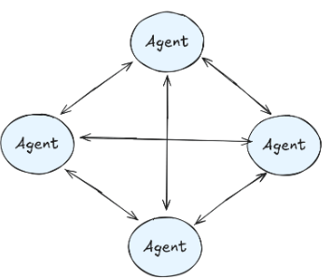
Multi-Agent Systems Architecture(p5)
4 types of MAS:
Network MAS: multiple agents operate independently, each equipped with their own tools, and communicate by routing tasks among themselves. This architecture leverages collaboration and coordination between agents for solving complex problems.
Framework like Swarm, CrewAI, LangGraph use this architecture.
SA's communicate by determining the next agent in the sequence to handle a task. Routing decisions are made dynamically, based on the current task and agent capabilities.
Advantage of network MAS
Decentralized Decision-Making: Agents can make independent decisions, reducing reliance on a single central controller.
Flexibility: The architecture can adapt dynamically to changing task requirements or agent capabilities.
Parallelism: Multiple agents can operate concurrently, improving system throughput for tasks that can be processed in parallel.

Slide 8
Multi-Agent Systems Architecture(p6)
Disadvantages of Network MAS
Loose Communication Patterns: Lack of strict control over how agents communicate leads to unpredictability. Agents may route tasks inefficiently, causing delays or redundant work.
High Costs: Frequent communication between agents results in excessive LLM calls, increasing operational costs. Agents may unnecessarily route tasks back and forth, compounding expenses.
Unreliability in Production: The decentralized nature makes debugging and error handling challenging. Inconsistent task routing can lead to failed workflows or incomplete results.
Coordination Overhead: With no central control, maintaining coordination across agents requires complex protocols, adding computational overhead.
Practical Applications of N/w MAS
While the network of agents architecture is rarely recommended for production due to its inefficiencies, it has niche applications in:
- Exploratory Systems: Research prototypes or academic experiments where flexibility and dynamic task routing are prioritized over cost and reliability.
- Distributed Problem Solving: Use cases like swarm intelligence, where decentralized agents simulate behaviors found in natural systems (e.g., ant colonies, bird flocks).

Slide 9
Multi-Agent Systems Architecture(p7)
2. Supervisor Agent
How It Works
Supervisor Agent:
- Acts as the central controller.
- Decides which sub-agent should handle a specific task based on the task requirements.
- Manages the overall workflow and ensures the completion of tasks in a structured manner.
Sub-Agents:
- Specialized agents with expertise in specific domains (e.g., data analysis, coding, content generation).
- Perform their tasks independently without worrying about routing or decision-making.
Communication Flow:
- The supervisor receives a task, analyzes it, and routes it to the appropriate sub-agent.
- The sub-agent processes the task and returns results to the supervisor, which then decides the next steps.

Slide 10
Multi-Agent Systems Architecture(p8)
Advantages of Supervisor MAS
a) Simplified Sub-Agent Roles: Sub-agents focus exclusively on their tasks, without needing to handle routing or inter-agent communication. This improves their efficiency and accuracy.
b) Centralized Control:
The supervisor ensures that tasks are executed in the correct sequence, reducing errors caused by miscommunication.
It provides a clear view of the overall workflow, making it easier to debug and maintain.
c) Scalability:
New sub-agents can be added to the system without disrupting the existing architecture.
The supervisor can dynamically allocate tasks to the most suitable agent.
d) Improved Resource Management: The supervisor optimizes task routing to minimize redundant LLM calls and computational overhead.

Slide 11
Multi-Agent Systems Architecture(p9)
Challenges of supervisor MAS
Supervisor Bottleneck:
If the supervisor becomes overloaded with too many tasks or too much decision-making, it can slow down the entire system.
Mitigation: Using a hierarchical approach where supervisors manage groups of sub-agents.
Complex Supervisor Logic:
Designing the supervisor’s task-routing logic can become complex, especially in dynamic environments with many sub-agents.
Single Point of Failure:
The system’s functionality heavily depends on the supervisor. If it fails, the entire workflow is disrupted.
Mitigation: Implementing redundancy or fallback mechanisms.

Slide 12
Multi-Agent Systems Architecture(p10)
Example Use Case of supervisor MAS
A company develops an AI-powered business assistant:
1. The supervisor agent handles user requests and delegates them to sub-agents. Example: A user asks for a project timeline and budget analysis.
2. Sub-agent 1 (Planner) creates the project timeline.
3. Sub-agent 2 (Finance Expert) performs budget analysis.
4. Results are returned to the supervisor, which consolidates and delivers the final output to the user.

Slide 13
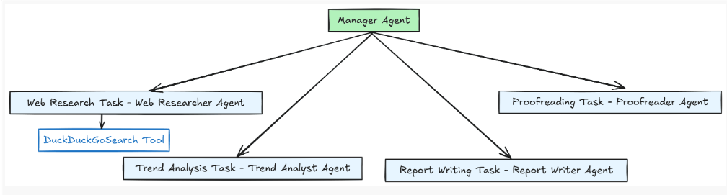
Multi-Agent Systems Architecture(p11)
Example Use Case of supervisor MAS: MAS to generate a report on a specific topic we want
The structure detail is simple; we will have four specialized agents:
Web researcher agent
Trend analyst agent
Report writer agent
Proofreader agent
The manager agent supervises all of these agents which only perform their tasks if directed. Additionally, the web researcher agent has access to the web search tool to access the internet to research the intended topic.

Slide 14
Multi-Agent Systems Architecture(p12)
3. Hierarchical MAS
How It Works
Layered Supervision:
A top-level supervisor agent manages high-level tasks and delegates them to mid-level supervisor agents. These mid-level supervisors handle specific groups of sub-agents, each specializing in distinct domains or tasks.
Sub-Agents:
Operate at the lowest level, performing specific tasks based on instructions from their respective supervisors. Sub-agents focus solely on execution, leaving routing and decision-making to their assigned supervisors.
Task Flow:
- Tasks are broken down at each hierarchical level. The top-level supervisor divides a large task into manageable subtasks. Mid-level supervisors further refine and distribute these subtasks to sub-agents.
Communication:
- Supervisors communicate with their direct subordinates (other supervisors or sub-agents).
- Results flow upward through the hierarchy for aggregation and final output.

Slide 15
Multi-Agent Systems Architecture(p13)
Advantages Hierarchical MAS
Scalability:
The hierarchical structure supports systems with a large number of sub-agents by distributing the workload across multiple layers.
Each supervisor only needs to manage a subset of the overall tasks, reducing bottlenecks.
Specialization:
Mid-level supervisors can manage groups of sub-agents specializing in particular domains (e.g., financial analysis, content generation). This enables highly modular and efficient task execution.
Improved Efficiency: Breaking tasks into smaller subtasks and routing them to appropriate agents minimizes processing delays and resource usage.
Enhanced Debugging and Maintenance:
The layered structure allows pinpointing of errors or bottlenecks to a specific supervisor or sub-agent.
Maintenance is easier since changes in one layer do not necessarily affect others.

Slide 16
Multi-Agent Systems Architecture(p14)
Challenges of Hierarchical MAS
Design Complexity:
Building a multi-layered supervisor system requires careful planning to ensure tasks are routed efficiently.
Designing logic for supervisors at each level can be time-consuming and prone to errors if not well-structured.
Communication Overhead:
Hierarchical communication can introduce latency as information flows through multiple layers.
Mitigation: Optimize task granularity to reduce unnecessary back-and-forth between layers.
Single Point of Failure at the Top:
The top-level supervisor is critical to system functionality. If it fails, the entire hierarchy is disrupted.
Mitigation: Introduce redundancy or a failover mechanism for the top-level supervisor.
Resource Management:
Large systems with many layers can consume significant computational resources.
Mitigation: Monitor and optimize resource allocation, ensuring supervisors at all levels operate efficiently.

Slide 17
Multi-Agent Systems Architecture(p15)
Practical Applications of hier. MAS
Enterprise Automation: Complex workflows requiring task division across multiple departments, such as project planning, resource allocation, and reporting.
Autonomous Systems: Scenarios like autonomous vehicles, where high-level supervisors manage route planning while lower layers handle obstacle avoidance and vehicle control.
Dynamic Multi-Agent Systems: Real-time decision-making systems, such as financial trading bots, where tasks must be delegated and resolved quickly across layers.

Slide 18
Multi-Agent Systems Architecture(p16)
Example Use Case of Hier. MAS: AI-Powered Research Platform
Top-Level Supervisor:
Receives a request to generate a comprehensive research report.
Breaks the task into subtasks: literature review, data analysis, and report writing.
Mid-Level Supervisors:
Literature Supervisor: Manages sub-agents specialized in retrieving and summarizing articles.
Data Supervisor: Delegates tasks to agents performing data collection and statistical analysis.
Content Supervisor: Coordinates agents responsible for drafting and editing the report.
Sub-Agents:
Each sub-agent performs its specific role (e.g., searching academic databases, running statistical tests, or refining written content).
Results Aggregation:
Results flow back up the hierarchy, where the top-level supervisor consolidates them into the final output.

Slide 19
Multi-Agent Systems(p2)
Examples of MAS:
Stock market simulation :A classic example of MAS is a stock market simulation where multiple "agent" programs representing different traders interact with each other, buying and selling stocks based on their own algorithms and strategies, simulating real market dynamics and competition.
Robot soccer team: Multiple robots on a field act as individual agents, coordinating their movements and actions to play against another team, simulating real soccer strategies.
MAS can be used for tasks like coordinating multiple robots to perform complex jobs, such as search and rescue

Slide 20
RAG (Retrieval-Augmented Generation)

Slide 21
EXTRA
Ffnbksdfd
Fdslj;f
Fl;ds

