Slide 1
AI AGENTS

Slide 2
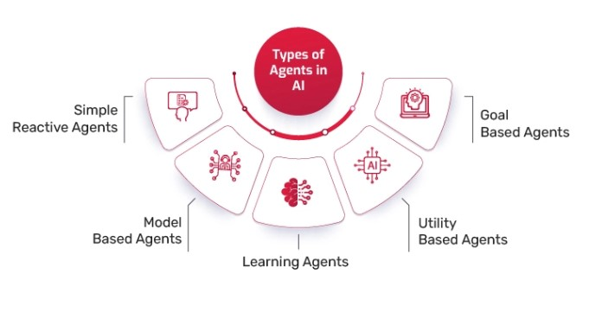
Types of AI Agents(p1)
Reactive Agents
These agents do not have memory or the ability to learn from past experiences.
They respond directly to environmental stimuli based on predefined rules.
Example: Chess-playing AI (Deep Blue) – It makes moves based only on the current board state.
Model-Based (Deliberative) Agents
These agents maintain an internal model of the world and use it to make decisions.
They can plan actions based on their understanding of the environment.
Example: Self-driving cars – They build a model of the surroundings to navigate safely.

Slide 3
Types of AI Agents(p2)
Goal-Based Agents
They take actions that bring them closer to achieving a specific goal.
They evaluate different possible actions and select the one that maximizes goal achievement.
Example: Pathfinding AI in robotics and games – It determines the shortest route to a destination.
Utility-Based Agents
They optimize actions based on a utility function, considering multiple factors like cost, efficiency, and risk.
Used in applications requiring decision-making under uncertainty.
Example: Recommendation systems (Netflix, Spotify) – They optimize user engagement and satisfaction.

Slide 4
Types of AI Agents(p3)
Learning Agents
These agents improve their performance by learning from past experiences.
They use machine learning techniques to adapt to new data and environments.
Example: Chatbots (ChatGPT, Bard) – They learn from user interactions to improve responses.
Multi-Agent Systems (MAS)
A group of AI agents that work together to achieve a common goal.
Used in swarm robotics, distributed computing, and collaborative AI.
Example: Stock trading AI – Multiple AI agents analyze different market aspects and make trading decisions collectively.

Slide 5
Types of AI Agents(p4)
Theory of Mind Agents
The theory of mind defines each living being as having sentiments, thoughts, ideas, and a mental state distinct from the others. A theory of mind AI agent describes the next step in artificial intelligence evolution. It is a leap forward from the Reactive and Limited Memory systems and describes agents as having a deeper understanding of the human mind. These agents understand complex emotional states and consider them when making a decision.

Slide 6
Types of AI Agents(p5)
Self-Aware Agents
Self-awareness is an extension of the theory of mind principle. A self-aware agent not only understands others but also itself. It has a working consciousness and sense of being similar to humans. Theoretically, a self-aware agent will be a sentient being that thinks and behaves exactly like a human, and its interactions will reflect emotional prowess.
The theory of mind and self-awareness stages are the true representation of a sentient AI. However, these developments are still a topic of research, and little advancement has been made toward reaching human-level cognition. Current AI systems lack the depth of understanding, reasoning, and subjective experience that characterize true sentience.
Significant progress has been made in areas like natural language processing (NLP) and emotional simulation. However, the leap to a fully self-aware or conscious AI, capable of independent thought and genuine emotions, remains speculative and far from realization.

