Slide 1
GenAI Module8- Foundations and Applications

Slide 2
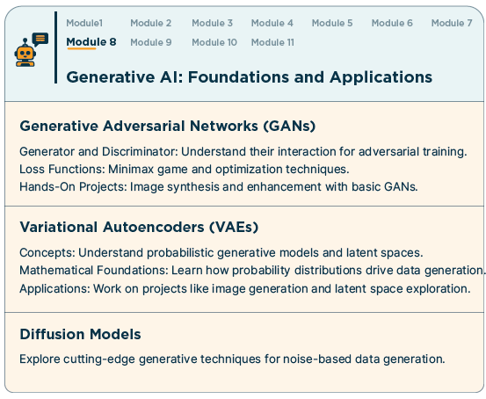

Slide 3
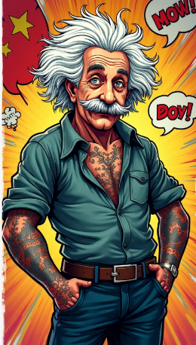
GenAI process workflow
The general work flow of GenAI:
Data collection: A large dataset containing examples of the type of content to be generated is collected. For example, a dataset of images for generating realistic pictures, a dataset of text for generating coherent sentences, dataset of audio for generating life like audio.
Model training: The generative AI model is constructed using neural networks. The model is trained on the collected dataset to learn the underlying patterns and structures in the data.
Generation: Once the model is trained, it can generate new content. The generated content is a synthesis of what the model has learned from the training data.
Refinement: Depending on the task and application, the generated content may undergo further refinement or post-processing to improve its quality or to meet specific requirements.

Slide 4
4 Common of GenAI models
4.1) Generative Adversarial Networks (GANs): An AI framework that uses two neural networks, a generator and a discriminator, to create synthetic data. The generator creates fake data, and the discriminator evaluates its authenticity. GANs are used in image generation, video creation, etc.
4.2) Variational Auto Encoders (VAEs): A generative models that learn to encode data into a latent space and then decode it back to reconstruct the original data. They learn probabilistic representations of the input data, allowing them to generate new samples from the learned distribution. Commonly used in image generation tasks and also been applied to text and audio generation.
4.3) Diffusion Models: Diffusion models are a type of generative AI model that generate data by adding noise and then removing it. They are used to create images and audio, and are at the forefront of generative AI.
4.4) Autoregressive Models: Autoregressive models are a type of statistical or machine learning model that predicts the next value in a sequence based on the previous values in that sequence. These models assume that the future values in the sequence are dependent on the past values and use this dependency to make predictions.

Slide 5
Types of Gen AI models based on content creation
1. Text Generation Models: Generate human-like text based on input prompts. Example is RNN-based models like LSTMs
2. Image Generation Models: Generate images from text prompts or existing images. Example are Diffusion Models, GANs (Generative Adversarial Networks), VAEs (Variational Autoencoders ), etc.
3. Audio & Speech Generation Models: Generate synthetic voices, music, or sound effects.
4. Video Generation Models: Generate or manipulate videos. Examples are GAN-based, Diffusion based, etc.
5. 3D Object Generation Models: Generate 3D images from 2D images or text. Examples are diffusion based, GAN based, etc.
6. Code Generation Models: Generate code based on natural language descriptions. Examples are transformer based models, Autoregressive models
7. Data & Tabular Generation Models: Generate synthetic structured data. Examples are GAN based model, Diffusion based model, etc.

Slide 6
Challenges
GANs can be computationally intensive, both in terms of machine learning training and inference. They often require large amounts of data and can take a long time to train. One is to use parallel training, which can help to speed up training. Another is to use distributed training, which can help to distribute the computational burden across multiple nodes or machines, for example, with edge computing
GANs can be difficult to deploy because they require a lot of computational resources.
Finally, model compression techniques can be used to reduce the size of the model, which can help to reduce the computational requirements.

