Slide 2
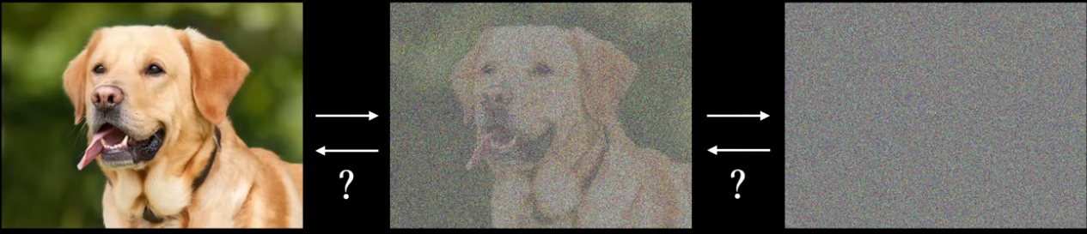
Diffusion models are a type of generative artificial intelligence (AI) model that generate data by adding noise and then removing it.
How they work
1. Start with a clean sample of data
2. Gradually add noise to the data
3. Reverse the process to remove the noise and generate a structured output
Clean
data
Noise added
Noise added
Source: Youtube - Seff

Slide 3
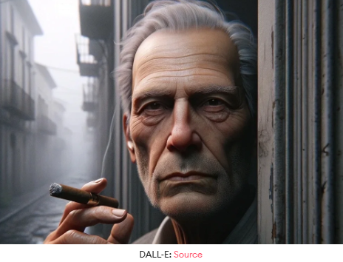
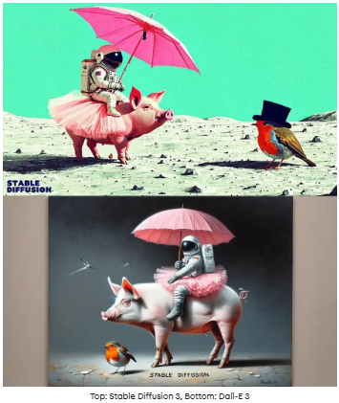

Slide 4

Applications of Diff Models
Image generation: Diffusion models are used to generate high-quality images for computer vision tasks
Data denoising: Diffusion models can handle data that has degraded over time
Image editing: Diffusion models can be used to edit and retouch photos
Missing data: Diffusion models can generate coherent data points even when some input data is missing
The famous DALL-E 2, Midjourney, and open-source Stable Diffusion that create realistic images based on the user's text input are all examples of diffusion models.
Also see Sora

Slide 5
Applications of Diff Models
In graphic design and illustration, diffusion models provide a tool for rapidly generating visual content. Designers can input sketches, layouts, or rough ideas, and the models can flesh these out into complete, polished images. This can significantly speed up the design process, offering a range of possibilities from the initial concept to the final product.
In music and sound design, generative diffusion models can be adapted to generate unique soundscapes or represent music, offering new ways for artists to visualize and create auditory experiences.

Slide 6
🧠 FULL WORKFLOW (Teach This Flow)
🔁 2 Main Phases
1. Forward Process (No Learning)
👉 Add noise step-by-step
2. Reverse Process (Learning)
👉 Model learns to remove noise

Slide 7
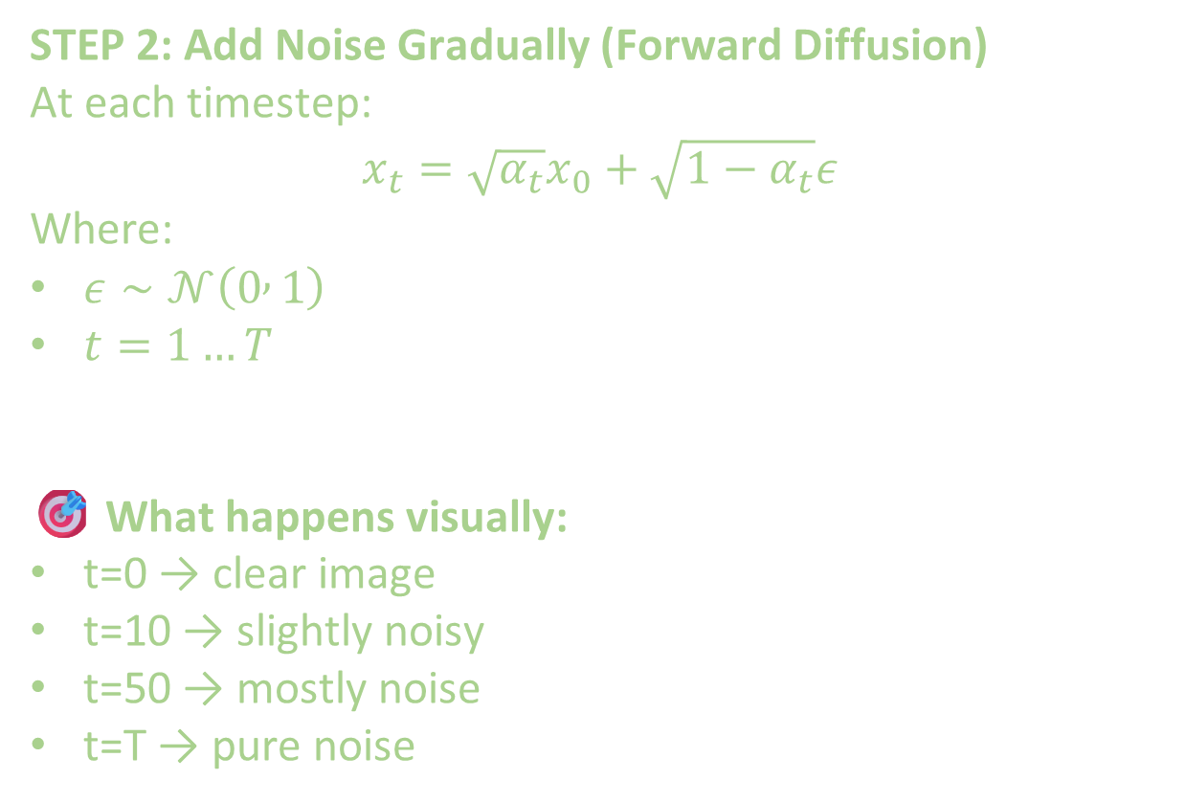
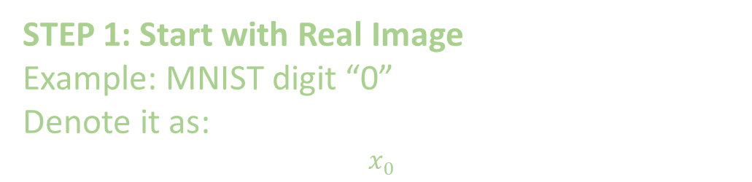
STEP 1: Start with Real Image
Example: MNIST digit “0”
Denote it as:
$$x_{0}$$
STEP 2: Add Noise Gradually (Forward Diffusion)
At each timestep:
$$x_{t}=\sqrt{α_{t}}x_{0}+\sqrt{1−α_{t}}ε$$
Where:
$ε∼𝒩\left(0 , 1\right)$
$t=1…T$
🎯 What happens visually:
t=0 → clear image
t=10 → slightly noisy
t=50 → mostly noise
t=T → pure noise

Slide 8
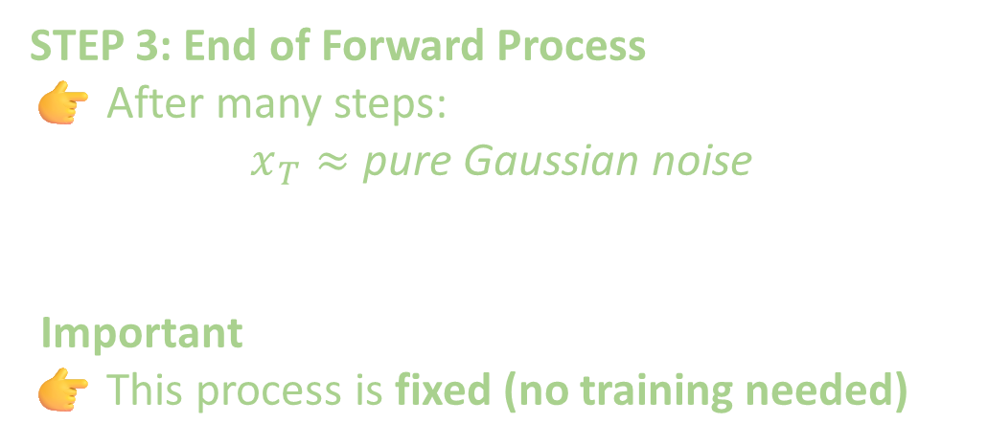
STEP 3: End of Forward Process
👉 After many steps:
$$x_{T}≈\text{pure} \text{Gaussian} \text{noise}$$
Important
👉 This process is fixed (no training needed)

Slide 9
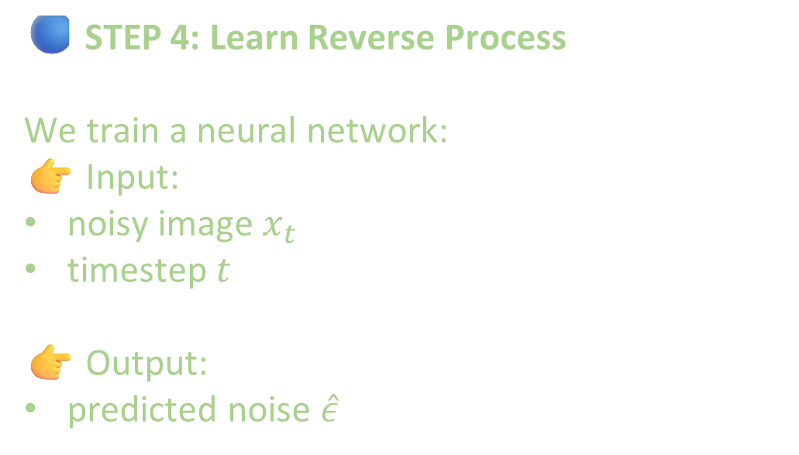
🔵 STEP 4: Learn Reverse Process
We train a neural network:
👉 Input:
noisy image $x_{t}$
timestep $t$
👉 Output:
predicted noise $\hat{ε}$
🧠 Key Learning Idea
👉 Instead of predicting image directly:
👉 Model predicts noise

Slide 10
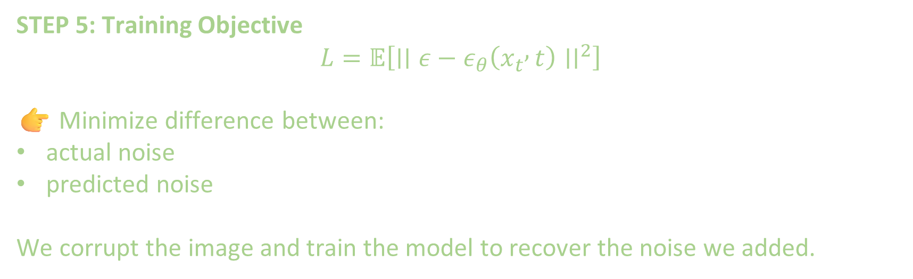
STEP 5: Training Objective
$$L=𝔼\left[∣∣ε−ε_{θ}\left(x_{t} , t\right)∣∣^{2}\right]$$
👉 Minimize difference between:
actual noise
predicted noise
We corrupt the image and train the model to recover the noise we added.

Slide 11
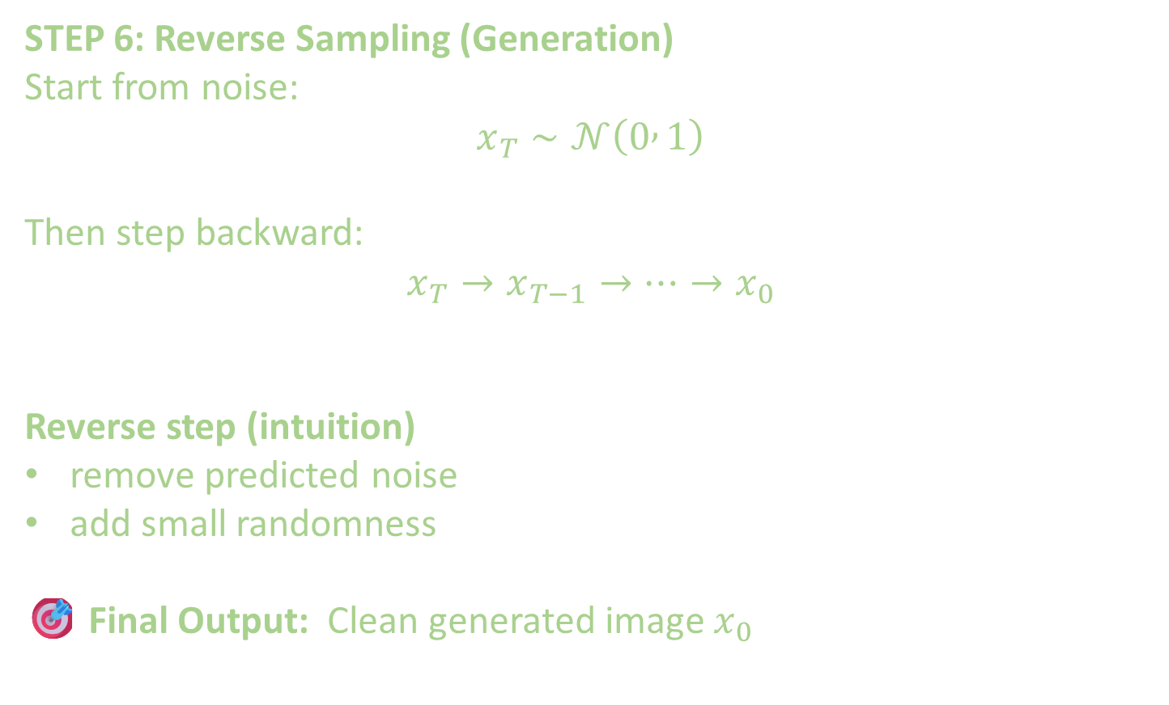
STEP 6: Reverse Sampling (Generation)
Start from noise:
$$x_{T}∼𝒩\left(0 , 1\right)$$
Then step backward:
$$x_{T}→x_{T−1}→⋯→x_{0}$$
Reverse step (intuition)
remove predicted noise
add small randomness
🎯 Final Output: Clean generated image $x_{0}$

Slide 12
STOP

Slide 14
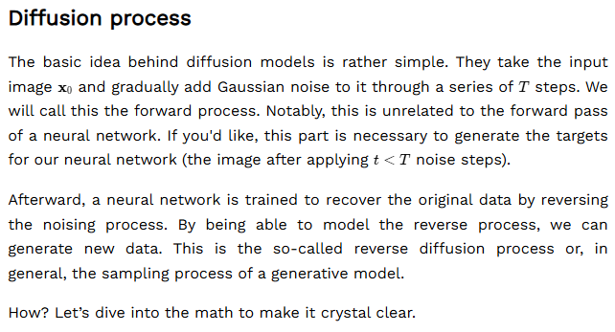
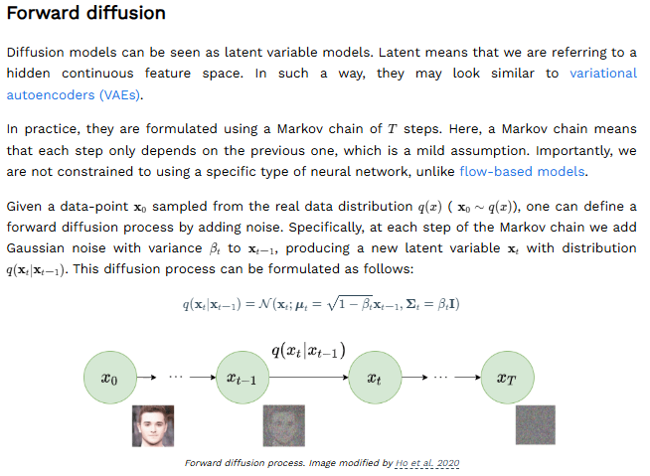
Math of Diffusion models p1
Source https://www.superannotate.com/blog/openai-sora

Slide 15
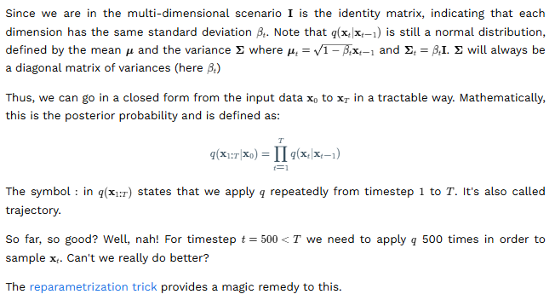
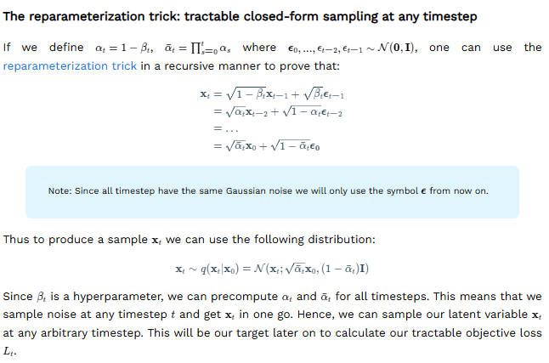
Math of Diff Model p2

Slide 16
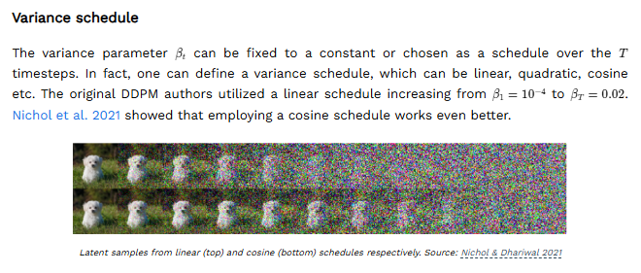
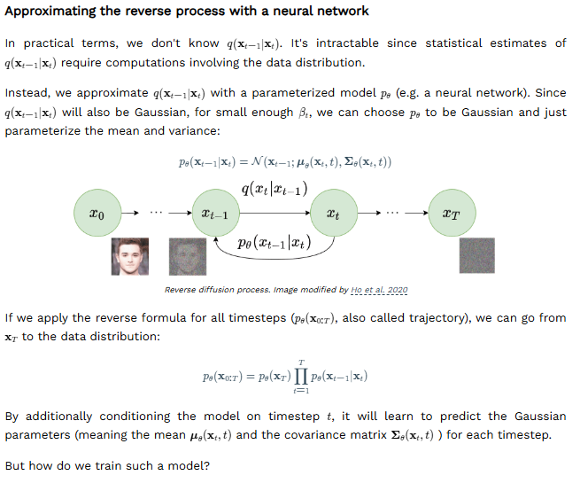
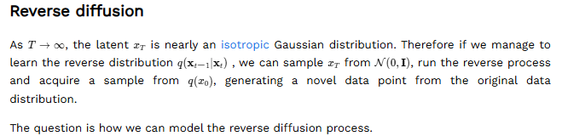
Math of Diff model p3

Slide 17
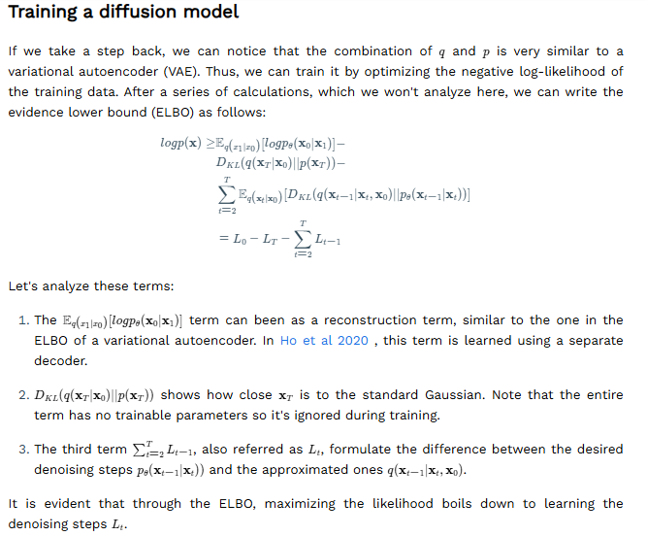
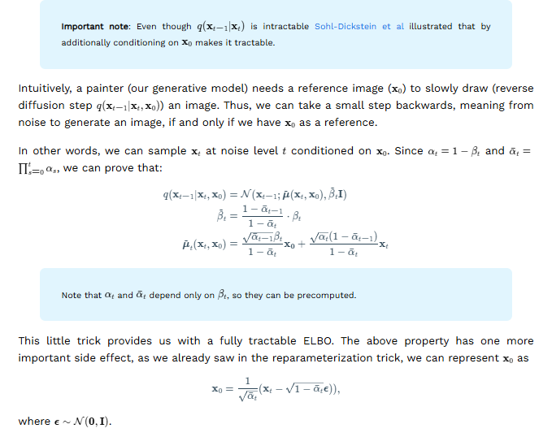
Math of Diff model p4

Slide 18
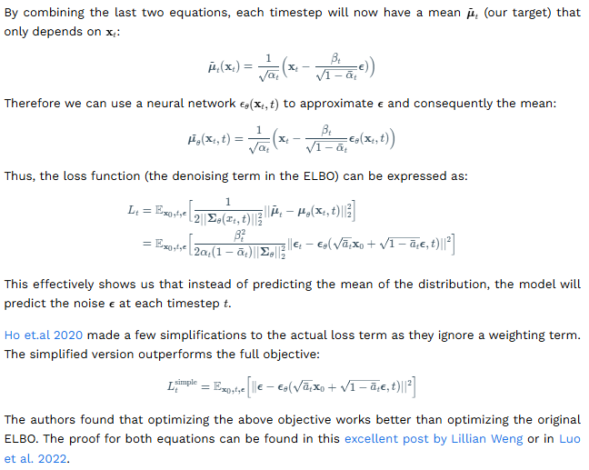
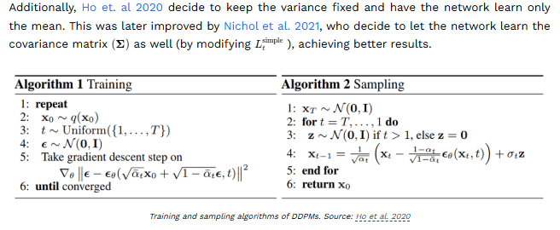
Math of Diff model p5

