Slide 2
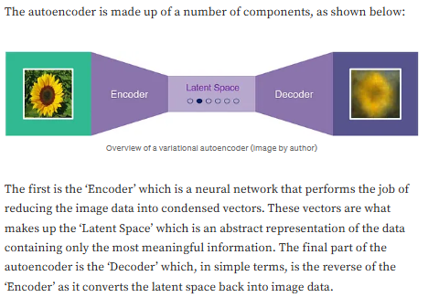
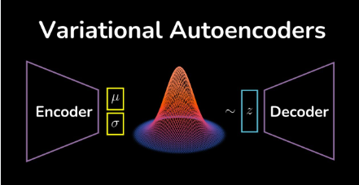
4.2) Variational Autoencoders (VAEs) p1
In 2013, Diederik P. Kingma and Max Welling introduced VAEs in a paper called "Auto-Encoding Variational Bayes.“
A variational autoencoder, in essence, learns how to describe the nature of some data. This description is then modified slightly to generate a distribution of the data. Then, using this distribution, a sample can be taken at any point and the associated data reconstructed.

Slide 3
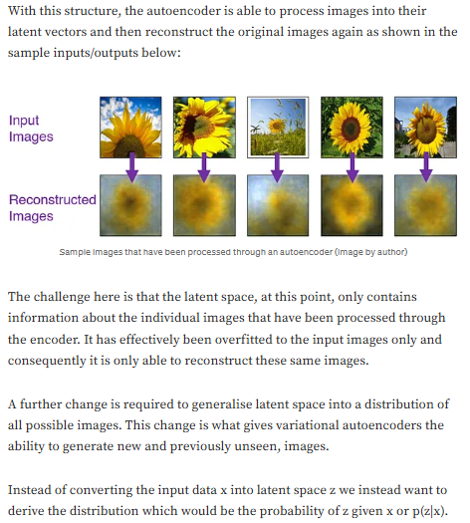

Slide 4
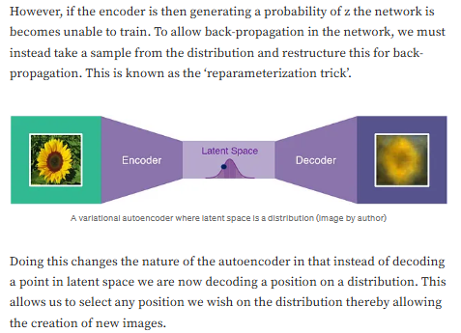

Slide 5
VAE math here
https://synthesis.ai/2023/02/07/generative-ai-i-variational-autoencoders/

Slide 6
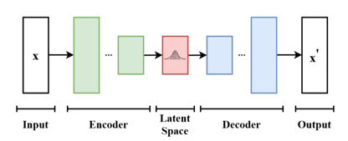
VAE implementations
https://medium.com/@morgan_lynch/generative-ai-with-variational-autoencoders-86d1926df6e8

