Slide 2
Autoregressive models are a type ML model that predicts the next value in a sequence based on the previous values in that sequence.
These models assume that the future values in the sequence are dependent on the past values and use this dependency to make predictions.
In the context of natural language processing, autoregressive models are often applied to generate text or make predictions based on previous words in a sentence.

Slide 3
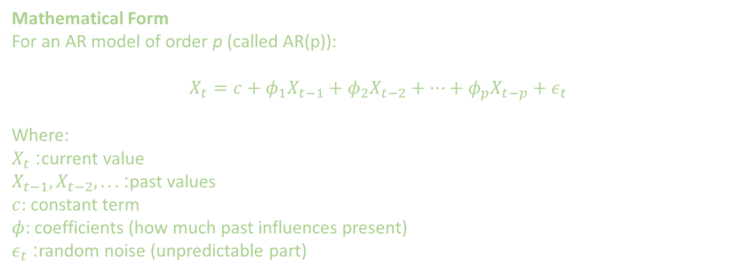
Mathematical Form
For an AR model of order p (called AR(p)):
$$X_{t}=c+φ_{1}X_{t−1}+φ_{2}X_{t−2}+⋯+φ_{p}X_{t−p}+ε_{t}$$
Where:
$X_{t}$: current value
$X_{t−1},X_{t−2},...$: past values
$c$: constant term
$φ$: coefficients (how much past influences present)
$ε_{t}$: random noise (unpredictable part)

Slide 4
The following animation of Google DeepMind’s WaveNet illustrates this well:
the t-th output is generated in a feed-forward fashion from several input x values
India has huge coastal area. This gives fisherman ability to make money for family. It helps ????

Slide 5
Use cases of Auto Regressive Models
Generative AI & NLP:
Modern LLMs use "autoregressive decoding" to generate text one token at a time, where each new word is conditioned on all previous words in the sentence.
Financial Forecasting:
They are used to predict stock prices, exchange rates, and market trends by analyzing historical records

