Slide 1
NumPy for Neural Networks
🎯 Objective of this Module
By the end, students should be able to:
Understand vectorization vs loops
Use NumPy for fast computation
Implement:
Single neuron
Multi-neuron (layer)
Understand weights, bias, dot product

Slide 2
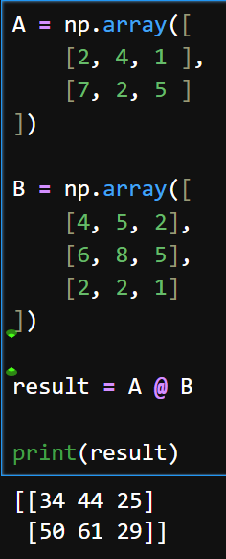
. 1. Why NumPy in Neural Networks?
👉 Neural Networks = requires a lot of matrix math
Numpy perform matrix math fast and provides a clean code:

Slide 3
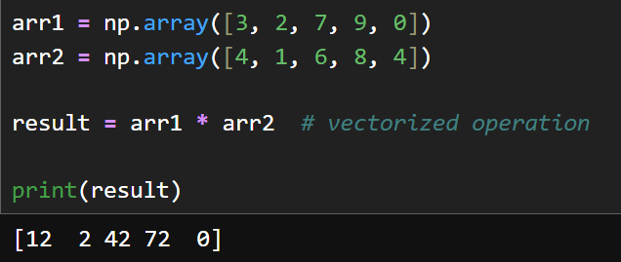
2. Vectorization

Slide 4
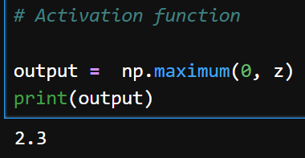
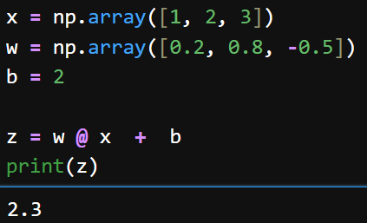
3. Implementing a single NN
1st Part of NN
Activation
Function

Slide 5
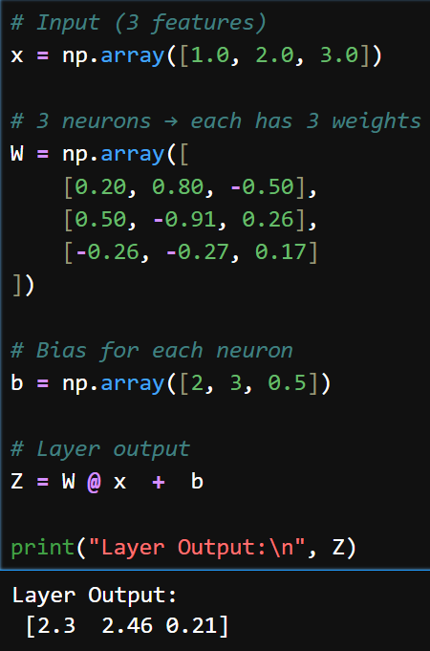









4. Multi-Neuron Layer
Now instead of 1 neuron → multiple neurons
Each neuron has:
its own weights
its own bias
a) 1 input: (Formula)

Slide 6
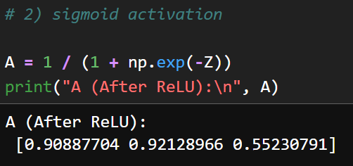







4. Multi-Neuron Layer
Now instead of 1 neuron → multiple neurons
Each neuron has:
its own weights
its own bias
a) 1 input: (Formula)

Slide 7
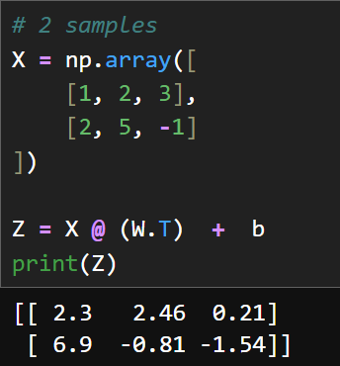
4. Multi-Neuron Layer
b) With Batch input (2 input)
Formula:
X1 | X2 | X3
1 | 2 | 3
2 | 5 | -1

Slide 8
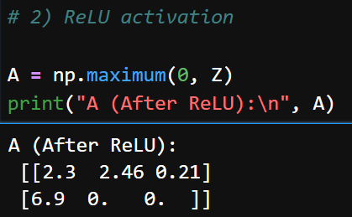
4. Multi-Neuron Layer
b) With Batch input (2 input)
Formula:
X1 | X2 | X3
1 | 2 | 3
2 | 5 | -1

Slide 9
There are tensorflow and pytorch libraries available that would do this for you with lot less code for many many neuron layers

Slide 10
EXTRA
Xxxxxxxxxxx
xxxxxxxxxxxx

