Slide 1
Artificial Neural Network
ANN

Slide 2
Common Applications of NN
Image classification
Speech recognition
Natural language processing – Google translate, text completion, etc.
Regression problems
Function approximation -

Slide 3
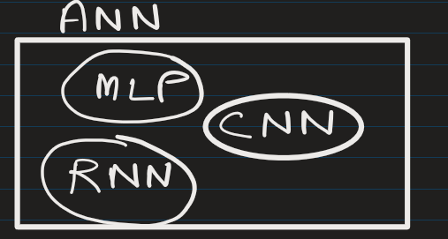
ANN can include many different architectures such as:
Single Layer Perceptron
Multilayer Perceptron (MLP)
Convolutional Neural Networks (CNN)
Recurrent Neural Networks (RNN)
Transformers
Some interesting site to learn ANN:
https://playground.tensorflow.org/

Slide 4
Key terms:
Structural Components (Architecture):
Neurons/Nodes
Input Layer
Hidden Layers
Output Layer
Weights
Bias
Operational Terms (Forward & Backward Pass):
Forward Propagation
Activation Function: ReLU (Rectified Linear Unit), Sigmoid, Tanh, SoftMax
Loss Function (Cost Function)
Backpropagation
Gradient Descent
Training & Hyperparameters:
Learning Rate
Optimizer
Epoch
Batch Size
Batch Normalization

Slide 5
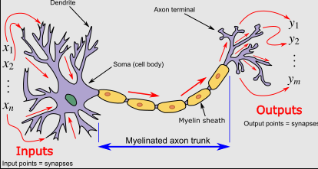
Inspiration:
Simulate neuron with some mathematical model
Source : Wikipedia

Slide 6















Decision:
When enough neuron fire up, then they produce impulse that would make you choose between A and B
Source : Wikipedia

Slide 7
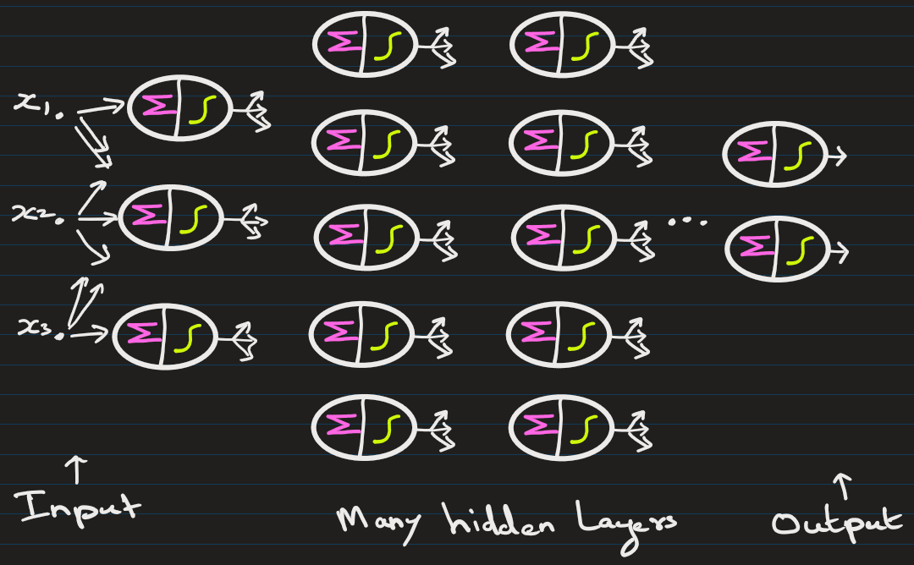
The deep NN is based on similar principals

Slide 8
Lets understand mathematical model of
1 neuron

Slide 9
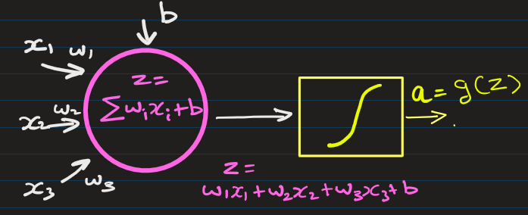
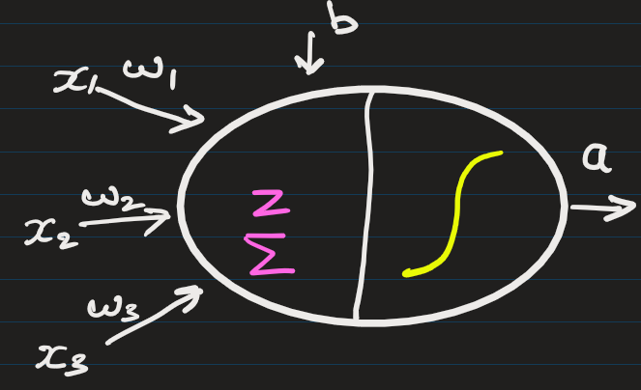
Neuron (Node): It performs following computations.
1 Neuron ->
OR ->

Slide 10
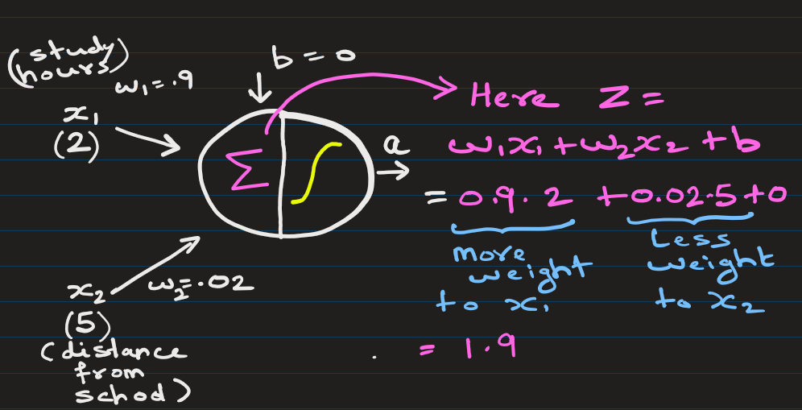
For each neuron, the process is
Take weighted sum of inputs and add a bias term ( i.e. calculate Z ),
Apply activation function
Pass result to next neurons (next layer)
Study_hours | distance
2 | 5

Slide 11
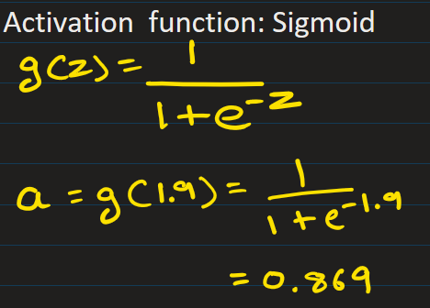
For each neuron, the process is
Take weighted sum of inputs and add a bias term ( i.e. calculate Z ),
Apply activation function
Pass result to next neurons (next layer)
Study_hours | distance
2 | 5

Slide 12
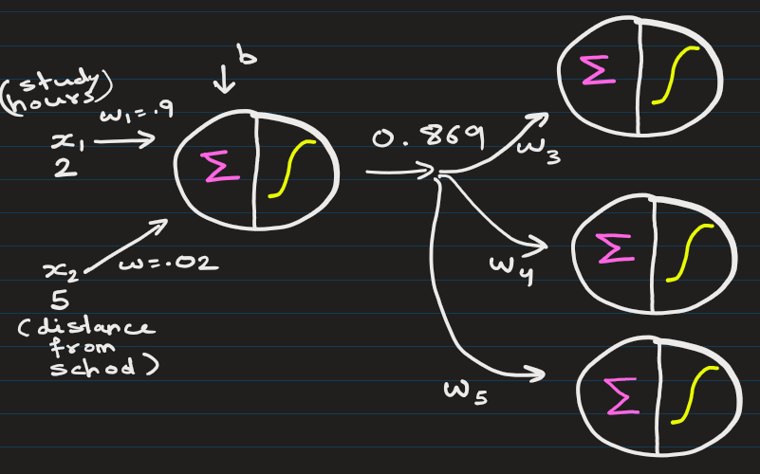
For each neuron, the process is
Take weighted sum of inputs and add a bias term ( i.e. calculate Z ),
Apply activation function
Pass result to next neurons (next layer).
Each layer contains multiple neurons that perform similar computations.

Slide 13
Weights
Each connection between two neurons has a weight.
Weights represent the importance of inputs: A higher absolute value = more influence.
Positive weights amplify input; negative weights can invert it.
Weights can be (–inf to +inf).
These are learned during training.

Slide 14
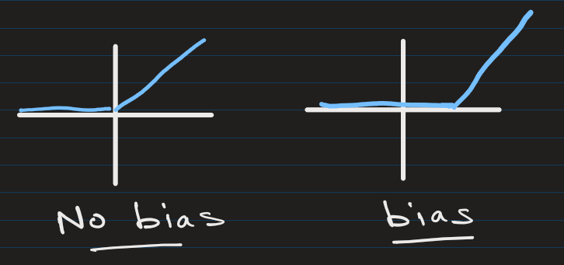
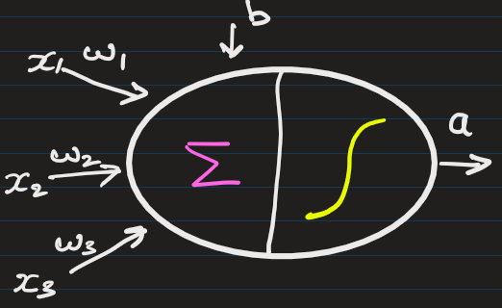
Bias (b)
It allows the network to shift the activation function.
Without a bias, the neuron output would always pass through the origin
(zero input = zero output).

Slide 15
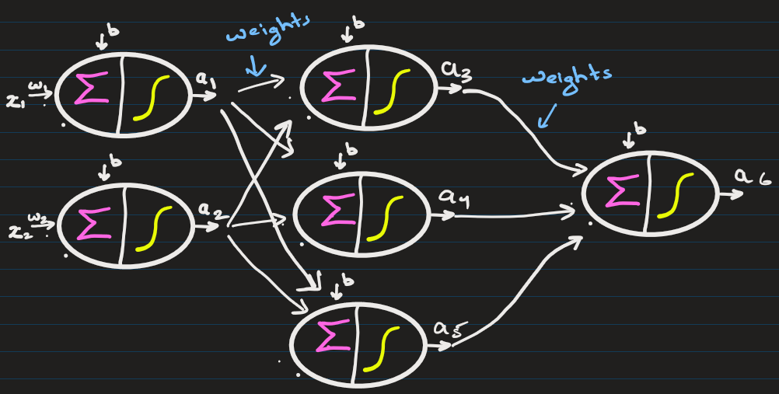
THE WHOLE GAME OF NEURAL NETWORK IS FINDING WEIGHTS, BIAS, etc.
The free parameters (bias + weights) of the neural network are determined from training data.

Slide 16
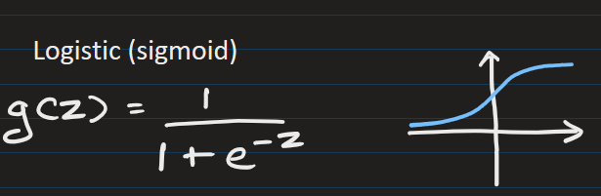
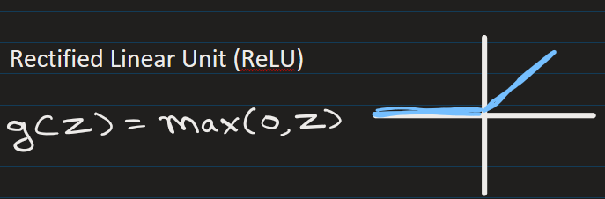
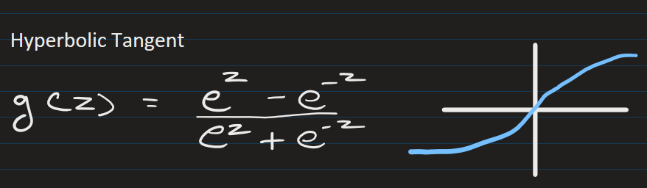
Activation Functions:
Each neuron applies a activation function (non-linear function- like ReLU, sigmoid, or tanh) to enable the network to learn non-linear patterns.

Slide 17
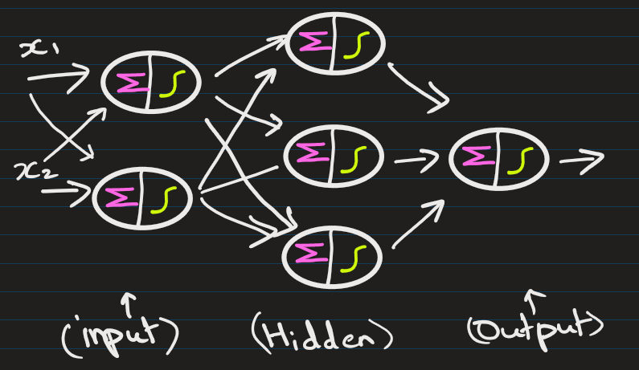
Basic Structure of a Neural Network:
Input Layer: Receives the raw data/features
Hidden Layer(s): One or more layers that process information
Output Layer: Produces the final prediction or classification
The term "multi-layer" means there's at least one hidden layer between input and output.

Slide 18
The Neural Network can have many hidden layers

Slide 19
How does neuron make prediction

Slide 20
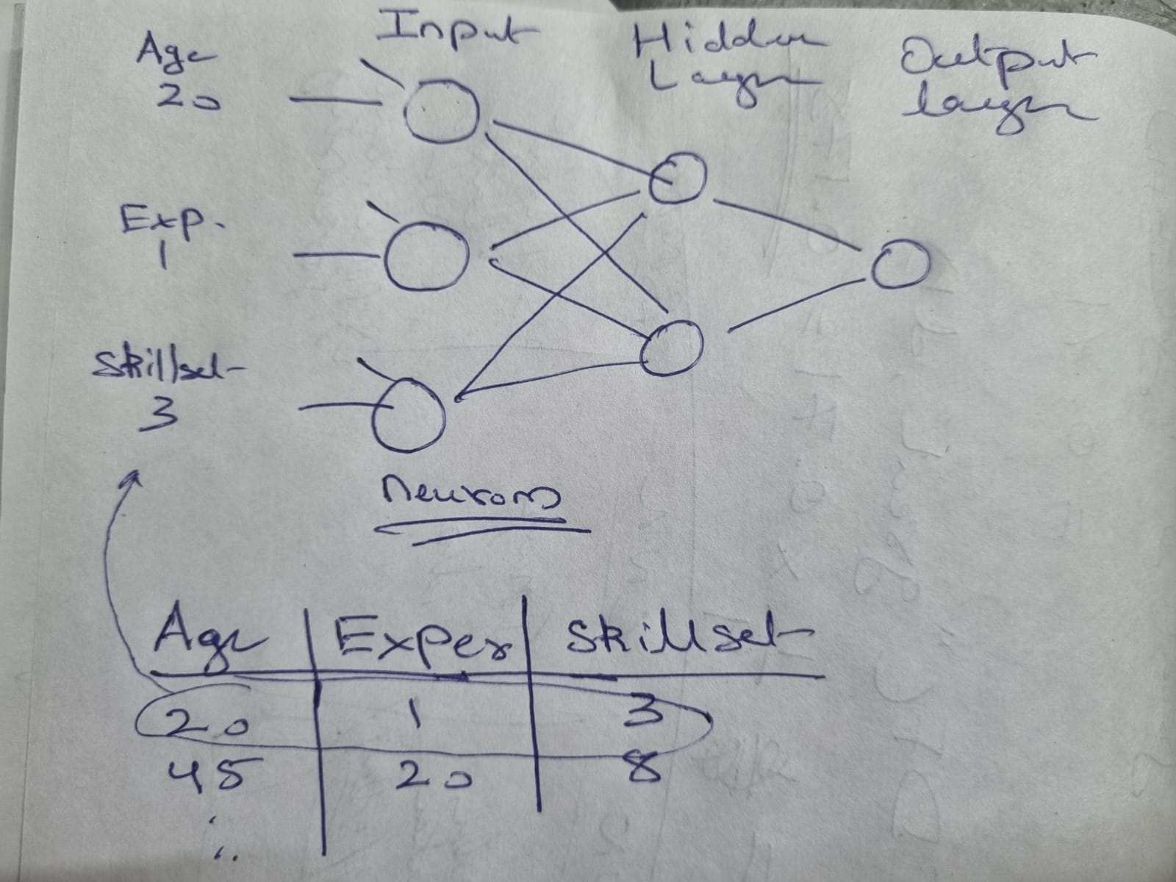
The number of neurons in input layer = number of input features.
The number of neurons in output layer:
Predict number: (Regression problem). Output layer has 1 neuron.
Predict Class: (Classification problem). Output layer has 1 or more neurons.
In Binary -> only 1 out neuron -> value is between 0 – 1 (probability of class 1)
Predict Salary
Here the number of features = 3
Input: Age, Experience, Skillset
Output: Salary (Regression)

Slide 21
Predict Class
Here the number of features = 3
Input: Age, Experience, Skillset
Output:
Probability of being happy (84%)
-> Happy -> 1

Slide 22
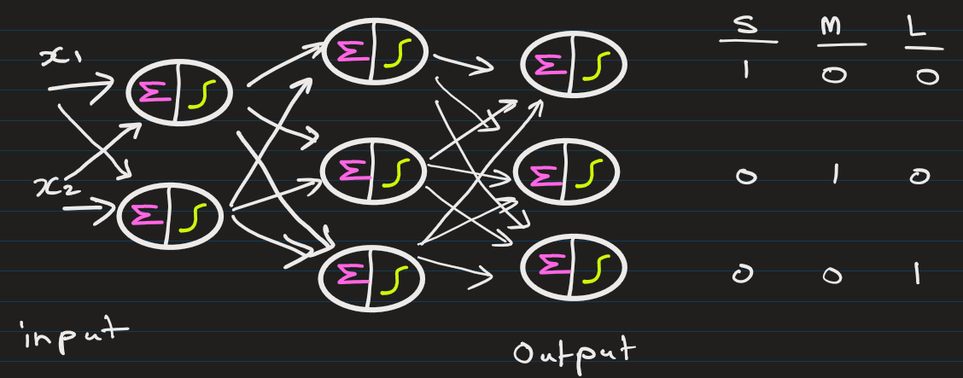
In multi-classification, output layer has number-of-classes neurons.
Suppose a NN predicts the size of shirt based on age and height of a customer:
Here the number of input features = 2
Input: (Age, Height)
Output: Size of shirt -> S, M or L Here, S = [1, 0, 0] M = [0, 1, 0] L = [0, 0, 1]

Slide 23
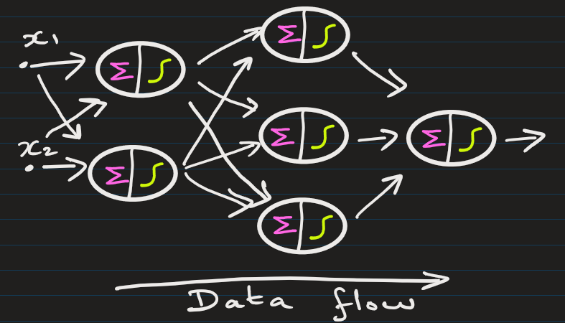
How "Feedforward" Works
Information flows in one direction only:
Data enters through the input layer
Passes through hidden layers sequentially
Exits through the output layer
No cycles or loops (unlike Recurrent Neural Networks)
Think of it like a assembly line where each station processes the product and passes it forward — never backward.

Slide 24
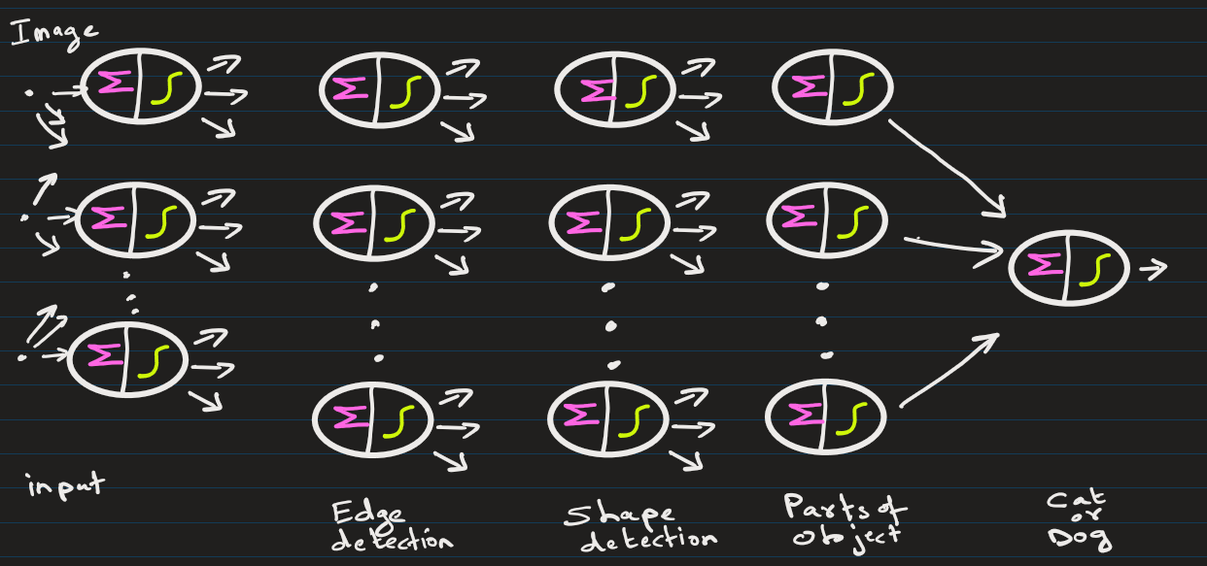
Why "Multi-layer" Matters
Multiple layers allow the network to learn hierarchical representations:
For example in image recognition
Early layers detect simple patterns (edges, basic features)
Deeper layers combine these into complex patterns (shapes, objects, abstract concepts)

Slide 25
Training

Slide 26
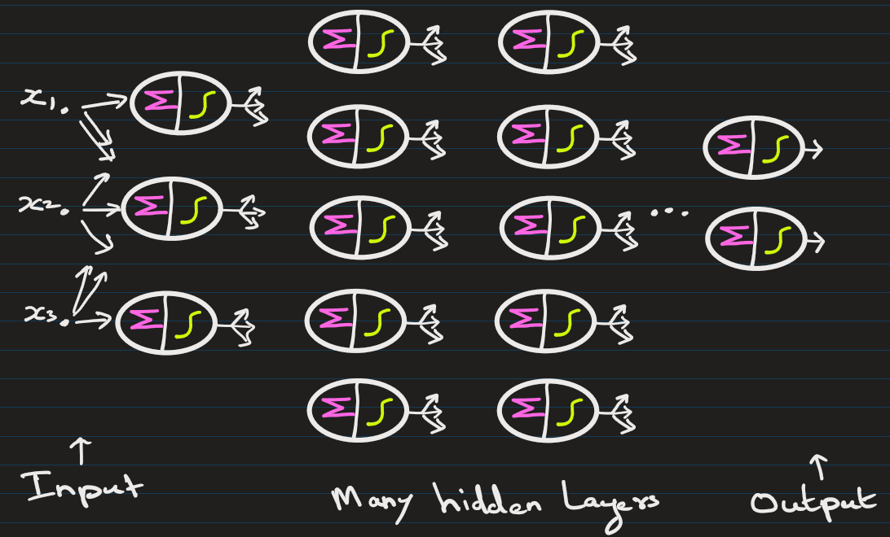
These networks typically learn through backpropagation:
Make predictions (forward pass)
Calculate error between predictions and actual values
Propagate error backward through the network
Update weights using gradient descent to minimize error/loss
Prediction target y` (20)
Updates weights + bias
Optimizer
Loss score
Loss function
True/Actual target y (43)
E.g.: SGD, AdamOptimzer, RMSProp, AdaGrad, etc.
E.g. : Mean Squared Error, Cross-Entropy, etc.

Slide 27
Loss function = defines the feedback signal
which is used for learning
Optimizer = Algorithm that adjusts the attributes of the neural network, such as weights and learning rates.
Prediction target y` (20)
Updates weights + bias
Optimizer
Loss score
Loss function
True/Actual target y (43)
E.g.: Gradient Descent, Stochastic GD, AdamOptimzer, RMSProp, AdaGrad, etc.
E.g. : Mean Squared Error, Cross-Entropy, etc.

Slide 28


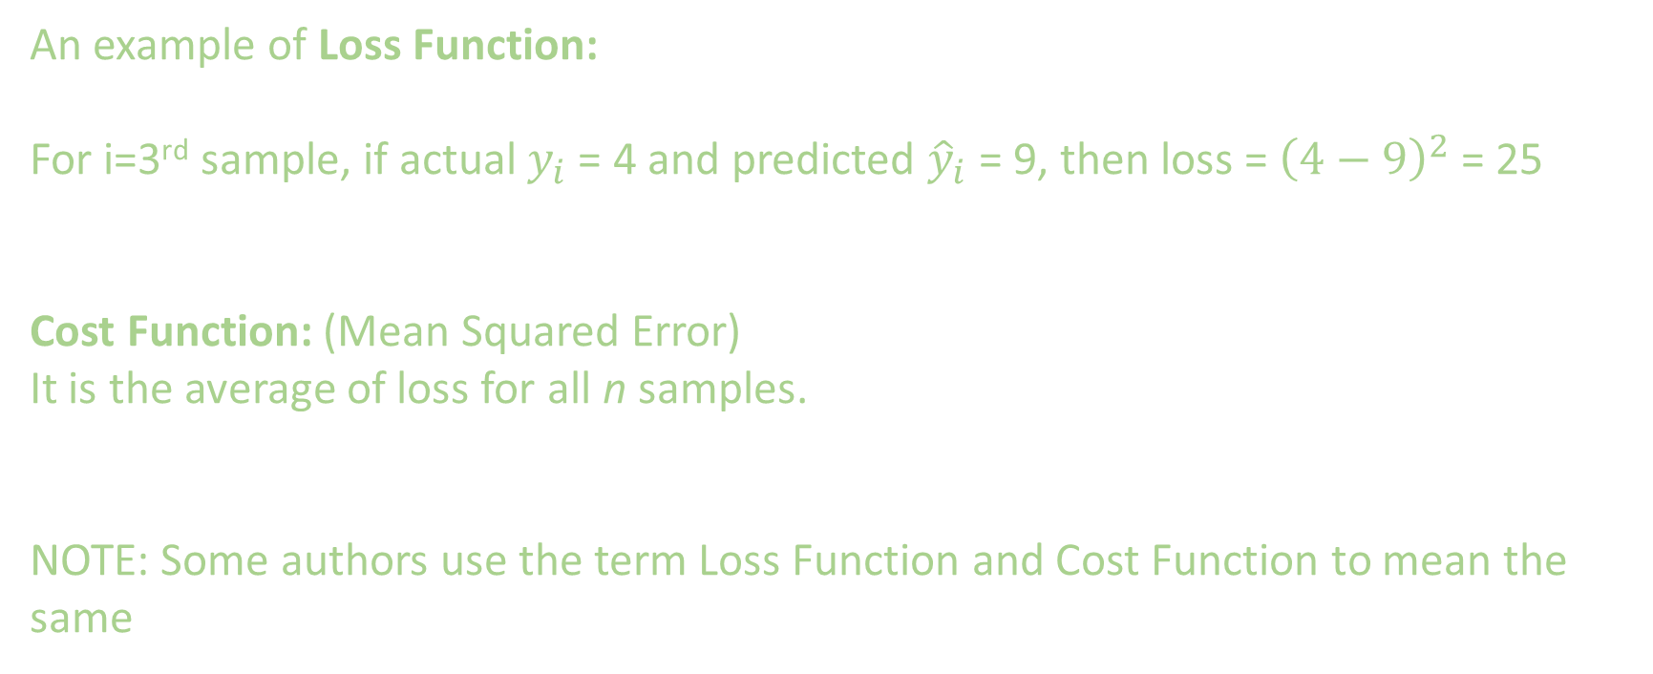
An example of Loss Function:
For i=3rd sample, if actual $y_{i}$ = 4 and predicted ${\hat{y}}_{i}$ = 9, then loss = ${\left(4−9\right)}^{2}$ = 25
Cost Function: (Mean Squared Error)
It is the average of loss for all n samples.
NOTE: Some authors use the term Loss Function and Cost Function to mean the same

Slide 29
Initializing weights and bias before start of training:
Weights and biases are usually initialized with small random values.
Common Weights:
Uniform Initialization: W∼U(−a,a), where a is typically small
(e.g., 0.01, or based on input size).
Normal Initialization: W∼N(0,σ^2) with small standard deviation.
Biases are often
Initialized to zero, or
Initialized with small values like 0.01.

Slide 30
Updating weights and bias is computationally expensive.
Emergence of GPU(Graphical Processing Unit) and TPU(Tensor Processing unit) has helped.

Slide 31
Some interesting site to learn ANN:
https://playground.tensorflow.org/

Slide 32
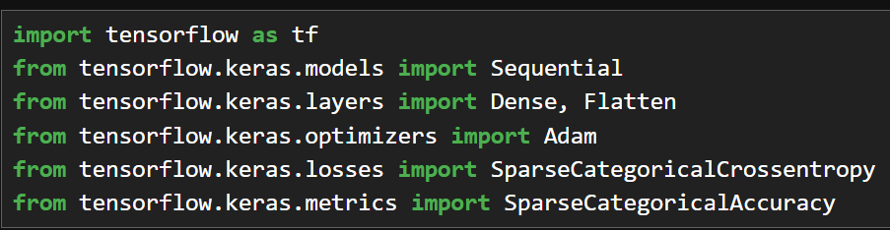
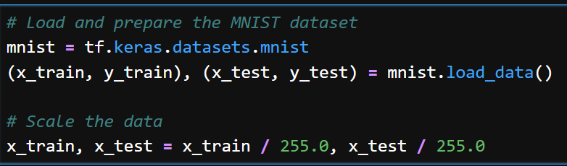

Slide 33
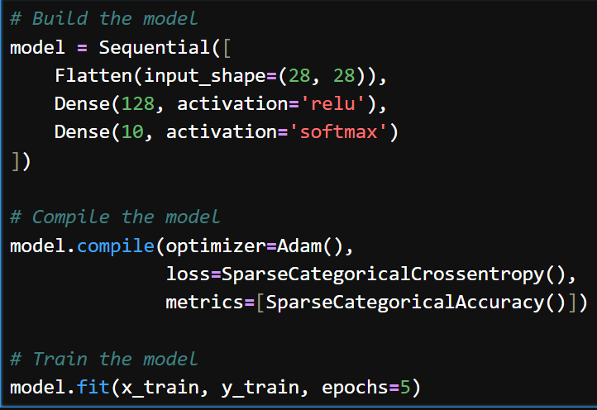
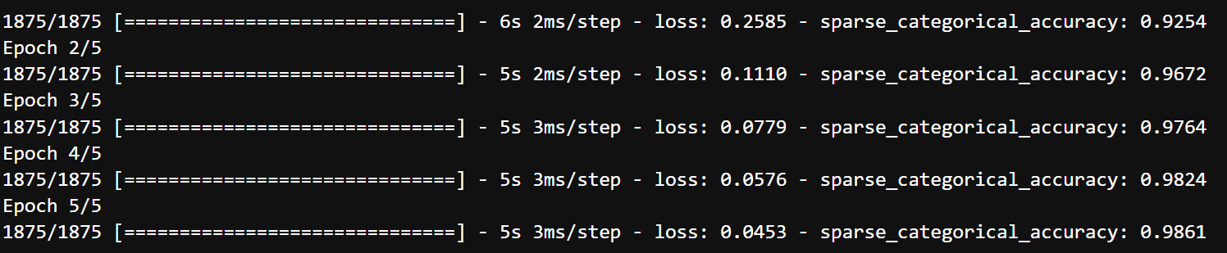

Slide 34
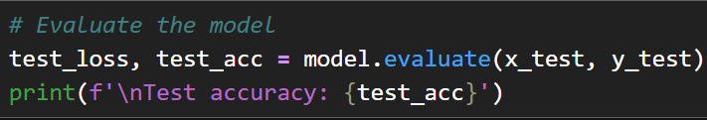

Slide 35
Difference between ANN and MLP:
Feature | ANN | MLP
Meaning | General term | Specific architecture
Layers | Any structure | Input + Hidden + Output
Connectivity | Various | Fully connected
Examples | CNN, RNN, MLP | Only feedforward networks

Slide 36
EXTRA
Xxxxxxxxxxx
xxxxxxxxxxxx

Slide 37
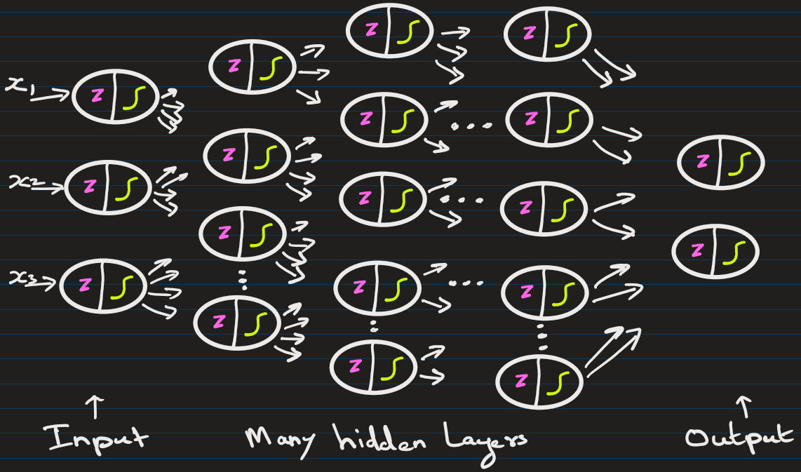
Deep Neural Network has many hidden layers

