Slide 2
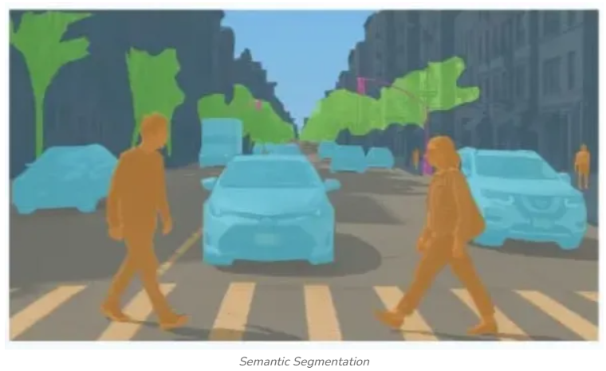
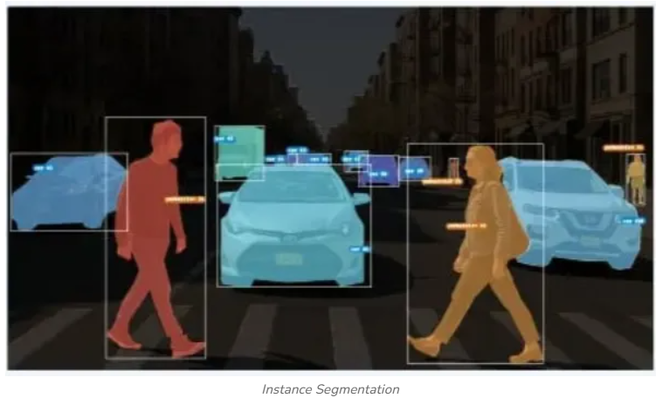
🧠 1. What is Image Segmentation?
Unlike object detection (boxes), segmentation gives pixel-level output
Types:
Semantic Segmentation
Instance Segmentation
Panoptic segmentation
Source: Geeks for Geeks

Slide 3
Semantic Segmentation
Label every pixel
(no distinction between instances)
Example:
In an image with multiple trees all pixels corresponding to any tree would be labelled as "tree" regardless of how many trees appear in the image.
Source: Geeks for Geeks

Slide 4
Instance Segmentation
Separate each object individually
Example:
If there are multiple trees in an image it will differentiate each tree and treat them as separate entities despite them all being labelled as “trees."
Source: Geeks for Geeks

Slide 5
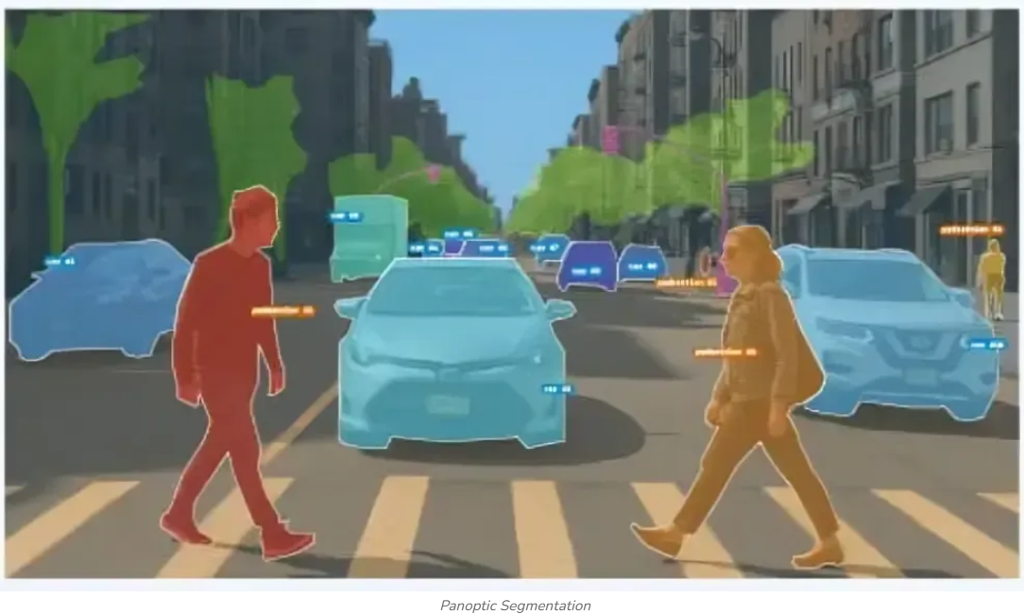
Panoptic Segmentation
Combines both semantic and instance segmentation
Example:
In a traffic scene it would label all pedestrians and cars which is semantic segmentation while also outlining the location of each individual person and car which is instance segmentation.
Source: Geeks for Geeks

Slide 6
Why do we need image segmentation ?

Slide 7
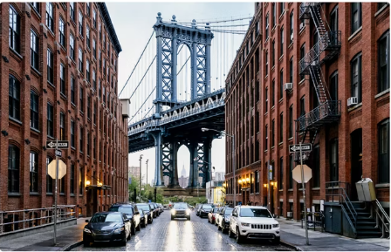
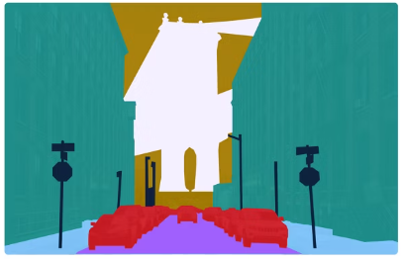
1) Self-Driving Cars:
A car's computer needs to know exactly where the drivable road ends and the sidewalk begins. It segments the scene into categories like "road," "pedestrians," "cars," and "traffic signs" to navigate safely and avoid obstacles.
Source: IBM Website

Slide 8
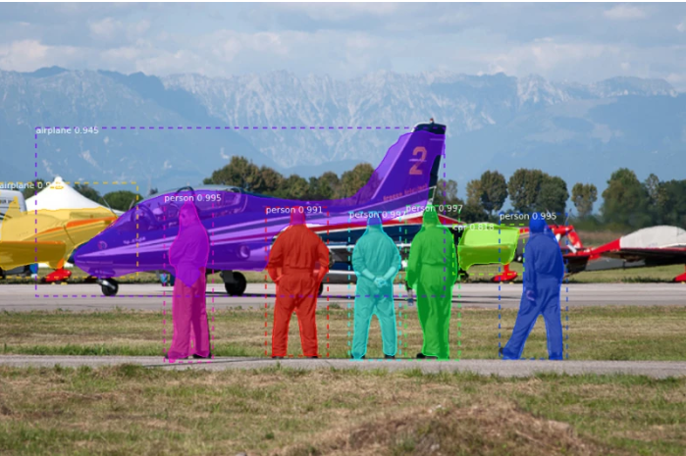
2) Filter image
Filter on Instagram or TikTok, uses segmentation to separate you from your background. This allows the software to blur the background
Source: Internet

Slide 9
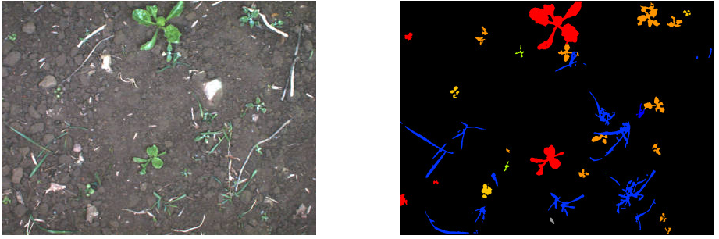
3) Smart Agriculture
Drones fly over fields and segment images to differentiate between healthy crops and weeds
Source: www.ipb.uni-bonn.de/data/sugarbeets2016/

Slide 10
Evolution of Segmentation Models

Slide 11
Phase 1: Classical CNN Era (2014–2017)
Fully Convolutional Networks (FCN) → first breakthrough
Then came:
U-Net
SegNet
DeepLab
Phase 2: Detection + Segmentation (2017–2020)
Mask R-CNN → instance segmentation breakthrough
Built on object detection pipelines
Phase 3: Advanced CNN Architectures
Variants of U-Net: UNet++ , Attention U-Net , ResUNet

Slide 12
Phase 4: Transformer Era (2020–Present)
Vision Transformers (ViT) ,
SAM (Segment Anything)
Phase 5: Multimodal & Foundation Models (Latest)
CLIP, SAM, DINO-based models
Zero-shot segmentation
Prompt-based segmentation

Slide 13
Industry | Primary Models Used | Key Application
Healthcare | U-Net, DeepLab, V-Net | Tumor/organ segmentation in MRI, CT, and X-rays.
Automotive | DeepLabv3+, Mask R-CNN, FCN | Lane detection, pedestrian tracking, and obstacle avoidance.
Agriculture | SAM, ViT, Mask R-CNN | Crop health monitoring and identifying individual fruits for automated harvesting.
Manufacturing | YOLO-seg, FCN | Defect detection on circuit boards and assembly line monitoring.

Slide 15
Popular Models
U-Net: Famous in medical imaging for its encoder-decoder structure that retains precise spatial information.
Mask R-CNN: Extends Faster R-CNN by adding a mask branch for instance segmentation.
DeepLab: Uses atrous (dilated) convolutions to handle object multi-scale recognition.
Segment Anything Model (SAM): A recent zero-shot model from Meta AI capable of segmenting any object without specific training

